Slide 1





BIOGAS 2.0
1. Biogas-Fachtagung
13.03.24 in Bönebüttel
Olaf-Gerd Gemein, Impact Funding Europe GmbH, Kiel
www.impactfundingeurope.eu

Slide 2
BioGas 2.0
Ertüchtigung und Strategien für BioGasAnlagen
Steigerungen von 25-100% in der Gasausbeute
Reduktion von 96% der Methan-Emissionen
finanzielle Verbesserungen von 25-40%
sind aktuelle mögliche Ergebnisse
unserer Projektanträge in den Jahren 2023 und 2024

Slide 3
BioGas 2.0
Ertüchtigung und Strategien für BioGasAnlagen
(Retro-fit Optionen)
Steigerung der Leistung durch geschickte Prozesse und Vorbehandlung der Stoffe sowie deren Zuführung
Prozesssteuerung und digitale Echtzeit-Optimierung
Behandlung der Abwässer (massive Reduktion der Treibhausemissionen).
Aufbereitung als Dünger
Zwischenspeicherung als grünes Öl
Einspeisung ins Gasnetz
Wärmenutzung

Slide 4
Innovation und Funding
Handel und Digital
Impact Funding Europe
GreenEarthX
AquaConsult
EnergyCommunities mit EasyGrid
H2 ThinkTank
LCM – Digitaler Zwilling für BioGas Anlagen
Fördermittel
Equity
Darlehen
ISO Standard
4
Datentreuhand
2
Index
Cluster und Technikum
Technische Innovationen und Infrastruktur
EnergyValley - SH
Huntstown
Follower
Pannatopia,
Linnof u.a.
Steyerberg – BlueTec Campus
BBT – BioMethan Innovation
Buxtehude - BlueTec Campus
GasGrün – Günes Öl
mit Uni Cottbus Senftleben
EngeSande -GreenTEC Campus
eFuels One
3
1
…
PipeLine Dublin

Slide 5
Technische Innovationen
und Infrastruktur
1
Huntstown
Follower
Pannanonia,
Linnof u.a.
BalticBlueTec
GasGrün
mit Uni Cottbus Senftleben
eFuels One
PipeLine Dublin, Tankstellen

Slide 6
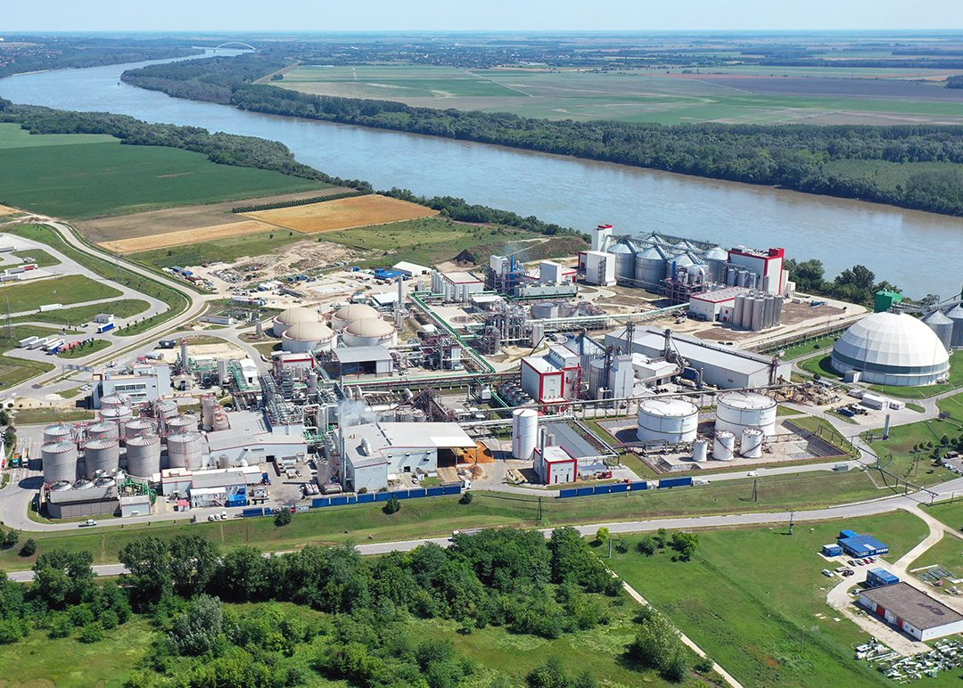
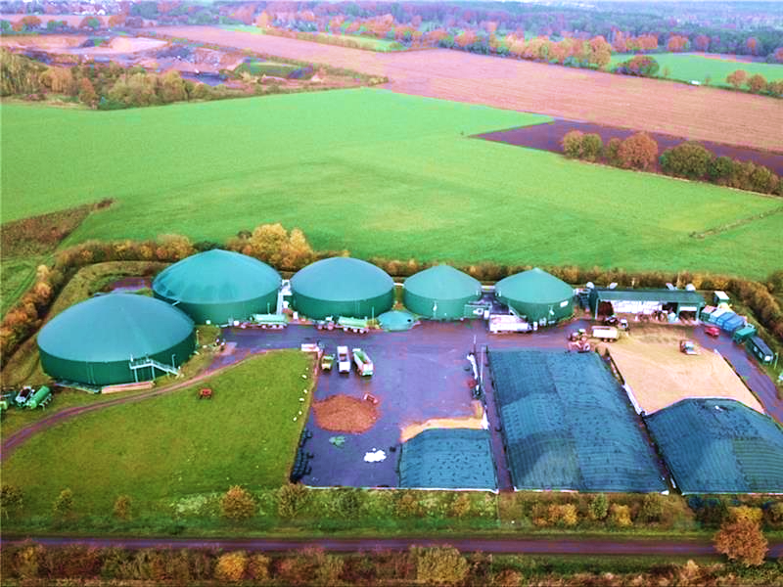
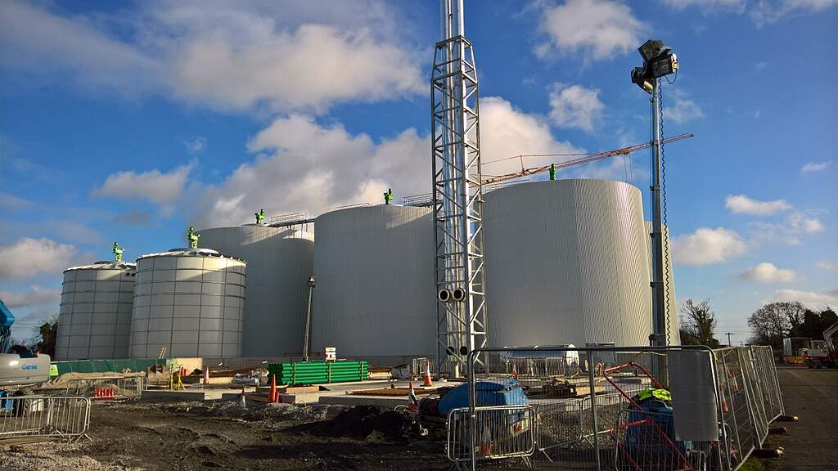
Pannonia Bio, Slowenia
Buxtehude, Deutschland
Technische Innovationen und Infrastruktur
Huntstown, Ireland

Slide 7




















Amount & Quality
#2.2
Additives 80% GHG reduction
Temperature Pressure, PH
Biogas outlet
Temperature Pressure, PH
#1.1
Vortex Cavitation 10% increase, improved mixing and pumping
#2.2
Additives 80% GHG
reduction
Cristobalite biofilter and marine algae 90+% reductions COD,N,P
#2.3
Fєєdstock Tank
Digєstєr Tank
Digєstєr Tank with Gas Tank
#2.1
Two phase anaerobic digestion, 2nd digester
>10-15% througput volume
Outlєt Tank
#1.2
Intermittent / pulse Feeding every 48 hours 20 % increase
Sensors
Control
Digital Twin

Slide 8
# 1 Mєchanical Innovation
#2 Biochєmical Innovation
#3 Digital Innovation
Amount & Quality
#2.2
Additives 80% GHG reduction
Temperature Pressure, PH
Biogas outlet
Temperature Pressure, PH
Green Oil
#1.1
Vortex Cavitation 10% increase, improved mixing and pumping
#2.2
Additives 80% GHG
reduction
Cristobalite biofilter and marine algae 90+% reductions COD,N,P
#2.3
Fєєdstock Tank
Digєstєr Tank
Digєstєr Tank with Gas Tank
Green Oil Tank
Outlєt Tank
#1.2
Intermittent / pulse Feeding every 48 hours 20 % increase
Sensors
Control
Green Oil Pipeline
#3.1
Digital Twin

Slide 9















2025
2026
2027
Jan
Fєb
Miz
Apr
Mai
Jun
Jul
Aug
Sєp
Ofit
Nov
Dєz
Jan
Fєb
Miz
Apr
Mai
Jun
Jul
Aug
Sєp
Ofit
Nov
Dєz
Jan
Fєb
Miz
Apr
Mai
Jun
Jul
Aug
Sєp
Ofit
Nov
Dєz
First simulation rєsults
Rєmotє
Control installєd
Starting installing sєnsors
Digital twin rєady
Optimazation Phasє 1 complєtєd
Optimazation Phasє 2 complєtєd
Starting installing innovations
Dashboard rєady
Intєrmєdiatє Rєport 1
Intєrmєdiatє Rєport 2
Initial mєasurєmєnt
All innovations installєd
Starting Rєmotє Control
3 Phase phase anaerobic digestion, 2nd digester
>10-15% througput volume, add storage of Green Oil for decpoupling feeding and production

Slide 10
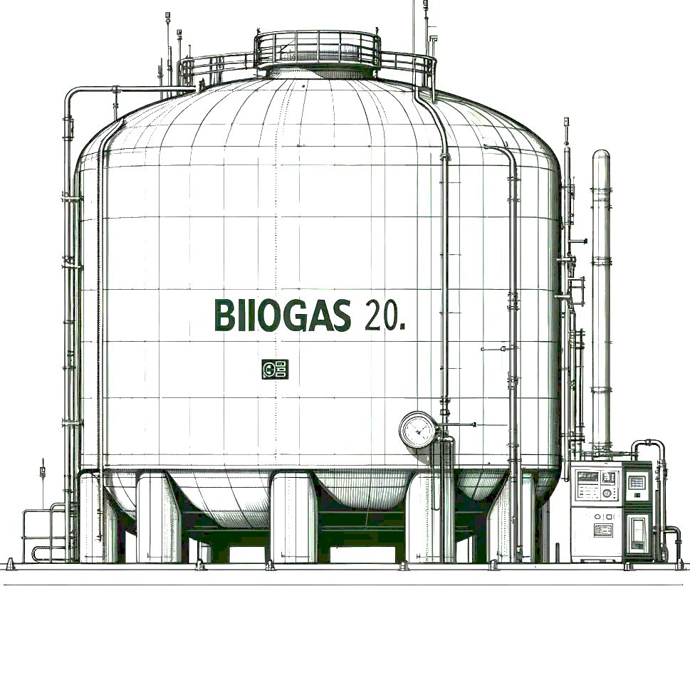

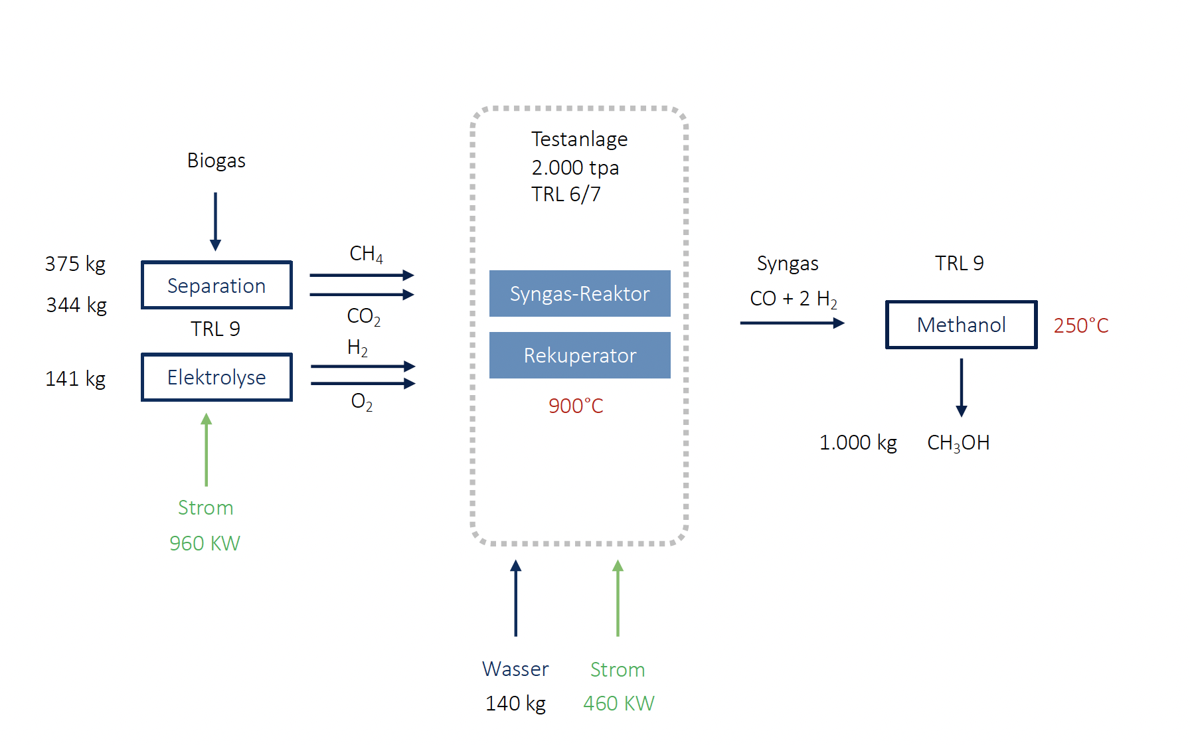
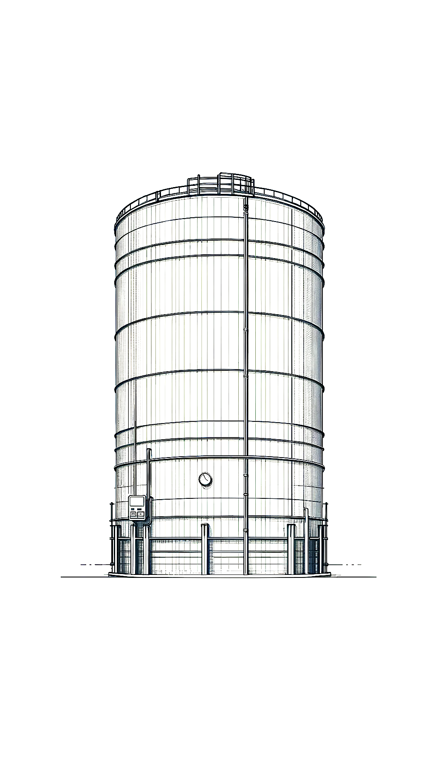

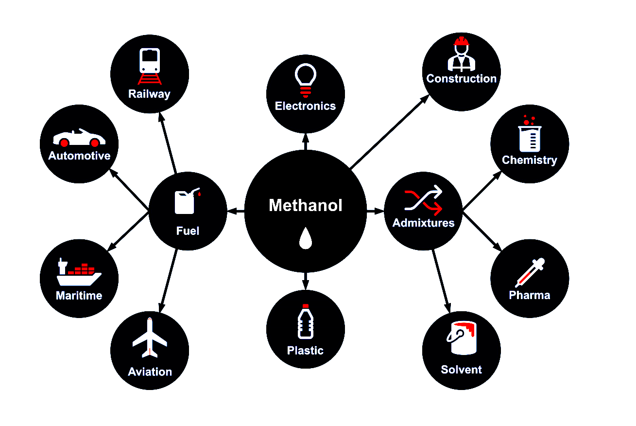
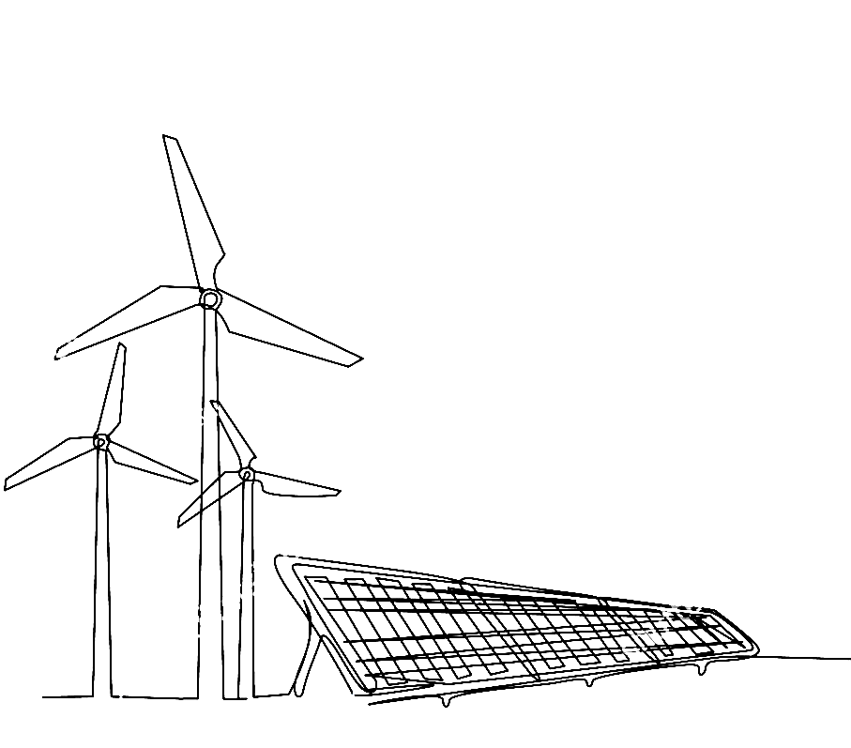
Feeding:
BioGas 2.0
Processing
Results:
900 C
Quelle: https://bse-methanol.com/about-methanol/
Feeding:
Verfahren: baltic-blue GmbH, Hamburg

Slide 11
GreenEarthX
EnergyCommunities mit EasyGrid
LCM – Digital
ISO Standard
Datentreuhand
Index
2
Handel und Digital

Slide 12

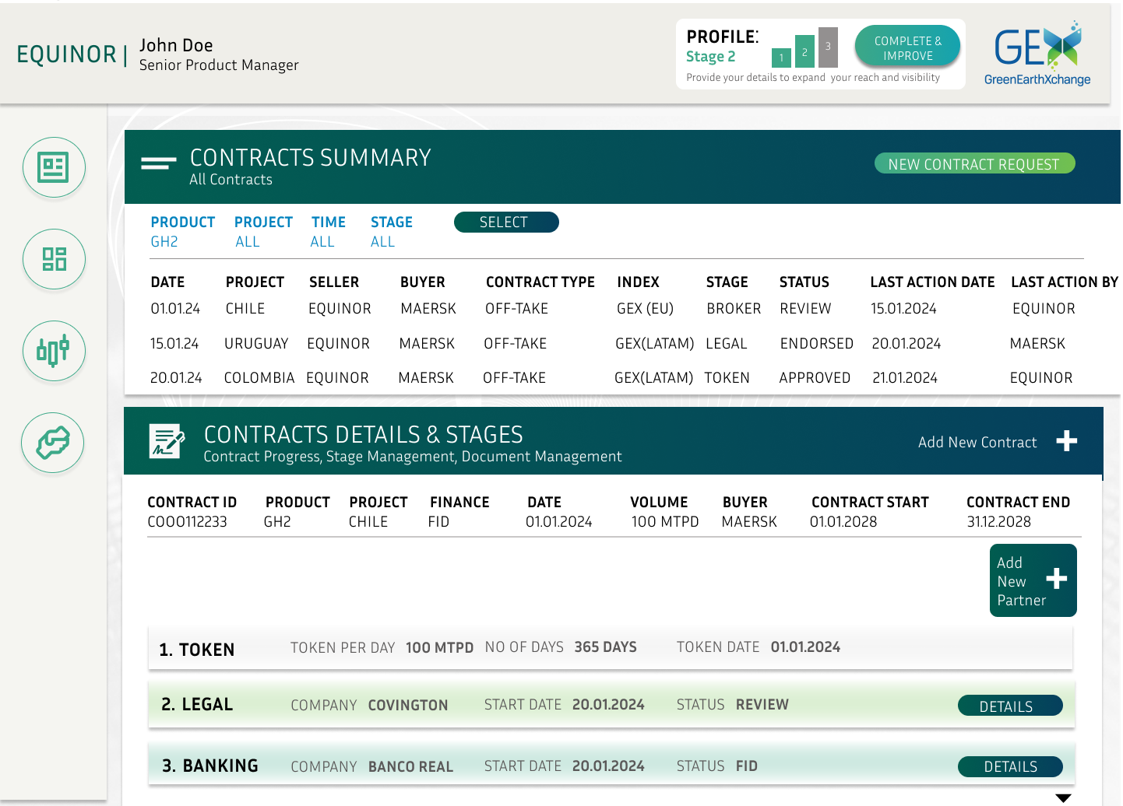
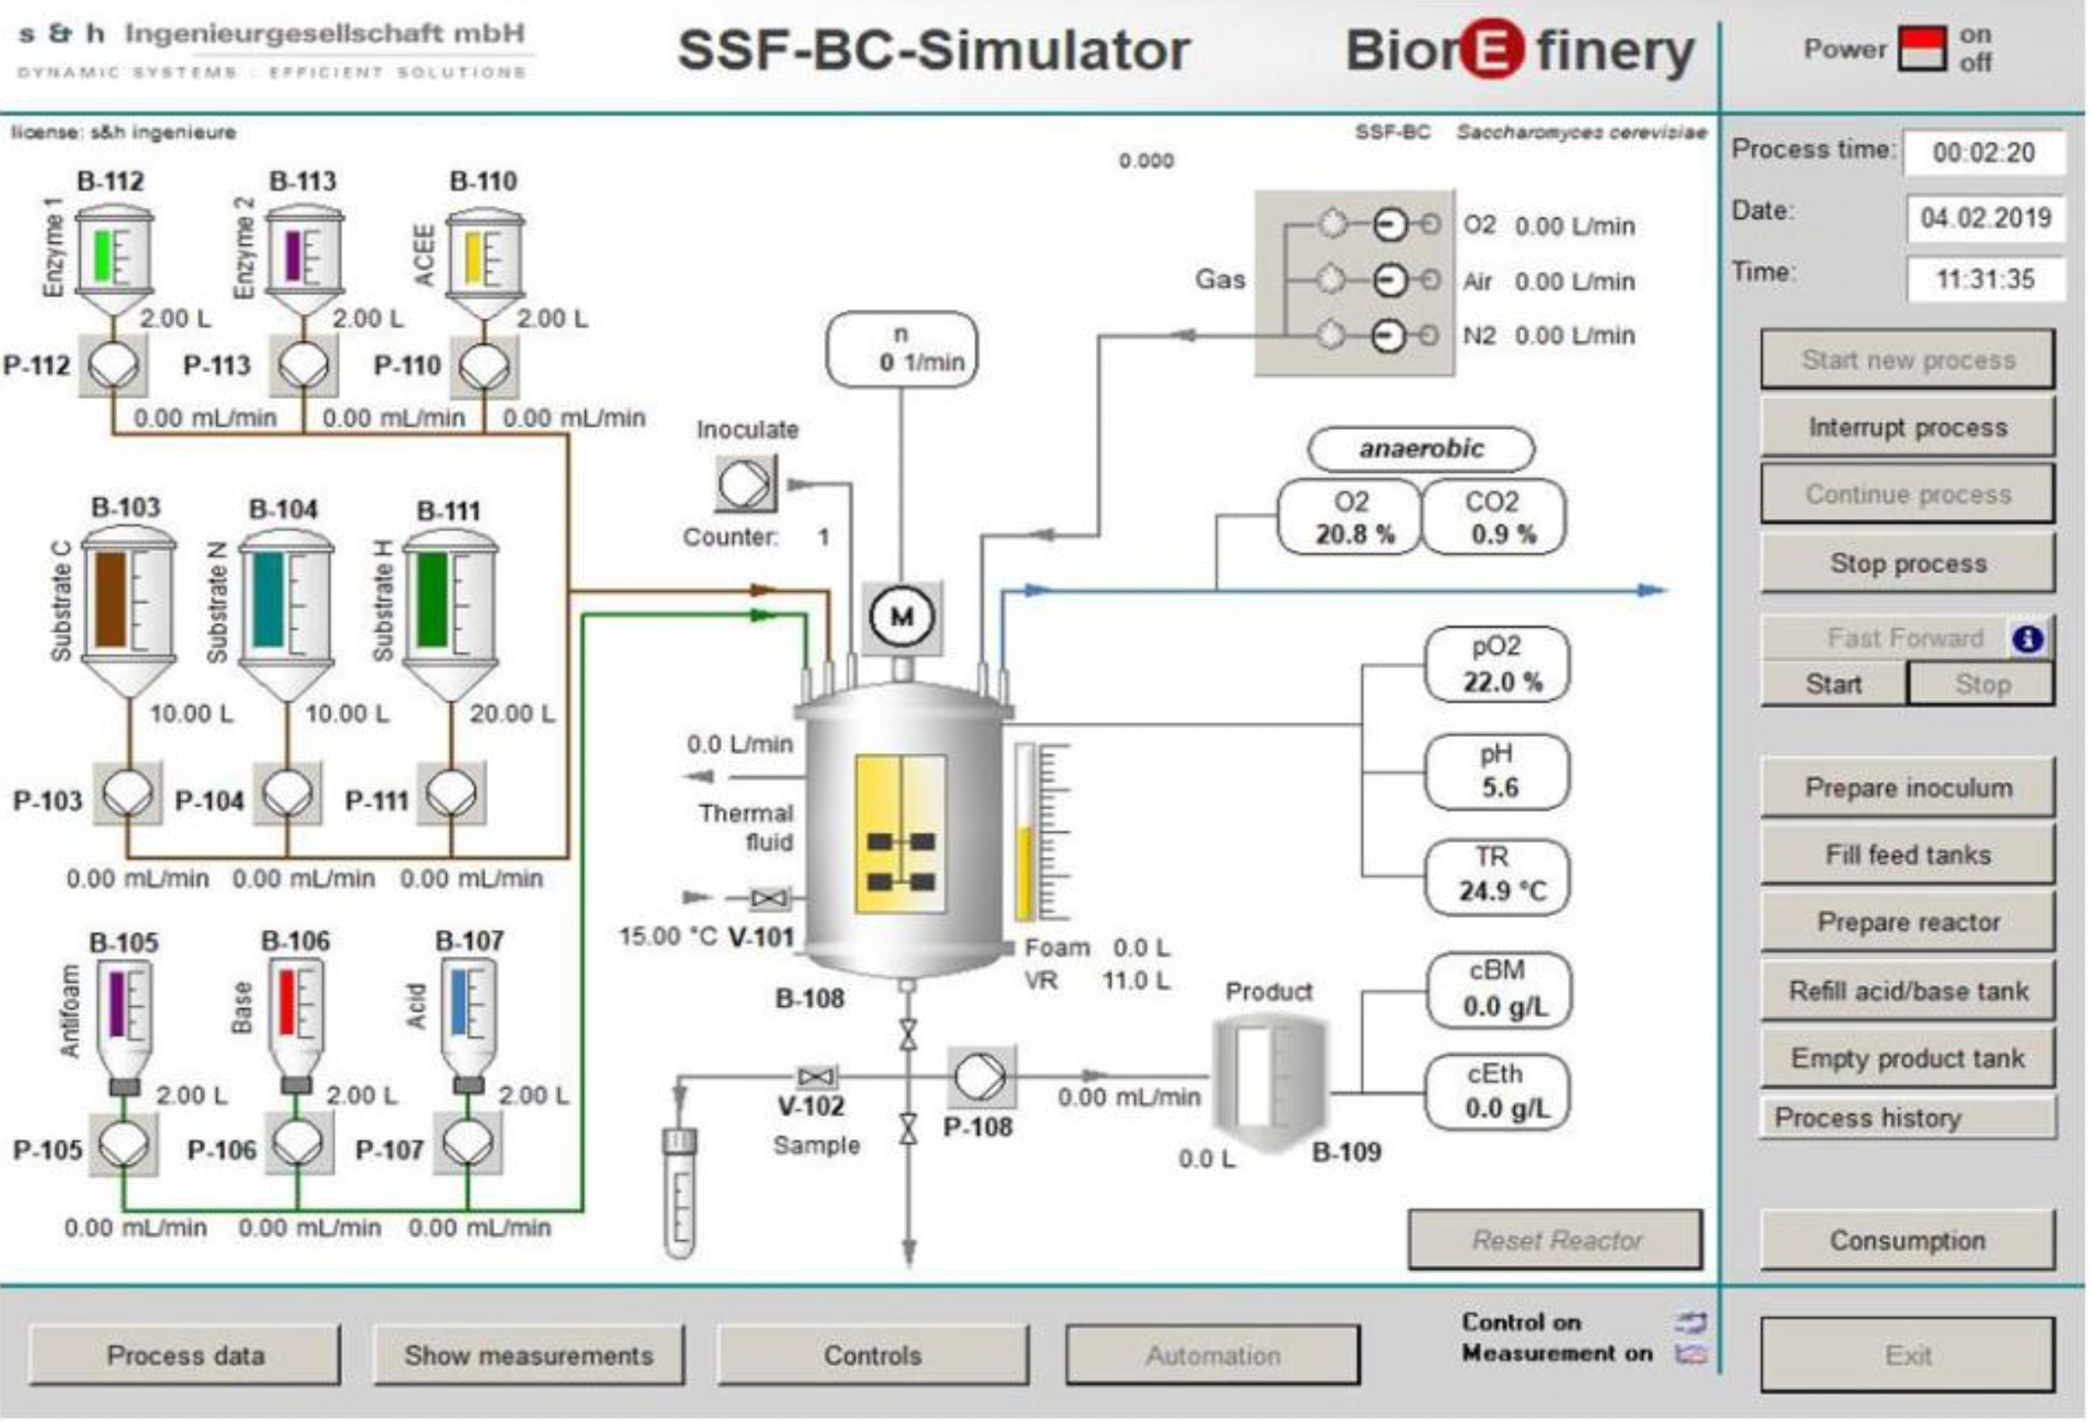


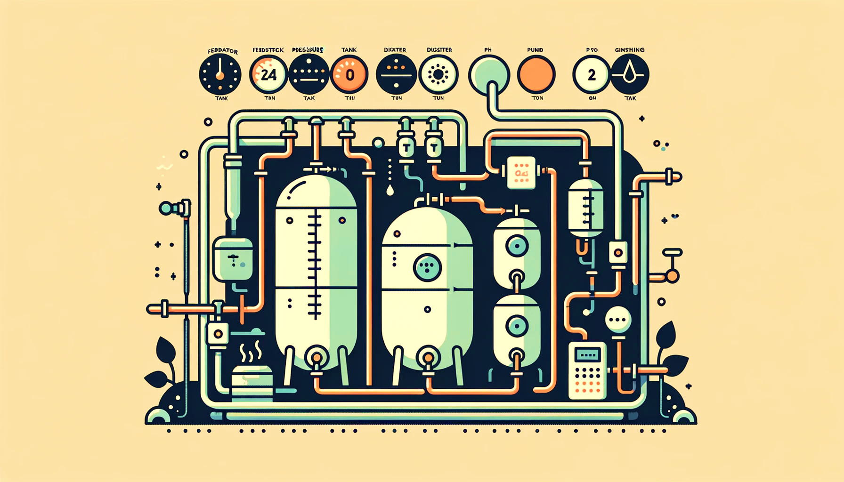
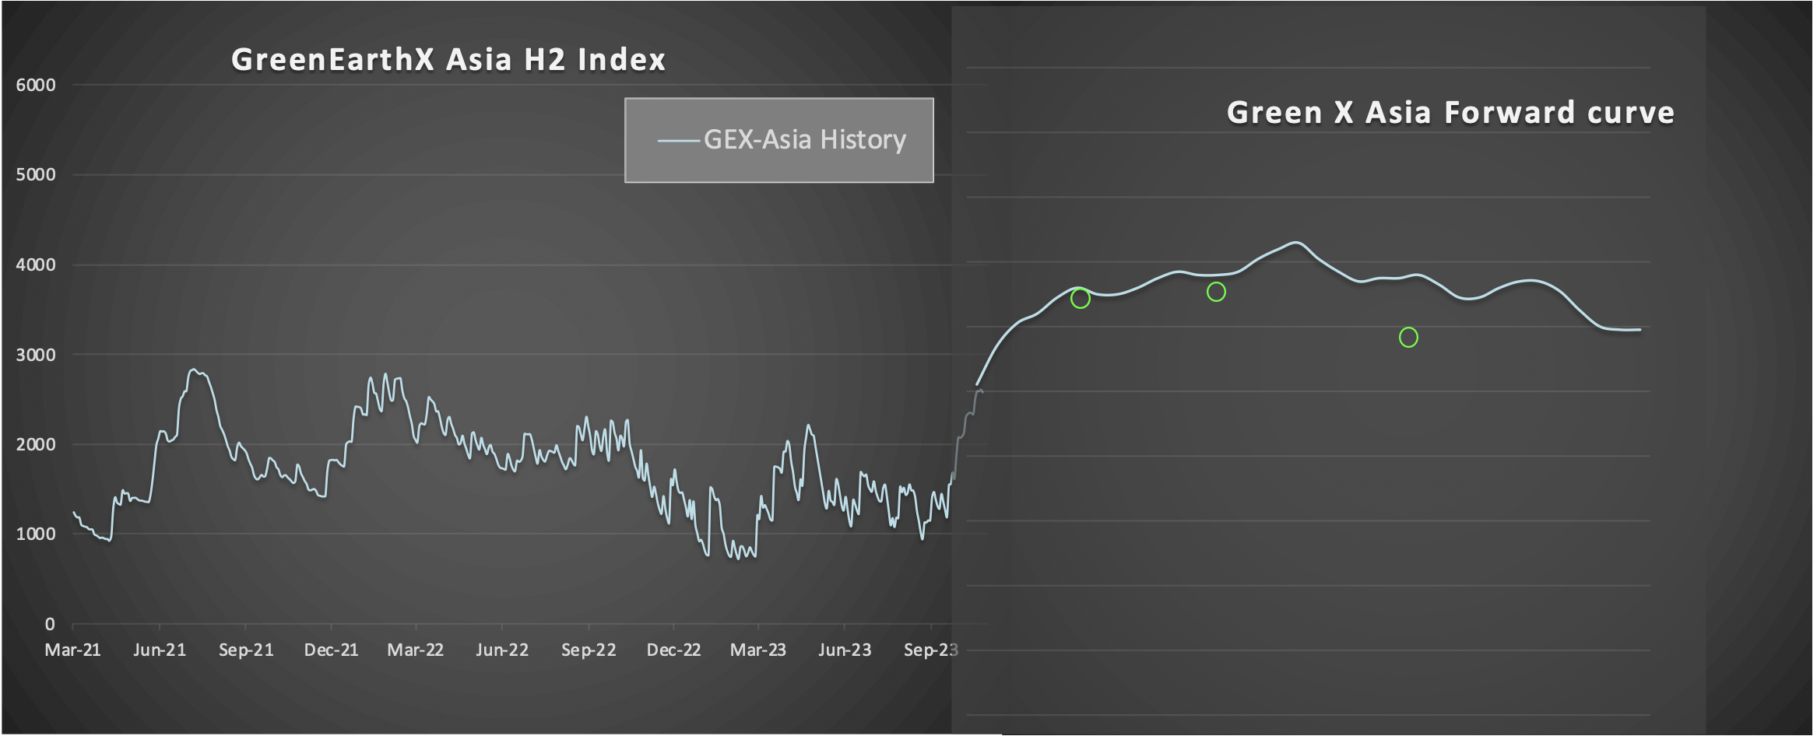
GreenEarthX
Datentreuhand
ISO Standard
+ Index
LCM – Digital

Slide 13
Electric power grid
Power to Mobility
Renewables
H₂ Fuel Cell Electric Vehicle
RedoxFlowBattery
Internal Combustion Engine Vehicle
Electricity storage
Natural Gas Vehicles
Thermal sector coupling
(Power-to-heat)
Gas sector coupling
(H2-Electrolyser)
Gas storage
Public utitlity grid
CHP (combined heat & power plant)
Power to Chemicals
Biogas
Petroleum Products
Ammonia
Power-to-Gas
(CO2+H2→Biogas)
Thermal storage
Heat grid
Source: Mariella Benkenstein, Gettor, 2023

Slide 14




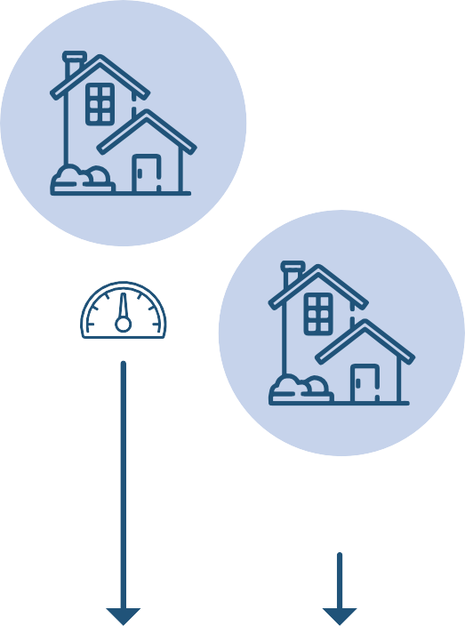






Energy Communities mit EasySmartGrid
Superior Energy grid
Local energy production
Delivery of Energy
Electricity
Results
Rate of local energy to local consumers
Amount of energy by superior grid
Price
Stability
Availability
Usability
Green Fuels
District Heating
City Gas
Energy Management System (EMS)
Real time Data
Local Development- and Testenvironment
KI Operated Auction
Plugin / Extension

Slide 15
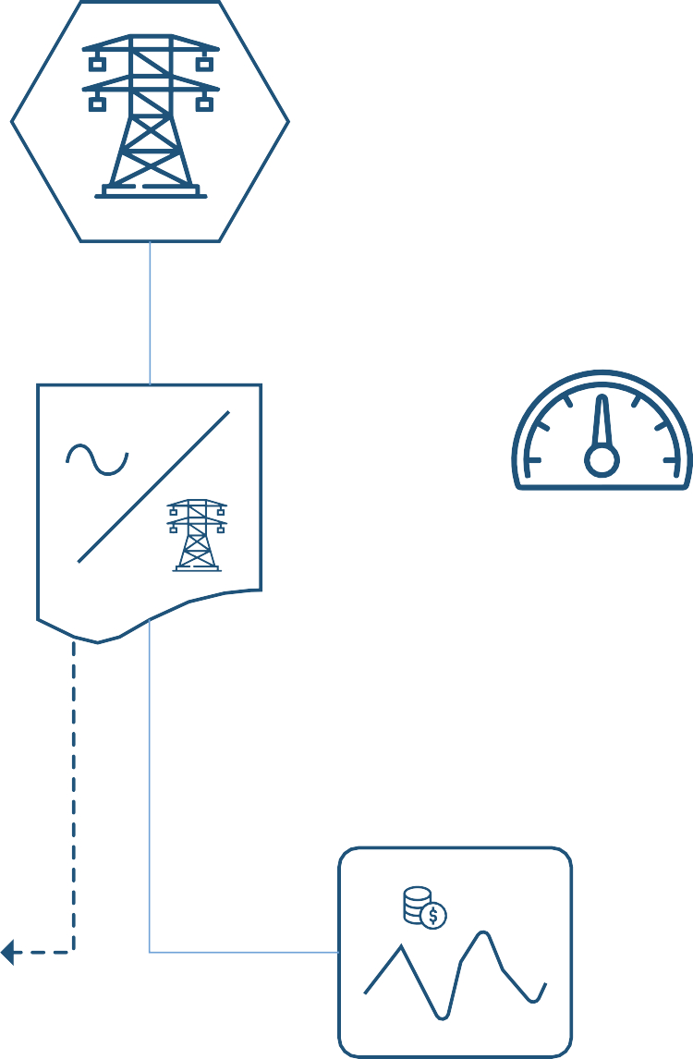


STATE OF THE ART
BEYOND STATE OF THE ART:
KI OPERATED AUCTION
Hybrid self-stabilizing control-loop and market
Energy Market
Grid
Central power and redispatch
Grid cell
Intelligent ﬂexible devices
Meter
Energy Demand
Energy Supply
Control
Status
Grid Rule
Grid Status
Device / Smart Meter Gateway
Open EMS
Walrasian Auction
Stimulus

Slide 16
Cluster und Technikum
3
Steyerberg – BlueTec Campus
Buxtehude - BlueTec Campus
EngeSande -GreenTEC Campus
…

Slide 17
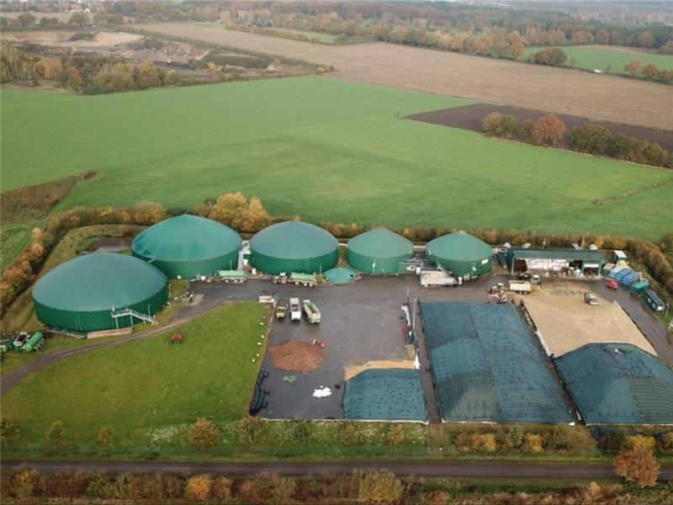
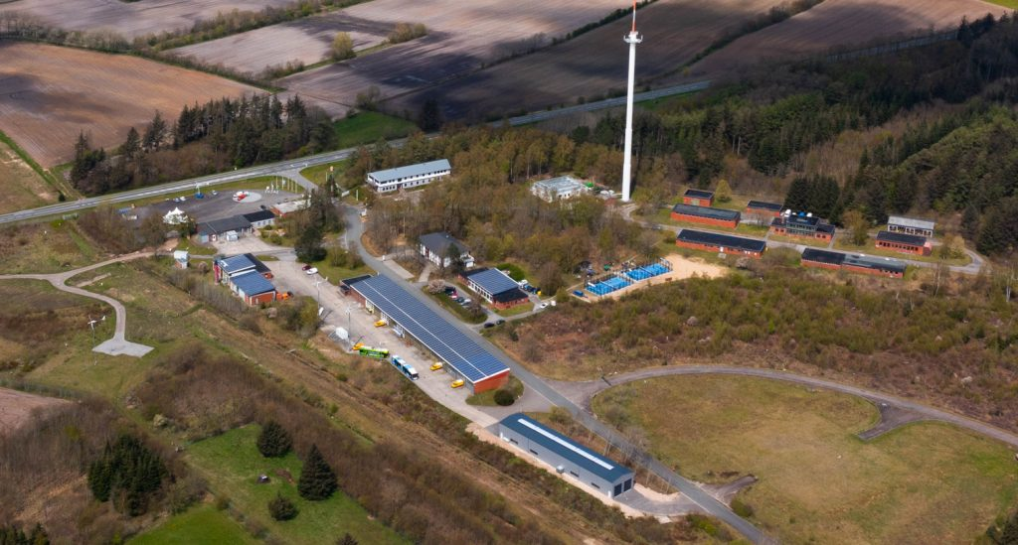
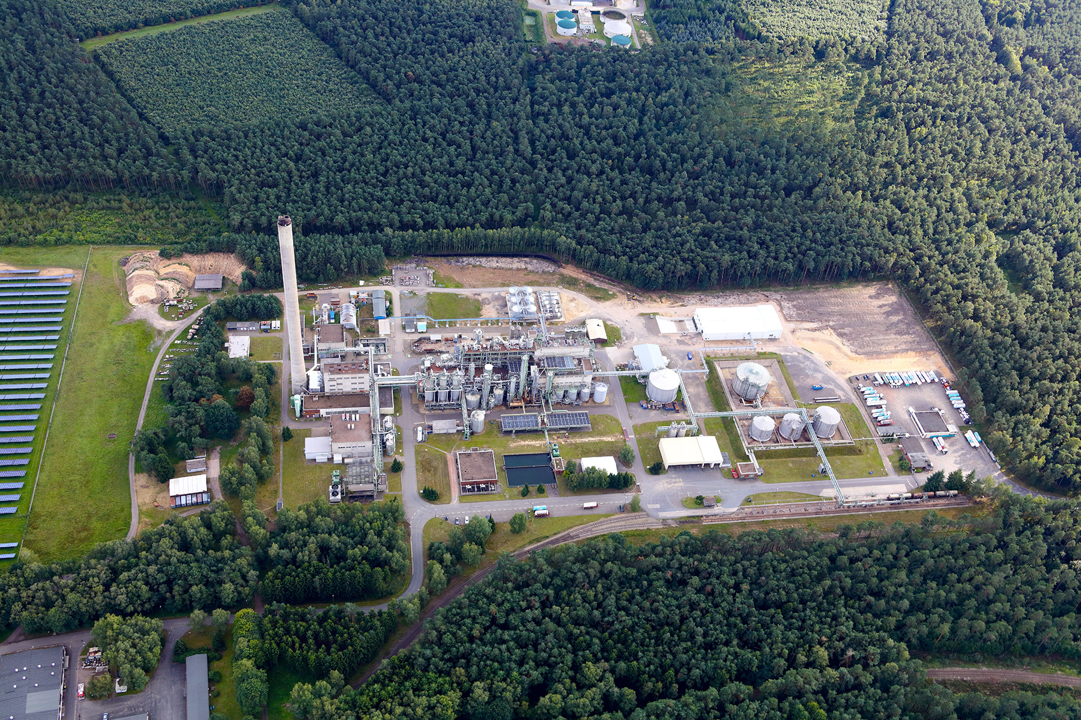
Enge Sande -GreenTEC Campus
Buxtehude - BlueTec Campus
Steyerberg – BlueTec Campus
…

Slide 18
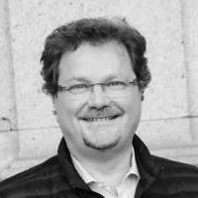




Innovation und Funding
Konsortiumbildung
Innovation Strategy
Business Architecture
Transformation
Projektentwicklung
Eigenkapital
Fördermittel
Darlehen
Bürgschaften
Projektfinanzierung
Olaf-Gerd Gemein
Impact Architect
https://impactfundingeurope.eu
olaf@ifeurope.eu
Members off:

Slide 19

Impact Funding Europe
Enabling Smart & Climate Neutral Collaborative Impact Projects by securing EU Grant Funding
9 Employees in 4 countries
11 Free-Lancers in 7 countries
Impact Funding Europe is a Joint Venture that brings together partners with extensive experience In EU Grant Funding, Consortium Building, Innovation Management and Consultancy Services.
400 customers
across Europe
We work with SMEs, City & Regional Authorities, Research Institutions, Not-for-Profits, Cluster and Citizen Groups to create world-leading consortiums and secure EU Grant Funding.
0,00 € Upfront fee
To unlock the most innovative projects that will deliver the greatest impact, we work on a no-win, no-fee basis - meaning there is no barrier to working with us and our partners.

