Slide 1

Subject: EAI 6010: Application of Artificial Intelligence
Prepared By:
Dennis Darko, Harsh Dodhiya, Romin Patel, Hetvi Shah
Submitted to:
Prof. Richard Munthali

Slide 2
Deployment of AG News Category Prediction Microservice

Slide 3
Agenda
Introduction
Business Problem
Dataset Selection & Parameters
Model Validation Results
Service Description
Service Deployment Files
User Interface (UI) Files
Service Deployment on Google Cloud Run
Specific Examples of Service’s Input and Output
Challenges Faced During Deployment
Conclusion
References

Slide 4
Introduction
This project involves the deployment of a microservice designed to classify news articles into predefined categories using a machine learning model trained on the AG News dataset.
The service was developed using Python, containerized with Docker, and deployed on Google Cloud Run, providing scalability and accessibility.
The microservice automates text classification, making it valuable for news platforms, content filtering, and sentiment analysis tasks.

Slide 5
Business Problem
The need for automating the classification of news articles has become increasingly important for news platforms and aggregators.
Manual categorization is time-consuming and prone to errors, leading to inconsistent user experiences.
The AG News Category Prediction Microservice aims to solve the following business problems:
News Categorization
Content Filtering
Sentiment Analysis
Automating the classification of news articles into predefined categories for efficient content organization
Providing personalized content to users by filtering and recommending news articles based on their preferences
Analyzing trends and sentiments within different news categories, which can be used for market research and audience engagement strategies.

Slide 6
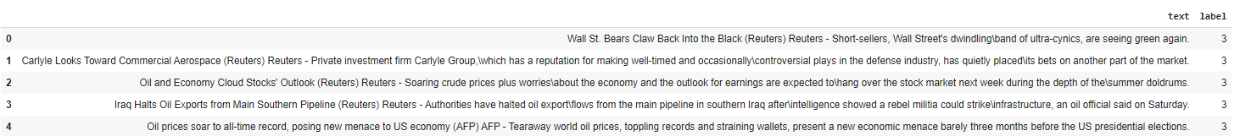
Dataset Selection & Parameters
The AG News dataset was selected for its structured format and widespread use in text classification tasks. It contains 96,000 news articles categorized into four classes:
World, Sports, Business, and Sci/Tech.
Parameter Tuning: Learning rate, batch size, and number of epochs were fine-tuned to optimize the model's performance.
A subset of 10% of the dataset (9,600 observations) was used for training and validation to manage computational resources effectively.
Dataset

Slide 7
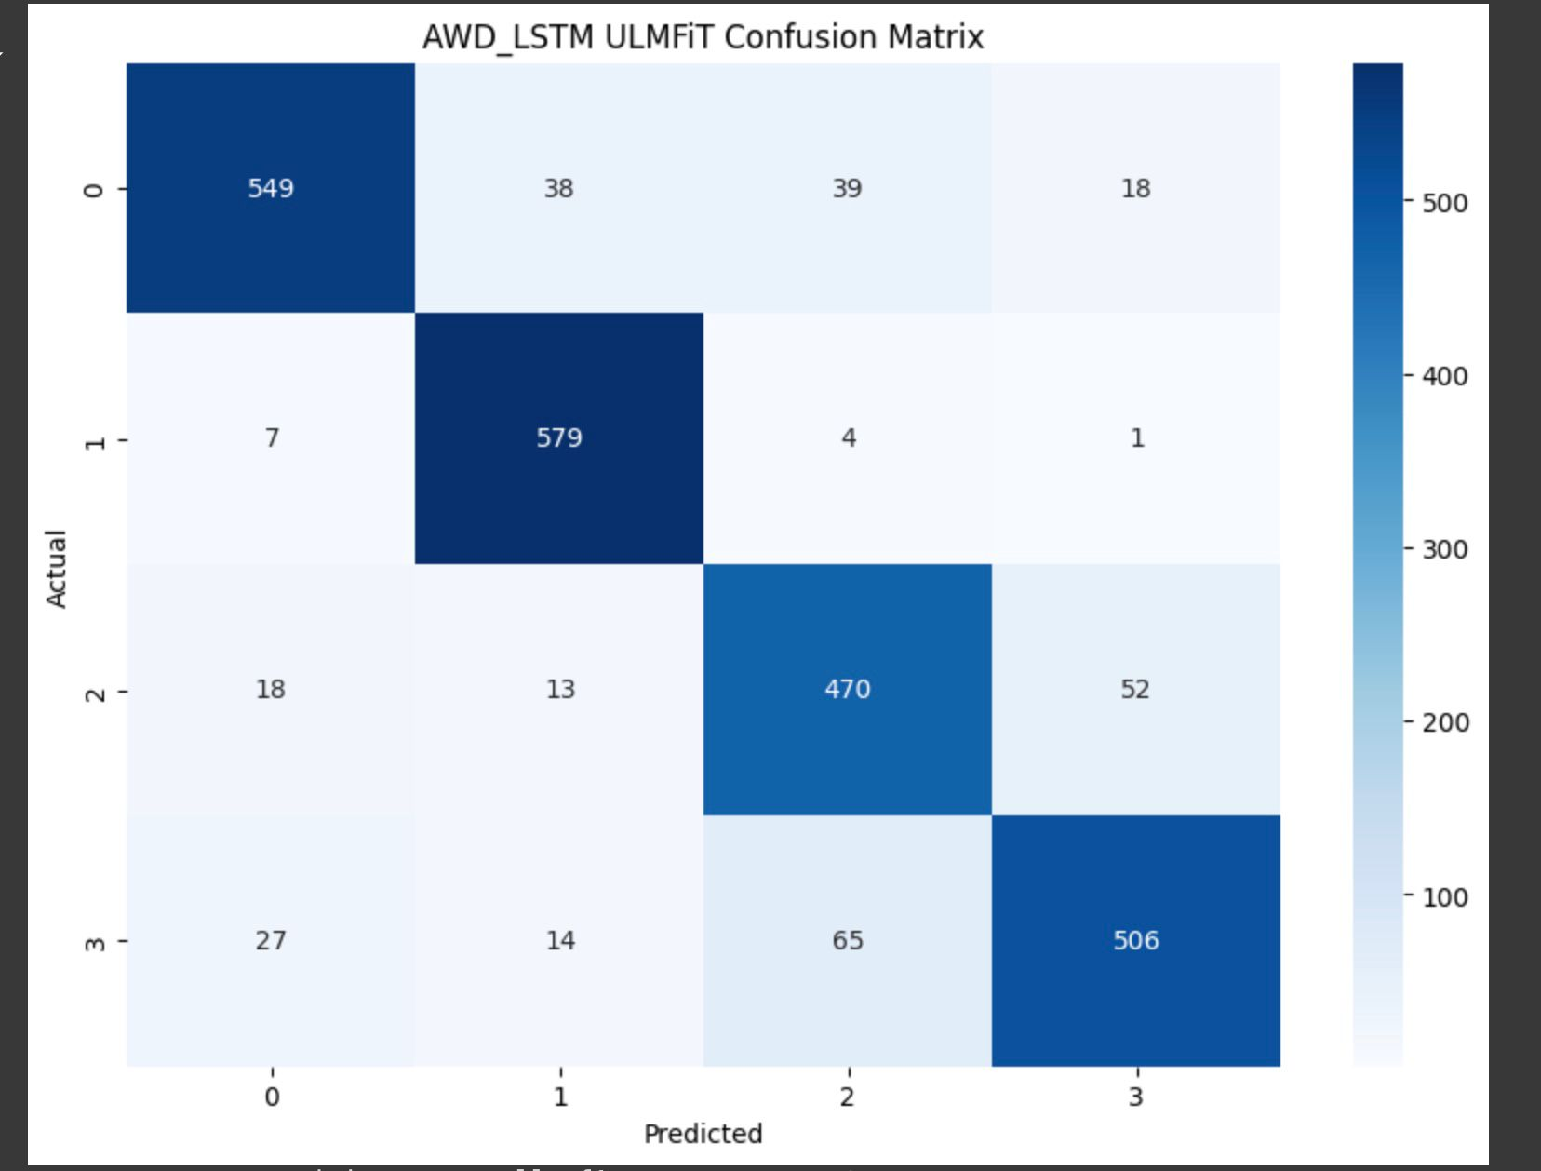
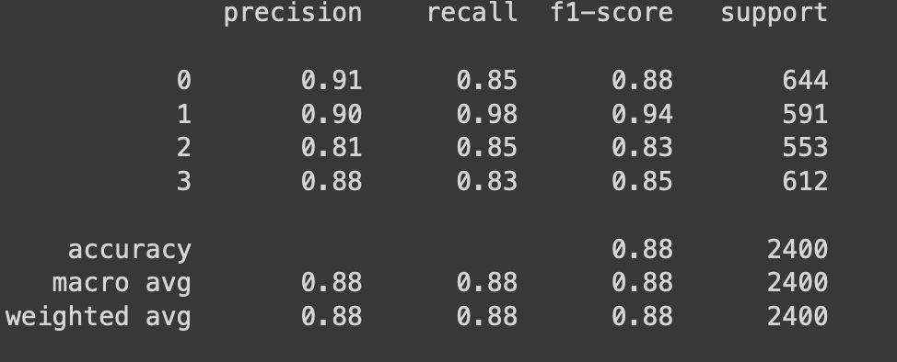
Model Validation Results
The AWD_LSTM ULMFiT model was validated on the AG News dataset, achieving the following results:
Confusion Matrix
Classification Report

Slide 8
Service Description
The deployed microservice accepts the text of a news article as input and returns a predicted category.
World
Input
(Text of a news article)
Output (Predicted Category)
Sports
Business
Sci/Tech

Slide 9
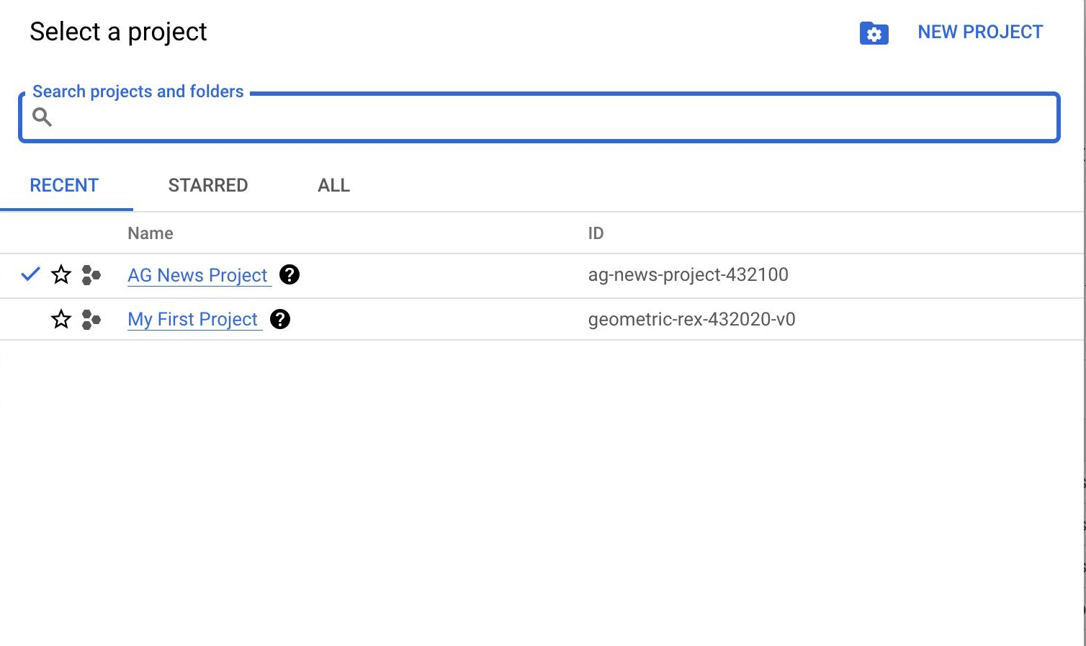
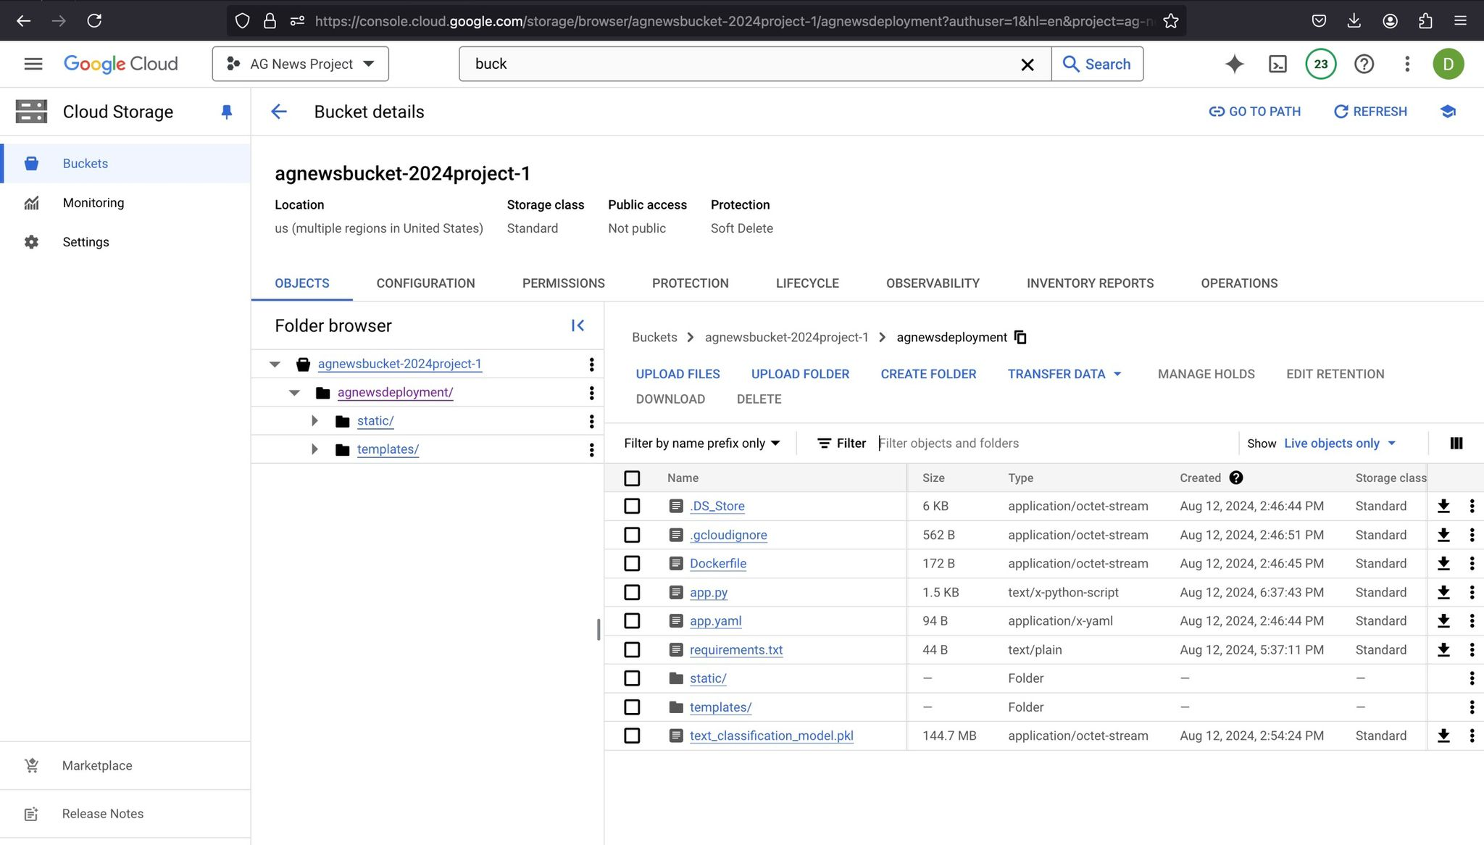
Service Description
The service is accessible via an API endpoint hosted on Google Cloud Run.
Google Cloud Project Creation
Bucket Creation

Slide 10
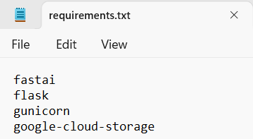
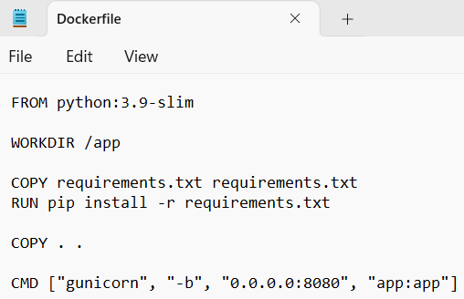
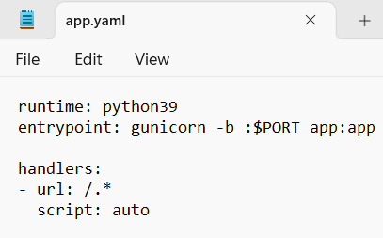
Service Deployment Files
Requirements File
Docker File
Yaml File

Slide 11
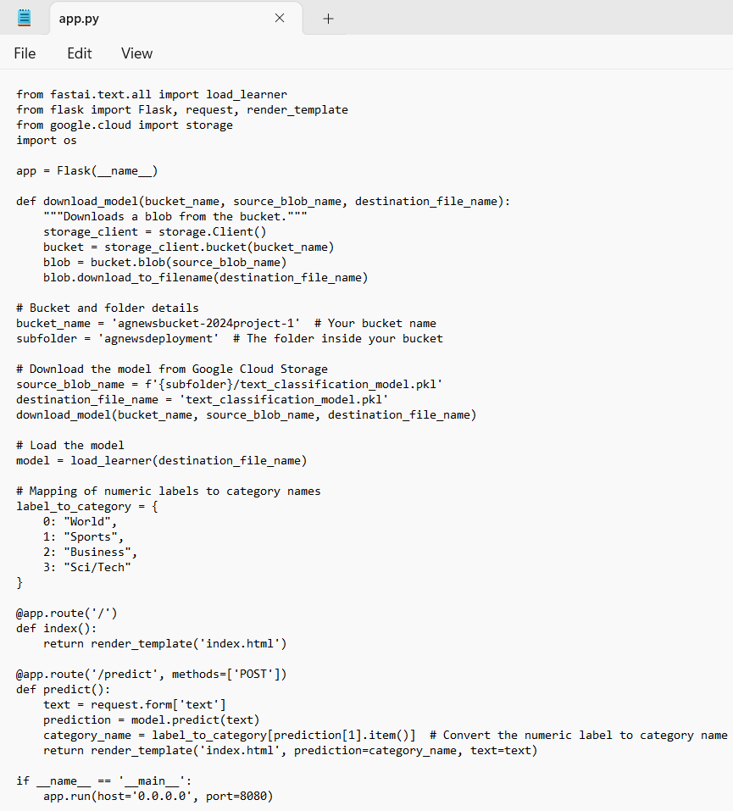
Service Deployment Files
Application File

Slide 12
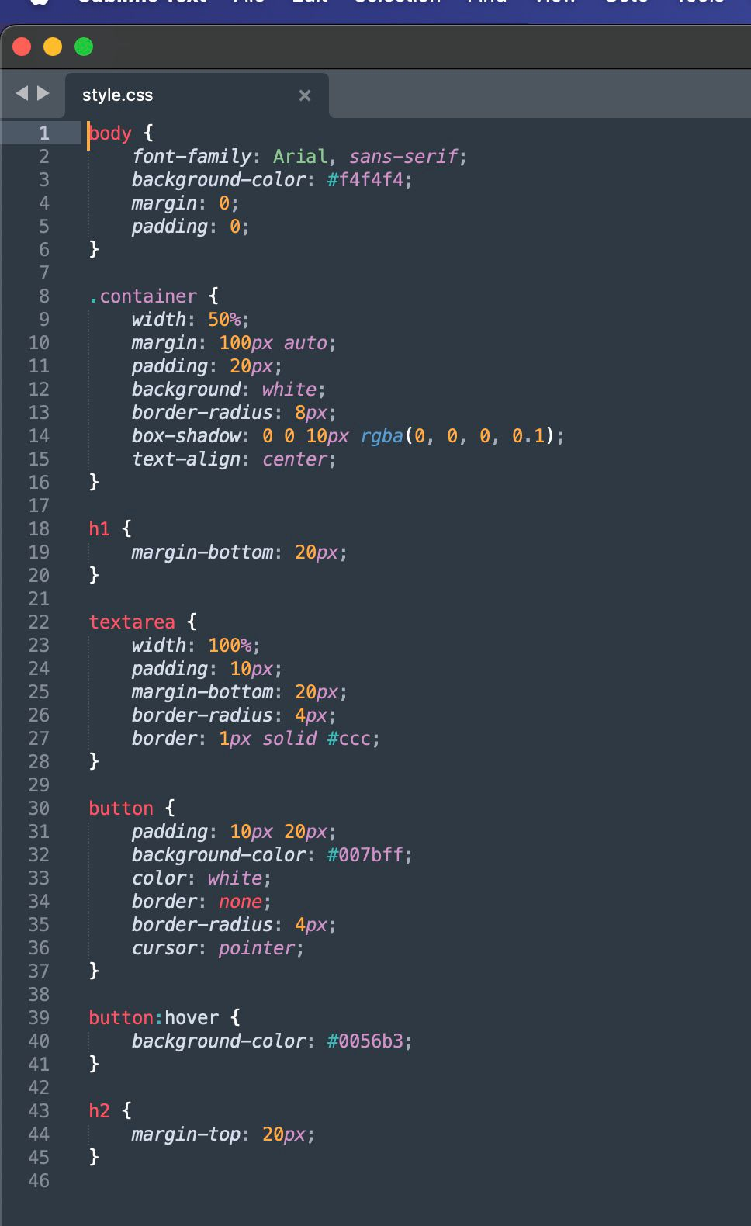
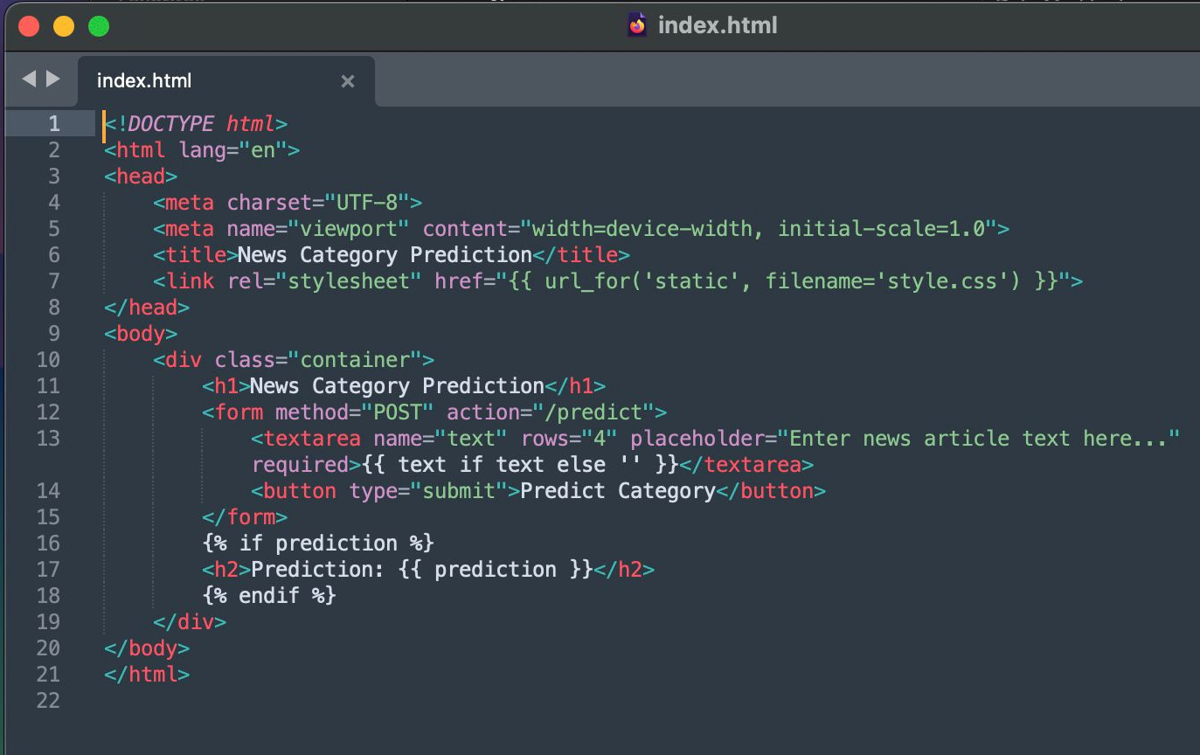
User Interface (UI) Files

Slide 13
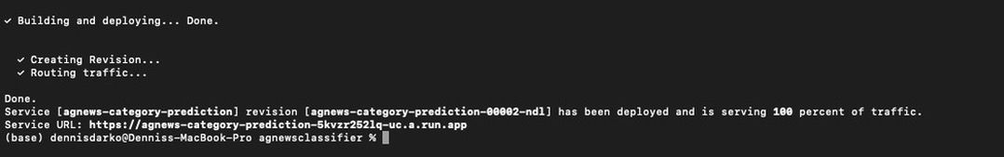
Service Deployment on Google Cloud Run
The service was deployed using Google Cloud Run, a fully managed computing platform that automatically scales applications based on incoming requests.
Project Setup: A Google Cloud project was created with the ID 'ag-news-project-432100'. The trained model and necessary files were stored in a Cloud Storage bucket named 'agnewsbucket-2024project-1’.
The service was containerized using Docker and deployed using the Google Cloud SDK.
Model Deployment

Slide 14
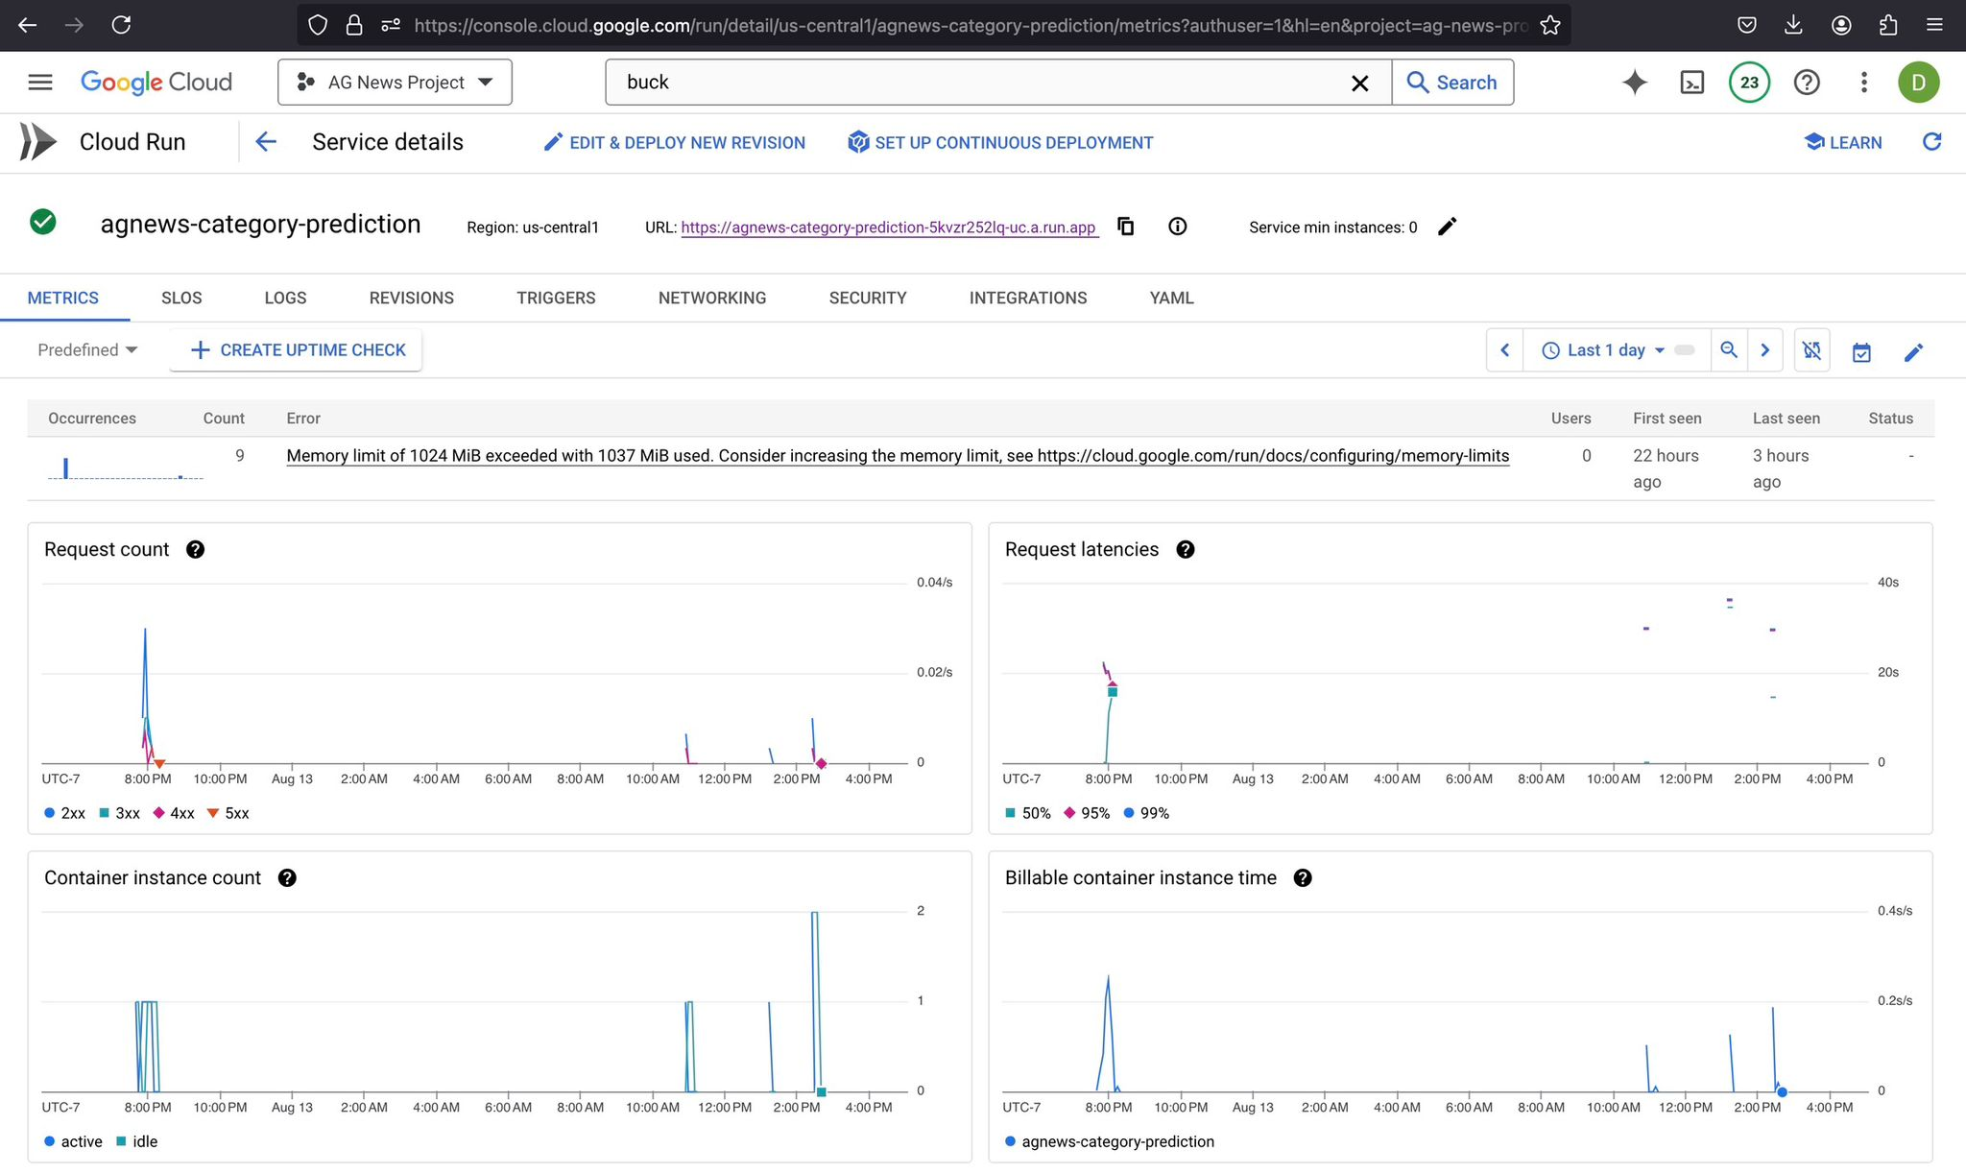
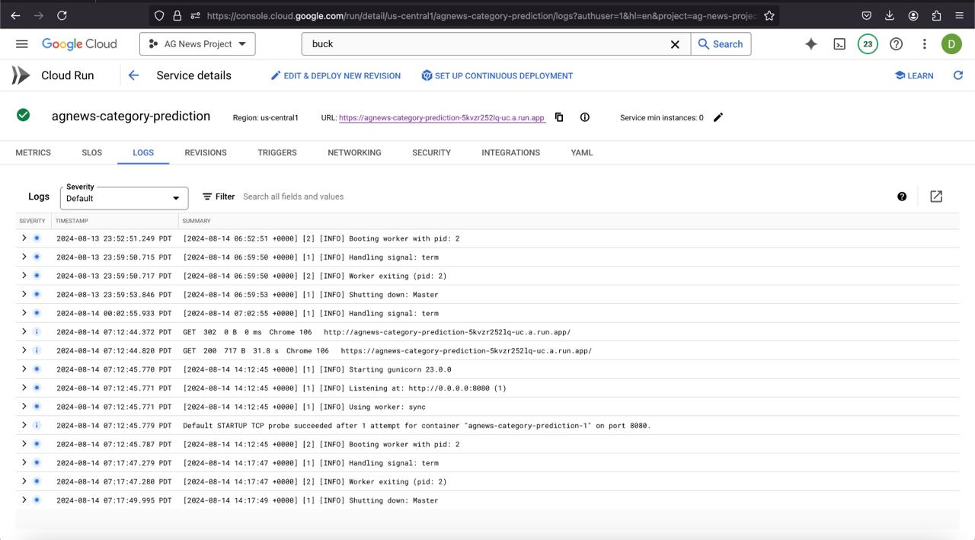
Service Deployment on Google Cloud Run
Service Details
Logs

Slide 15
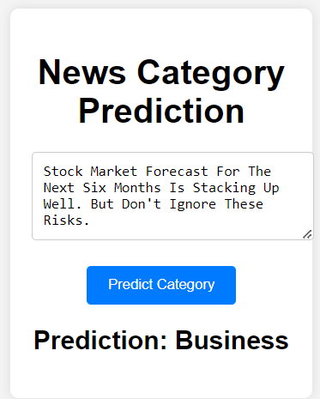
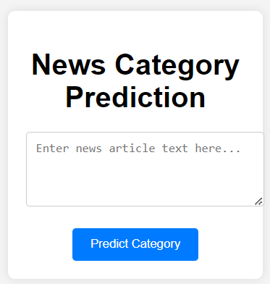
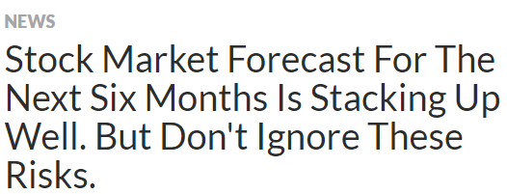
Specific Examples of Service’s Input and Output
Link: https://agnews-category-prediction-5kvzr252lq-uc.a.run.app/
The microservice was tested with various news articles. Here are some examples:
Output
Start
Input

Slide 16
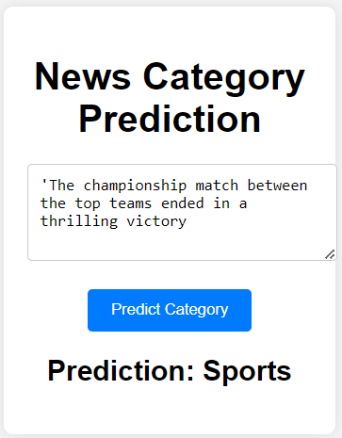
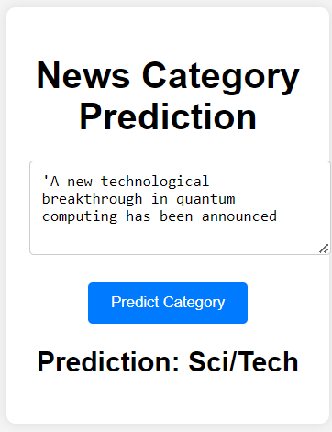
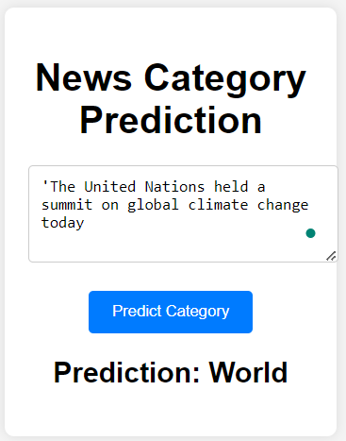
Specific Examples of Service’s Input and Output
Examples of Sports, Sci/Tech and World Categories:

Slide 17
Challenges Faced During Deployment
Issue: Despite successful deployment of all required files, the web application consistently displayed a "Service Unavailable" error when accessing the URL.
Impact: This issue hindered the ability to test and verify the deployment on Windows OS, leading to delays in the deployment timeline.
Issue: Significant challenges were encountered during the installation of the SDK, particularly with the Homebrew package manager.
Details: Manual intervention was required to add Homebrew to the system's PATH environment variable, causing delays in the deployment process.
Resolution: After resolving the PATH issue, the service was successfully deployed on macOS.
Windows OS
MAC OS

Slide 18
Conclusion
This project demonstrates the successful deployment of a text classification microservice on Google Cloud Run.
The service is capable of accurately categorizing news articles, making it a valuable tool for news platforms and content filtering applications.
The project faced challenges during deployment, but these were overcome through careful configuration and troubleshooting. The service is now live and ready for use.

Slide 19
References
Zhang, X., Zhao, J., & LeCun, Y. (2015). Character-level convolutional networks for text classification. arXiv. https://arxiv.org/abs/1509.01626
Howard, J., & Ruder, S. (2018). Universal language model fine-tuning for text classification. In Proceedings of the 56th Annual Meeting of the Association for Computational Linguistics (ACL 2018). arXiv. https://arxiv.org/abs/1801.06146
Google Cloud. (n.d.). Google Cloud Run documentation. Google Cloud. https://cloud.google.com/run/docs
Google Cloud. (n.d.). Google Cloud SDK documentation. Google Cloud. https://cloud.google.com/sdk/docs/install
Docker Inc. (n.d.). Docker documentation. Docker Inc. https://docs.docker.com/
Howard, J., & Gugger, S. (2020). Fastai: A layered API for deep learning. arXiv. https://arxiv.org/abs/2002.04688
PyTorch. (n.d.). PyTorch documentation. PyTorch. https://pytorch.org/docs/stable/index.html
Pedregosa, F., et al. (2011). Scikit-learn: Machine learning in Python. Journal of Machine Learning Research, 12, 2825-2830. https://scikit-learn.org/stable/
Zhang, X., Zhao, J., & LeCun, Y. (2015). AG News dataset. Retrieved from https://raw.githubusercontent.com/mhjabreel/CharCnn_Keras/master/data/ag_news_csv/train.csv

Slide 20
Thank You
For Your Attention
Any Questions
?

