Slide 1

Enhanced Public Policy Optimization: Leveraging Predictive Modeling for Tailored Benefit Analysis
Group A Members
Oguche Ausa
Dennis Darko
Adewale Jayeola
Ebenezer-Boako-Aggrey
Master in Analytics, Northeastern University College of Professional Studies
ALY 6080: Integrated Experiential Learning
Instructor: Dr. Herath Gedara, Chinthaka Pathum Dinesh

Slide 2
Agenda
Introduction
Project Description
Data Collection
Data Analysis
Data Preprocessing
Policy Categorization
Feature Engineering
Handling Class Imbalances
Model Training & Evaluation
Model Performance
Deployment
API Request
API Workflow & Result
Real-World Application
Conclusion

Slide 3
Introduction
Objective
To deploy a predictive model capable of identifying the most advantageous public policy for each individual, guided by demographic attributes and interaction histories.

Slide 4
Project Description
CIVA's data-driven platform aims to optimize government relationships and enhance government-funded initiatives by analyzing diverse datasets including demographics, user interactions, and policy outcomes.
Focus: Investigate the efficacy of public policies in delivering maximum benefits based on user profiles and engagement patterns.

Slide 5
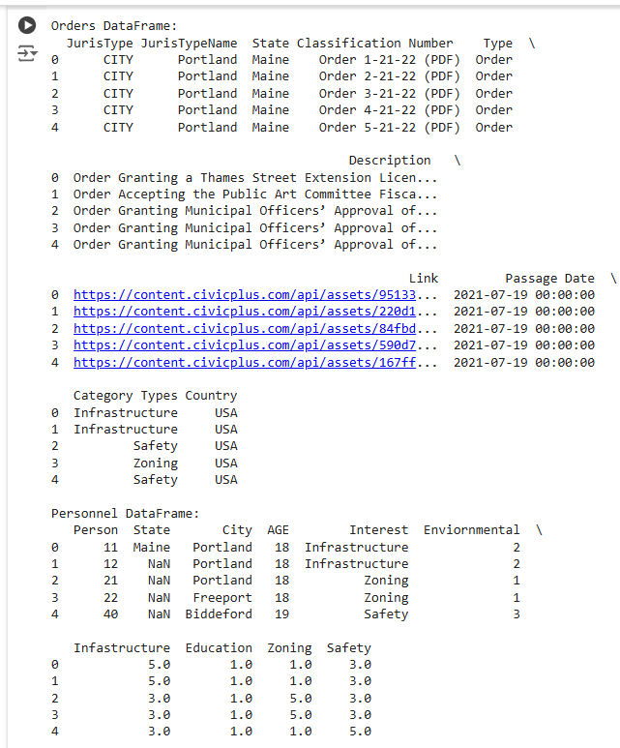
Data Collection
Data Sources
Orders and Bills dataset (policies)
Personnel dataset (user demographic and interaction data)
Dataset consists of 2 sheets
Sheet 1 contains 1465 observations and 10 attributes
Sheet 2 contains 1001 observations and 10 attributes

Slide 6
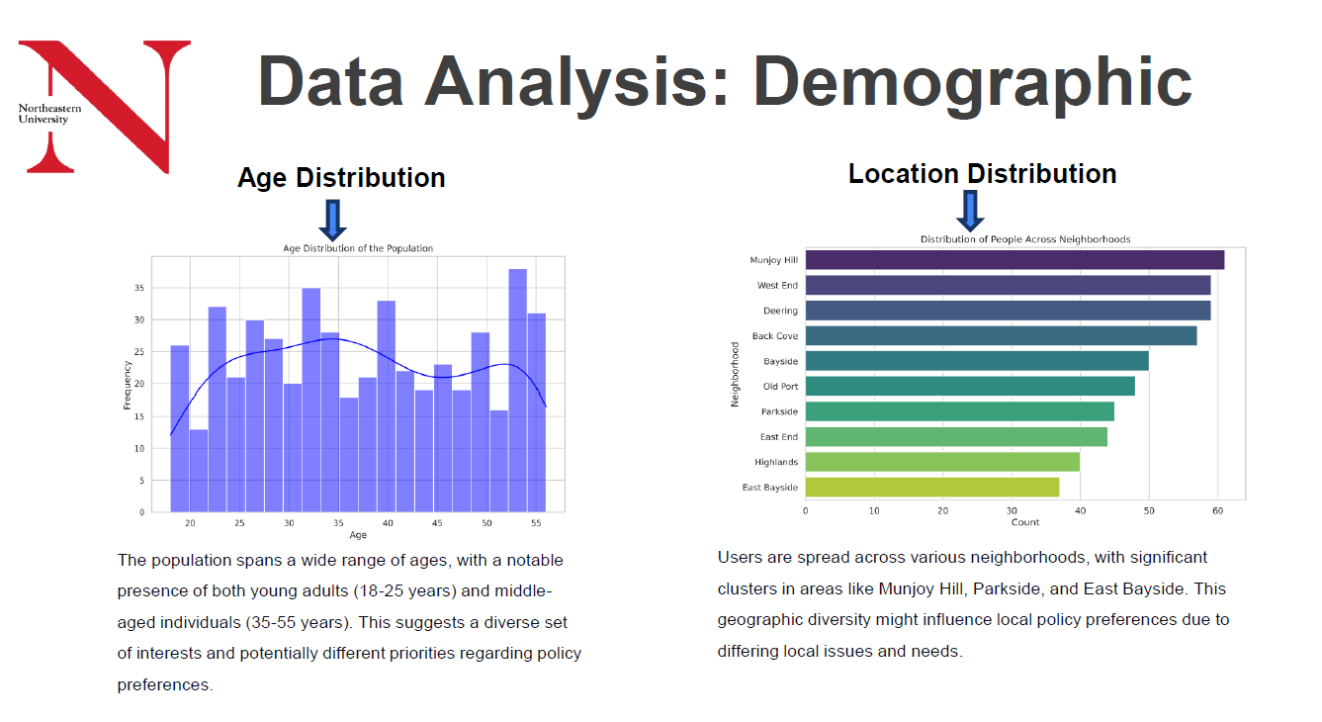

Slide 7
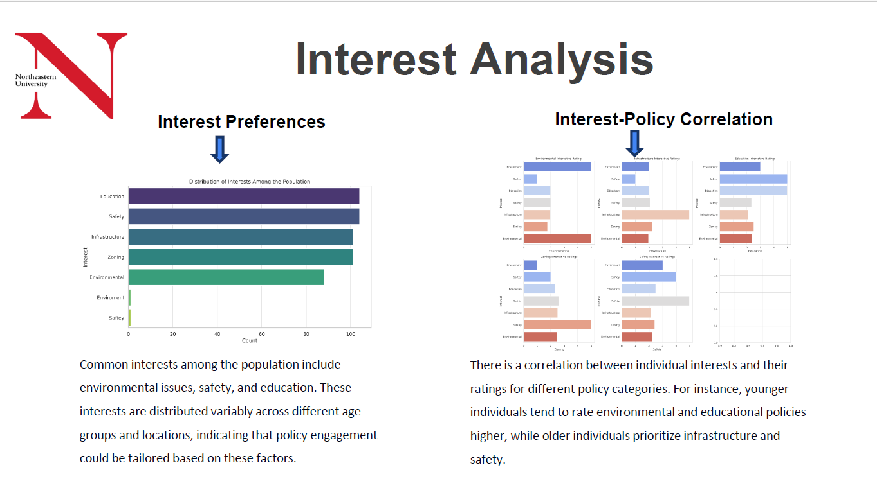

Slide 8
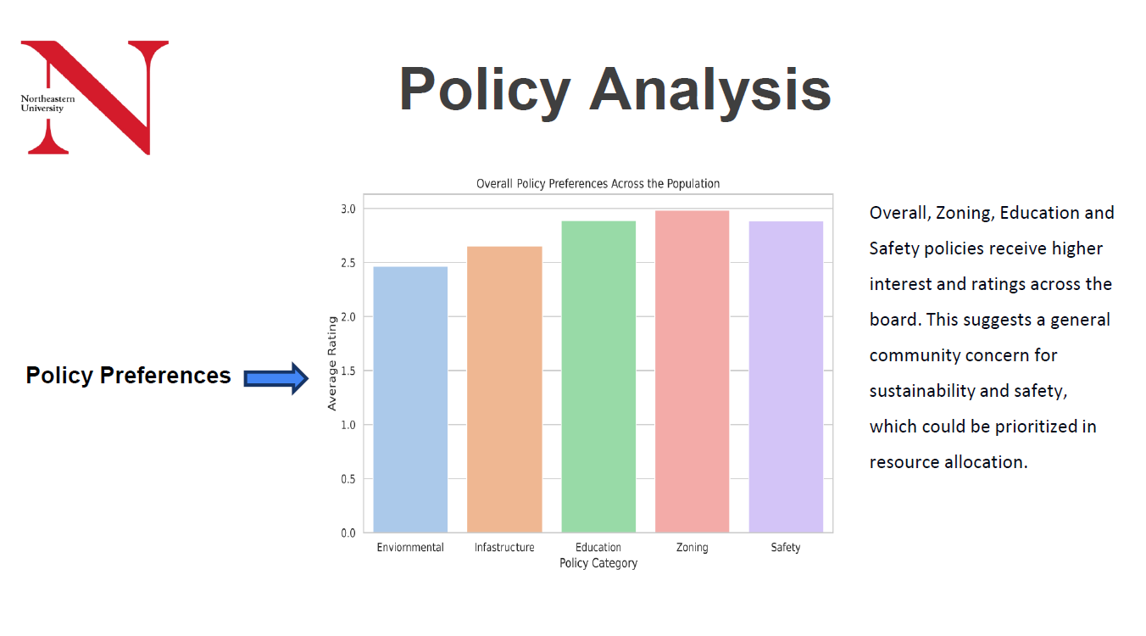

Slide 9
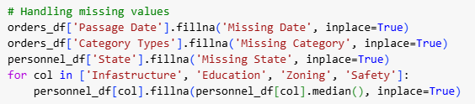
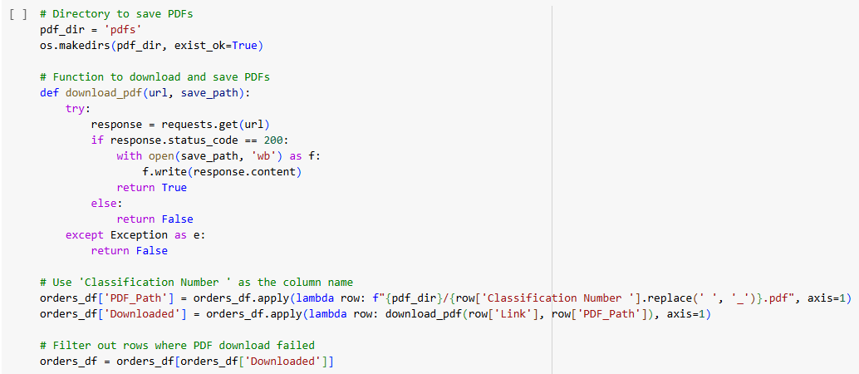
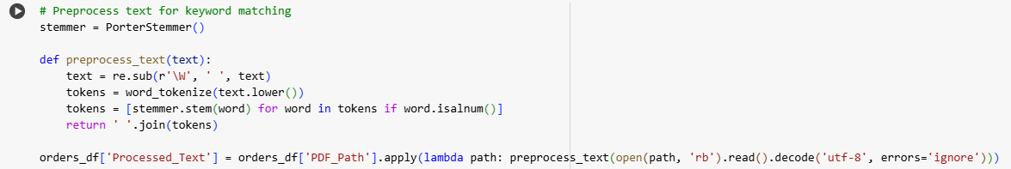
Data Preprocessing
Handling missing values
Downloading and extracting text from policy documents
Text preprocessing for keyword matching( tokenization, stemming,stop word removal)

Slide 10
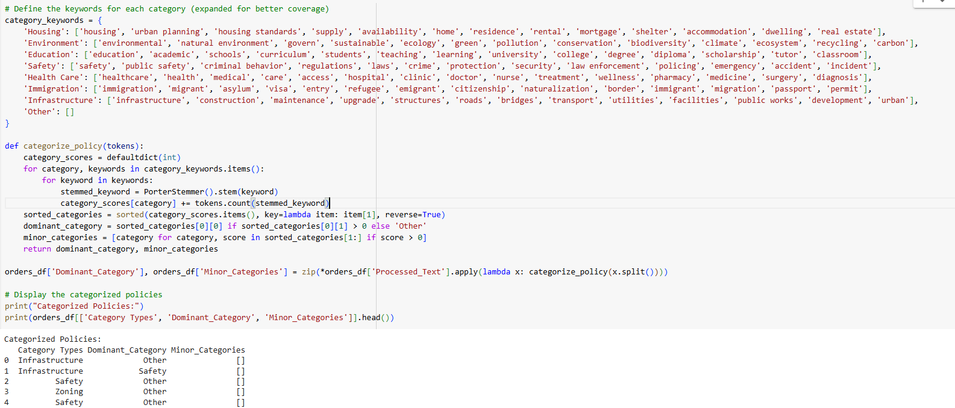
Policy Categorization
Approach:
Keyword-based categorization using expanded keyword lists for each policy category.
Dominant and minor category assignment based on keyword matching.

Slide 11
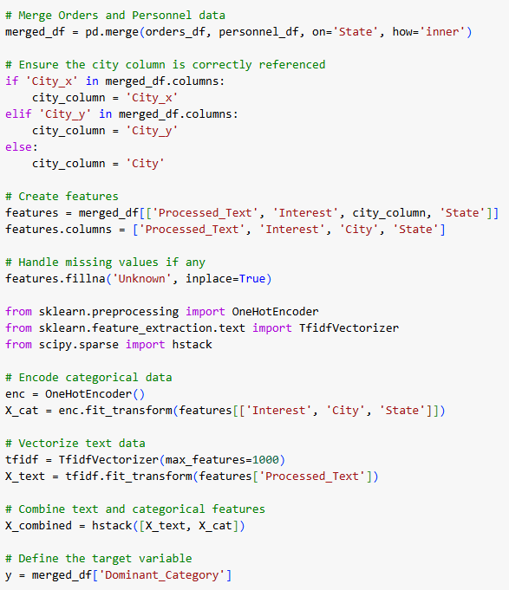
Feature Engineering
Combining Features
Text data from policies (TF-IDF vectorization)
User demographic data (One-Hot Encoding)

Slide 12
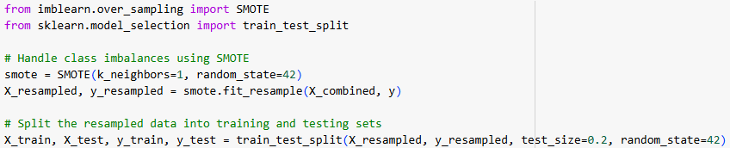
Handling Class Imbalances
Method:
SMOTE (Synthetic Minority Over-sampling Technique) to handle class imbalances

Slide 13
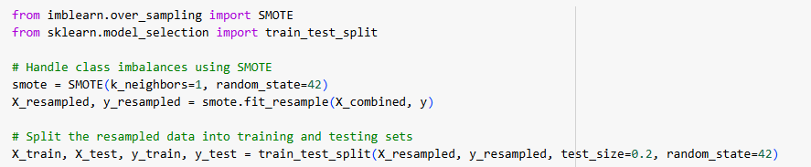
Handling Class Imbalances
SMOTE application

Slide 14
Model Training and Evaluation
Models Used:
Gradient Boosting Classifier
Training Process:
Split data into training and testing sets
Model training and validation
Evaluation Metrics:
Accuracy
Precision
Recall
F1 Score

Slide 15
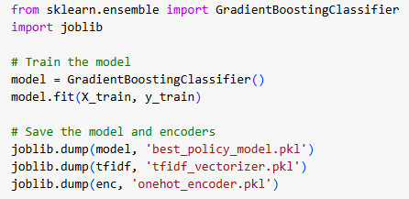
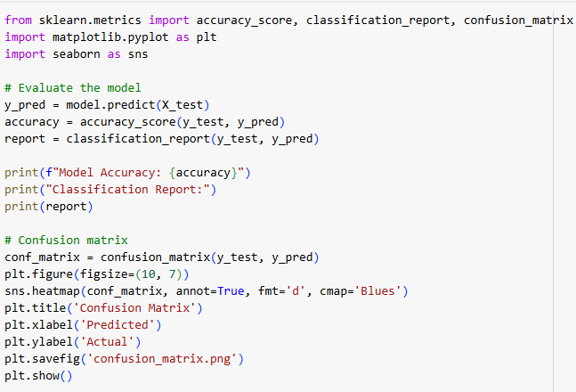
Model Training and Evaluation cont’d
Model Training
Model Evaluation

Slide 16
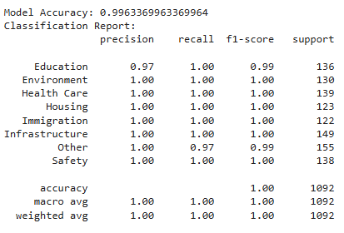
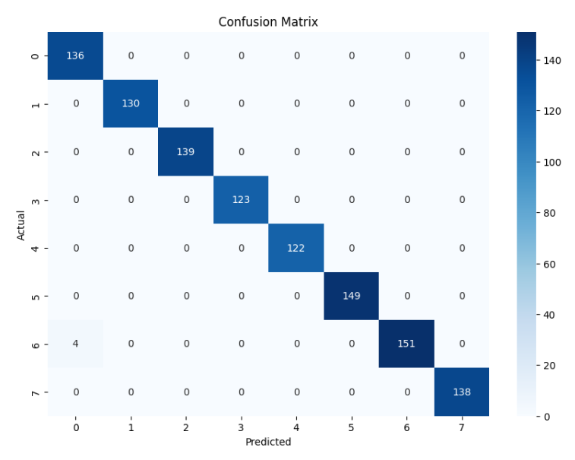
Model Performance
Accuracy & Classification Report
Confusion Matrix
The model is highly accurate and performs well across categories, with precision, recall, and F1-scores near 1.0. There are a few misclassifications (e.g., "Other" misclassified as "Education"), but overall, the model performs excellently.

Slide 17
Deployment
Developed a Flask API( Recommendation System) to serve predictions based on user inputs (interest, city, state)
Functionality:
Predicts the most advantageous policy and serves the corresponding PDF document

Slide 18
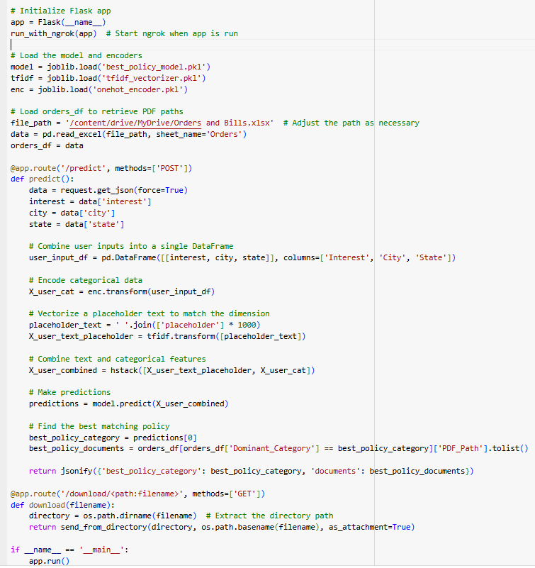
API Request
API Development(Recommendation System)

Slide 19
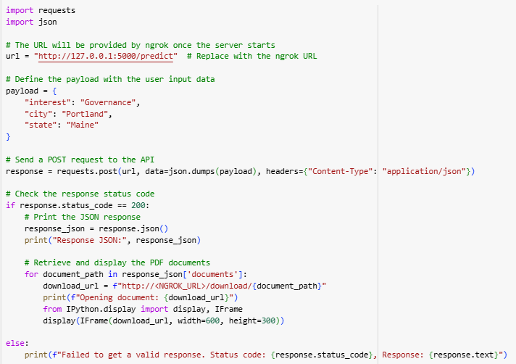
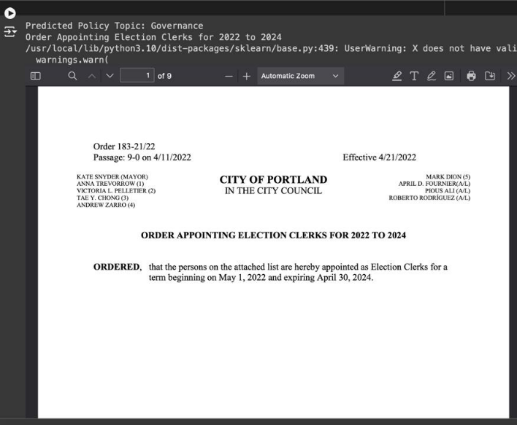
API Workflow & Result
API Testing

Slide 20
Real-World Application
Use Case:
Users can input their interest and location to receive tailored policy recommendations
Benefits:
Personalized delivery of public services
Enhanced user engagement with government policies

Slide 21
Conclusion
Summary:
Successfully developed a predictive model and API for policy optimization
High accuracy and robust performance in categorizing and recommending policies
Future Work:
Continuous improvement through feedback
Expansion of keyword lists
Integration with more datasets

Slide 22
Q&A
Questions and Answers:
Open the floor for questions from the Sponsor(CIVA), Instructor, Students.

