Slide 1
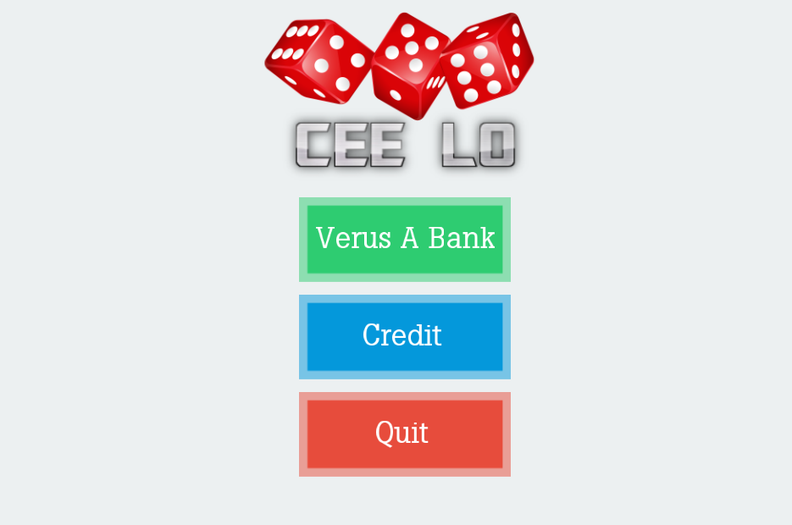
[ HIN104] GameLoft
Lê Viết Huy – CeeLo Game
Place your screenshot here

Slide 2

Game Idea

Slide 3
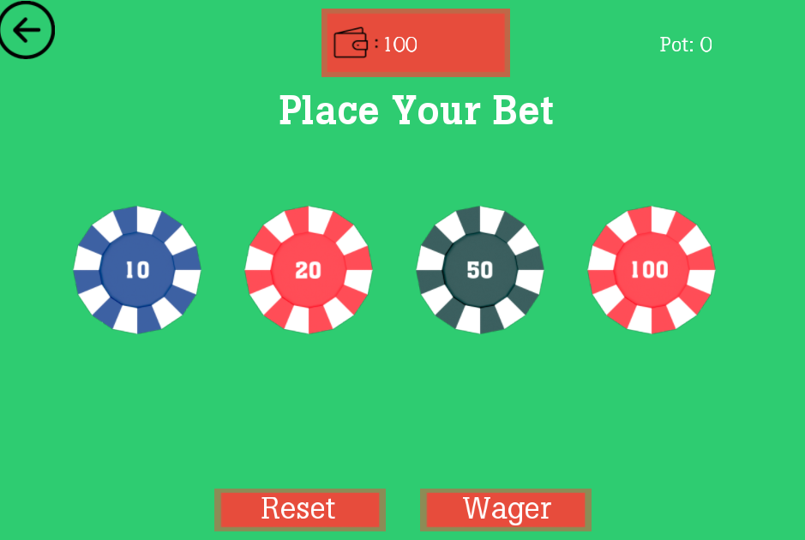

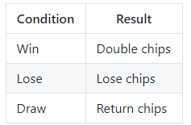
Game Rules

Slide 4

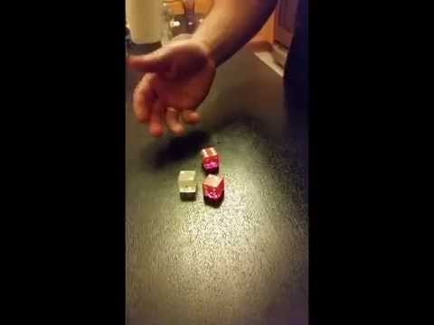
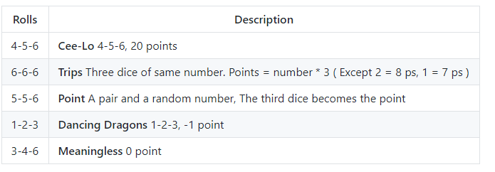

Game Rules

Slide 5
Tools Used
TrainningFramework
Game Framework
SoLoud
Sound Library
Freetype
Draw text on screen
Difficulties
Hard To Optimize
IT Best Kept Secret Is Optimization
Design UI/UX
Which way is most appropriate ?
Lack experience
Biggest Problems

Slide 6
In the Future
Port to mobile App.
Mobile games are the future
Optimize Code / Design suitable UI/UX
Better gaming experience
New Game Modes
More Modes More Fun
Multiplayer
Playing with friends is even more fun

