Slide 1
High frequency trading
Infrastructure introduction and simple strategy example
Nick Huang
2019.7.7

Slide 2
Introduction
High-frequency trading is high frequency
Latency does matter
High-frequency strategy is more stable, not so easy to decay
Very high sharp ratio, limited capital capacity
High infrastructure cost
More strict supervision

Slide 3
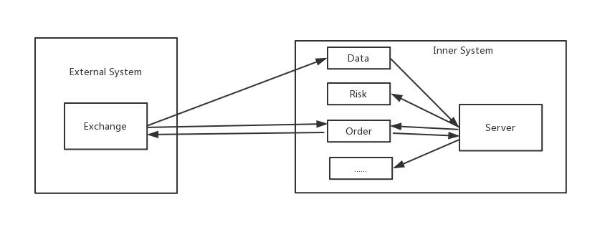
A brief framework

Slide 4
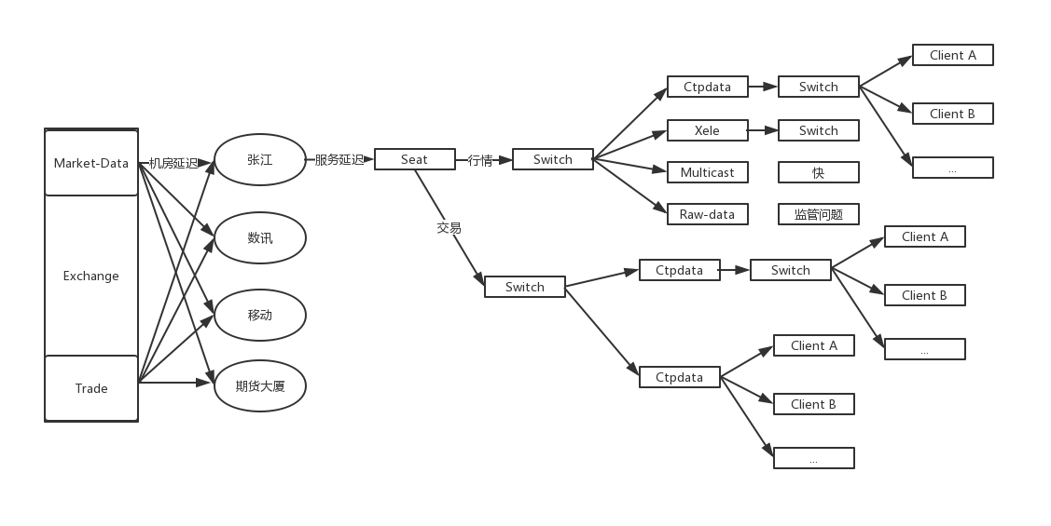
External system

Slide 5
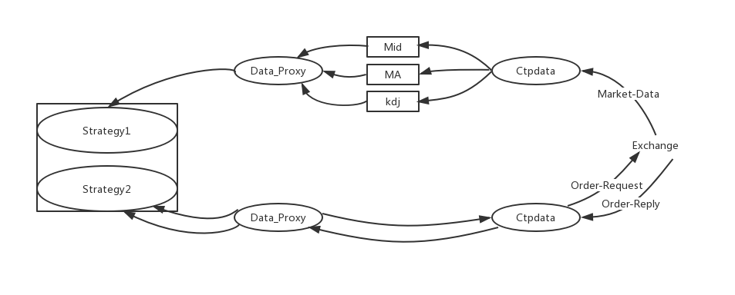
Inner system

Slide 6
Strategy part implementation
Two thread:
Main thread: received data from market, if logic is satisfied, send order
Exchange thread: get exchange info from exchange, update strategy status.
Most problems happened here
Code:
Make most common function fixed in the abstract class(neworder, cancelorder, modifyorder)
Leave interface for the different strategy:
Ready()
DoOperationAfterFilled()
DoOperationAfterCancelled()
DoOperationAfterUpdatePosition()
DoOperationAfterUpdateData()
ModerateOrders()

Slide 7
My work about co-location
Cooperate with brokers’ IT to get best co-location service, best position, less customer
Pay attention to all the error message from the backend, analyze why it happened, sometimes it is caused by some unpredictable reason.
Keep contact with brokers’ IT, to know if there any changes happened
Deploy our code, make the production environment uses the up-to-date code

Slide 8
Some tricks
Device configuration：
Powerful network card：solarfare 10G，with processor in network card，reduce cpu interrupt, improve tcp network protocol.
Linux system configuration(also about tcp):
echo 1 > /proc/sys/net/ipv4/tcp_low_latency
Server with many cores：good performance in parallel processing
Programming tricks(c++)：
Basic type is better than std library (use array instead of vector, string)
Float is better than double
Reference is better than pointer or value, when pass a parameter to function
Allocate high-load task to one single thread (print and log can send to a queue)
Less recursion
Function will cost more time than use it directly (a=b+c > a=add(b,c))
Pay attention to Physical location(gross_pnl and net_pnl)

Slide 9
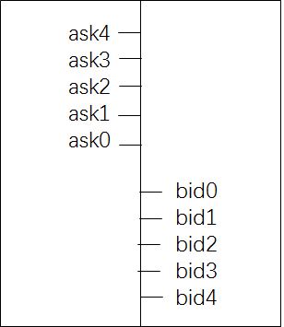
A high frequency strategy example
Market-maker strategy
Risk:
One leg traded
The other leg is waiting
Market have bad trend

Slide 10
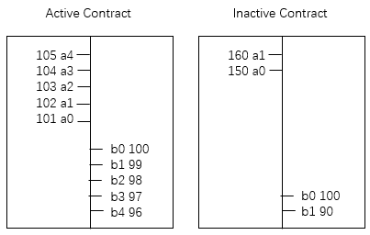
Main idea
Market making for one inactive contract
Use one active contract to hedge
Should have high correlation, same futures contract with different due date are good to do this

Slide 11
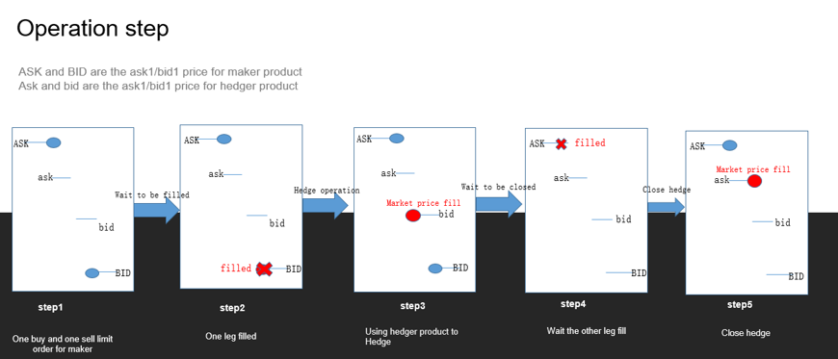
operation

Slide 12
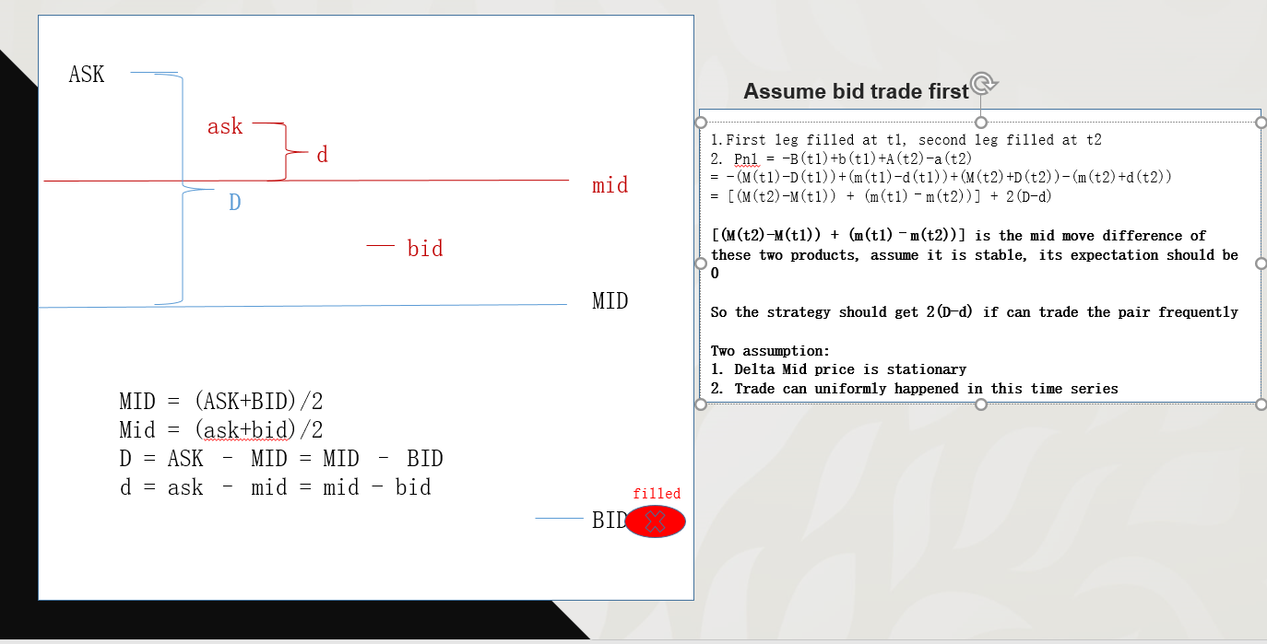
analysis

Slide 13
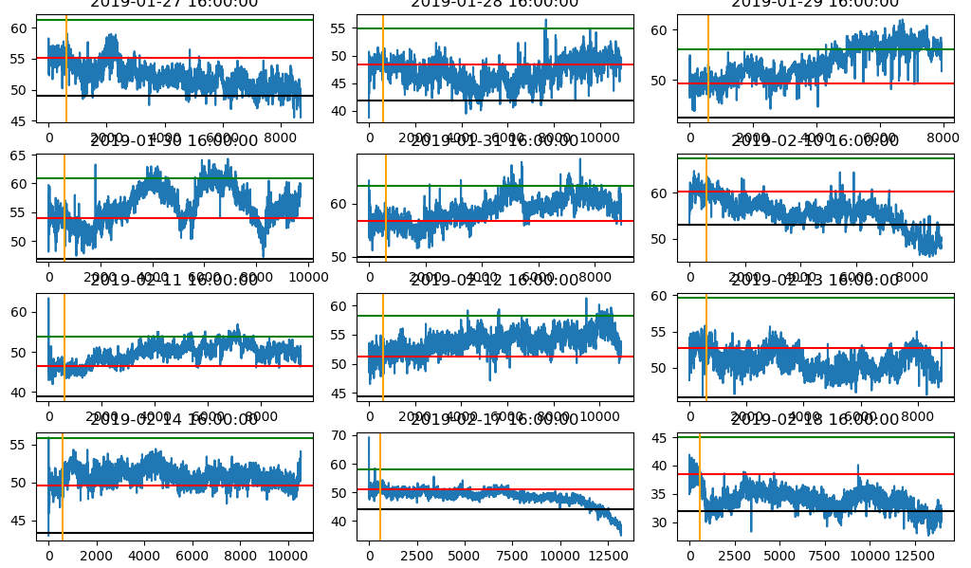
For the stationary assumption
Add statistical arbitrage idea: if current mid delta is located in the high position in history, don’t buy the mid

Slide 14
Some code details
Modify orders to always get bid0 and ask place, hit cancel limit
If mid delta are jump up and down along the history high line, use sleep order to handle
Max position control
Balance price, use clip operation to make close operation wont loss
balance price = (current_ask_price of hedger – buy_filled_price+ask_filled_price)

Slide 15
Implement strategy with interface
DoOperationAfterFilled(): if main traded, hedge with market orders, if hedge traded, nothing to do.
DoOperationAfterCancelled(): if modify orders, make up one, count the cancel number, stop strategy if
cancel limit hit
DoOperationAfterUpdatePosition():Calculate balance price, moderate orders price, check it wont >
Max_pos
DoOperationAfterUpdateData(): AddOrders();CheckSleepLogic(); ModerateOrders()
ModerateOrders(): price = clip(balance_price, current_market_price), moderate it
OrderPrice(): main->=best limit order price hedge->market price

Slide 16
To be improved
For high frequency, limit orders are always better than market orders, consider the queue position
Model for the 2nd assumption
OU process can model the waiting time

Slide 17
Thanks

