Slide 1

Bond Index Replication
Nick Huang
August 1st 2019

Slide 2
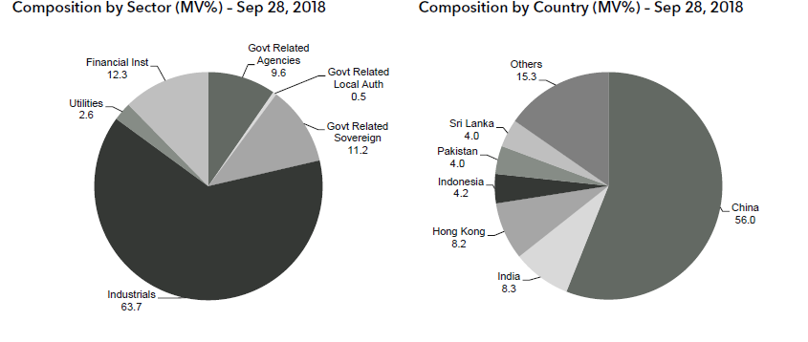
Product design
Meet clients' demand: a product can track with Barclays Asian Bond Index.
Barclays Asian Bond Index:

Slide 3
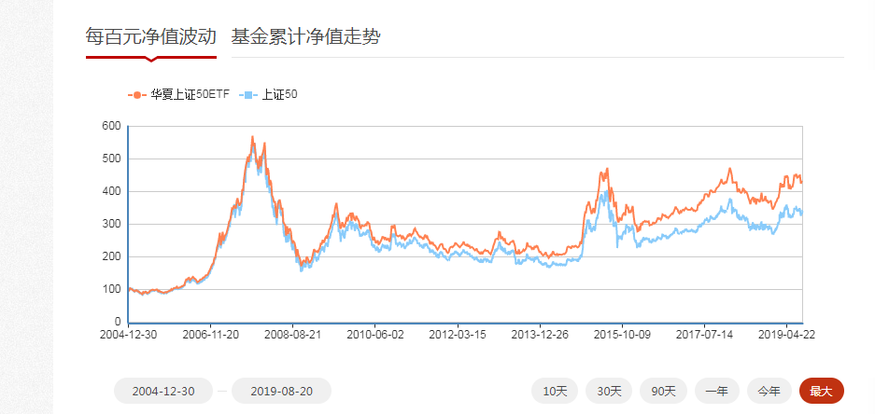
Similar product in china
ETF: Exchange traded fund, managed by fund management company which is authorized by CSRC
Can Trade in Secondary market, buy ETF and hold can get similar yield with index. Application: use stock to get the ETF; Redemption: use ETF to get stocks
An example for 50ETF510050， managed by huaxia fund management company.
Replicate methods: Complete replication, buy stocks according to the application
What we need to do is quite similar with fund management company.

Slide 4
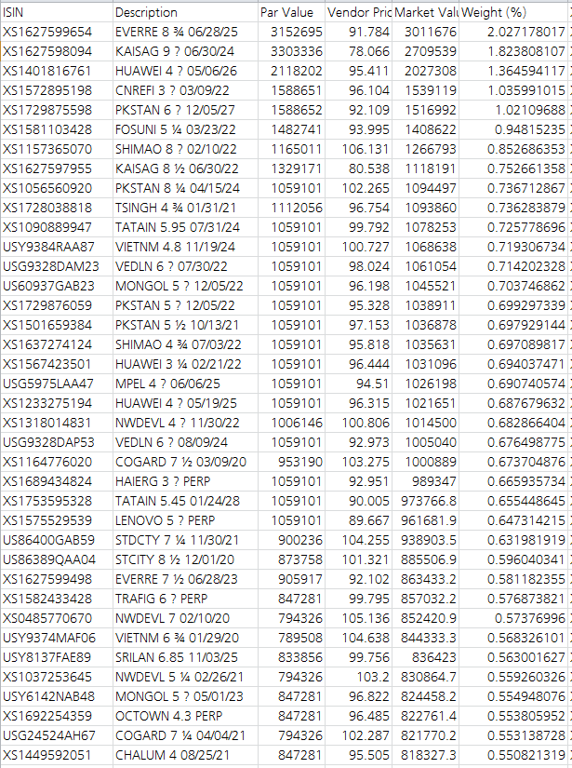
Best solution
Best solution:
buy bonds according
to the doc of bond index,
and get the perfect replication.

Slide 5
Rebalance problem
Rebalance: Barclays Asian Bond Index adjusts composition at each month-end (maturity < 1 year will be kicked out, new bonds will be added in).
If we want to replicate it perfectly, we need to buy new-joined in bonds and sell kicked-off out.

Slide 6
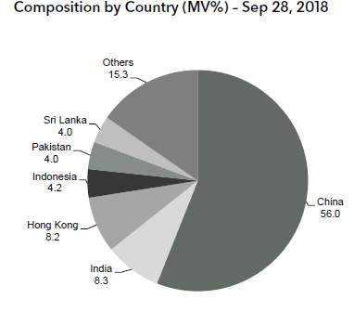
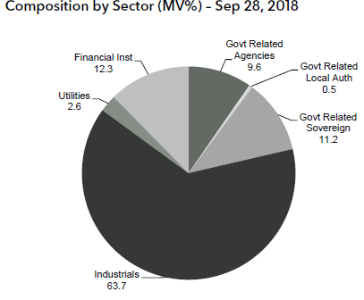
What we want - static basket
We want a stable basket of Bonds (hold for one year).
Benefits: don’t need to do buy/sell operation every month.
Loss: cant do a prefect replication, track error.
Targets for static replication:
Similar price move (between Index and basket)
Similar duration
Similar rating
Similar sector ratio
Similar country ratio
Similar yield

Slide 7
Steps of our solution
Select bonds
Assign weight: buy those bonds according to the weight.
Hold them for the whole year

Slide 8
Methodology (cross-validation)
Outline: base on history, predict the future
Details:
Separate historical data into train dataset and test dataset.(For Example, 2017.1-2017.5 as train, 2017.5-2018.12 as test)
Train the model in the train dataset
Test model in the test dataset
Best performance in test dataset will be the best model

Slide 9
Model
1. Auto-encoder + Linear Regression (LR)
2. Linear Regression

Slide 10
Auto-Encoder+LR
Auto-encoder for selecting bonds, idea come from paper "J. B. Heaton. Deep learning in finance"
LR for assigning weight

Slide 11
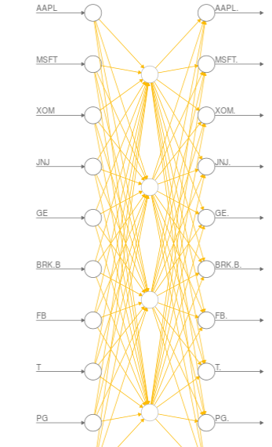
Auto-encoder for index replication
The training target is to make input closer to the output.
After training, the useful part in the network is the hidden unit of the mid layer(the middle four units in the picture), according to the paper, the middle units can be seen as the highly aggregated information of the index.
For single stock, The closer between the stock and the middle units, The more communal information is included in the stock.
The best selection - The top10 and the bottom 10 communal information stocks, the top 10 contains the most communal information, the bottom contains the most distinctive information

Slide 12



Linear regression
Lasso: OLS + L1 norm
Advantages: make the weight sparse, kind of like dimension reduction; can use it to select bonds
Ridge: OLS + L2 norm
Advantages: avoid overfitting
ElasticNet: OLS + L1 norm + L2 norm

Slide 13
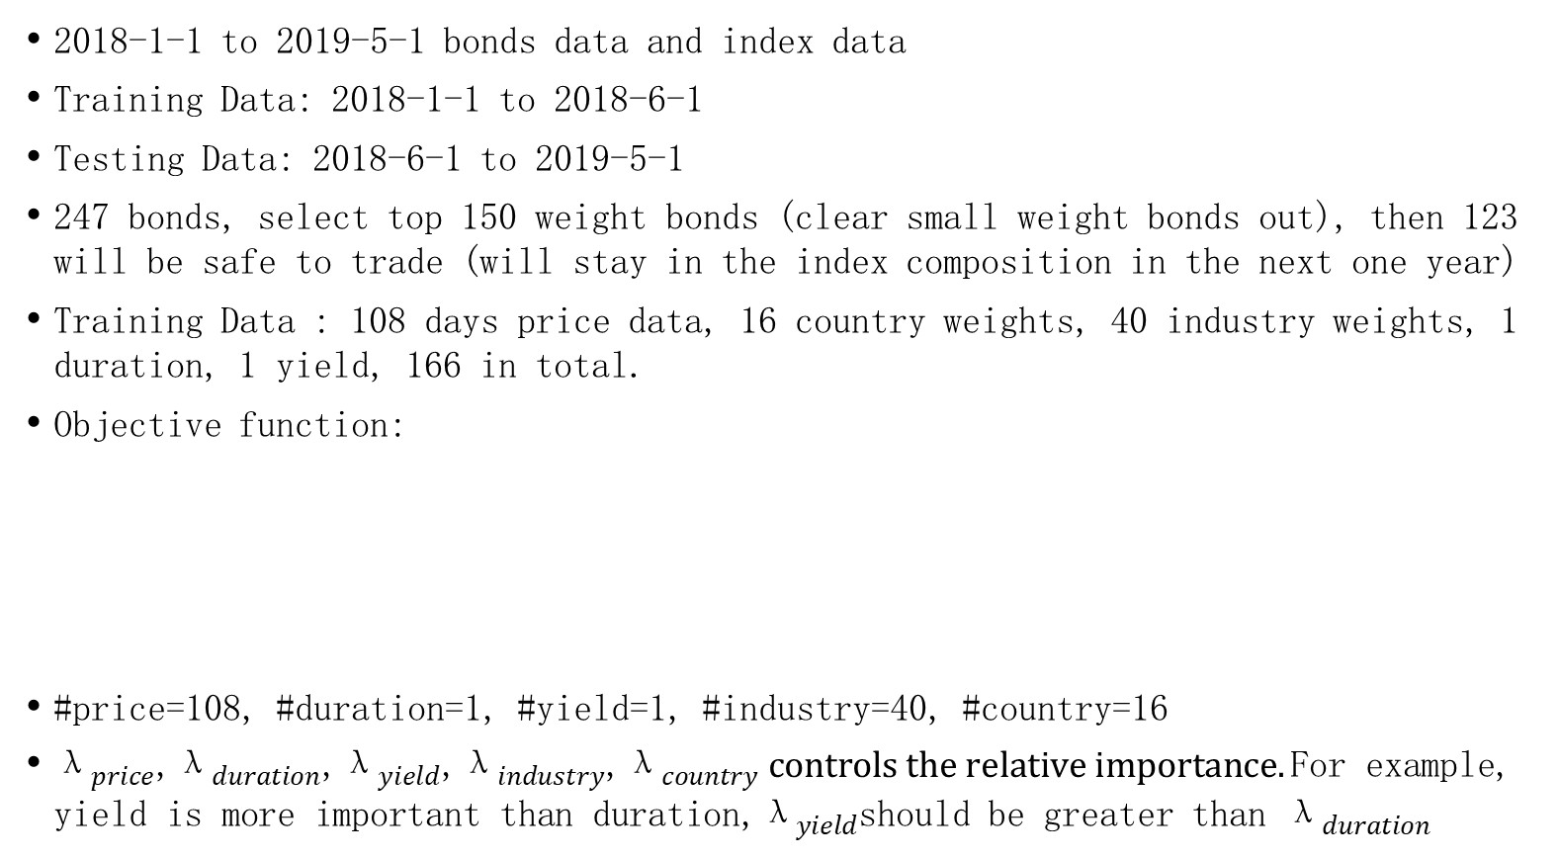
Objective function
2018-1-1 to 2019-5-1 bonds data and index data
Training Data: 2018-1-1 to 2018-6-1
Testing Data: 2018-6-1 to 2019-5-1
247 bonds, select top 150 weight bonds (clear small weight bonds out), then 123 will be safe to trade (will stay in the index composition in the next one year)
Training Data : 108 days price data, 16 country weights, 40 industry weights, 1 duration, 1 yield, 166 in total.
Objective function:
#price=108, #duration=1, #yield=1, #industry=40, #country=16
${\text{λ}}_{price}$,${\text{λ}}_{duration}$,${\text{λ}}_{yield}$,${\text{λ}}_{industry}$,${\text{λ}}_{country} controls the relative importance.\text{For} \text{example}\text{, }\text{yield} \text{is} \text{more} \text{important} \text{than} \text{duration}\text{,}{\text{λ}}_{yield}$should be greater than ${\text{λ}}_{duration}$

Slide 14
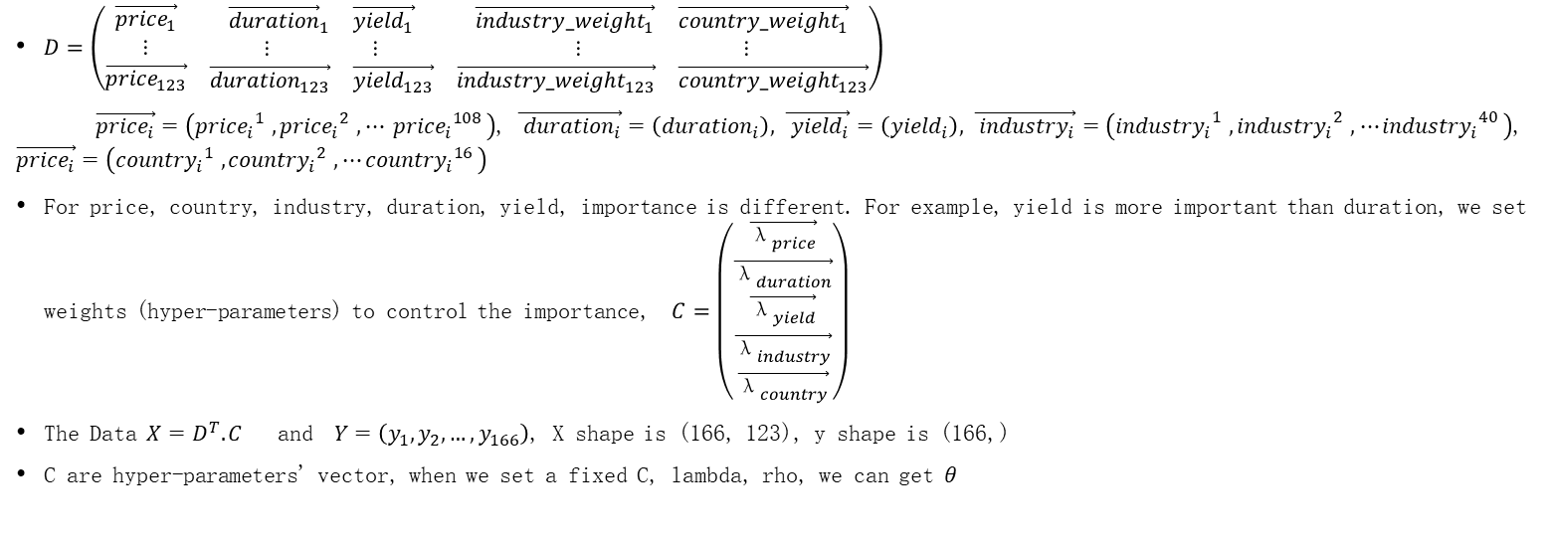
Detailed Operation
$D=\left(\begin{matrix}\vec{{price}_{1}} & \begin{matrix}{\vec{duration}}_{1} & \vec{{yield}_{1}}\end{matrix} & \begin{matrix}\vec{{industry_weight}_{1}} & \vec{{country_weight}_{1}}\end{matrix} \\ ⋮ & \begin{matrix}⋮ & ⋮\end{matrix} & \begin{matrix}⋮ & ⋮\end{matrix} \\ \vec{{price}_{123}} & \begin{matrix}\vec{{duration}_{123}} & \vec{{yield}_{123}}\end{matrix} & \begin{matrix}\vec{{industry_weight}_{123}} & \vec{{country_weight}_{123}}\end{matrix}\end{matrix}\right)$
$\vec{{price}_{i}}=\left({{price}_{i}}_{}^{1},{{price}_{i}}_{}^{2}{,{ ⋯ price}_{i}}_{}^{108}\right)$, $\vec{{ duration}_{i}}=\left({duration}_{i}\right),$ $\vec{{ yield}_{i}}=\left({yield}_{i}\right),$ $\vec{{ industry}_{i}}=\left({{industry}_{i}}_{}^{1},{{industry}_{i}}_{}^{2}{,{ ⋯industry}_{i}}_{}^{40}\right)$, $\vec{{price}_{i}}=\left({{country}_{i}}_{}^{1},{{country}_{i}}_{}^{2}{,{ ⋯country}_{i}}_{}^{16}\right)$
For price, country, industry, duration, yield, importance is different. For example, yield is more important than duration, we set weights (hyper-parameters) to control the importance, $C=\left(\begin{matrix}\vec{{\text{λ}}_{price}} \\ \vec{{\text{λ}}_{duration}} \\ \begin{matrix}\vec{{\text{λ}}_{yield}} \\ \begin{matrix}\vec{{\text{λ}}_{industry}} \\ \vec{{\text{λ}}_{country}}\end{matrix}\end{matrix}\end{matrix}\right)$
The Data $X=D^{T}.C$ and $Y=\left(y_{1}, y_{2},…,y_{166}\right)$, X shape is (166, 123), y shape is (166,)
C are hyper-parameters' vector, when we set a fixed C, lambda, rho, we can get $θ$

Slide 15
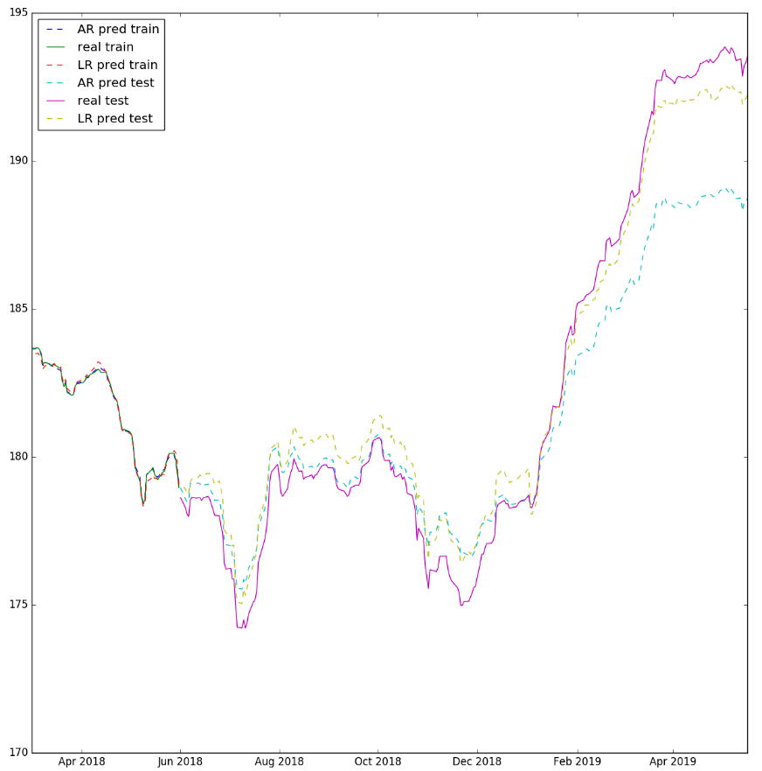
Select Model
Pure LR is better than Auto-Encoder+LR
Results Comparison:
We choose Pure LR

Slide 16
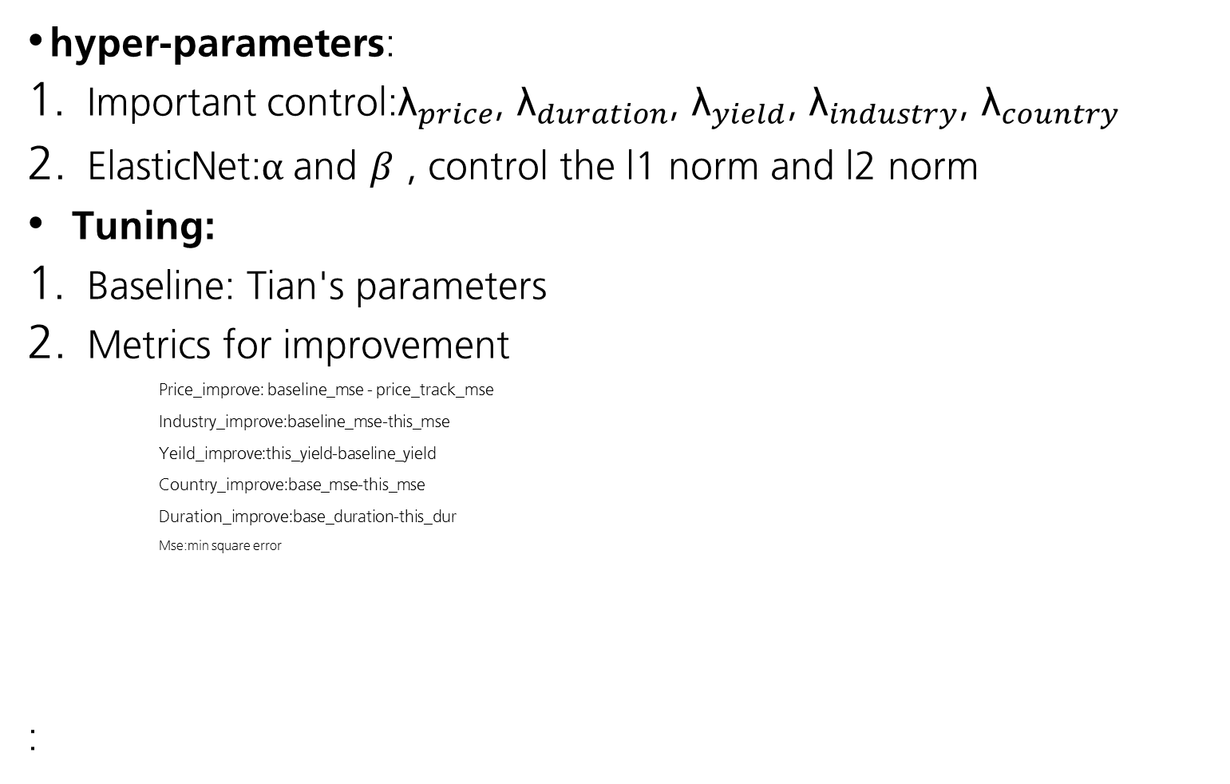
Tune hyper-parameters
hyper-parameters:
Important control:${\text{λ}}_{price}$, ${\text{λ}}_{duration}$, ${\text{λ}}_{yield}$, ${\text{λ}}_{industry}$, ${\text{λ}}_{country}$
ElasticNet:$α$and $β$ , control the l1 norm and l2 norm
Tuning:
Baseline: Tian's parameters
Metrics for improvement
Price_improve: baseline_mse - price_track_mse
Industry_improve:baseline_mse-this_mse
Yeild_improve:this_yield-baseline_yield
Country_improve:base_mse-this_mse
Duration_improve:base_duration-this_dur
Mse:min square error
:

Slide 17
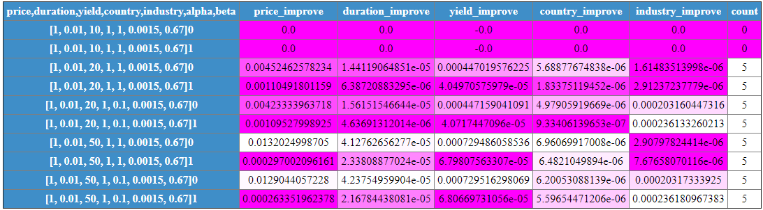
Tuning results

Slide 18
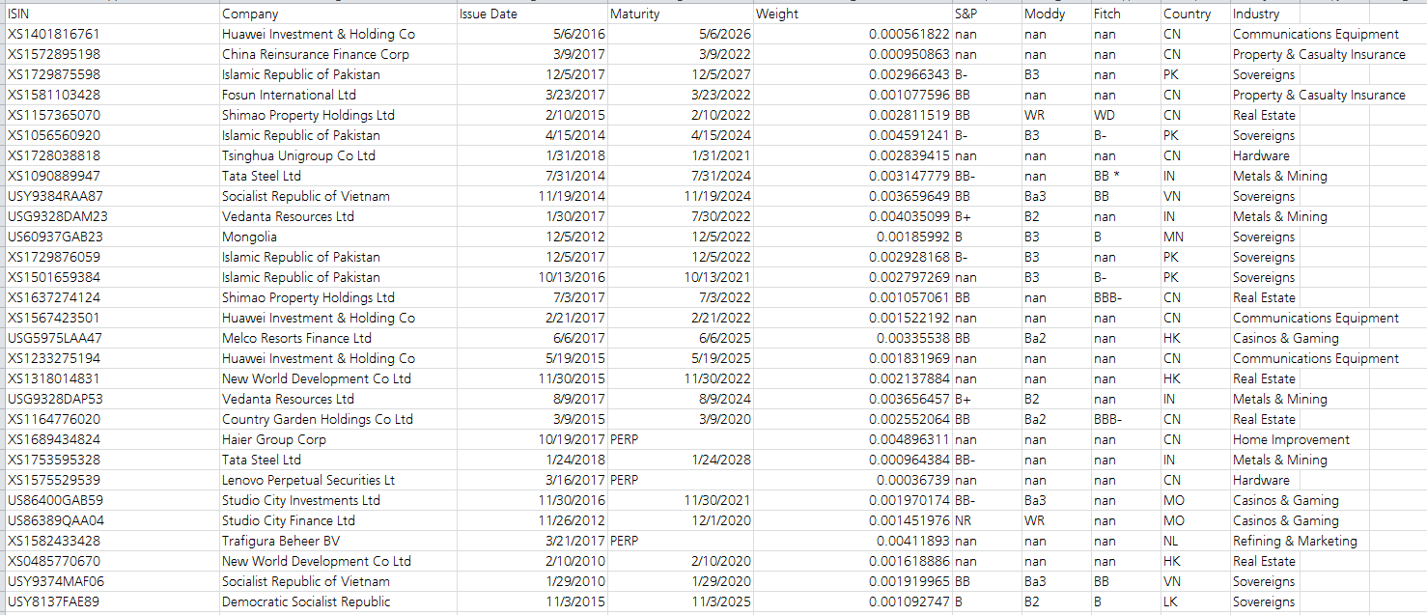

Outcome
Best hyper-parameters:
104/123 bonds are selected
Weights are:
Track error:

Slide 19
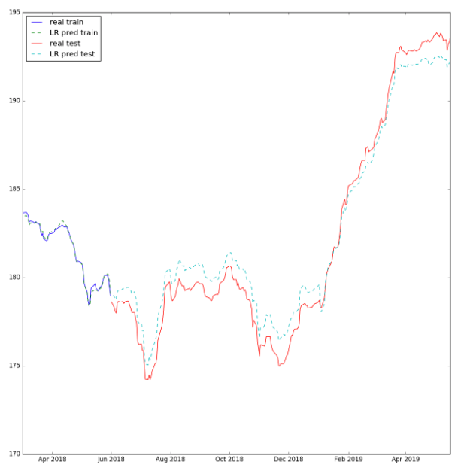
Price track

Slide 20
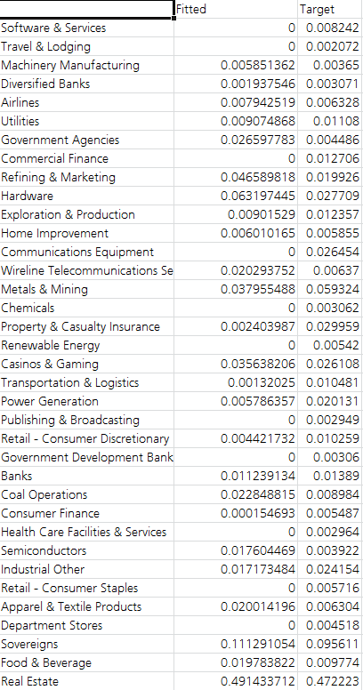
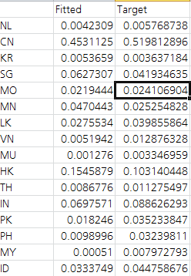
Details of industry and country weight
Country weight
Industry weight

Slide 21
Code
All codes are on github
https://github.ldn.swissbank.com/huangni/BondIndexTracking

