Slide 1
Neural Network Approach

Slide 2
Further Preprocess
Resampling
Original
Dataset
Pre-process
Dataset
Pre-process
Upscale
Dataset
Pre-process
Downscale
Dataset
Normalisation
0
1

Slide 3
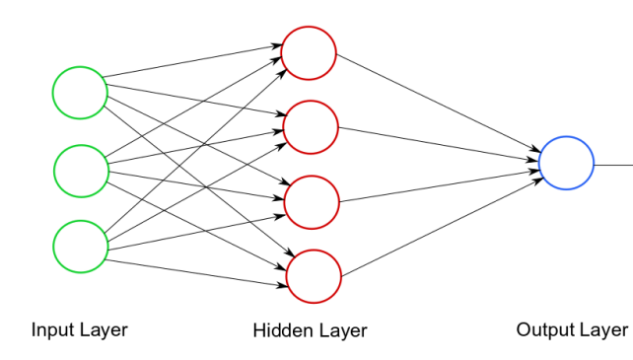


Models’ Optimal Hyperparameters
Early Stopper
Layers
Trainset
Dropout
Batch Size
Neurons
Optimizer
Weight Decay
Notes:
Building (Consideration) Hidden Layers (Neurons,# of Layers, Dropout, batchsize
Training (Consideration) EarlyStopper(for Epochs), Optimizer, Weights Decay, Learning Rate (Initial Momemtum Only)

Slide 4
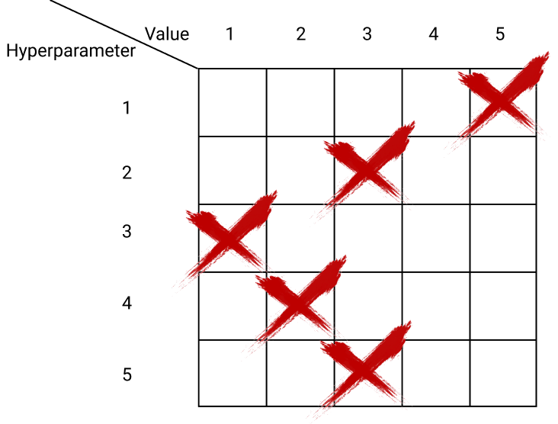
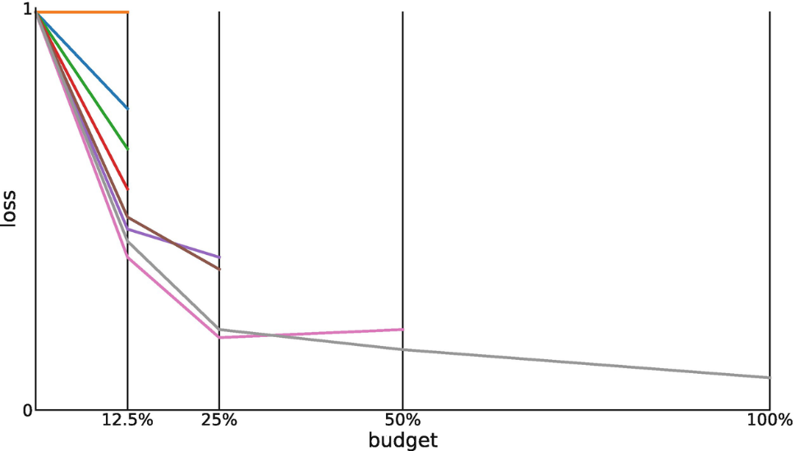
Optimal Hyperparameter Techniques
K-Fold
Hyperband

Slide 5
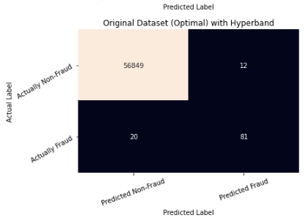
Results
S/N | Various Result | Precision | Recall | F1-Score
1 | Original | 0.86 | 0.62 | 0.72
2 | Preprocess | 0.89 | 0.62 | 0.73
3 | Preprocess Upscale | 0.03 | 0.91 | 0.06
4 | Preprocess Downscale | 0.19 | 0.77 | 0.3
5 | Original (Optimal) | 0.87 | 0.80 | 0.84
6 | Preprocess (Optimal) | 0.89 | 0.74 | 0.81

Slide 6
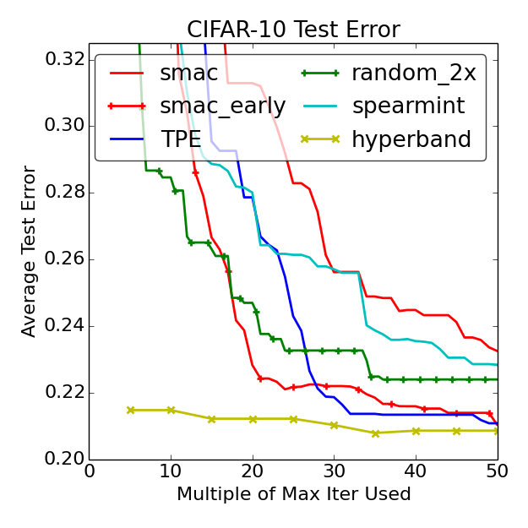

https://arxiv.org/abs/1603.06560

