Slide 1
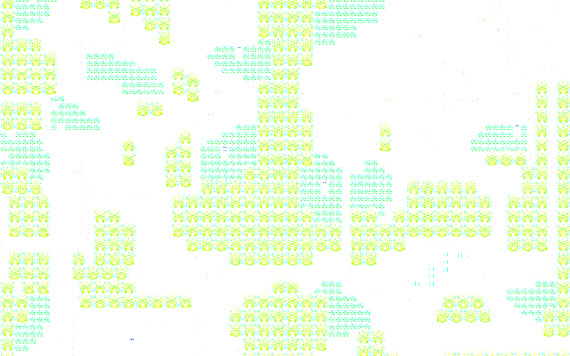
GGWP
Admin
Dev
Leroy Tang
Alson Kong
Sam Jian Shen
Karen Wong
Lim Wei Cong
Zane Ho
Cole Ting-Chun Kuo
Jing Herng Pow
Norman Fung

Slide 2
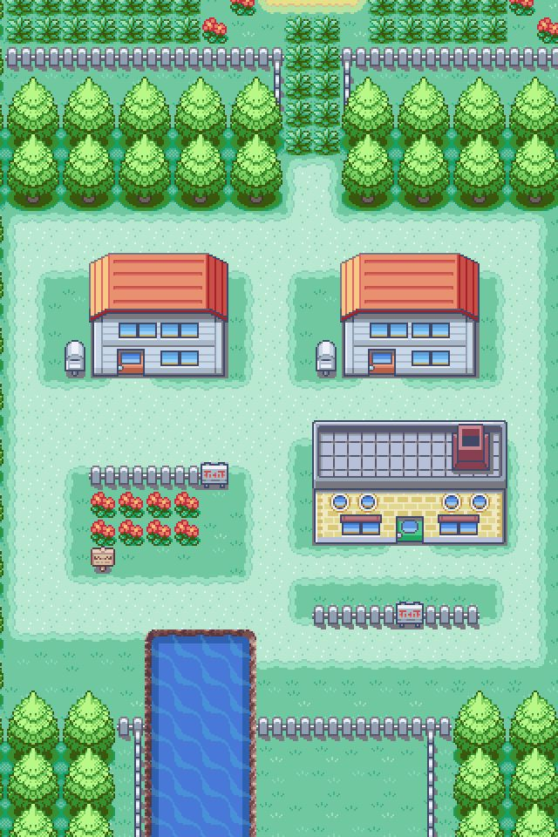
Content
Team Goal
Introduction to GGWP
Introduction
Product Scope
Artist Illustration
Functionality
Analysis Models
Context diagram
Dialog Map
Architecture Design
Overall system
Subsystem
Our Interface

Slide 3
Team ggwp’s goal
Good Game Well Played Introduction
Purpose:
“Provide Non-STEM knowledge through visual communication and interactive teaching”
“Teach knowledge outside of school curriculum”
“Allow the user to gain general knowledge and also to inculcate good learning habits.”
Scope:
“Using Active Recall and Spaced Repetition Concept”
“ RPG game environment with movable character in 2D world”
“Explore world and compete with friends while learning new things”
“Offers bit-sized information from a variety of non STEM subjects. The subjects include geography, general, cooking and history.
Notes:
GGWP is a game application that aims to provide non-STEM knowledge to user through the usage of visual communications and interactive teaching where application will provide subject specific questions and explanation of solution to players using a gamification concept. As formal education emphasis mainly on STEM subject. However, having a holistic education is an important skills as well and motivation of this application is to provide a gamified experience for learning a variety of subjects that may not be taught in the school curriculum.
Product scope: The game is designed around the “Active Recall and Spaced Repetition” concept, which are principles of efficient learning. GGWP adopted the concept of a Role Playing Game (RPG) with a top down view containing movable characters in a 2D world. This allow user to explore the game environment while earn points and compete by answering questions so as to learn content not traditionally taught.

Slide 4
What is GGWP?
Good Game Well Played overall design -product scope
Student/ Player
Teacher
Role: Student to earn subject via gamified environment
Role: Content creator
Create Question
Play Game
Play Game
Leadership Board
Manage Profile
Edit Question
Play game
Share on FB
Delete Question
Notes:
The main structure behind GGWP is to divide user into 2 roles - student and teacher. Teacher act as an administrator and have access to managing the question and content creator while also have access to the play game features. Managing of content is collected in a separate interface - management interface.
Student is any player accessing the game, they are able to play the game by answering questions and earn points along the way. With that, they are able to track ranking through leadership board, share question on Facebook and viewing their profile. The idea of having leadership board and earning points is to fuel their competitive spirit while they play with friends and encourage them to explore the world longer and learn knowledge from it. Currently, this application is targeted at secondary school student but anyone with a locally created account can access the game.

Slide 5
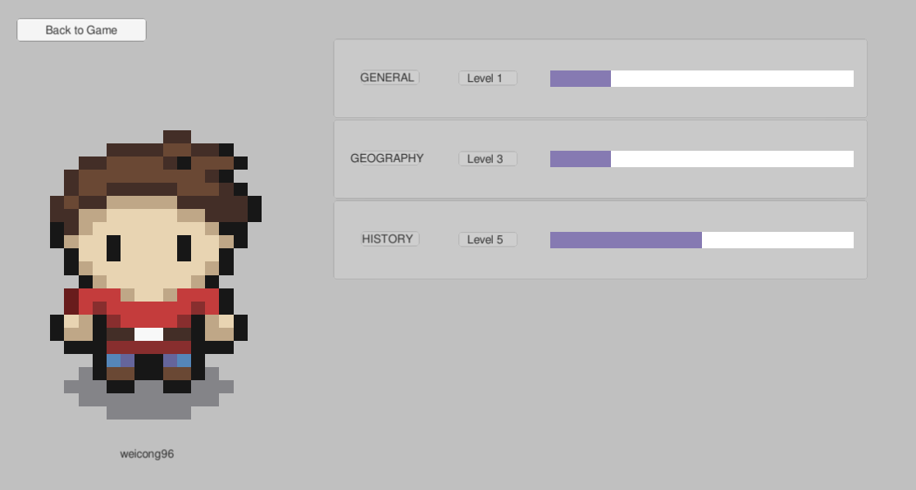
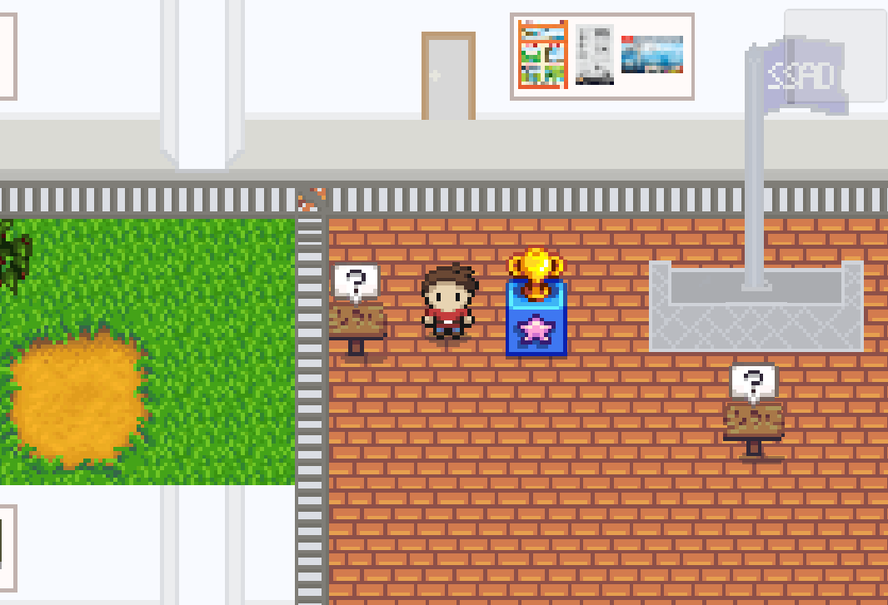
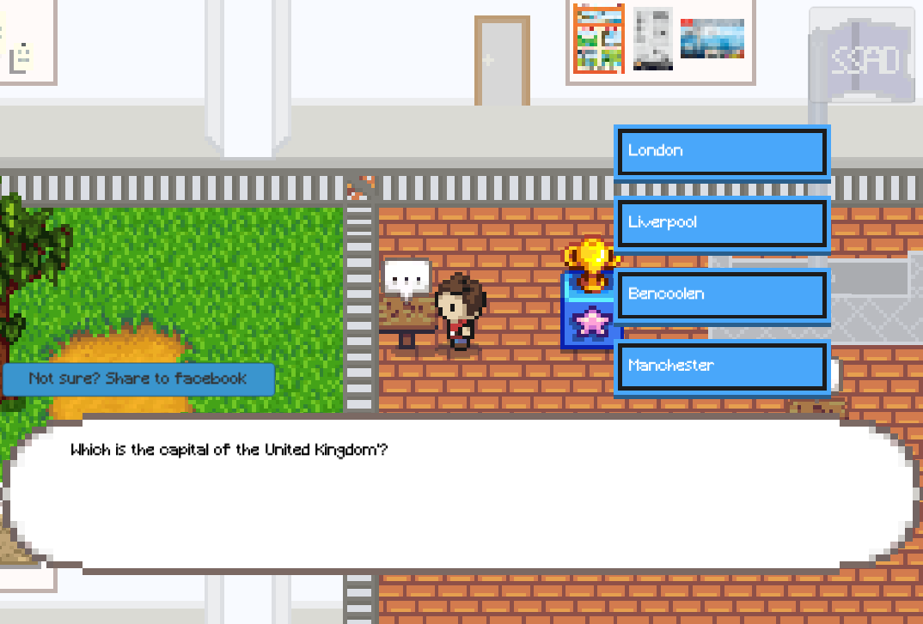
What is GGWP?
Good Game Well Played idea
Avatar: Player (Role = Student)
Able to move around the 2D world and interact with NPC
NPC’s Conversation
Generate subject specific question and allow player to select options.
Interface reference to Pokemon and Stardew Valley
Notes:
GGWP game client uses Unity to built with interface reference to Pokemon and Stardew Valley interfaces and uses sprite sheet design. Avataris capable to move around to explore world and interact with NPC to get quest/ leadership board.

Slide 6
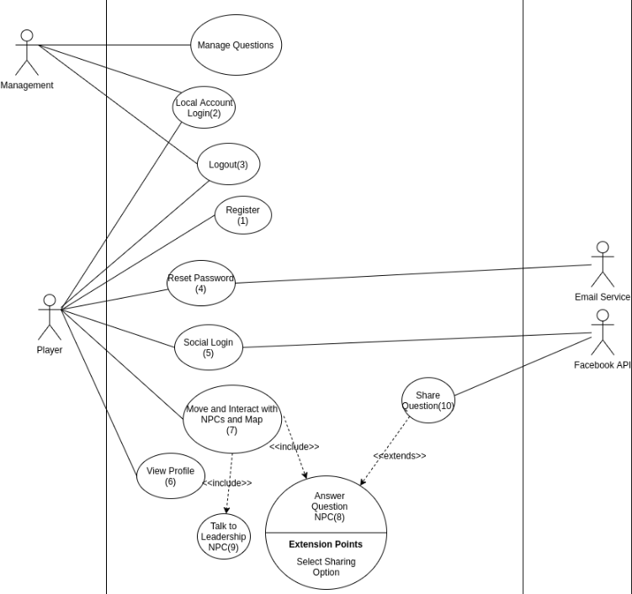
What is GGWP?
Good Game Well Played Overall functionalities
Game Play is the main functionality in GGWP and it comprises of:
Move and interact with NPC
Talk to Leadership NPC
Share question on Facebook
Notes:
The use case diagram show all the functionalities in GGWP, main functionalities as follows which will be further explained in the demo.

Slide 7
ANALYSIS MODEL
A look at our structure

Slide 8
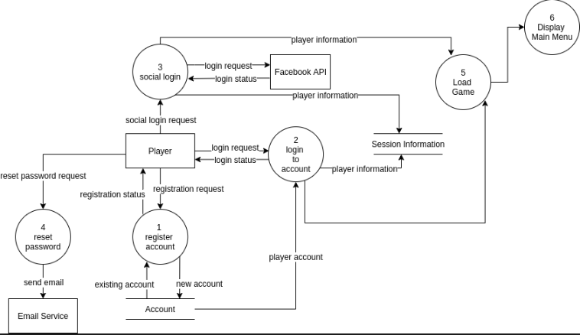
Context Diagram
Overall flow
Notes:
This is the context diagram of the player’s flow regarding accounts and external interfaces - sharing on social media.

Slide 9
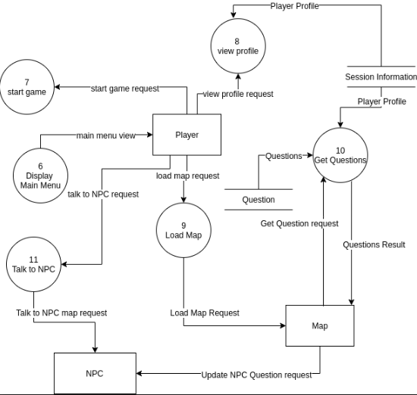
Context Diagram
Overall flow
Notes:
This context diagram shows interaction between players, map and NPC in the game client interface.

Slide 10
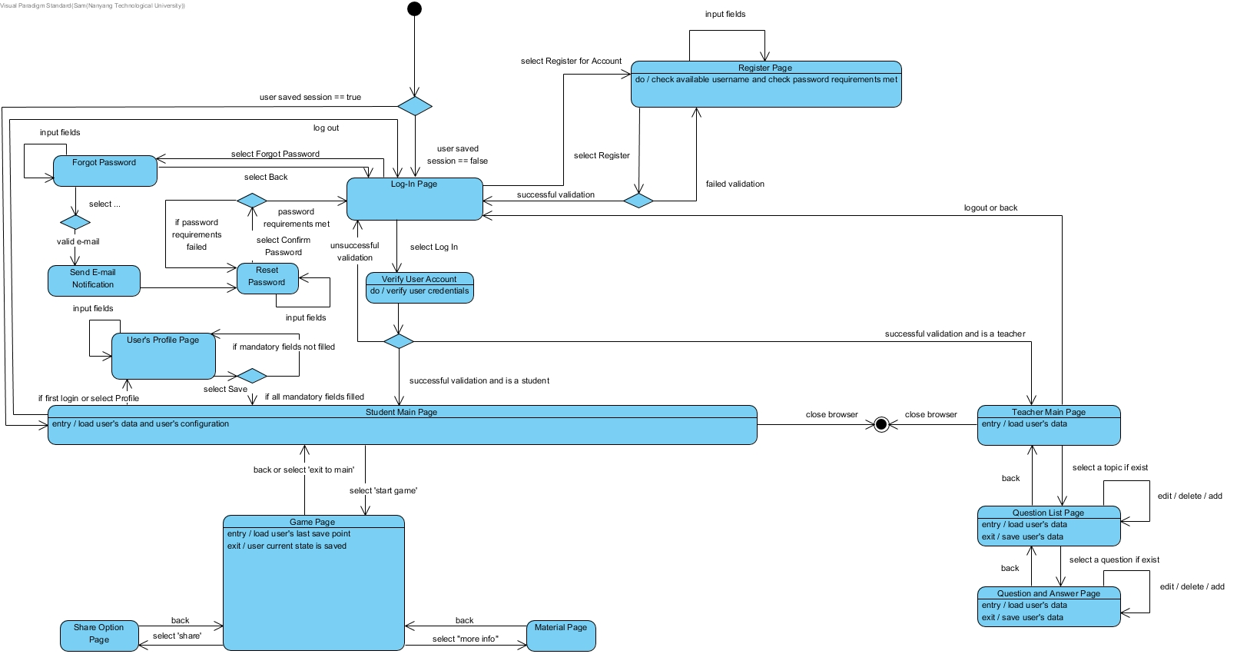
Dialog Map
Overall functionalities
Notes:
This is the dialog map of the whole application to understand how individual subsystems are place together.

Slide 11
Architecture Model

Slide 12
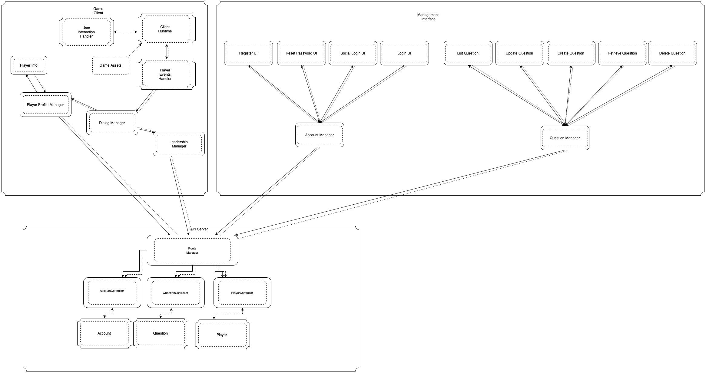
Candidate Architecture
Overall architecture - client and server
Overall architecture follows the
Client and Server Architecture Style
It is used because of its:
Flexibility
Testability
Reliability
Integrity
Notes:
The software quality attributes we have choose to focus on when we choose the architecture is -Flexibility: The ability to add/edit new components, Integrity: Ability to protect against unauthorize use/ data loss, Reliability: Probability of system failure, Testability: Ability to verify correct implementation.
This are important attributes and essential in commercial game application. These were chosen as the main focus of this software because flexibility allows new components to be added easily and maintained through easy reusing, testing and deployment. Integrity and reliability are important to ensure satisfactory user experience by ensuring there is no unauthorized access or data lost as well as service will be available as much as possible.
The main architecture GGWP will follow is the client and server structure as it fulfilled all the software quality we are looking at, so it will be used for the overall communication across our subsystems. while individual subsystems within the software will have its own architecture style based on what is more relevant and suitable for its functionality. More elaboration will be provided in the next few slides.

Slide 13
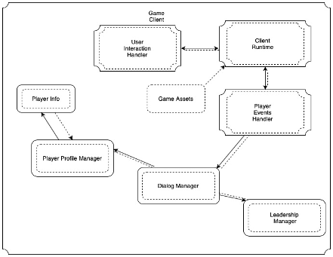
Candidate Architecture
Subsystem - game client
Game Client Subsystem follows the
Event system Architecture Style
It is used because of its:
Flexibility
Integrity
Testability
Notes:
Event System will be used in game client subsystem as the event system offers the most flexibility and does not have significant performance overhead.

Slide 14
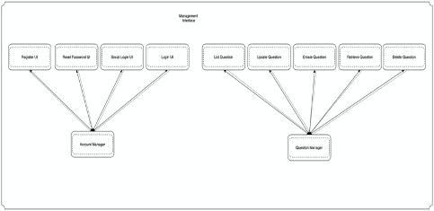
Candidate Architecture
Subsystem - management interface
Management Interface Subsystem
follows the
Main Program and subroutine
Architecture Style
It is used because of its:
Reliability
Notes:
The use of main program and subroutine makes it easy to achieve reliability of the system, especially if all subroutines are local to the program. This is especially the case if proper code review is done properly to ensure references to subroutines are correct. The use of static-typed languages may be able to help as this allows references to subroutines to be checked during compile time.

Slide 15
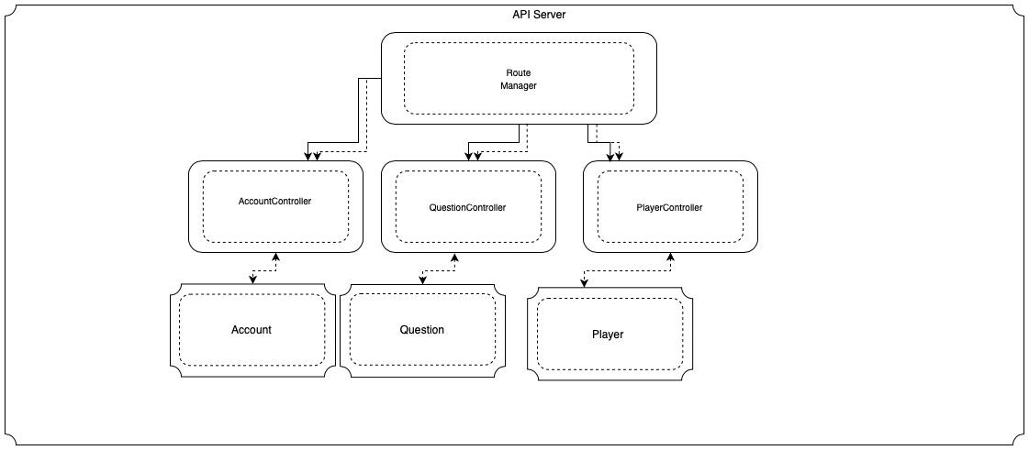
Candidate Architecture
Subsystem - API Server
API Server Subsystem follows the
Layered System Architecture Style
It is used because of its:
Flexibility
Testability
Notes:
Layered architecture is used as The use of layered architecture allows control logic to be added or updated easily as the control logic for layered architecture is often isolated to the business logic layer or controller layer. The use of layered architecture separates the user interface from control logic and the control logic from data logic which enables testing to be done easier since each layer can be tested independently.

Slide 16
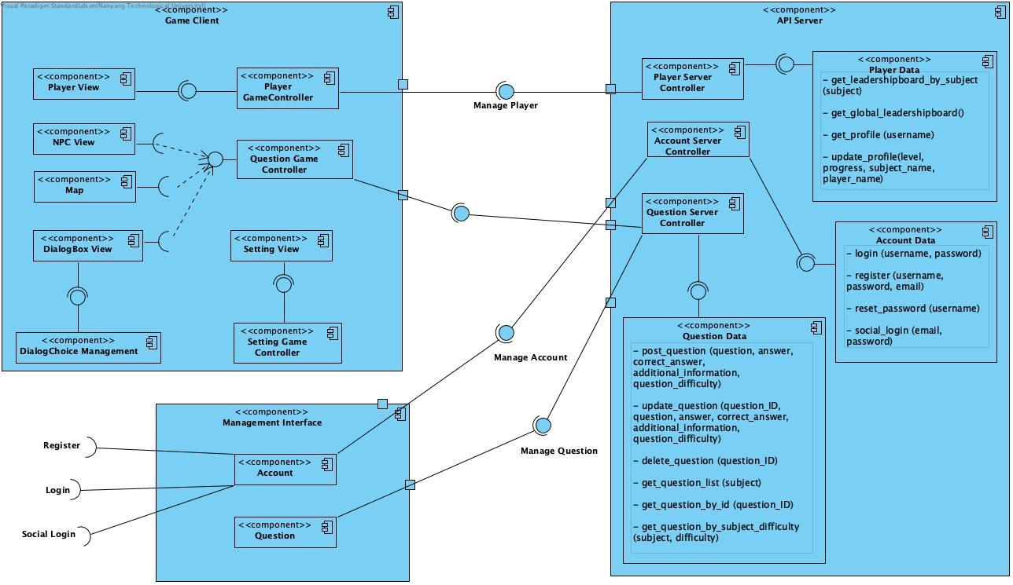
Component Diagram
Notes:
Management Interface :
This is a web interface that is built using React and Redux Single Page Application Framework.
A particularly unique point about React and Redux is that the data flows in a single direction. Because of this, by writing unit tests for the different checkpoints of the data flow, one can easily ensure functionality and isolate problems. Another point of the framework architecture that is worth mentioning is the link between each component is dependency injected(Dependency Inversion Principle). As a result, tests for this can be focused on the key functionality and not be bothered by retrieving or finding the required dependencies. Without the use of dependency injection, mocking would have to be done at a lower level instead of in code. (ie mock datastore in code by providing a memory based datastore instead of setting up a whole replica and test instance).
API Server :
This is a network server that will be built using Node.JS and Typescript. The purpose of this setup is for 2 reasons: Node.JS is a suitable and simple enough http server that is easy to understand and gets the things done.Node.JS is usually written in Javascript but we have chosen to write in Typescript due to its static typing capability. This helps to reduce most issues with incompatible data types and eliminate possible development mistaekes such as syntax errors. The use of Typescript ensures that the code, once able to compile, has a certain level of correctness. The use of Javascript however does not guarantee that until run time.
Game Client :
This is a Game Client that will be built using C# and Unity. Unity has been a popular choice among amateur game developers and has significant documentation available. This can help in maintainability of the application as new developers can pick it up easily. It also offers some levels of testing capabilities within the game runtime.

Slide 17
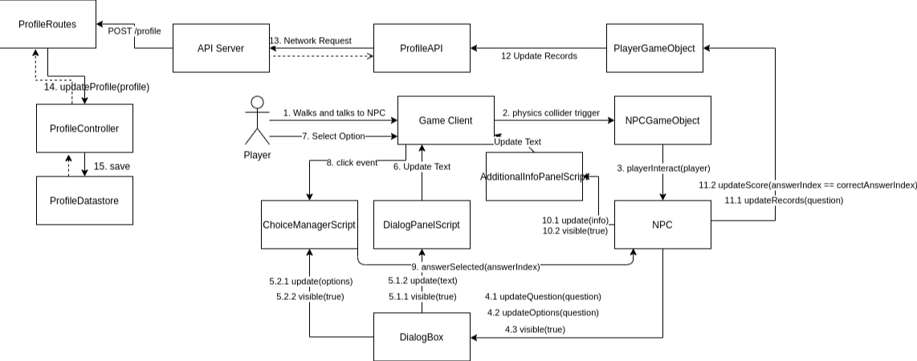
Communication Diagram
Notes:
Communication diagram shows the various interaction between the subsystems for “game play”, the main functionalities of this GGWP. As seen, it start when user approach the NPC in the game client.

Slide 18
Demo

Slide 19
Notes:
Our game starts in a school compound, providing a school like environment for the player to navigate around in. The player can choose talk to different NPCs which are indicated by the question marks above their sprites. In each classroom there is also a different “academic” experience for the users to learn in.

Slide 20
Notes:
This screens show the interaction when the user talks to an NPC. Interface should display the question and provide 4 options for the player to select and submit as the correct answer. There should be an option for the player to share the question on his/her facebook page.

Slide 21
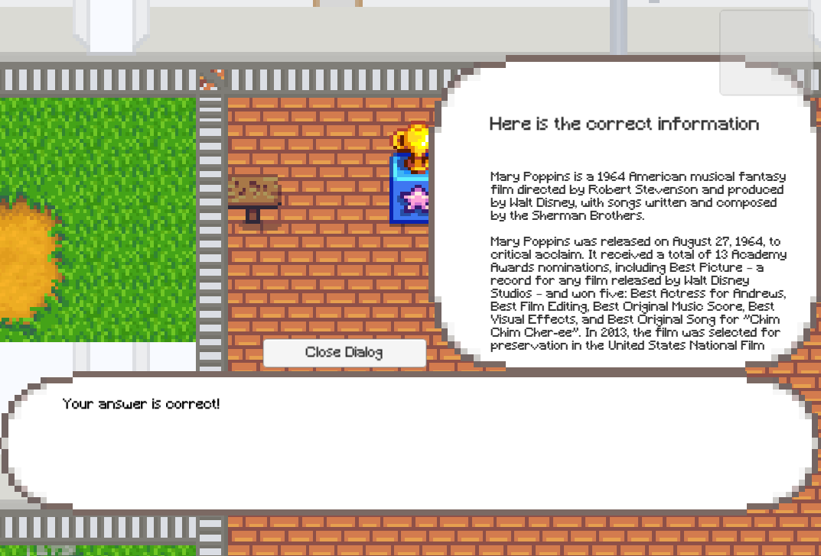
Notes:
This screen shows what happens when the user selects an answer correctly or wrongly, which provides the actual information source for the student to read about.

Slide 22
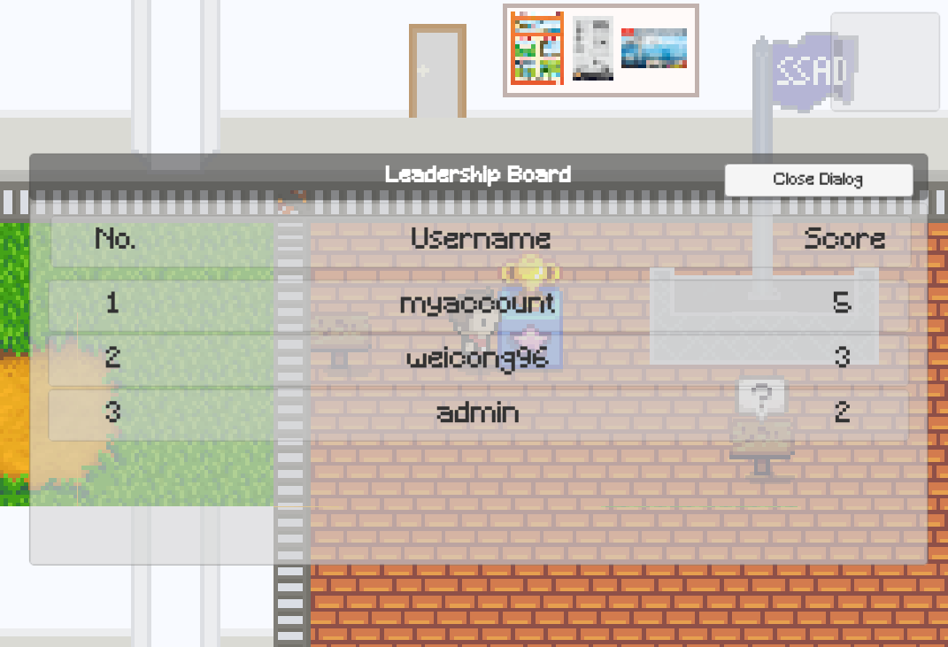
Notes:
This screen shows the list of highscores for the student in order for them to compete with one another. The player is required to approaches the trophy display in the local map, it will show the ranking, username and score for the “general knowledge” topic. If the trophy display is approached by the player in the building map of a subject, the subject’s leadership information should be displayed in a similar format.

Slide 23
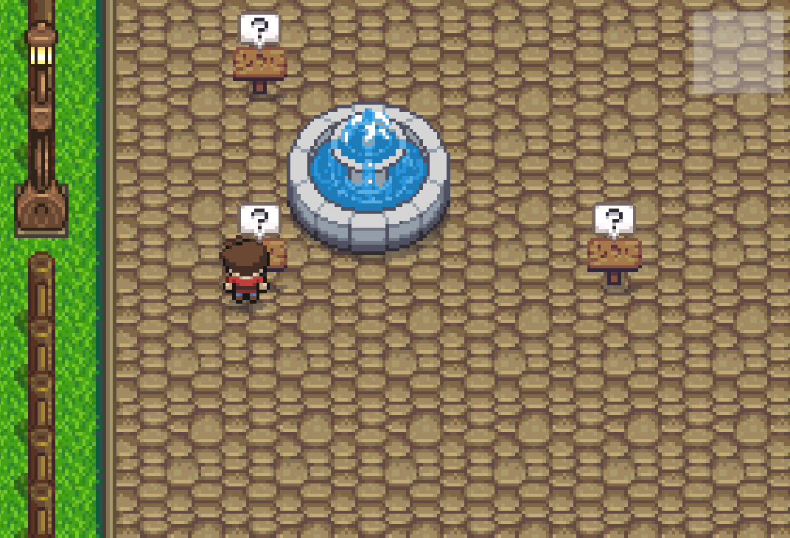
Notes:
As mentioned before, Different classrooms provide different themed environments, and it allows students to learn in new experiences/places they are not able to go to. This one is inspired by a chill Japan town(see next picture for sakura trees!)

Slide 24
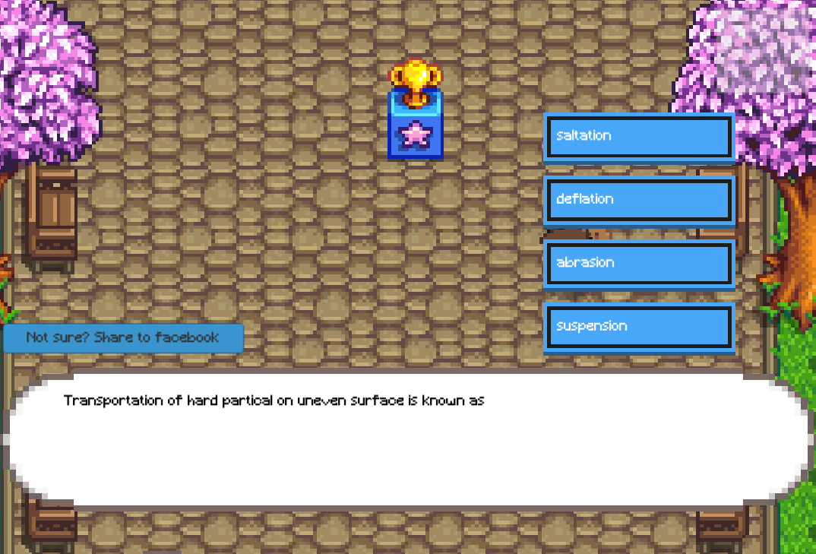
Notes:
This picture contains the management interface

Slide 25
Notes:
This is the profile page of the user, accessible from the main menu and within the game. Profile should include the avatar image, username and the level and experience bar for each “subject”.

Slide 26
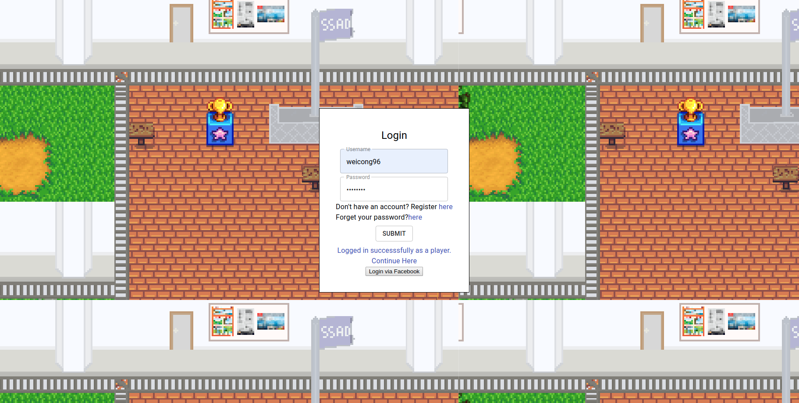
Notes:
This picture shows the login interface for the user to access the game or management interface. Users will be redirected to the management interface if it is a player.

Slide 27
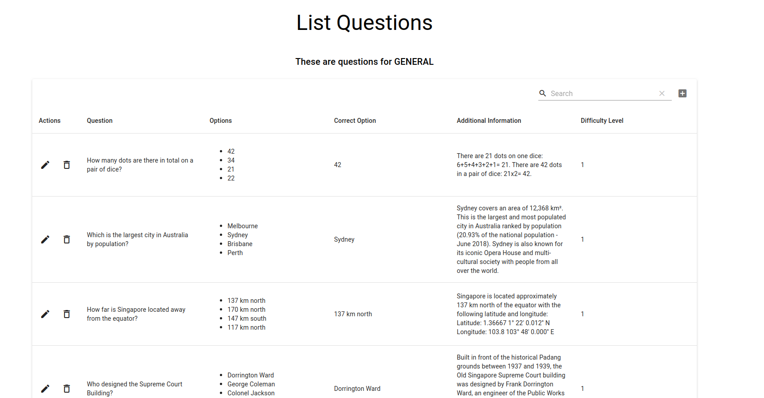
Notes:
This screens show the management interface for teachers to modify or add questions

Slide 28
Thank you!

