Slide 1
Detection of spherical nanoparticles on the surface of bicompatible materials
The aim of the work: to investigate the possibilities of using synthetic data to train a detector of images of spherical nanoparticles on the surface of biocompatible materials under conditions of a limited experimental sample.
The use of synthetic data is necessary to overcome the problem of insufficient training sample size, since 100 images obtained by scanning electron microscopy are not enough to effectively train neural networks.
Table 1. Obstacles to obtaining sufficient training data
Let | Description
Time | Collecting experimental data on a scanning electron microscope (SEM) takes a considerable amount of time. A single scanning session can last several hours, depending on the size and complexity of the samples.
Cost | Conducting SEM scanning sessions requires costs for equipment maintenance and operation, as well as materials and reagents for sample preparation.
Limited resources | The laboratory may have limited access to equipment or insufficient staff to perform scanning sessions.
<number>/11

Slide 2
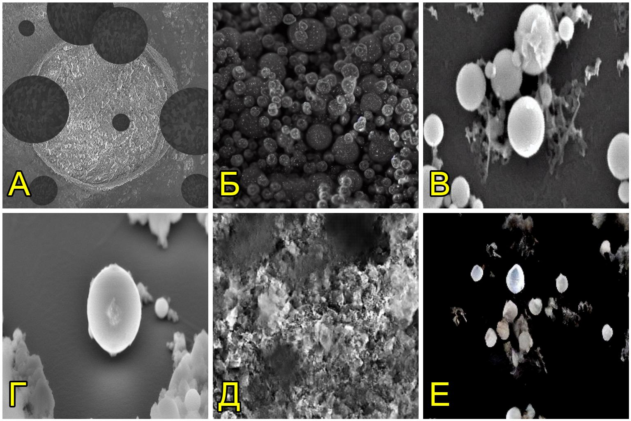
Comparison of methods for forming a synthetic sample
Table 1. Comparison of generation methods
Method | Metrics for evaluating the results of synthetic data generation
 | FID | SSIM × 10^-4 | PSNR × 10^-1 | COSIM × 10^-3 | EMD × 10^-3
Blender | 317±3 | 9941±2 | 613±1 | 892±3 | 73±5
Automatic | 271±2 | 9931±2 | 607±1 | 862±4 | 56±4
LoRA | 157±1 | 9932±4 | 609±2 | 875±6 | 77±4
Dream-Booth | 128±2 | 9925±3 | 605±2 | 838±6 | 65±5
GAN | 221±2 | 9924±1 | 603±1 | 840±3 | 44±3
DiT | 237±2 | 9781±7 | 564±1 | 290±4 | 343±6
Table 2. Comparison of retraining methods
Parameter | Teaching Method
 | LoRA | DreamBooth
Graphics Processing Unit (GPU) | GeForce RTX 3060 6GB Laptop (personal laptop) | Nvidia Tesla T4 16 GB (Selectel Cloud Server)
Peculiarity of the method | Saving Image Style | Training a new class of objects
Flaws | Mixing dissimilar images with each other | Low efficiency with small sample
Advantages | Low requirements and high learning speed | High diversity
Fig. 1. Examples of generating images of size (512x512): A – Blender software; B – Automatic software; C – DreamBooth retraining method; G – LoRA retraining method; D – generative adversarial networks (GAN); E – diffusion-transformer networks (Transformer)
<number>/11

Slide 3
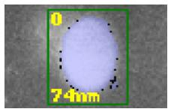
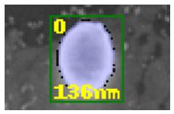
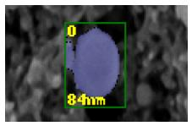
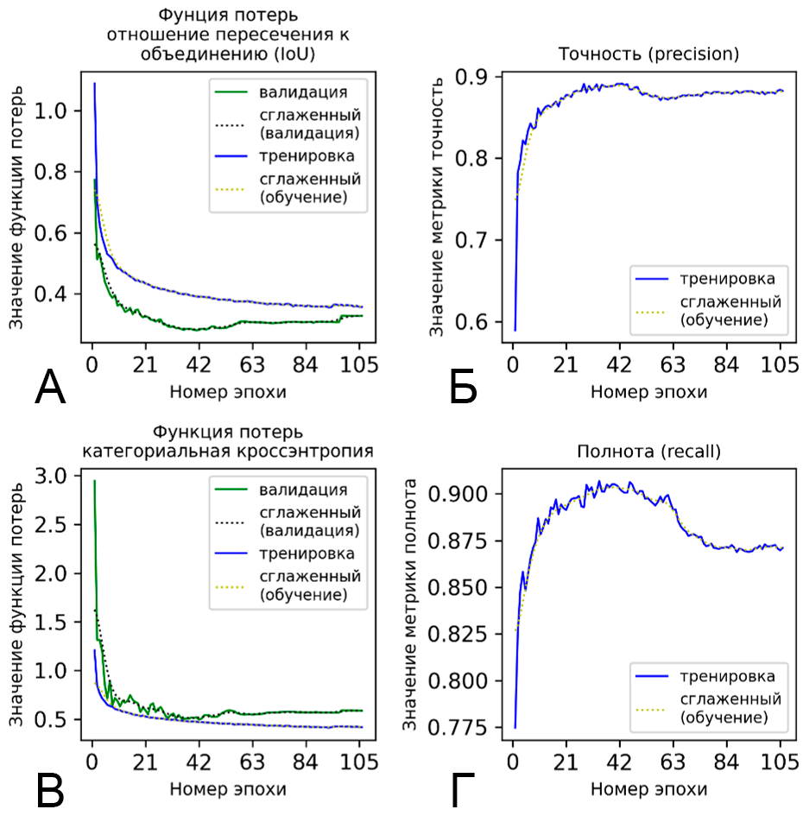
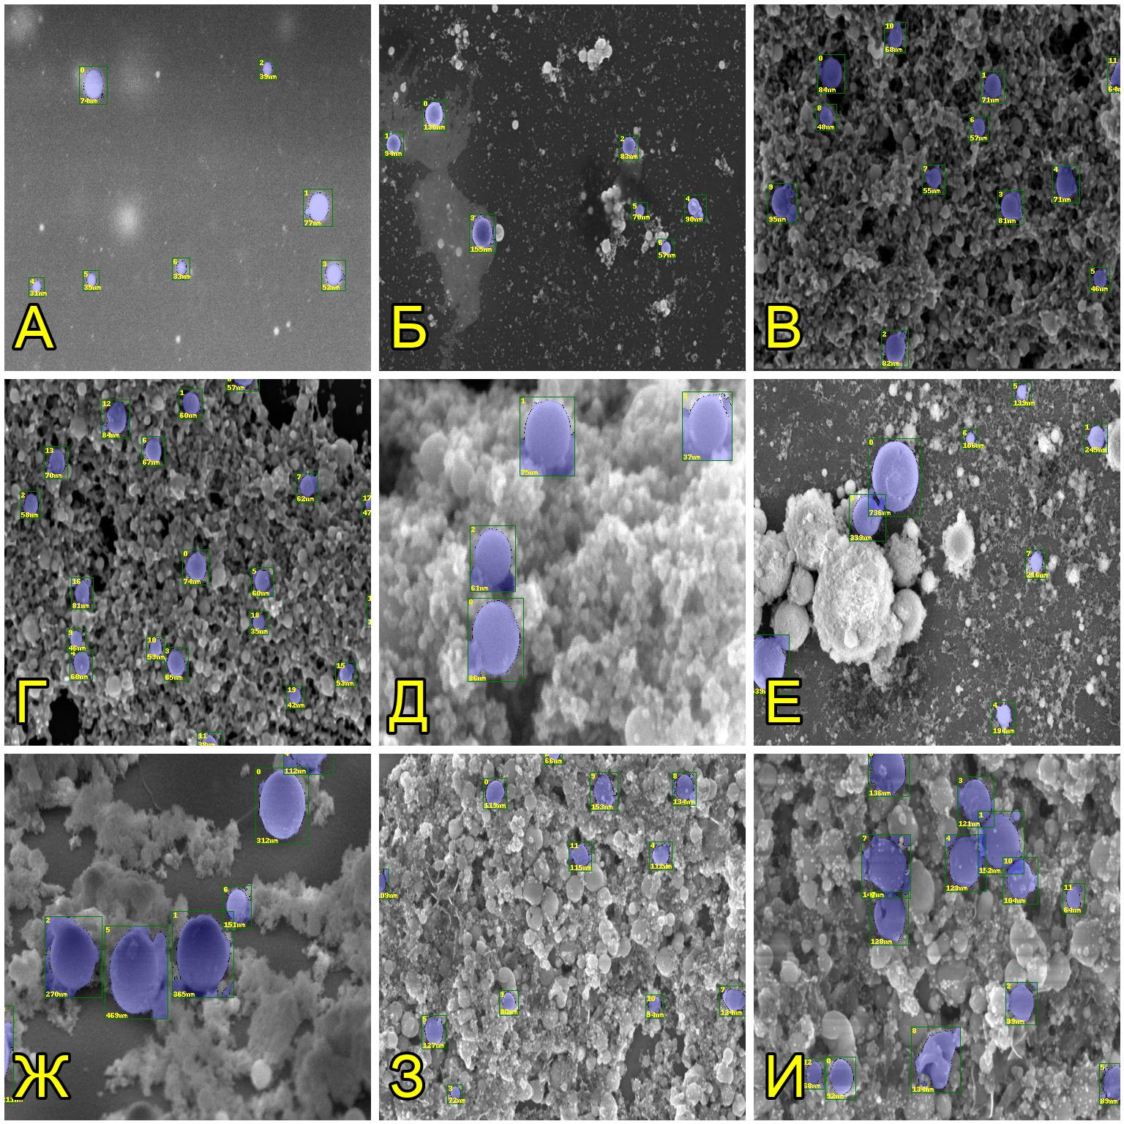
Yolov8n detector training results
Fig. 1. Graphs of the training quality metrics of detection model #1: A – intersection-to-union ratio (IoU) loss function; B – accuracy; C – categorical crossentropy loss function; G – recall.
Fig. 1. Examples of processed images: A – 7 particles; B – 7 particles; C – 12 particles; D – 20 particles; E – 4 particles; F – 8 particles; G – 7 particles; H – 12 particles; I – 13 particles.
3

