Slide 1

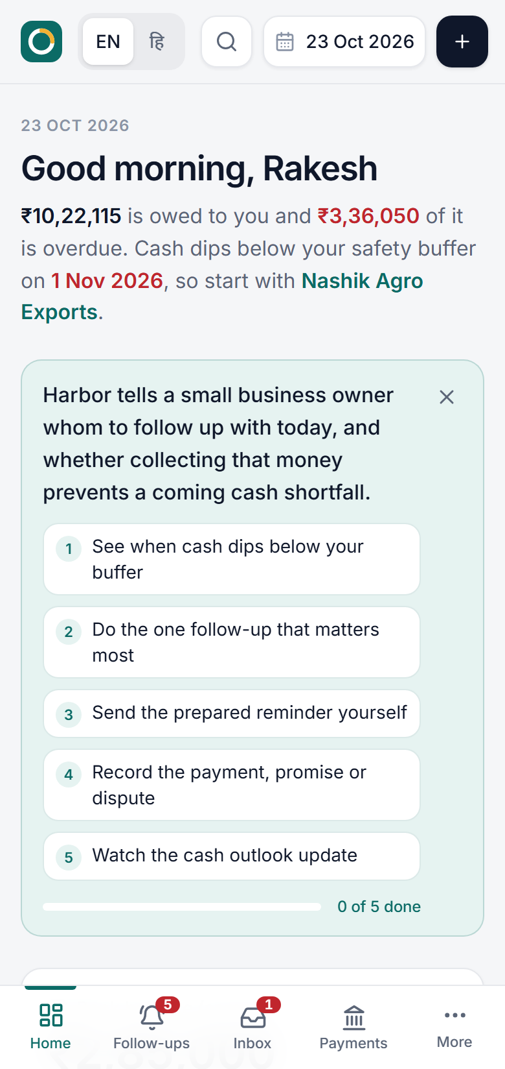

Finance & Banking
Harbor
Collect the right invoice first.
See when cash will dip below your safety buffer, which unpaid invoice can close the gap, and what to send today.
[Team name] · [Member names]
Notes:
Harbor helps a small business owner decide, every morning, which unpaid invoice to chase so they do not run short of cash. Problem statement 4, The Small Business Invoice Chase. Live at harbor-app-g6jt.onrender.com.

Slide 2



Profitable on paper, short on payday
₹3,36,050
overdue in our sample business, a carton supplier with 12 customers on 30-day terms
Invoices sit unpaid at different stages, follow-ups are irregular, and the owner finds the shortfall only when salaries or GST are due.
9 days
until its cash dips below the safety buffer, with salaries and rent due the same week
The problem: HackCache ’26 PS4, The Small Business Invoice Chase
Notes:
Our user is the owner of a small credit-selling business with no accounts team. Receipts and obligations are never connected, so a cash gap is a surprise. Both numbers come from our synthetic demo business, not from a survey. We have not run user interviews yet.

Slide 3
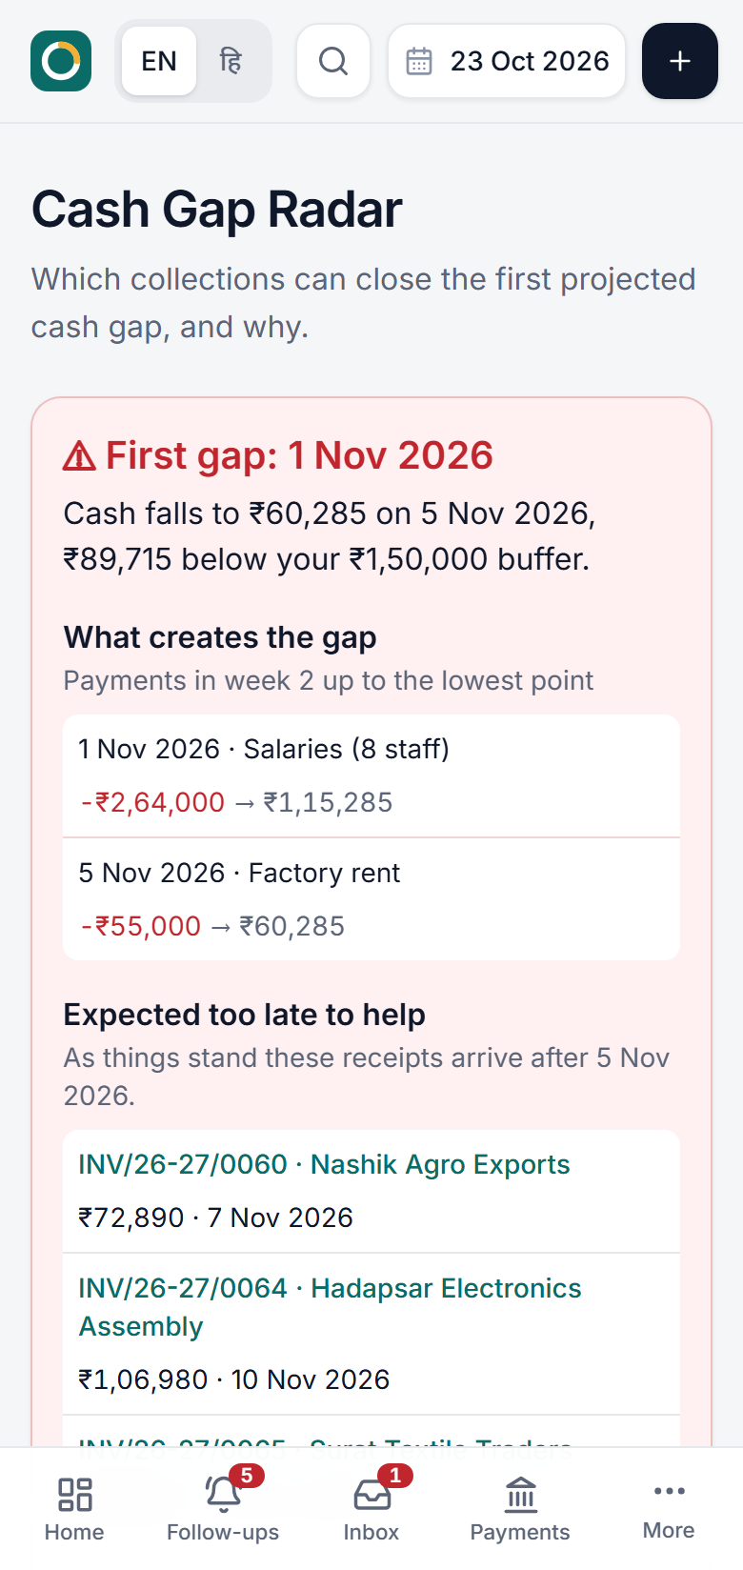
See the gap. Chase one invoice. Stay funded.
Harbor connects unpaid invoices to upcoming salary, rent, supplier and GST payments, then tells the owner which follow-up closes the gap.
Warns you before cash falls below your buffer
Shows why each invoice is first, no black-box score
Prepares the reminder, and you choose to send it
Notes:
Cash Gap Radar: the first projected breach, the payments that cause it, receipts that arrive too late, and a collection plan that could close it. Every priority shows its five factor scores and a plain reason.

Slide 4
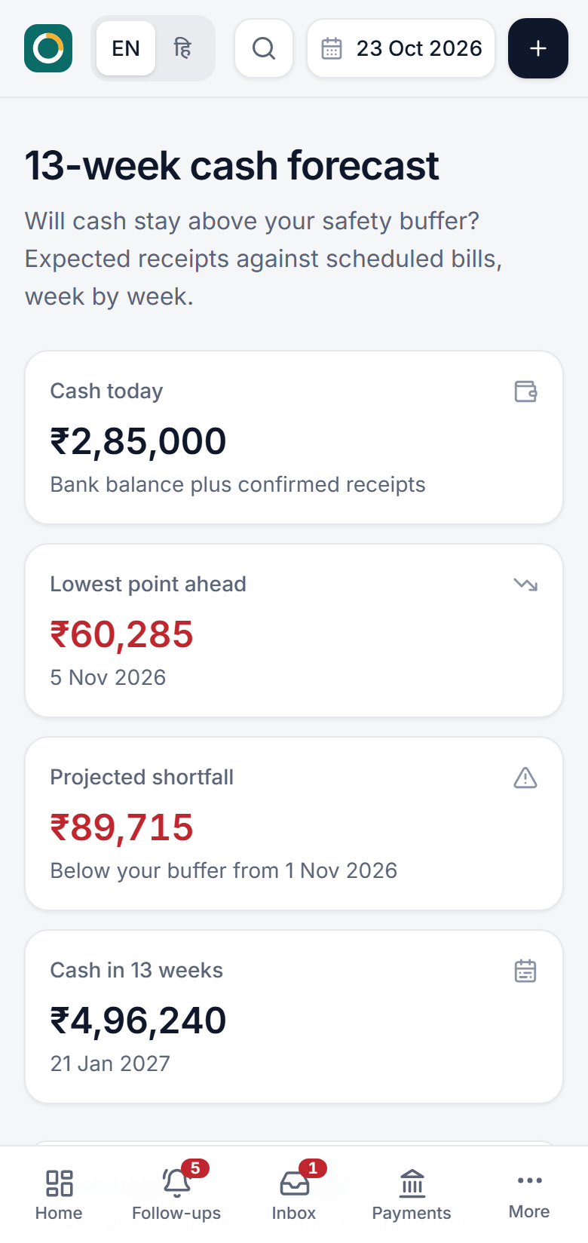
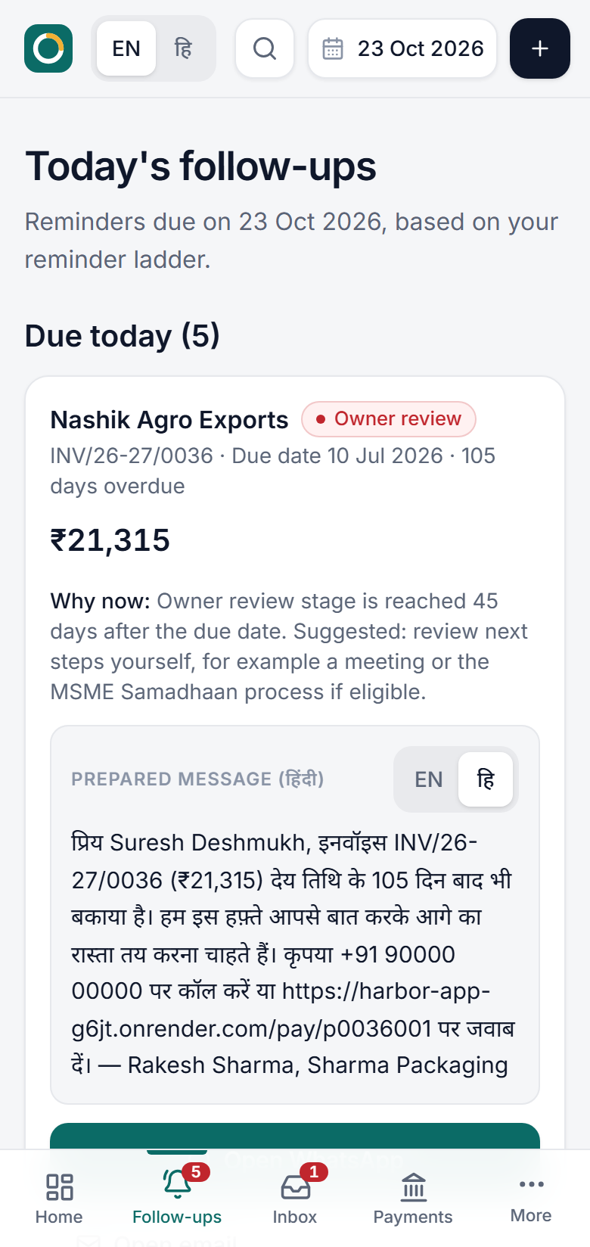
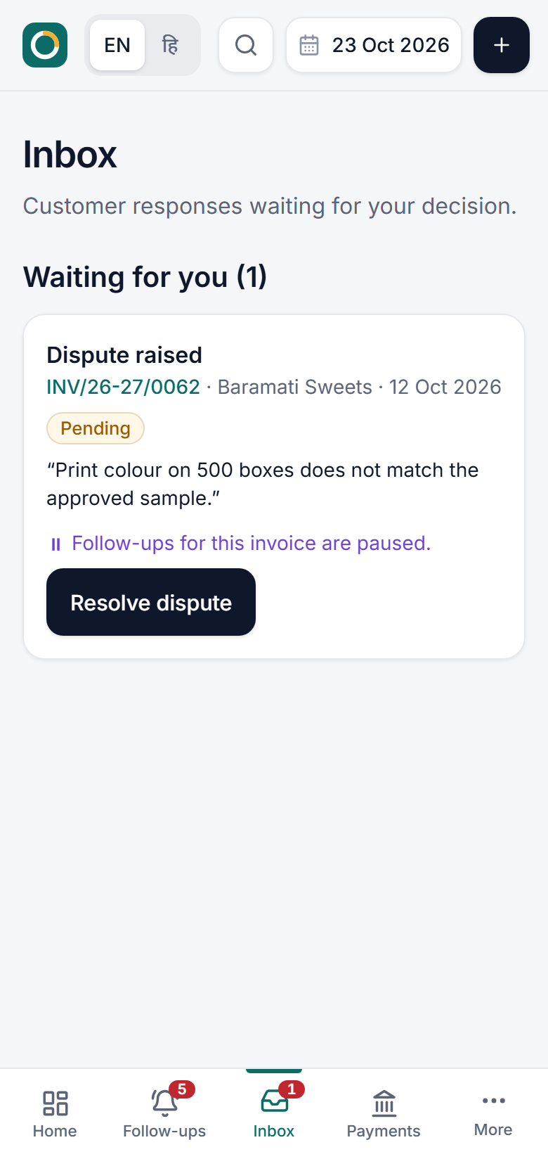

From cash gap to action in three steps
1
See when cash dips below your buffer
2
Chase the invoice that helps most
3
Replies and payments update the plan
Notes:
1. The 13-week forecast shows the lowest point and the shortfall. 2. Follow-ups lists who to chase today, why now, and a prepared message in English or Hindi. 3. Customer replies (paid, promise, dispute) land in the Inbox; nothing changes until the owner confirms, then the forecast recalculates.

Slide 5




Built with React, Express and Render
Built with
Claude Code
AI coding assistant. Wrote much of the code from our prompts.
Real
Simulated
13-week forecast and gap
Synthetic demo business
Express on Render
Serves the React app and keeps API keys on the server.
Explained priority score
Data stays in one browser
WhatsApp, email, SMS
GST invoices and letters
Opens a prepared reminder. The owner presses send.
Bank CSV matching
Notes:
Real: forecast, priority engine, GST maths (integer paise), reminder ladder, bank reconciliation, printable invoices and demand letters, 109 automated tests. Simulated: the business and all its data are synthetic; data lives in localStorage, so the customer page works in the same browser only. The Render Workflow integrity check is coded but not yet connected on the live deployment.

Slide 6



Who it helps, and what comes next
Who it helps
What we would build next
Accountants and CAs
Who chase payments for several small clients at once.
1
Pilot with three small-business owners
Owners with staff to pay
Who learn about a shortfall only when salaries are due.
2
Secure shared backend for customer replies
Wholesalers and suppliers
3
Bank feeds via Account Aggregator, with consent
Selling on 30-day credit, with no accounts team.
Notes:
Next, in order: test with at least three owners against a spreadsheet (time to pick the three invoices, correct shortfall date); an encrypted shared backend so the customer page works on any device; consented bank feeds instead of CSV import.

Slide 7


[Team name]
Try Harbor on your phone right now.
?
[Name]
?
[Name]
?
[Name]
[Role]
[Role]
[Role]
Live app
harbor-app-g6jt.onrender.com
Code
github.com/deneal2005/harbor
Notes:
Open the live link in a private window before submitting. The repo must be public for judges to open it.

