Slide 1
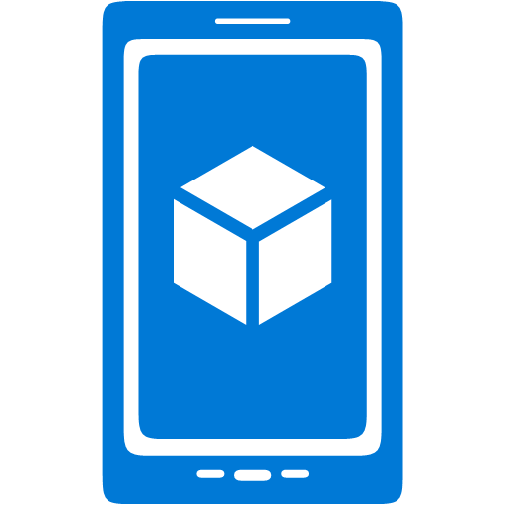
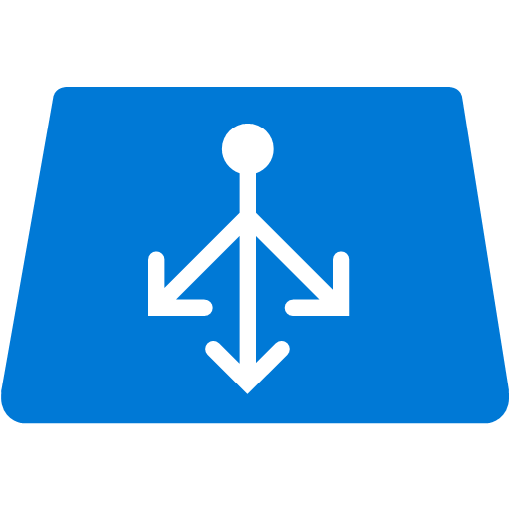


Gateway configured for authentication
Resource Group
All requests for mobile app’s URL
HTTP requests
Mobile app
All API app requests,
mobile app logon and token requests
Only authenticated requests
API app configured “Public (authenticated)”
All requests
Gateway
API app configured “Public (anonymous)”
Token Store

Slide 2
Web app authentication and authorization
HTTP requests
Only authenticated requests
Web app or API app
or mobile app

Slide 3


Client Flow
1. Login request, credentials
Client application
2. Access token
Identity provider
3. Access
token
4. Zumo
token
App Service
Gateway
Token Store

Slide 4
Server Flow
Client application
2. Credentials
(after redirect)
Identity provider
1. Login request
4. Zumo
token
3. Access token
App Service
Gateway
Token Store

Slide 5
Calling the identity provider API
1. Zumo token with API call
4. Provider token with provider API call
API app or Mobile app
Identity provider
2. Zumo token with request for
provider
token
3. Provider
token
App Service
Gateway
Token Store

Slide 6
Calling a SaaS platform API
API app or Mobile app
5. Zumo token with API call
7. SaaS access token with SaaS API call
3. Redirect to SaaS login page.
User logs in, grants consent
SaaS provider
2.Browser goes to consent link URL at gateway
6. Send Zumo token, get back SaaS access token
1. Send Zumo token, get back consent link URL
4. SaaS access token
App Service
Gateway
Token Store

Slide 7
Calling a SaaS platform
API app or Mobile app
3. Provider token
Identity provider
1. Zumo token with request for
consent link
2. Consent link URL
App Service
Gateway
Token Store

Slide 8
Basic Authentication Flow
Client app uses Active Directory Authentication Library to initiate login, user enters credentials which are sent to AAD
AAD returns an Access Token / Refresh Token pair for the mobile service to ADAL
The client passes the Access Token to the mobile service, exchanges for the Mobile Services token for a continued session
1
2
3

Slide 9

Access resources on behalf of the user
Mobile Service passes Access Token to AAD along with a requested resource URI and its Client ID / Client Secret
AAD sends back an Access Token / Refresh Token pair for the remote resource
Mobile Service talks to the remote resource on behalf of the logged-in user
1
2
3

