Slide 1
Next up: Invoke-BlueSky
# > winget install --id Git.Git
# > git clone https://github.com/thorstenbutz/bsky
Follow
along

Slide 2
3
3

Slide 3
2

Slide 4
1

Slide 5

Invoke-BlueSky
Follow
along
Thorsten Butz
Notes:
June 24, 2025
Malmö, Sweden
Room 4
16:00 h
Get the code and follow along!
winget install --id Git.Git
git clone https://github.com/thorstenbutz/bsky
Watch the recording:
https://youtu.be/balTrnOsCVg

Slide 6

Many thanks to our sponsors:
Notes:
Thanks to all the sponsors and – most important – to all the delegates, that make/made it possible to come together.

Slide 7
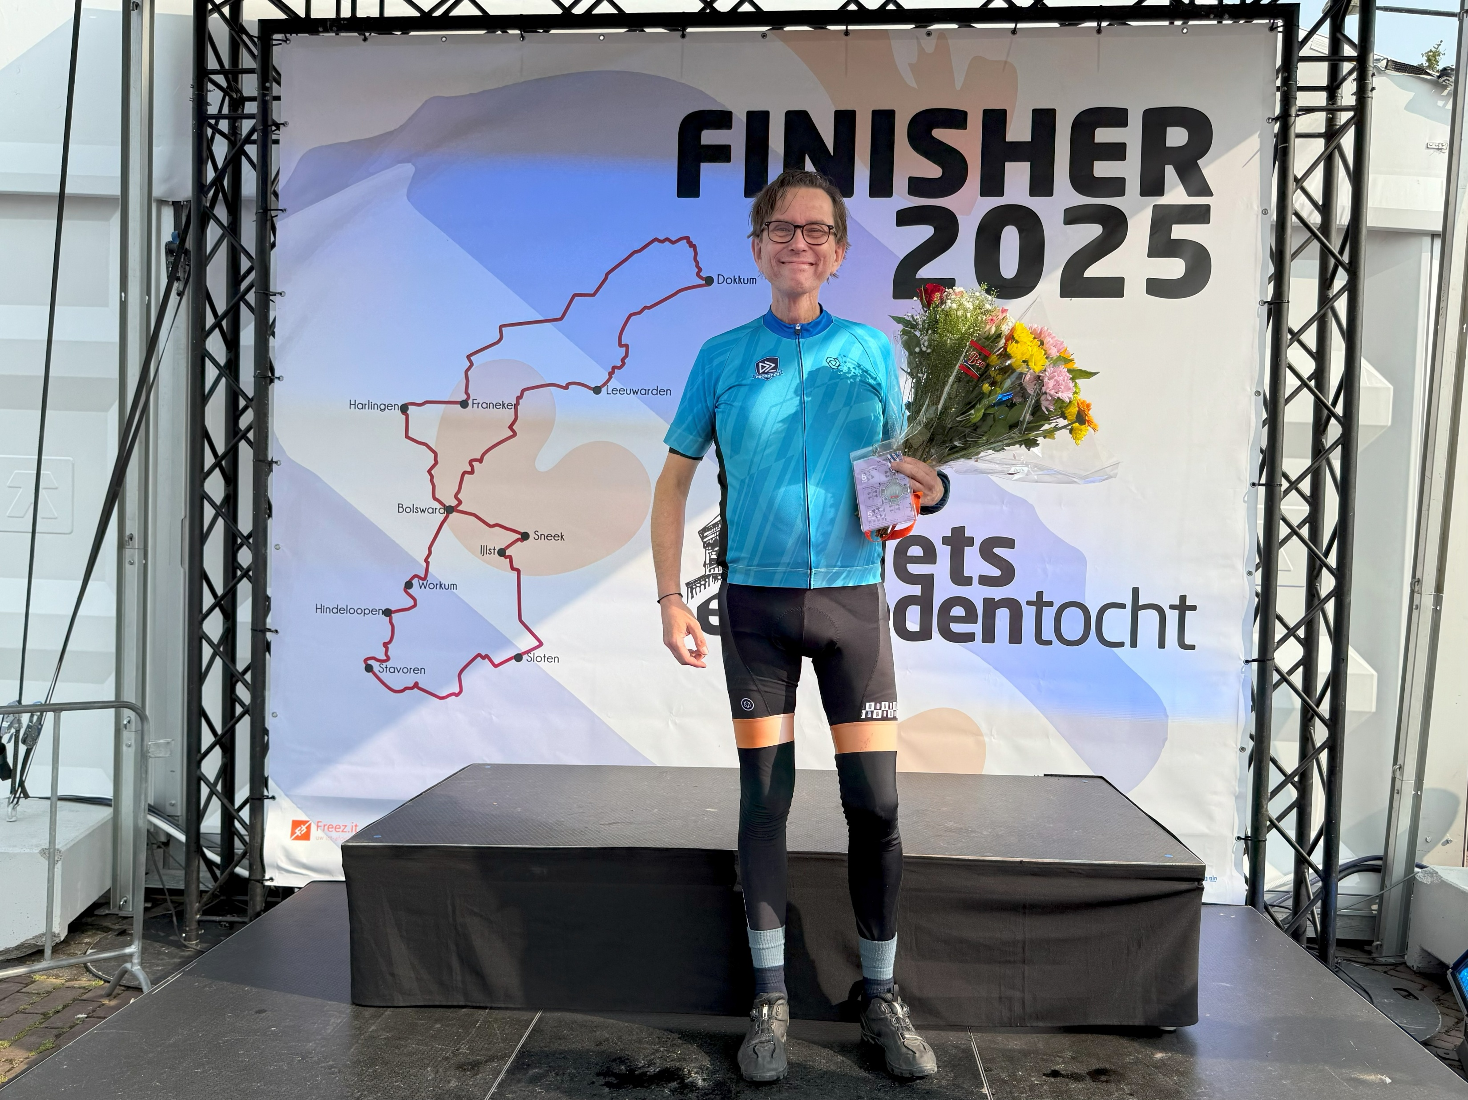
Notes:
I love cycling and my favourite tour (picture above) is the "11 steden tocht" (11 cities tour): https://www.fietselfstedentocht.frl/
You should definitely try this!

Slide 8






@thorsten.butz.io @thorstenbutz@twit.social @thorstenbutz
Notes:
You can find me an lots of social networks.
https://bsky.app/profile/thorsten.butz.io
https://twit.social/@thorstenbutz
https://x.com/thorstenbutz

Slide 9


(Still) Most user accounts
Politically controversial
No free REST API, centralized
YOUR MILEAGE
MAY VARY
Niche user base
Politically controversial
Free REST API, federated
"When two quarrel, the third is happy"
Politically relaxed
Free REST API, (yet almost) centralized
Notes:
https://swat.io/en/learn/x-alternatives-bluesky-threads-mastodon/

Slide 10
Follow
along
# > winget install --id Git.Git
# > git clone https://github.com/thorstenbutz/bsky
Follow
along
Notes:
I will (try to) update the demo repo from time to time.
https://github.com/thorstenbutz/bsky
You can find all slides and demos from the Malmö conference in the central repo:
https://github.com/psconfeu/2025

Slide 11
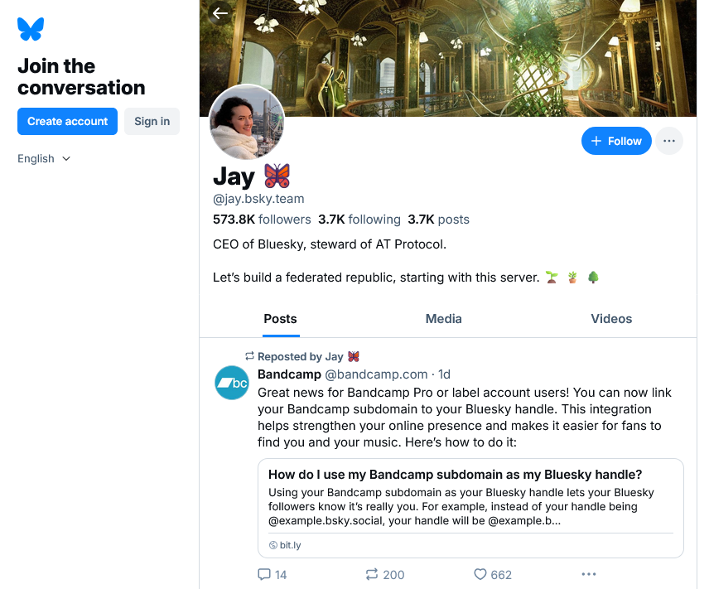
https://bsky.app/profile/jay.bsky.team
Follow
along
A
Notes:
→ A Bluesky user: **Handle** and **DID**
DID stands for Decentralized ID. DIDs are a W3C specification. DIDs are universally-unique identifiers , permanent and non-human-readable.
Handles are domain names which are used to identify users in a simple way. More than one handle may be assigned to a user, handles must not be permanent.

Slide 12
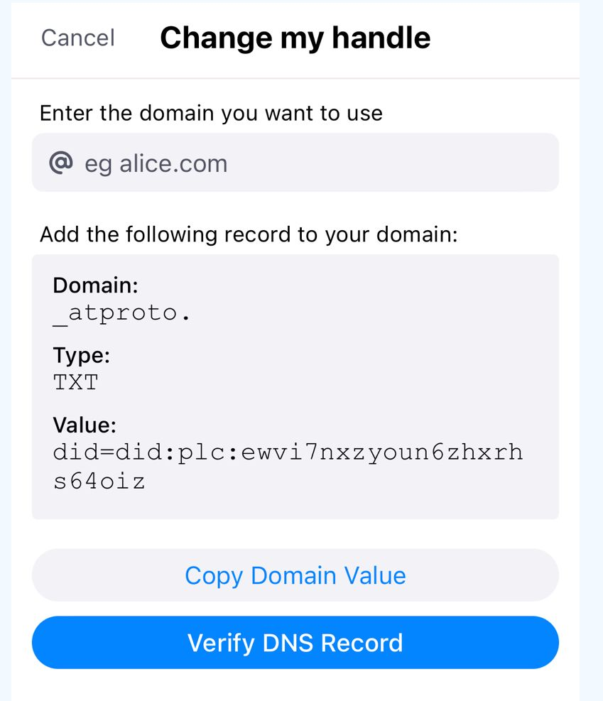
Custom handle
# > Resolve-DnsName -Type TXT -Name _atproto.dev.butz.io Name : _atproto.dev.butz.io Type : TXT TTL : 3276 Strings : {did=did:plc:kklrh34ii6m4eunzjsp32api}
https://bsky.social/about/blog/4-28-2023-domain-handle-tutorial
Notes:
Resolve-DnsName -Type TXT -Name _atproto.thorsten.butz.io Name : _atproto.thorsten.butz.io Type : TXT TTL : 2695 Strings : {did=did:plc:zfubrgofk23trzj7bapmym2d}
TEST-Account
Resolve-DnsName -Type TXT -Name _atproto.dev.butz.io | fl Name : _atproto.dev.butz.io Type : TXT TTL : 3276 Strings : {did=did:plc:kklrh34ii6m4eunzjsp32api}

Slide 13
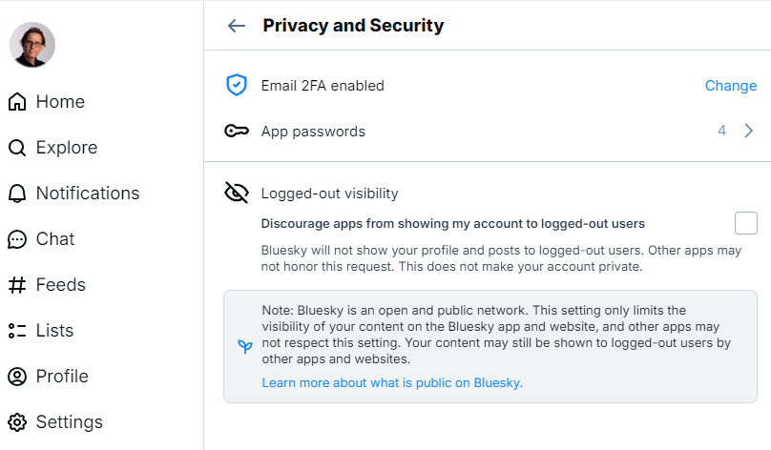
App passwords
Follow
along
C
Notes:
App passwords can also be used to simply login to the website. This way you can use a 2nd factor authentication for the main password while simplifying login with the username/apppassword approach.

Slide 14
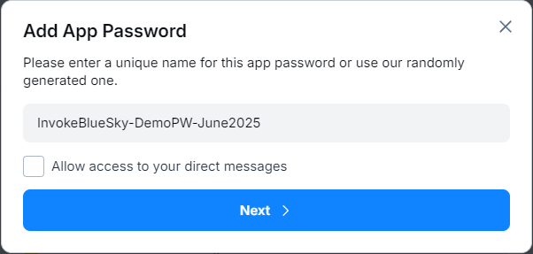
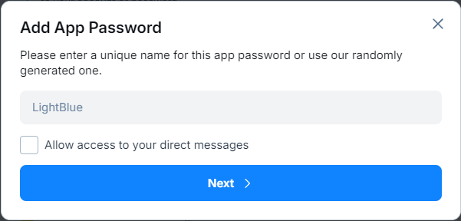
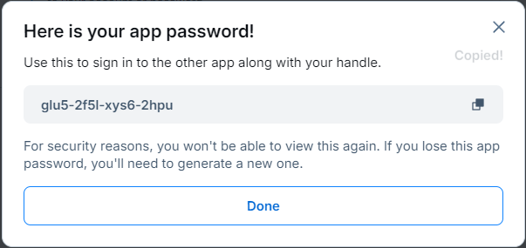
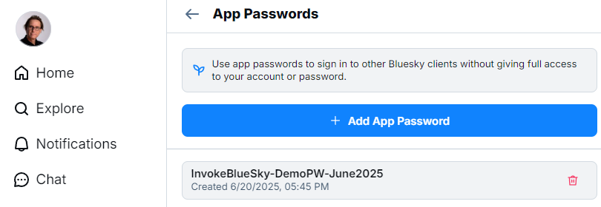
app password
Notes:
This app pw has been revoked.

Slide 15
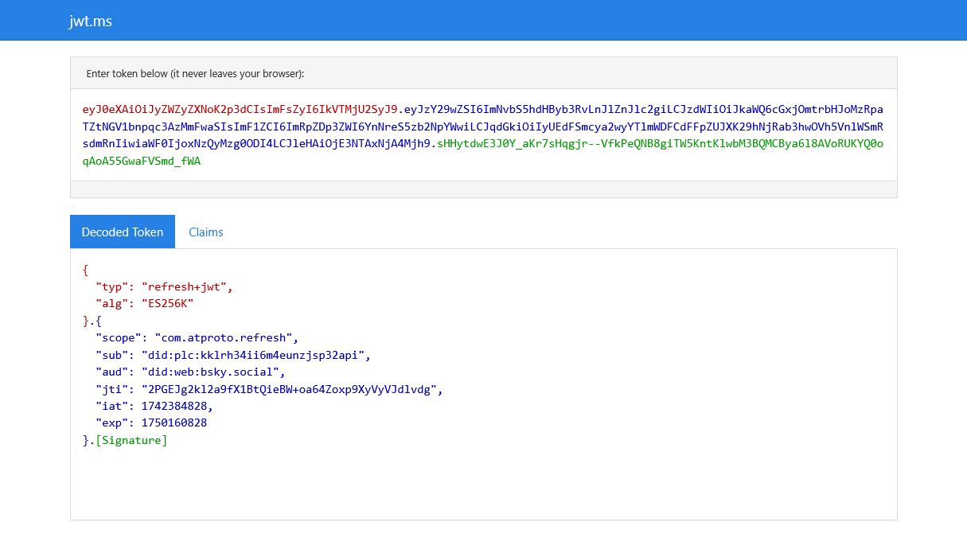
$mySession.refreshJwt (90 days lifetime)
Notes:
This is a refresh token.
A website by Microsoft to decode "JSON web tokens" (JWT):
https://jwt.ms
More about JWTs:
https://en.wikipedia.org/wiki/JSON_Web_Token
I used this module during the demo:
https://github.com/darrenjrobinson/JWTDetails
https://www.powershellgallery.com/packages/JWTDetails/1.0.3

Slide 16
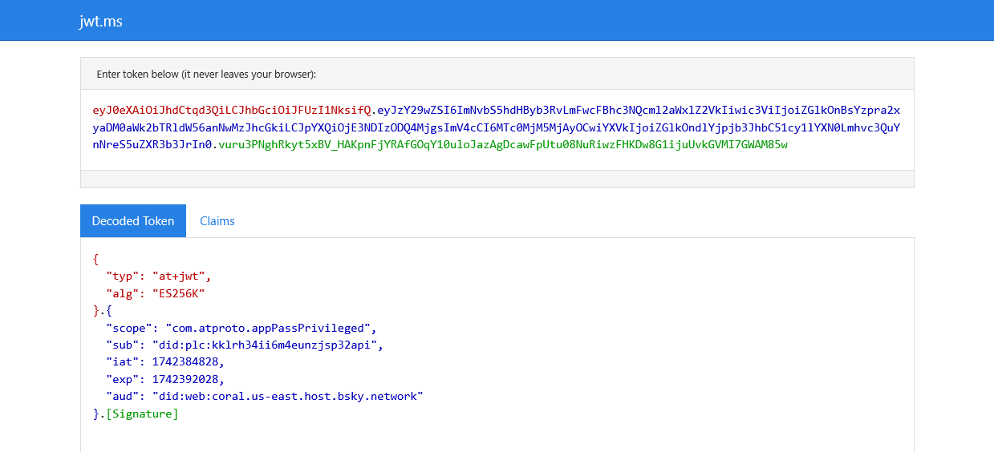
$mySession.accessJwt (2 hours lifetime)
Notes:
This is an access token.
Multiple tokens are provided. An ID or refresh token, that might last for a longer time period, while access tokens have a shorter lifetime.
https://auth0.com/blog/refresh-tokens-what-are-they-and-when-to-use-them/

Slide 17
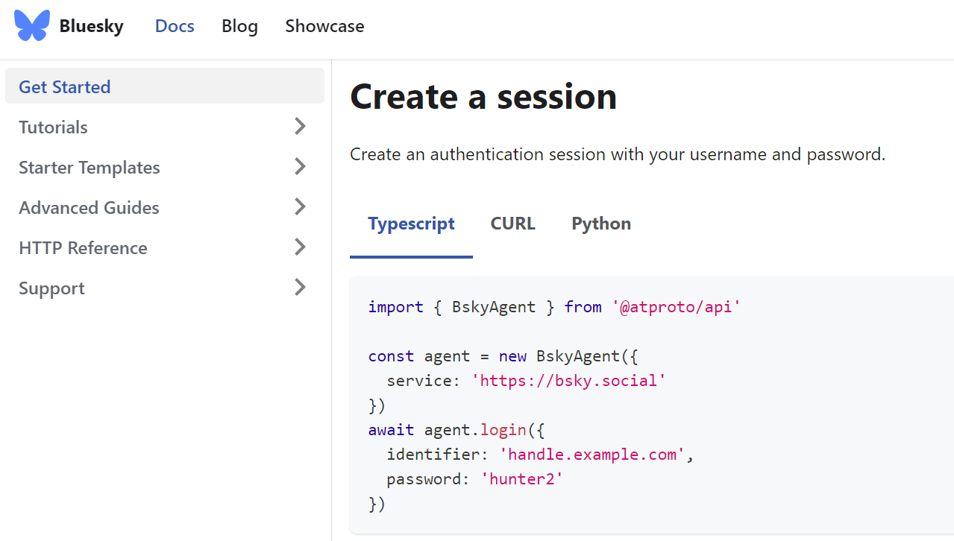
Documentation
https://docs.bsky.app/docs/get-started#create-a-session
Notes:
https://docs.bsky.app/docs/get-started
Documentation of in terms of Bluesky and the AT protocol is extremely detailed. This makes it also valuable for "vibe coding", the auto-creation of code using AI.

Slide 18
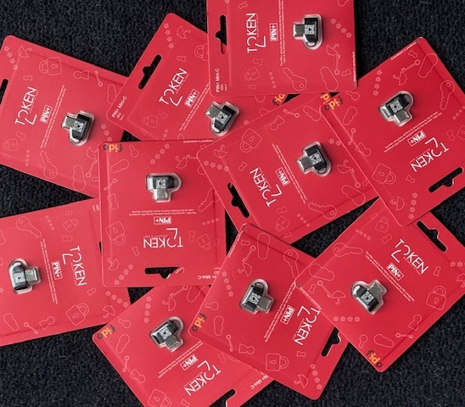


Swag
Create a new post in your native language:
token2.com
Mission accomplished,
@thorsten.butz.io
#PSConfEU
Notes:
These tokens are provided by the fine people of Token2.
https://token2.com/
Thanks for your support!
Merci pour votre soutien!

Slide 19

https://bsky.app/profile/pshnuts.bsky.social/post/3lbry4dzsb72a
Notes:
https://bsky.app/profile/pshnuts.bsky.social/post/3lbry4dzsb72a

Slide 20
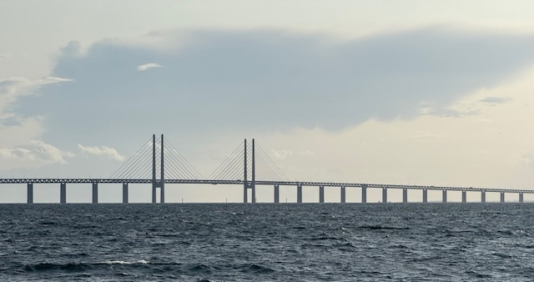
Bridging the social internet
https://fed.brid.gy
Notes:
The famous bridge between Copenhagen/Denmark and Malmö/Sweden, the
Öresund bridge
https://en.wikipedia.org/wiki/%C3%98resund_Bridge
The fedi bridge service
https://fed.brid.gy/
This is an independent service that acts a proxy between the fediverse and Bluesky.
You should definitely check this out.
You will find the Bluesky account of @psconf.eu via:
https://twit.social/@psconf.eu@bsky.brid.gy
.. or the other way around (my account):
https://bsky.app/profile/thorstenbutz.twit.social.ap.brid.gy

Slide 21
Q&A
15 minutes
Notes:
"What Are Refresh Tokens and How to Use Them Securely"
https://auth0.com/blog/refresh-tokens-what-are-they-and-when-to-use-them/
Highly recommended articles about authentication:
https://syfuhs.net/understanding-windows-auth
"What is Kerberos?"
https://www.vaadata.com/blog/what-is-kerberos-kerberos-authentication-explained/

Slide 22

KEEP
CALM
AND
ENJOY
#PSCONFEU
{
"Venue" : "PSConfEU 2025",
"Title" : "Invoke-BlueSky,
"Speaker" : "Thorsten Butz",
"Github" : "github.com/thorstenbutz",
"Uri" : "thorsten-butz.de",
"BlueSky" : "@thorsten.butz.io",
"Podcast" : "slidingwindows.de"
}
Notes:
Thanks for having me!

Slide 23
Swag
token2.com

