Slide 1
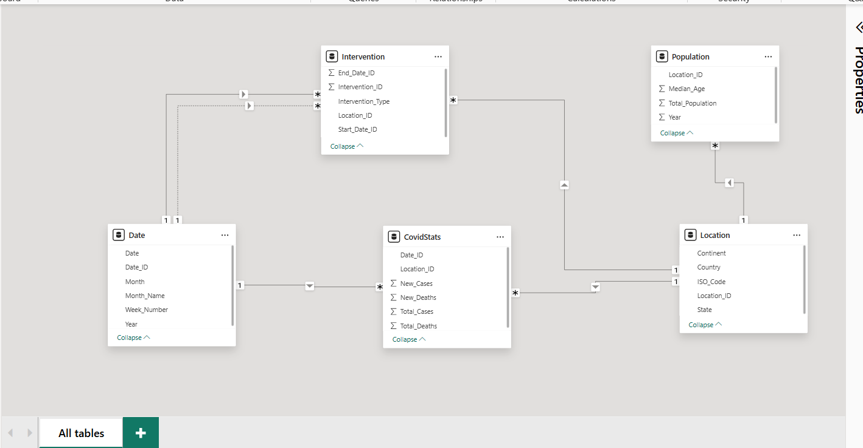

Slide 2
Relationship
From Table | From Column | To Table | To Column | Cardinality
CovidStats | Date_ID | Date | Date_ID | Many to One
CovidStats | Location_ID | Location | Location_ID | Many to One
Population | Location_ID | Location | Location_ID | Many to One
Intervention | Location_ID | Location | Location_ID | Many to One
Intervention | Start_Date_ID | Date | Date_ID | Many to One
Intervention | End_Date_ID | Date | Date_ID | Many to One

Slide 3
S.no | Analysis Description | Recommended Visual
1 | Total COVID-19 cases and deaths over time | Line Chart / Area Chart
2 | Monthly new cases and deaths trend | Column Chart (Stacked)
3 | Year-over-year case growth comparison | Line Chart with Year Legend
4 | Daily or weekly case spikes detection | Line Chart with Slicer

Slide 4
S.No | Analysis Description | Recommended Visual
5 | Country-wise total cases and deaths | Bar Chart (Horizontal)
6 | Continent-wise spread comparison | Treemap / Clustered Column
7 | Map view of case distribution by country | Filled Map / Shape Map
8 | Top 5 countries by total deaths | Top N Bar Chart
9 | Bottom 5 countries by new cases | Bottom N Bar Chart

Slide 5
S.no | Analysis Description | Recommended Visual
10 | Cases per 100,000 population | Column Chart + Tooltip
11 | Deaths per 1 million population | KPI Card / Bar Chart
12 | Median age vs. total deaths per country | Scatter Plot
13 | Population size vs. total cases correlation | Bubble Chart / Scatter

Slide 6
S.No | Analysis Description | Recommended Visual
14 | Number of interventions by country | Bar Chart / Matrix
15 | Timeline of interventions with case trends | Line Chart + Markers
16 | Before-and-after intervention impact on cases | Line Chart (highlight pre/post)
17 | Average new cases 14 days post intervention | Table + KPI Card
18 | Countries with longest or earliest lockdowns | Matrix / Bar Chart

Slide 7
S.no | Analysis Description | Recommended Visual
19 | Compare two countries' case trends | Line Chart with Legend
20 | Compare cases vs. deaths by country | Dual Axis Line or Column Chart
21 | Compare intervention effectiveness by region | Clustered Column Chart
22 | Case trends in countries with vs. without lockdown | Line Chart with Filter

Slide 8
S.no | Analysis Description | Recommended Visual
23 | Highest-case months across 5 years | Matrix or Heatmap
24 | COVID waves pattern (e.g., 1st, 2nd, 3rd wave) | Line Chart + Annotations
25 | Quarter-wise summary of new cases/deaths | Clustered Column Chart
26 | Week-over-week growth rate | KPI Card + Sparkline

