Slide 1
Updates on boreholes in EPOS Borehole UML model
104th OGC Technical Committee – GeoScience DWG session
Southampton, United Kingdom
Henning Lorenz, Uppsala University, Sweden
14th September 2017

Slide 2
Boreholes in EPOS
Step 1: BoreholeView service (cf. previous talk)
Borehole discovery (by a WFS and through EPOS portal)
Search and filter a set of attributes that describe a borehole
Access to more detailed borehole information/data by URI (link to existing pages/data sets at original data provider)
Comparatively quick and easy integration of new data/providers
Make data visible, improve data utilisation, help users to find data
Step 2: A borehole description service (this talk)
Aim: A service that is able to deliver a full borehole description, incl. drilling/scientific data, samples, completion & ??? (i.e. is flexible)
Guidelines and general concept of the work
The (conceptual) borehole UML model (under development)

Slide 3
Guidelines
Compatible with/add-on to BoreholeView
Re-use existing elements where possible (e.g. code lists;
not restricted to BoreholeView!)
Build on existing standards (to be defined)
(optional) use of the IGSN (International GeoSample Number) as identifier
Easy integration for projects that allocate IGSNs as UIDs
Incentive to upgrade existing databases to include IGSNs
Should be comparatively simple to implement
=> Incentive to participate and share data

Slide 4
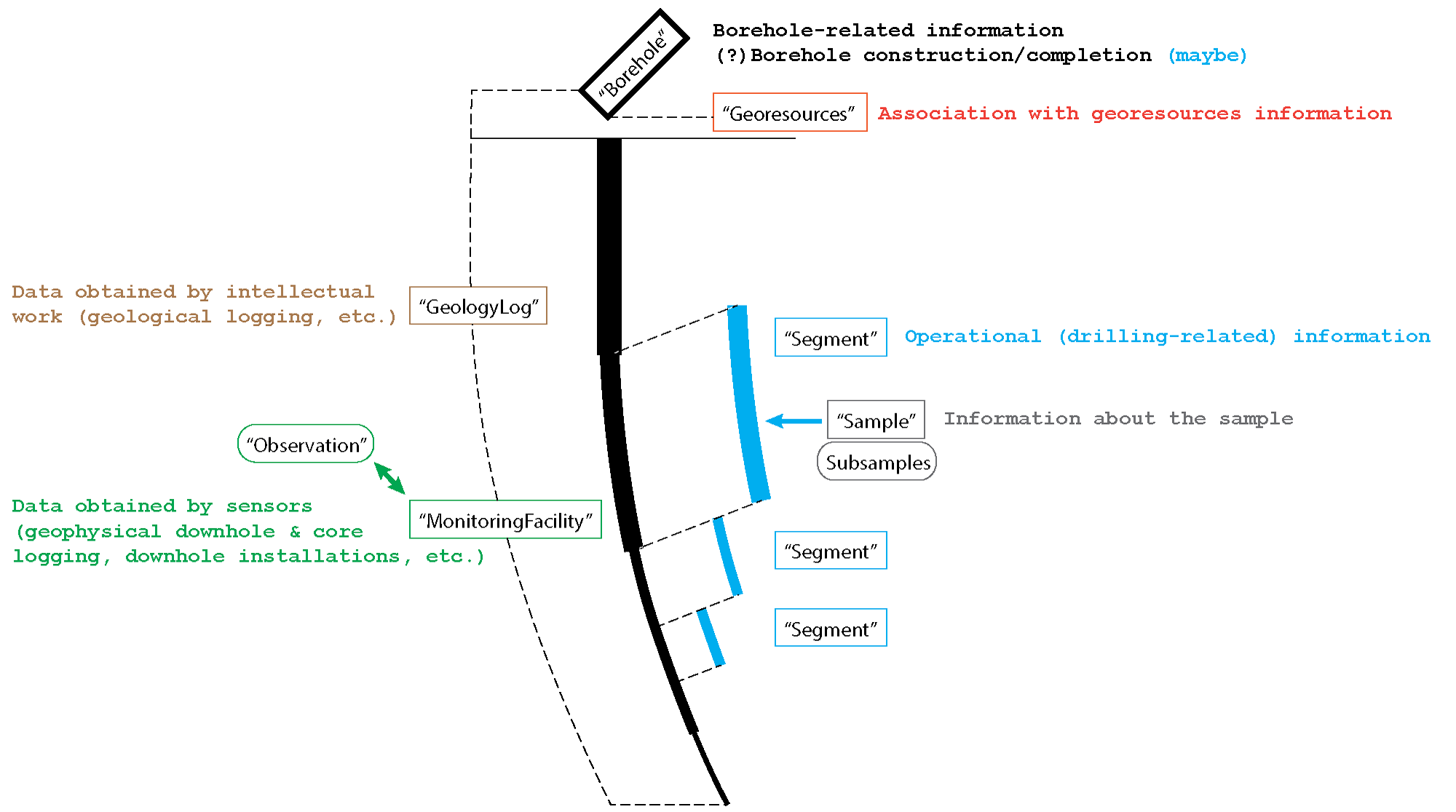
The general concept

Slide 5
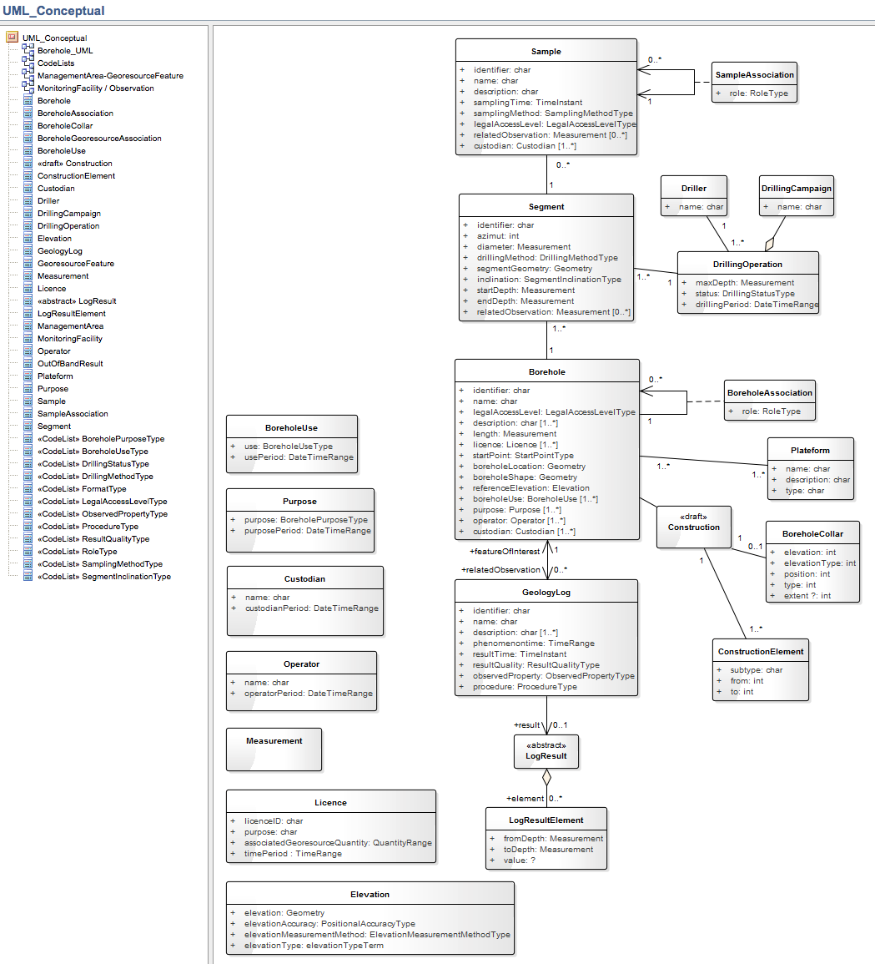
The conceptual UML model (work in progress)
Future work
Finish first version of the conceptual UML model
Discuss and decide on services, standards, code lists
Implement

