Slide 1
Borehole
Borehole-Segment
Sample
Well
Logs
logResultElement
Borehole
Drilling details
On borehole
How to position things down the hole
Borehole
Construction
Observations
Borehole
constructionElement
Reference(s) Z / origin
On sample
On monitoring facility
Borehole « context »: administrative
BoreholeTrajectory
Borehole « context »: platform
Georesource

Slide 2
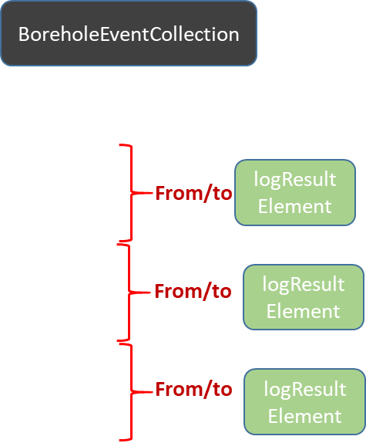
Borehole
Needs disambiguation
Well
linearElement
BoreholeTrajectory

Slide 3
BoreholeEventCollection
BoreholeEventCollection
BoreholeEventCollection
Observations
At
Observations
At
From/to
logResultElement
From/to
logResultElement
At
Observations
From/to
logResultElement
From/to
logResultElement
At
Observations
From/to
logResultElement
From/to
logResultElement
At
Observations

Slide 4
All the following slides are kept to keep memory of our discussions
Linear referencing discussion (and solution) has been framed using BhML flavour of ISO 19148. LinearReferencing.pptx can is here to help on the topic

Slide 5
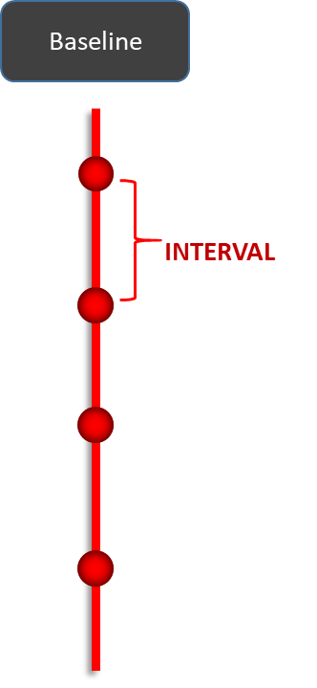
Webconf 17:
To be updated
Borehole
Needs disambiguation
Well
« Baseline » is a
temporary word
geometry
BoreholeTrajectory

Slide 6
Webconf 17:
To be updated
? <<FeatureType>> ? Baseline
Borehole
constructionElement: ?bhConstruction?
URI, type
INTERVAL
URI, type
<<FeatureTypes>>
connectionFeature
logResultElement:Observation
Pos°
(pk VS from/to)
Borehole-Segment:samplingFeature

Slide 7
Focus on logs
Webconf 17:
To be updated
? <<FeatureType>> ? Baseline
URI, type
connectionFeature
logResultElement:Observation
INTERVAL
URI, type
connectionFeature
logResultElement:Observation
INTERVAL
URI, type
connectionFeature
logResultElement:Observation
INTERVAL
Pos°
(pk VS from/to)

Slide 8
Focus on logs
Webconf 17:
To be updated
? <<FeatureType>> ? Baseline
URI, type
connectionFeature
logResultElement:Observation
INTERVAL
URI, type
connectionFeature
logResultElement:Observation
Log 1
INTERVAL
URI, type
connectionFeature
logResultElement:Observation
INTERVAL
Pos°
(pk VS from/to)

Slide 9
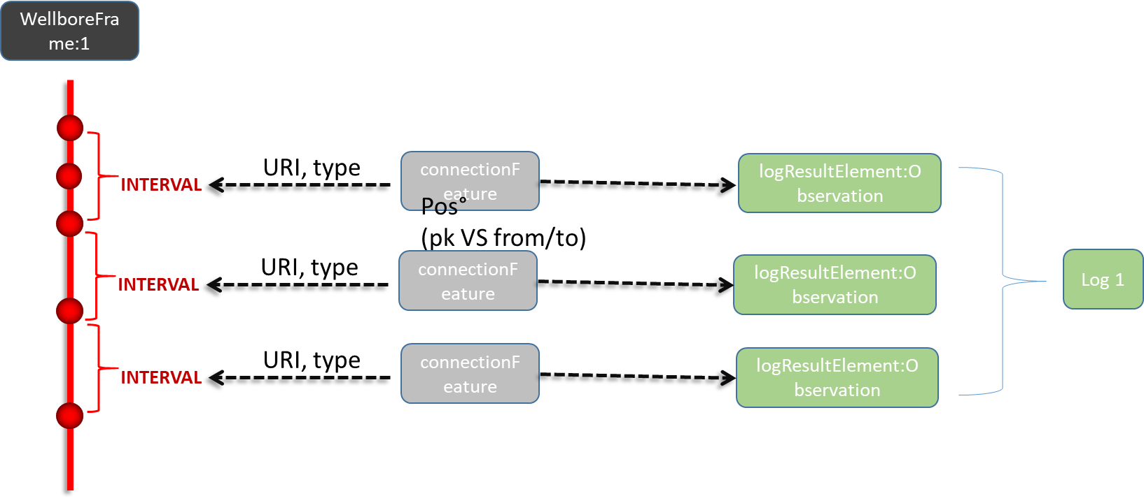
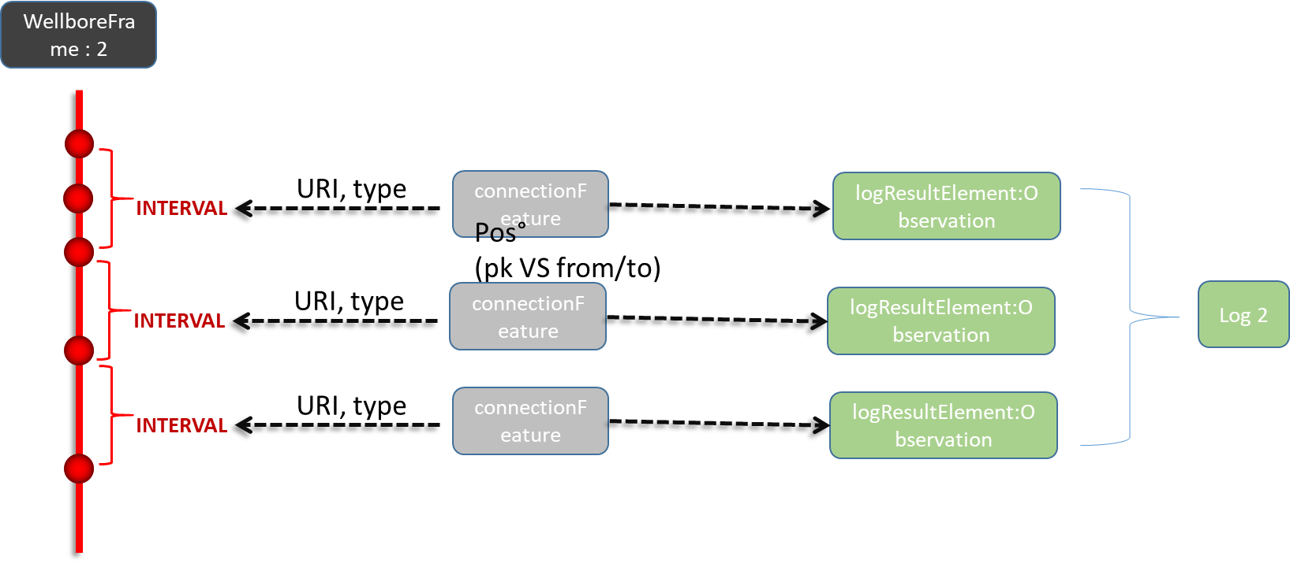
Focus on logs: WellboreFrame approach
Webconf 17:

Slide 10
Webconf 18
1D local ? engineering?
Coord System
-> check ISO 19107
-> check ISO 19148
LR_LinearElement
Checked
3D
constructionElement: ?bhConstruction?
LE_Event
Borehole
Trajectory
geometry
1D:LinearRef
URI, type
LE_Event
Baseline
URI, type
connectionFeature
logResultElement:Observation
Pos°
(pk VS from/to)
LE_Event
Don’t need this
Borehole-Segment:samplingFeature
LE_EventLocation
INTERVAL
Left to right navigation not feasible in this model
(should take other routes through other classes in the model)
Right to left navigation is granted : linear referencing)

Slide 11
Webconf 17
1D local ? engineering?
Coord System
-> check ISO 19107
-> check ISO 19148
3D
constructionElement: ?bhConstruction?
Borehole
Trajectory
geometry
1D:LinearRef
URI, type
Baseline
URI, type
connectionFeature
logResultElement:Observation
Pos°
(pk VS from/to)
Borehole-Segment:samplingFeature
INTERVAL

Slide 12
Open questions
Webconf 18
Refine BaseLine model
1D local ?engineering? / Coord System / -> check ISO 19107 terms
+ ISO 19148 terminology
Is the baseline a FeatureType ? a SRS ?
=> do we really need to create a specific concept or aren’t the Trajectory, ISO 19148 method and the ‘connected’ object sufficient ?
‘Topology’ needed ?
read “with its own constraints” = if you move a node then it has impacts...
can node can have properties ?
Bi-directionnality ?
Elements connected to the baseline know it.
BUT, should the baseline know all points and intervals that are attached to it ?
Look at NrCan 1998 contribution (https://geoscan.nrcan.gc.ca/starweb/geoscan/servlet.starweb?path=geoscan/fulle.web&search1=R=209958)
Baseline VS Trajectory
How when non discrete data ?
All relations bi-directionnal ?
From Baseline to connectors? (is the baseline aware of all the things plugged to it ) ?
Open segmentation
checked
checked
checked
checked
checked
checked
checked

Slide 13
Open questions
Webconf 17
Refine BaseLine model
1D local ?engineering? / Coord System / -> check ISO 19107 terms
+ ISO 19148 terminology
Is the baseline a FeatureType ? a SRS ?
=> do we really need to create a specific concept or aren’t the Trajectory, ISO 19148 method and the ‘connected’ object sufficient ?
Topology needed ?
read “with its own constraints” = if you move a node then it has impacts...
can node can have properties ?
Bi-directionnality ?
Elements connected to the baseline know it.
BUT, should the baseline know all points and intervals that are attached to it ?
Look at NrCan 1998 contribution (https://geoscan.nrcan.gc.ca/starweb/geoscan/servlet.starweb?path=geoscan/fulle.web&search1=R=209958)
Baseline VS Trajectory
How when non discrete data ?
All relations bi-directionnal ?
From Baseline to connectors? (is the baseline aware of all the things plugged to it ) ?
Open segmentation

