Slide 2
boreholeEvent

Slide 3
TrajectoryReferent
boreholeEventLocation

Slide 4
TrajectoryReferent
BoreholeTrajectory
boreholeEventLocation

Slide 5
BhML flavoured ISO 19148 figure 1 to 4 (vertically)
Start
Start
R
R
distanceAlong
distanceAlong
distanceAlong
A
A
B
End
End

Slide 6
Trajectory Referent ⬄ Top of Casing
Context : borehole perfectly vertical
1D world
BoreholeReferencingMethod: relative, going downwards
Elevation: 3D world
distanceAlong: -1
Platform
202 m
distanceAlong: 0
Top of Casing
201 m
R
Ground level
distanceAlong: 1
200 m
Borehole
Something 1
meter below ground
distanceAlong: 2
Casing (construction)
distanceAlong: 43
Depth 42
Final Depth
158 m
Trajectory

Slide 7
TODO : update slides 8-16 according to the latest edits done when publishing the ER

Slide 8
The collection defines its start and TrajectoryReferent

Slide 9
The TrajectoryReferent makes the connection between the local reference system (linear referencing) and the 3D geometry one

Slide 10
Within this linear referencing system, events locate Features at a given BoreholeEventLocation (at, fromMeasure/toMeasure, fromEvent/toEvent

Slide 11
Applied to geological log
Geometry or
Feature (URI) for complete description
Reference
TrajectoryReferent
Reference
Geometry or
Feature (URI) for complete description
BoreholeTrajectory
boreholeEvent
locatedFeature (URI)
Feature for
complete
description
boreholeEventLocation
(from/to)

Slide 12
Applied to geological log
Reference
THE BoreholeCollar (GWML2) description
or the WellHead (WITSML)
TrajectoryReferent
BoreholeTrajectory
Reference
the Borehole Geometry
boreholeEvent
locatedFeature (URI)
logResultElement
(ex : the earth
Material observed)
boreholeEventLocation
(from/to)
logResultElement

Slide 13
Applied to geological log
Reference
THE BoreholeCollar description
TrajectoryReferent
BoreholeTrajectory
Reference
the Borehole Geometry
1
boreholeEvent 2
3
4
5
6
7
8
A Log
(a BoreholeEventCollection)
…

Slide 14
Applied to Sample
Reference
THE BoreholeCollar (GWML2) description
or the WellHead (WITSML)
TrajectoryReferent
BoreholeTrajectory
Reference
the Borehole Geometry
boreholeEvent
locatedFeature (URI)
Sample (O&M)
taken at that
depth
boreholeEventLocation
(at Depth)
Sample

Slide 15
Applied to trajectory observation
Reference
THE BoreholeCollar description
TrajectoryReferent
BoreholeTrajectory
Reference
the Borehole Geometry
boreholeEvent
locatedFeature (URI)
boreholeEventLocation
(at Depth)
OM_Observation (O&M)
-> x,y,z values
+procedure: observed by
a ‘sensor’ or calculated by
an algotithm

Slide 16
Applied to trajectory observation
Reference
THE BoreholeCollar description
TrajectoryReferent
BoreholeTrajectory
Reference
the Borehole Geometry
A computed borehole trajectory
(a BoreholeEventCollection)
boreholeEvent

Slide 17
All the following slides are kept to keep memory of our discussions
They corresponds to the structure before revision 11

Slide 18
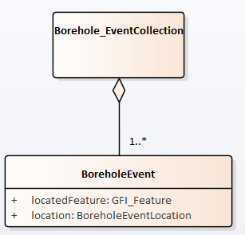
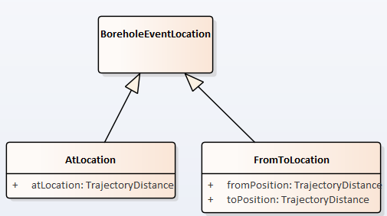
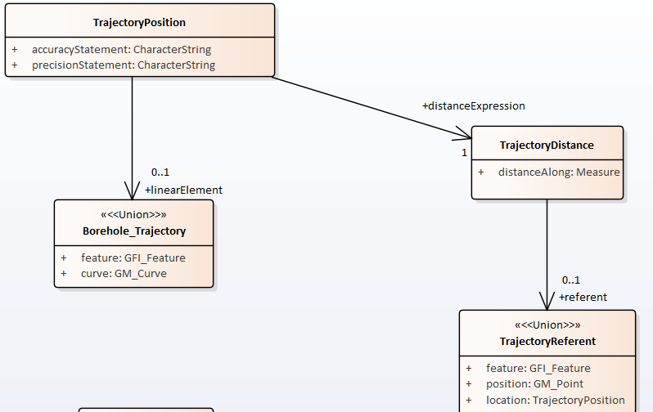
rev:10 model
1
2
3

Slide 19
rev:10 model
4
5

