Slide 1
BEETRUST / TRACK B / SP-A
Evidence first.
RELEASE
Release second.
100
/100
A local proof of collaborative Skills orchestration for a New Zealand MÄnuka honey export case.
local runtime evidence
Synthetic case / no external submission performed
01

Slide 2
01 / CASE
One shipment.
BASELINE GATES
Five gates.
Scientific fingerprint
PASS
Chain of custody
PASS
One decision.
MPI market access
PASS
Customs clearance
PASS
SYNTHETIC CASE
1,000 jars of New Zealand MÄnuka honey
Adversarial stress
PASS
Destination: Australia
RELEASE
100 / 100
BEETRUST / LOCAL E2E / 18 SEP 2026
02

Slide 3
02 / ORCHESTRATION
The workflow is a graph, not a chatbot
Parallel evidence roots merge into operational clearance, adversarial checks and final monitoring
01
Fingerprint
02
Custody
03
MPI access
lab reference check
hash-chain verification
destination rule snapshot
RUNTIME
3
PARALLEL ROOTS
04
Customs
05
Adversary
documents + landed cost
six controlled faults
10
DEPENDENCY EDGES
06
Monitor
4-stage critical path
release decision
BEETRUST / LOCAL E2E / 18 SEP 2026
03

Slide 4
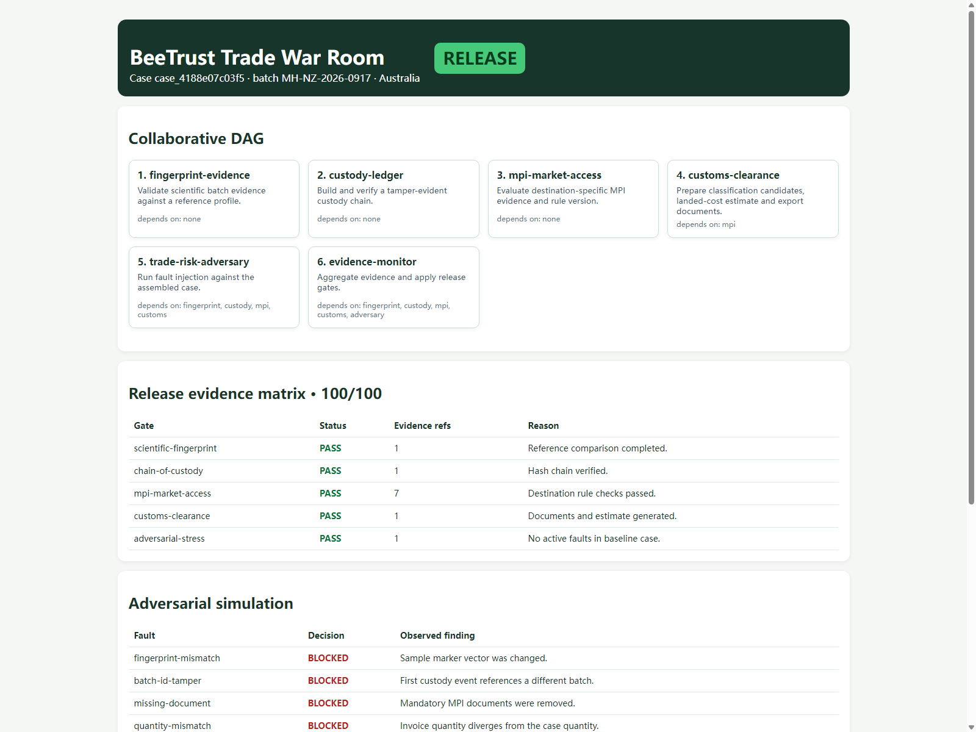
03 / RUNTIME PROOF
The proof is visible at runtime
Decision, orchestration and evidence appear together in the local dashboard.
RELEASE
100 / 100
5 gates PASS
All decision evidence is visible in one runtime view.
Screenshot: npm run demo
04

Slide 5
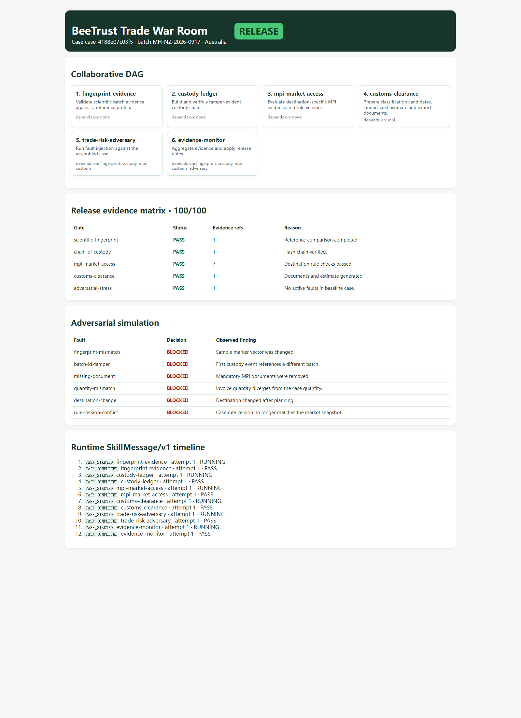
04 / ASSURANCE
Fail closed is part of the product
The adversarial stage injects faults after the operational outputs are assembled
6 / 6
faults blocked
Fingerprint mismatch
BLOCKED
Batch ID tamper
BLOCKED
Missing document
BLOCKED
Quantity mismatch
BLOCKED
Destination change
BLOCKED
Rule-version conflict
BLOCKED
12 runtime events / SkillMessage/v1
BEETRUST / LOCAL E2E / 18 SEP 2026
05

Slide 6
05 / HANDOFF
Judge-ready on one laptop
The local package is testable, repeatable and ready to demonstrate.
192
7
6
VERIFIED
Local package
Main pipeline
Red-team gates
Runtime dashboard
SELF-TESTS PASSED
SKILLS REGISTERED
RED-TEAM BLOCKS
RUN
npm run demo
npm run demo:live
OUT OF SCOPE
npm run acceptance
npm test
WorkHub / Wesome publication
Real shipment execution
Local demo evidence only / no external submission performed
06

