Slide 1
BEETRUST / TRACK B / SP-A
Can this shipment leave?
RELEASE
Evidence decides release.
100
/100
A 1,000-jar Mānuka honey shipment from New Zealand to Australia.
local runtime evidence
Synthetic case / no external submission performed
01

Slide 2
01 / CASE
One concrete question.
RELEASE GATES
Five checks.
Scientific fingerprint
PASS
Chain of custody
PASS
One auditable release.
MPI market access
PASS
Customs clearance
PASS
SYNTHETIC CASE
1,000 jars of New Zealand Mānuka honey
Adversarial stress
PASS
Destination: Australia
RELEASE
100 / 100
BEETRUST / LOCAL E2E / 19 SEP 2026
02

Slide 3
02 / ORCHESTRATION
One release decision, three visible moves
Confirm the batch → verify destination and customs → release or block
01
Confirm batch
02
Destination
03
Evidence pack
fingerprint + custody
MPI + customs
rules + docs + cost
RUNTIME
3
PARALLEL ROOTS
04
Stress test
05
Block anomalies
six controlled faults
stop on fact change
10
DEPENDENCY EDGES
06
Final release
4-stage critical path
broker decision
BEETRUST / LOCAL E2E / 19 SEP 2026
03

Slide 4
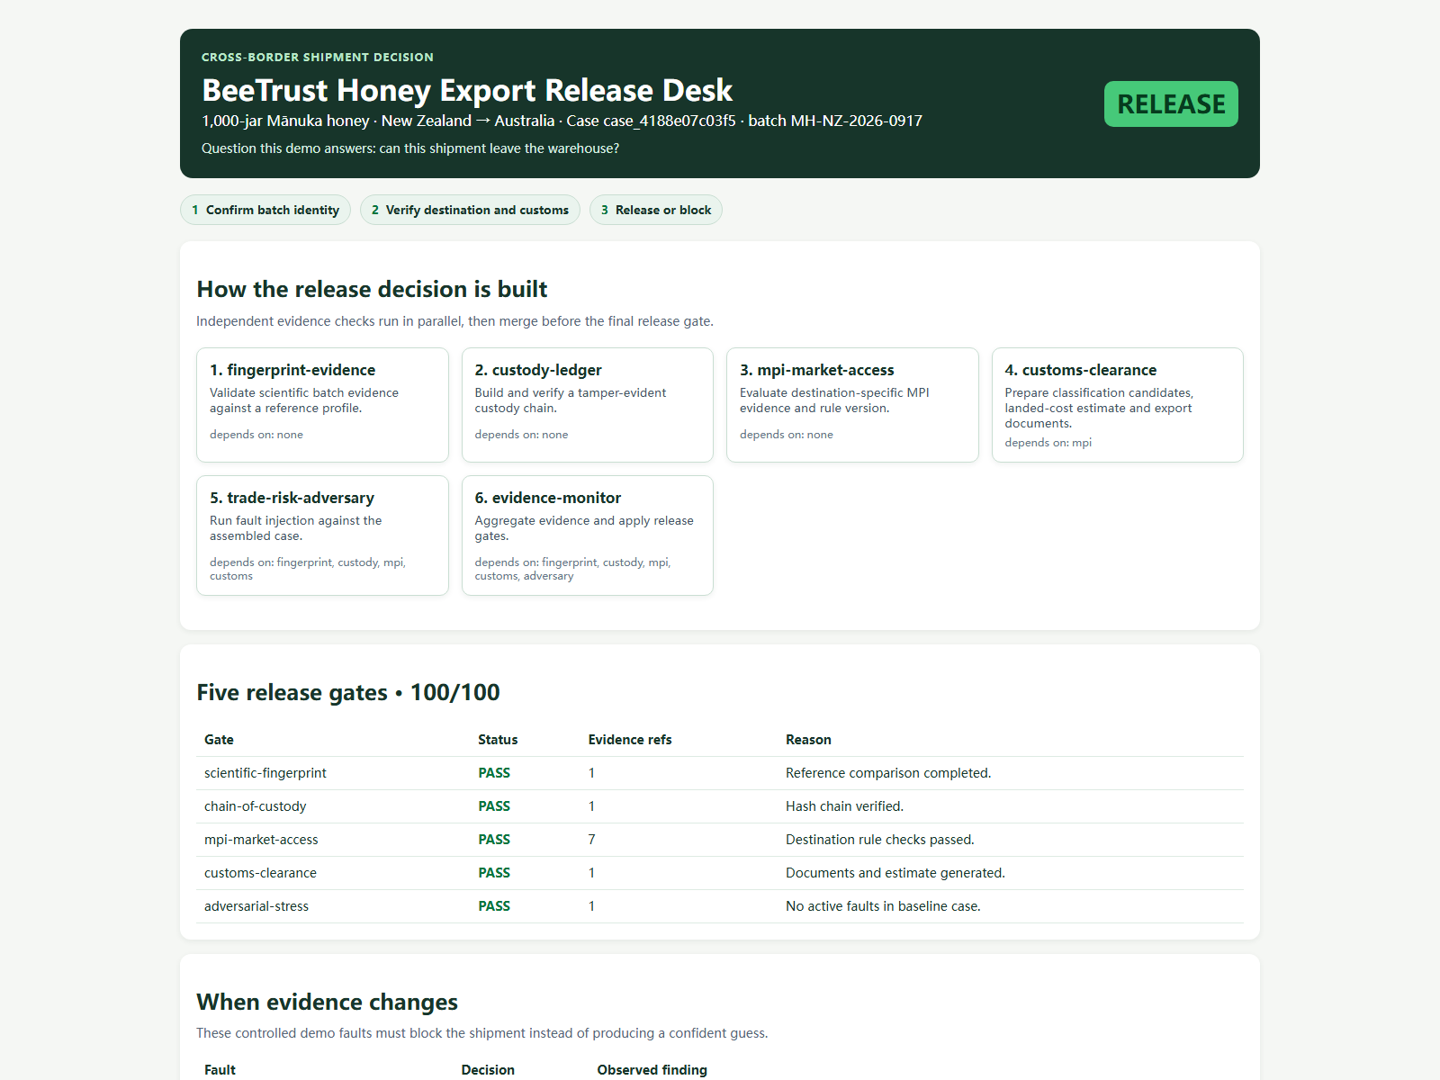
03 / RUNTIME PROOF
The page answers the business question
Runtime evidence explains why this shipment can be released.
RELEASE
100 / 100
5 gates PASS
Case, gates, faults and final decision in one view.
Screenshot: npm run demo
04

Slide 5
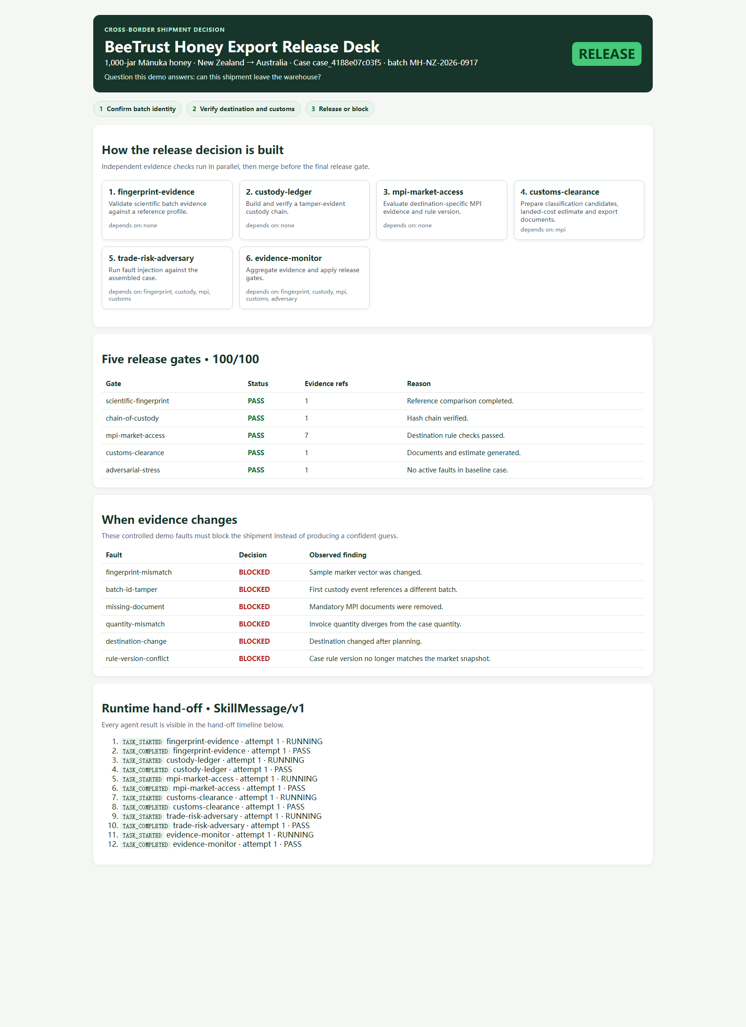
04 / ASSURANCE
When one fact changes, release stops
Inject six business-critical changes and make every one block the shipment
6 / 6
all faults blocked
Fingerprint mismatch
BLOCKED
Batch ID tamper
BLOCKED
Missing document
BLOCKED
Quantity mismatch
BLOCKED
Destination change
BLOCKED
Rule-version conflict
BLOCKED
12 runtime events / SkillMessage/v1
BEETRUST / LOCAL E2E / 19 SEP 2026
05

Slide 6
05 / HANDOFF
Explain one release decision in 90 seconds
Start with the shipment, follow the evidence, reach release or block.
192
7
6
VERIFIED
Local package
Main pipeline
Red-team gates
Runtime dashboard
SELF-TESTS PASSED
SKILLS REGISTERED
RED-TEAM BLOCKS
RUN
npm run demo
npm run demo:live
OUT OF SCOPE
npm run acceptance
npm test
WorkHub / Wesome publication
Real shipment execution
Local demo evidence only / no external submission performed
06

