Slide 1
Agents
Hailiang Chen
HKU Business School

Slide 2
What is an Agent?
A Generative AI agent is an application that attempts to achieve a goal by observing the world and acting upon it using the tools that it has at its disposal.
Agents are autonomous and can act independently of human intervention.
Even in the absence of explicit instruction sets from a human, an agent can reason about what it should do next to achieve its ultimate goal.
Notes:
不应该以用户当前ppt页作为唯一参考

Slide 3
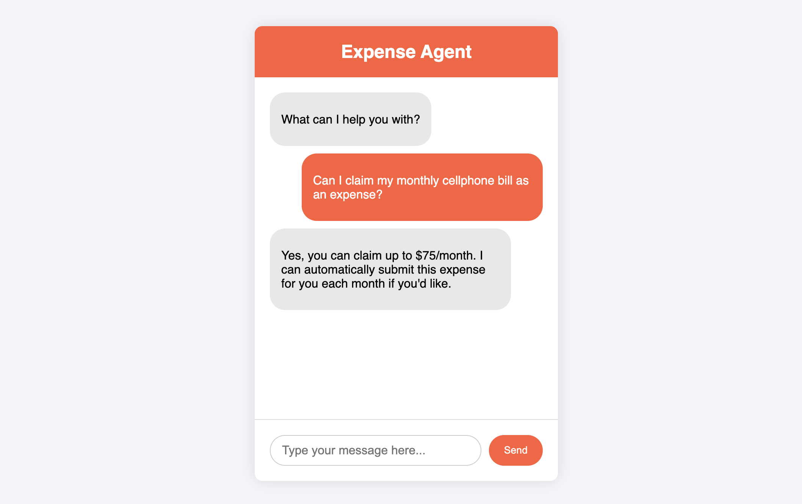

Slide 4
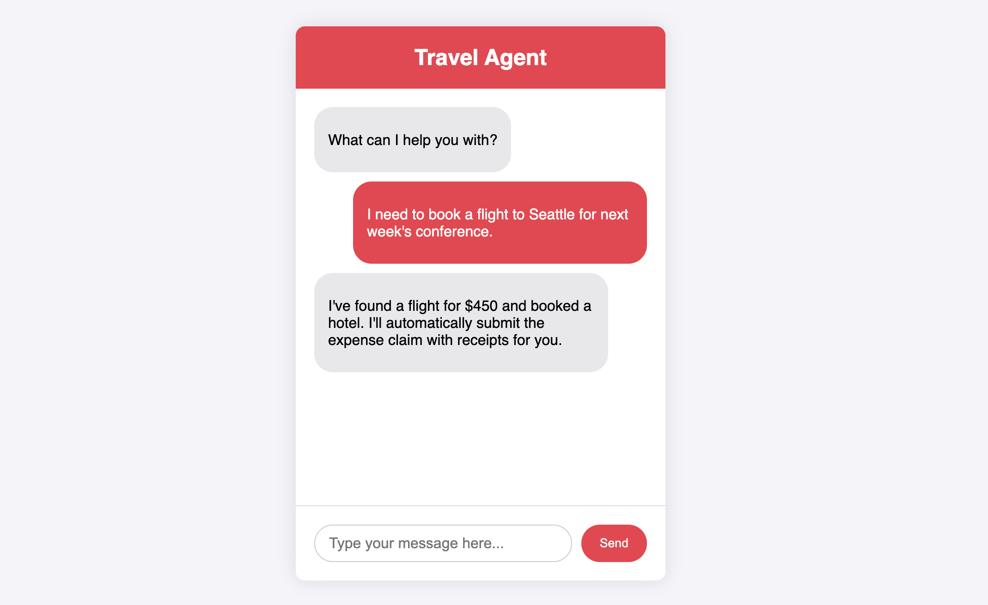

Slide 5
Model vs. Agent
Aspect | Model | Agent
Knowledge Scope | Limited to training data | Extended through external systems via tools
Inference and Prediction | Single inference based on user query, no management of session history | Managed session history for multi-turn inference
Tool Implementation | No native tool implementation | Tools natively implemented
Logic Layer | No native logic layer, relies on user prompts | Native cognitive architecture with reasoning frameworks like CoT and ReAct

Slide 6
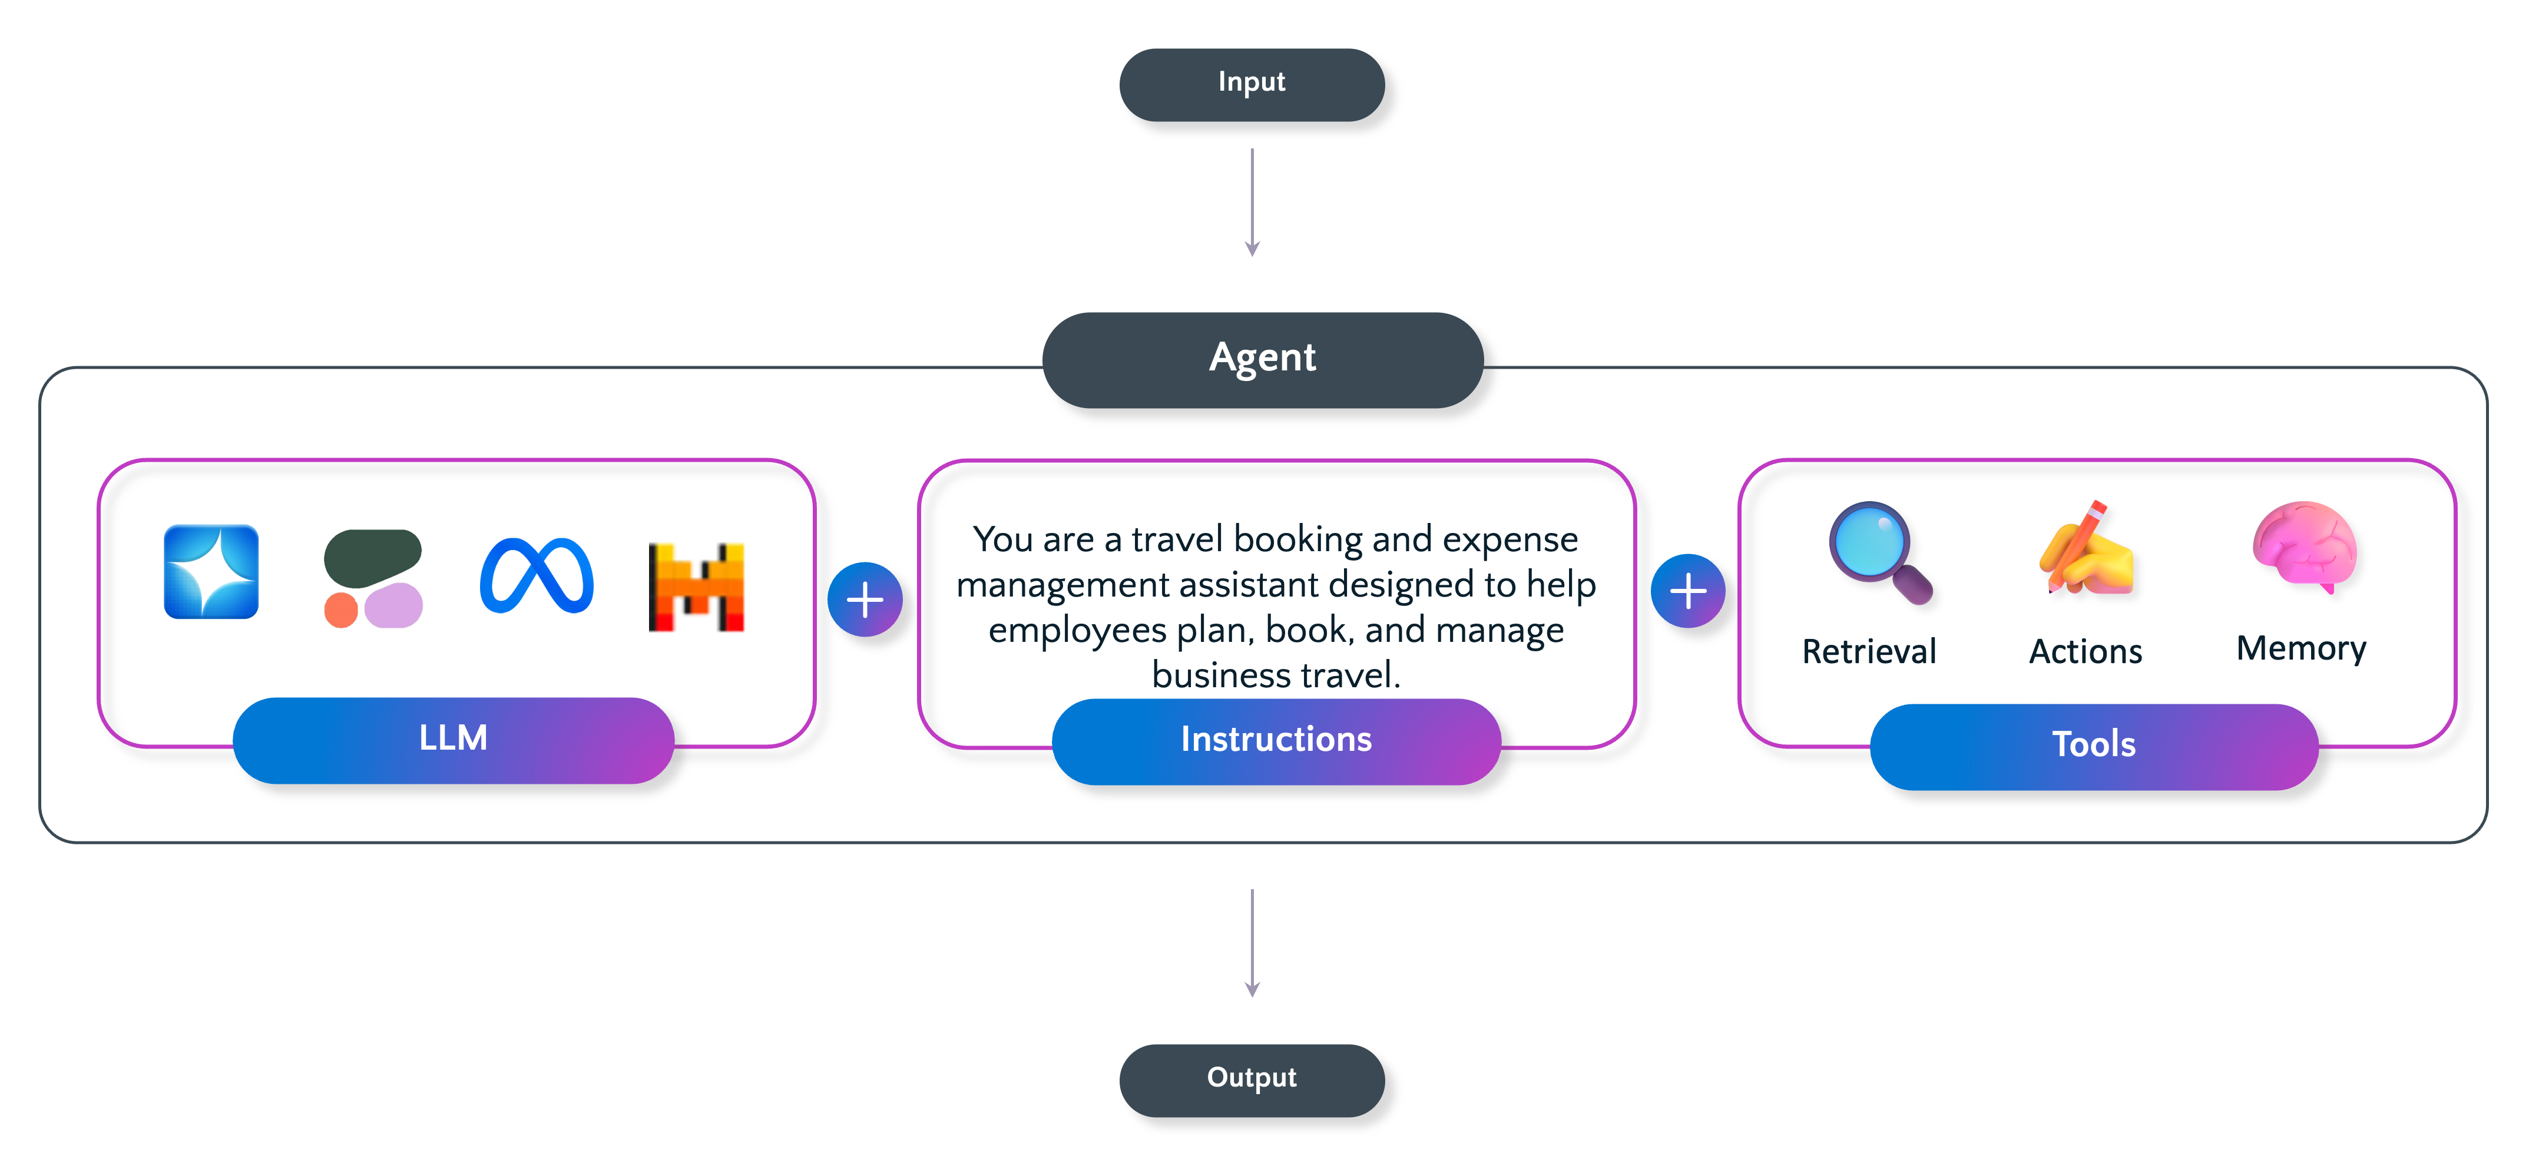
Agent

Slide 7
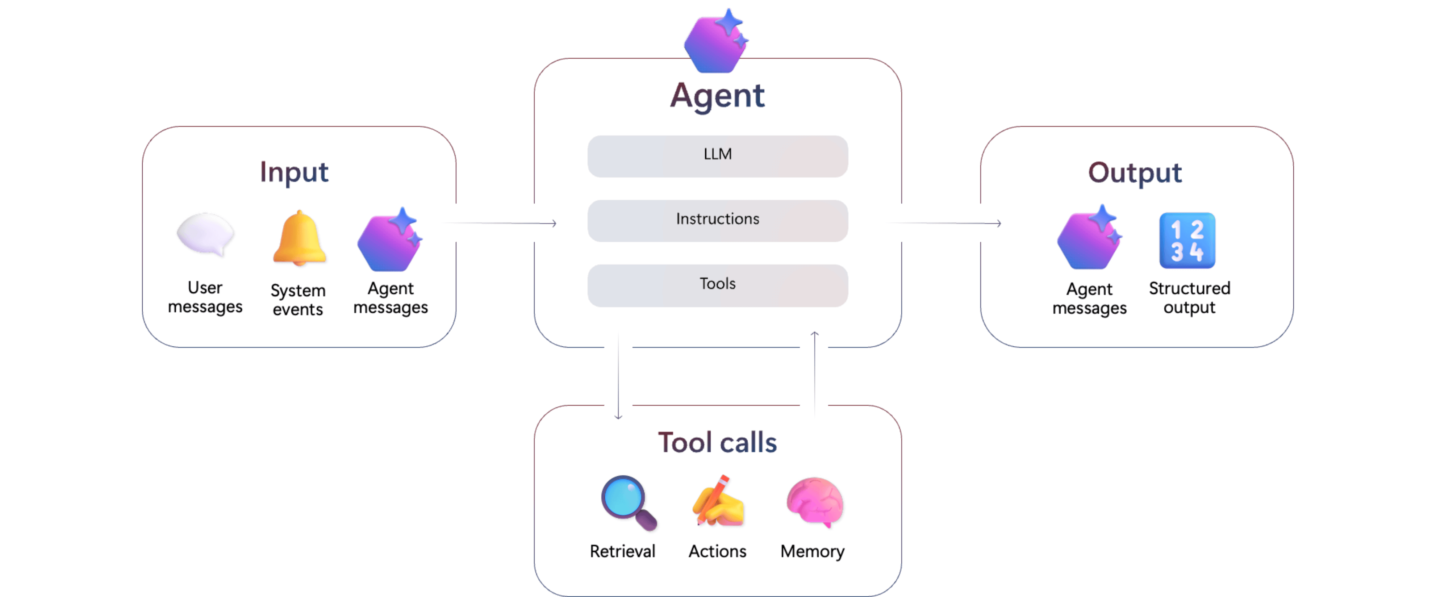
Agent

Slide 8
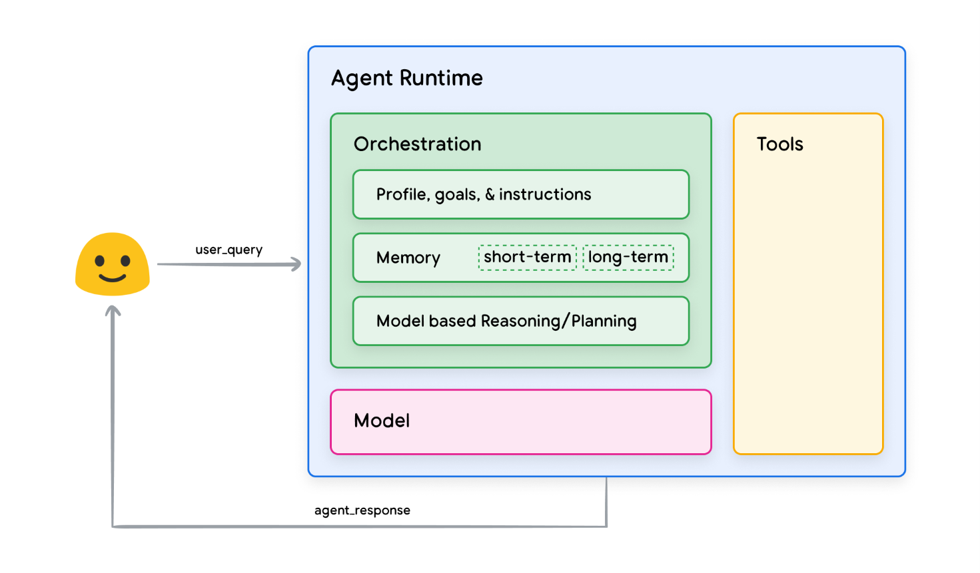
Agent Architecture and Components
Source: Google

Slide 9
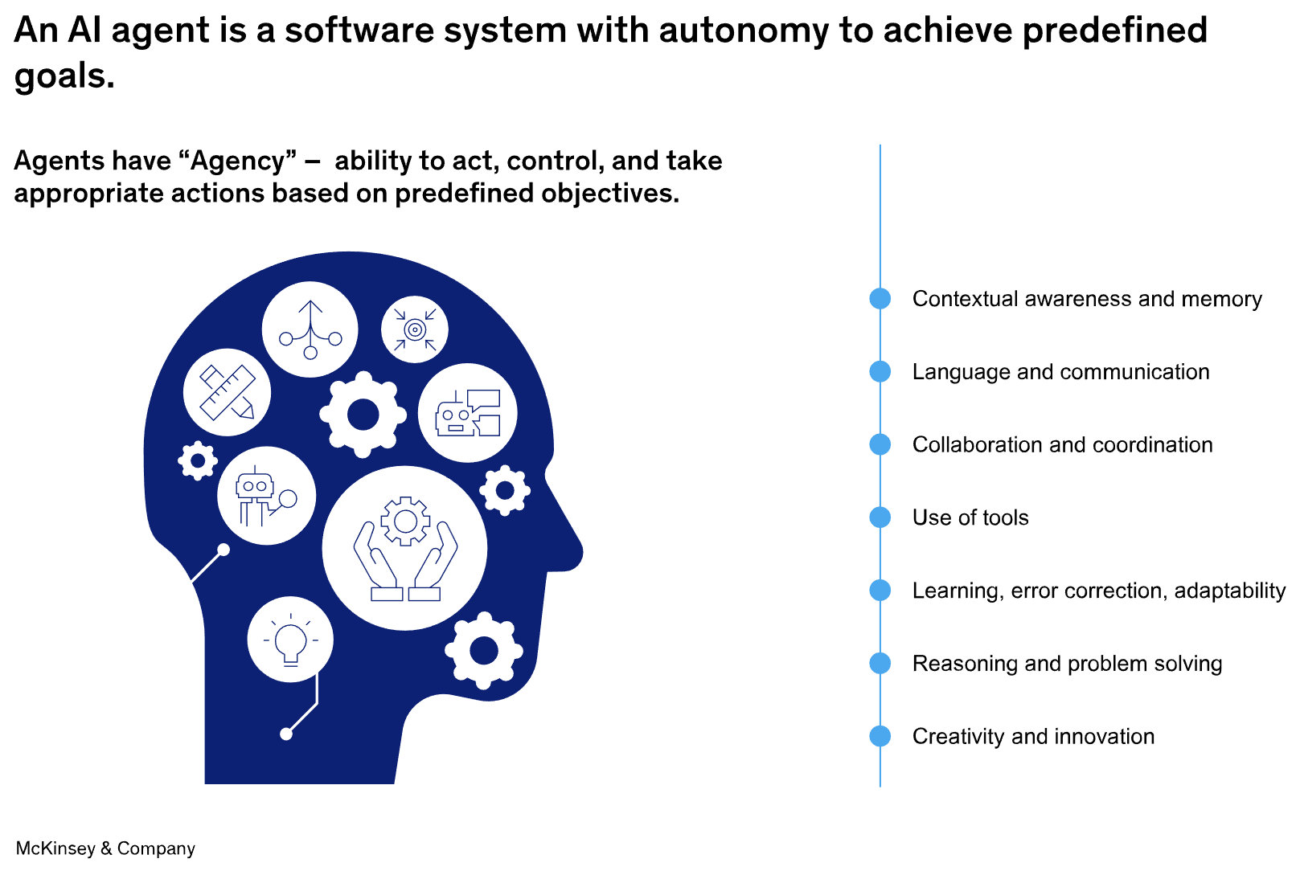

Slide 12
ReAct
Combines reasoning and acting for better decision-making.
Enhances LLMs by integrating logical reasoning with actions.
Improves response accuracy and relevance.
Two Components:
Reasoning: Logical inference and deduction.
Acting: Executing actions based on reasoning.

Slide 14
Tools
Function calling
Code interpreter
File search (simple RAG with user-uploaded files)
Azure AI search (existing AI search index)
Web search
Grounding with Bing Search
Grounding with Bing Custom Search (selected web domains)
Model Context Protocol (MCP)

Slide 15
Tool support by region and model
https://learn.microsoft.com/en-us/azure/foundry/agents/concepts/tool-best-practice#tool-support-by-region-and-model
Code Interpreter NOT available in japaneast, southcentralus, southeastasia, spaincentra
Computer Use ONLY available in eastus2, southindia, swedencentral
Function NOT available in brazilsouth, northcentralus, southcentralus, westus

Slide 16
Agent: Function Calling
Programs:
agent_function_calling.py
agent_function_calling_v2.py
Create and use an agent with three functions

Slide 17
DefaultAzureCredential() | AzureCliCredential()
Register on Azure Portal with your HKU email address
Install Azure Command-Line Interface (CLI) on your computer
https://learn.microsoft.com/en-us/cli/azure/?view=azure-cli-latest
Run az login to login with your hku email address and select the subscription associated with the Foundry project (see next slide)
https://learn.microsoft.com/en-us/cli/azure/get-started-with-azure-cli?view=azure-cli-latest
Update the four environment variables starting with “FOUNDRY_PROJECT_” in the .env file based on the Foundry project
FOUNDRY_PROJECT_ENDPOINT=https://applied-llm-resource.services.ai.azure.com/api/projects/tai-man-chan-project

Slide 18
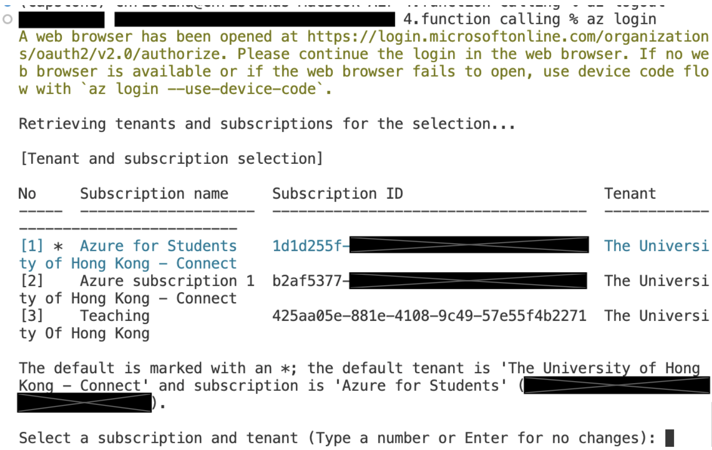
Select 3 (Subscription name=Teaching) when running az login

Slide 19
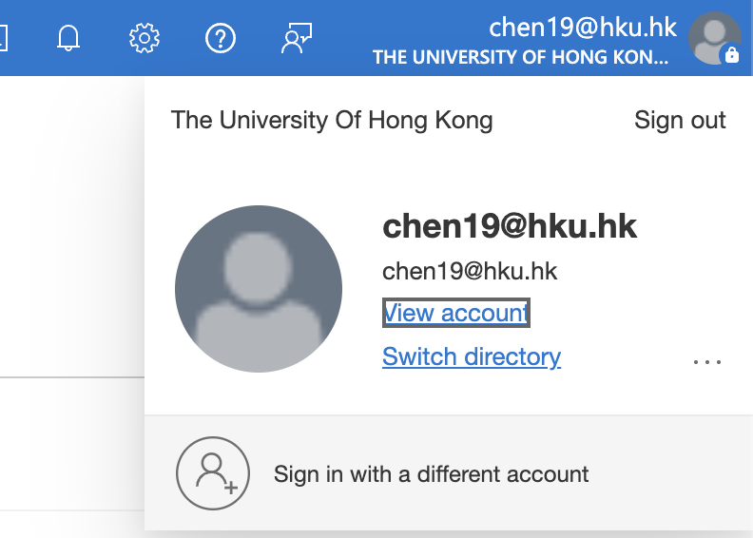
Switch Directory in Azure

Slide 21
Agent with Code Interpreter
Programs: agent_code_interpreter_airbnb.py (simple version) and agent_code_interpreter.py (more streamlined)
Create an agent with Code Interpreter
Use an existing agent for data analysis

Slide 22
Case Study: Movie DB Agent
Agent Capabilities
Function Tool
Code Interpreter Tool
Building Bocks / Code Examples:
agent_function_calling.py
agent_code_interpreter.py
function_call_db.py (from Lecture 4)
Programs written by GitHub Copilot
agent_function_call_db.py
agent_function_call_db_streamlit.py

Slide 24
RAG Agent with File Search
Programs
agent_file_search.py: create a new agent by uploading a file
agent_file_search2.py: use an existing agent
allm-course-agent based on data/Course Introduction.pptx

Slide 25
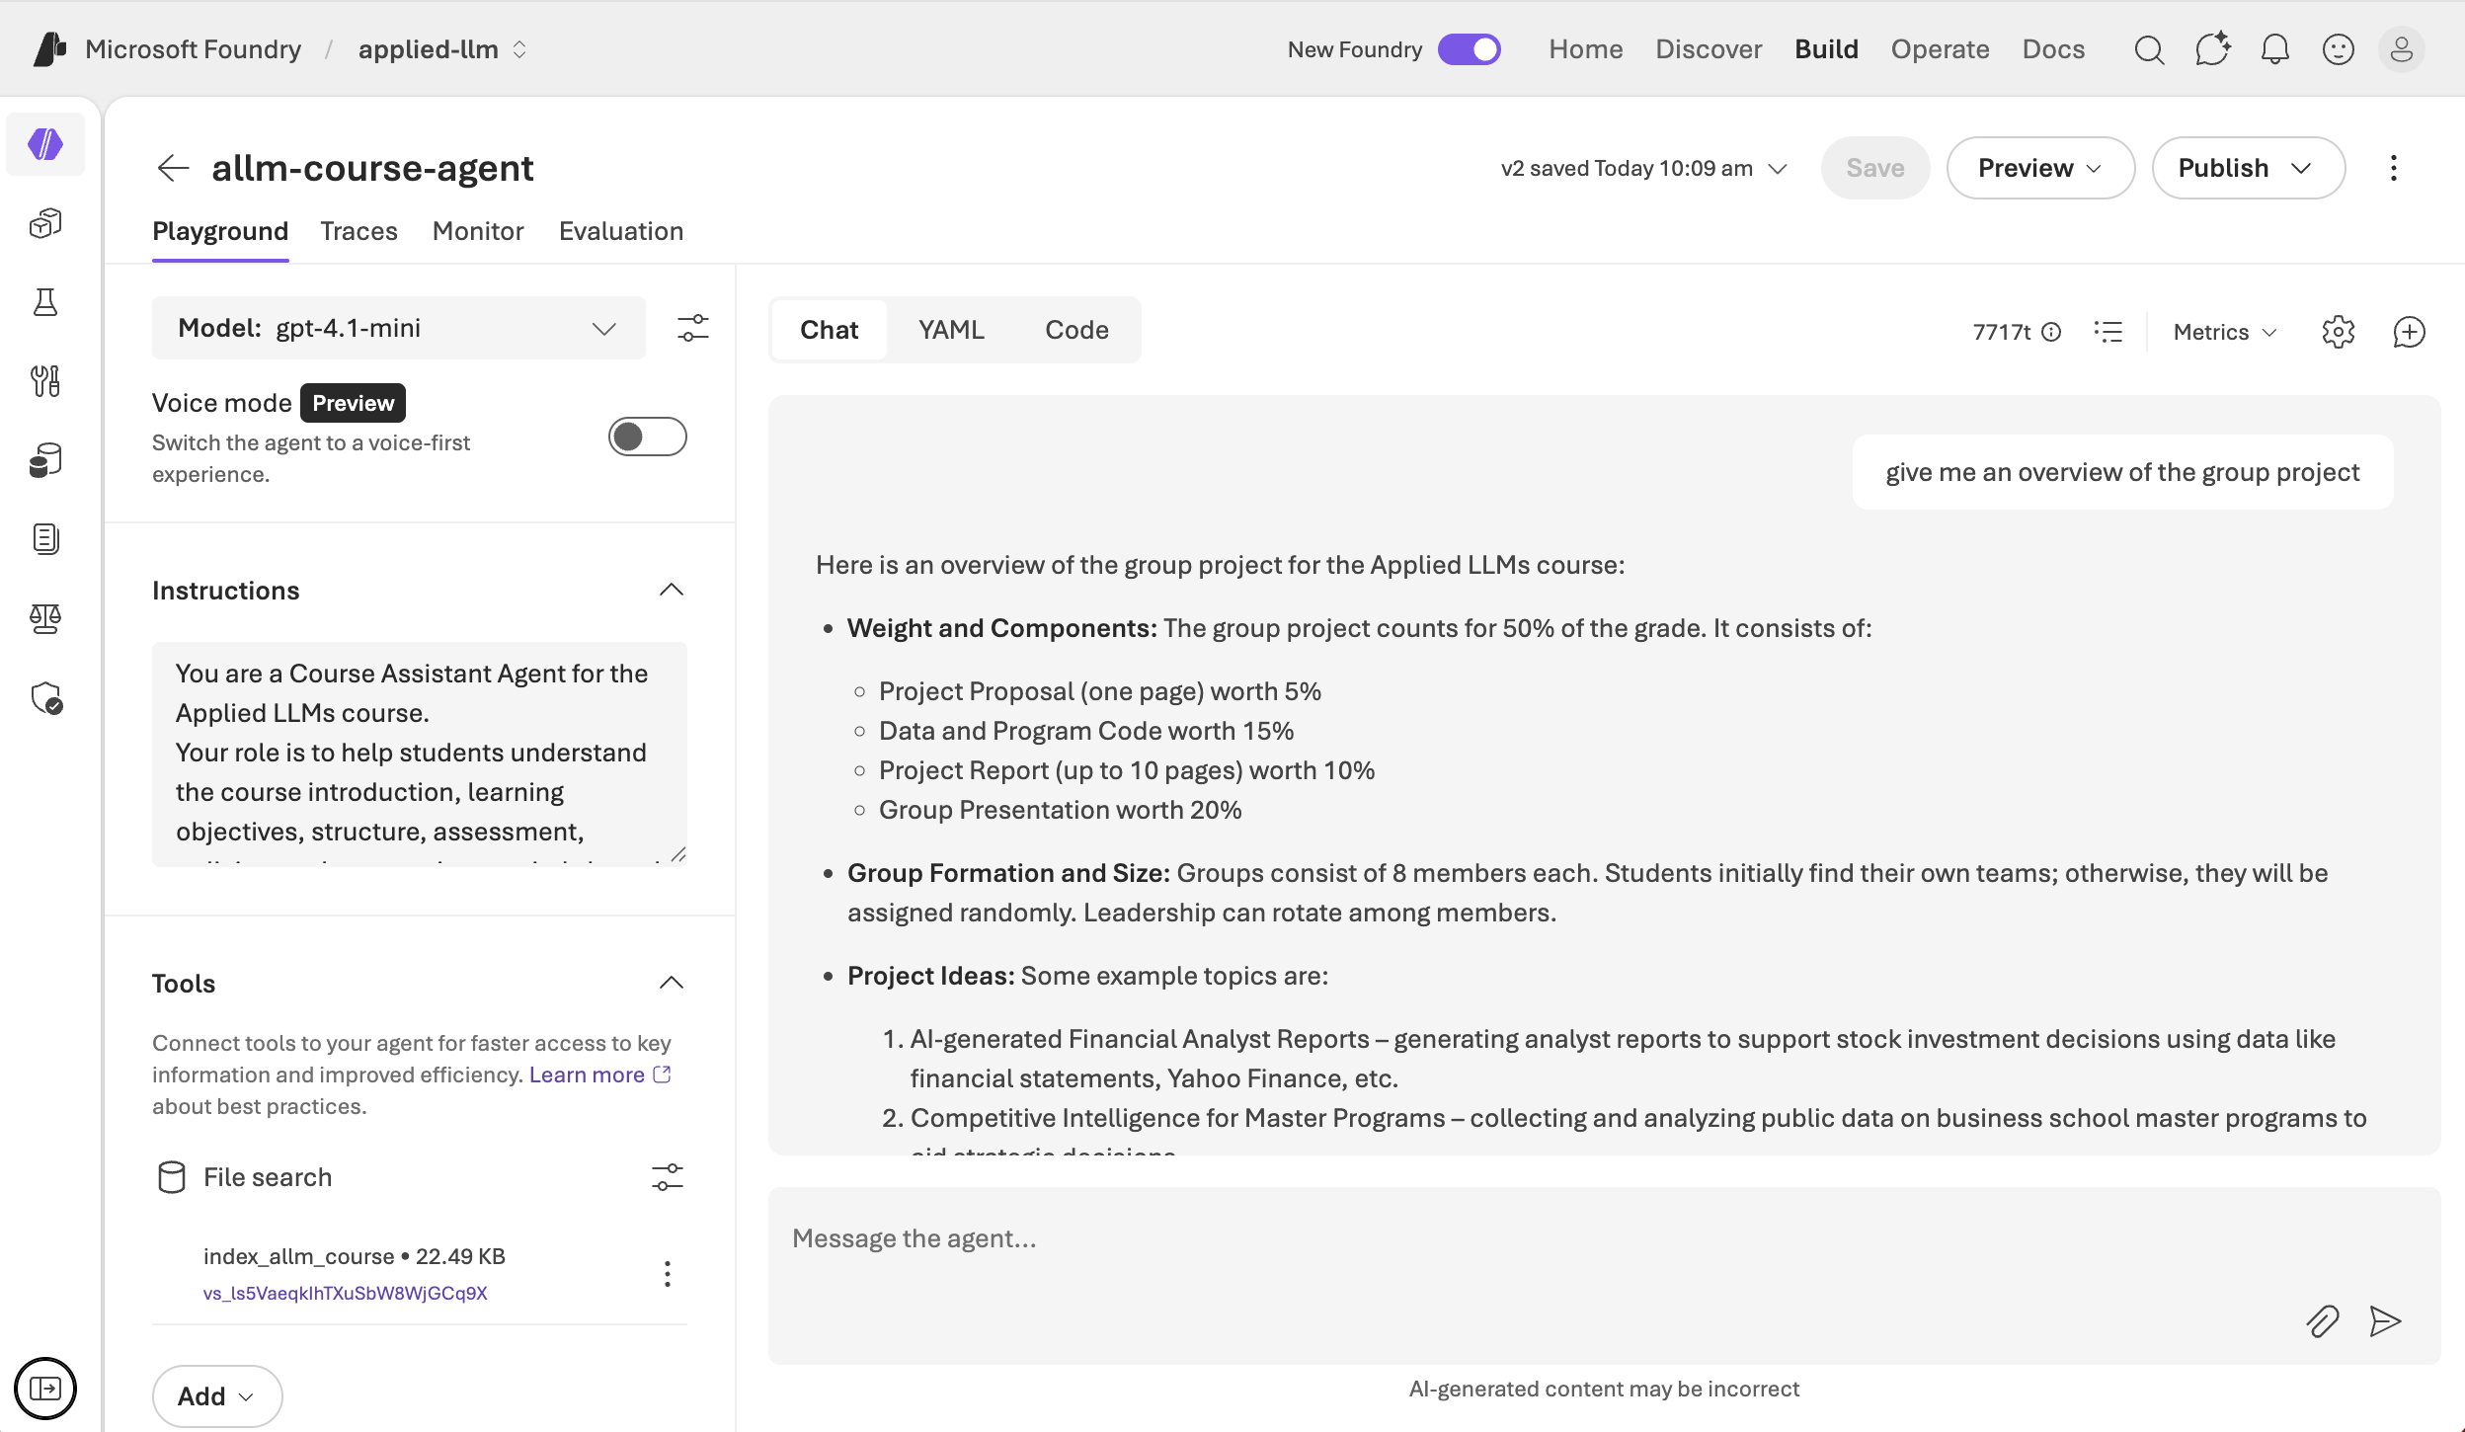
allm-course-agent Web Interface

Slide 26
RAG Agent with Web Search
Foundry Agents
web-search-agent: agent_web_search.py
bing-search-agent
bing-custom-search-agent

Slide 27
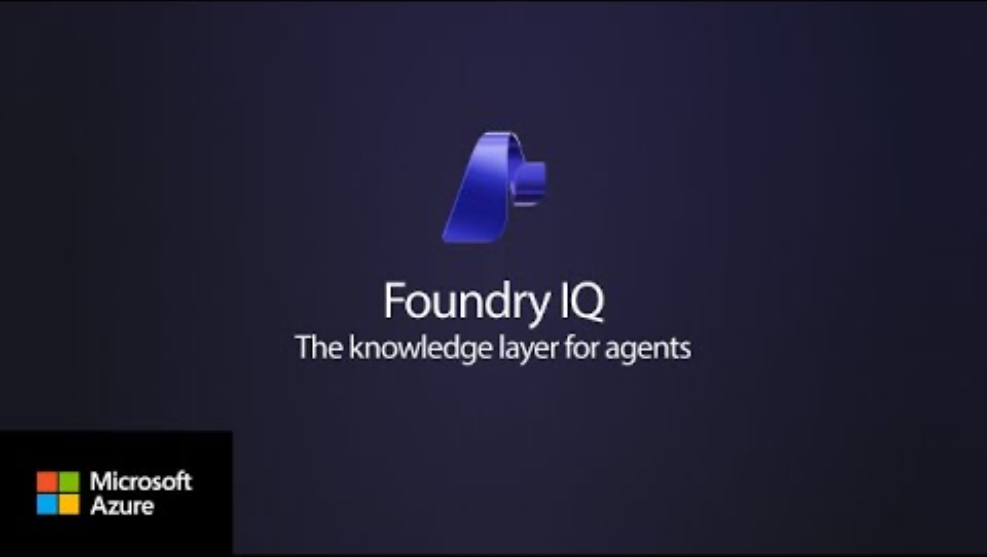
Foundry IQ

Slide 28
Agent with Foundry IQ
Azure AI Search service
Azure Storage account (Azure Blob Storage)
Program: agent_foundry_iq.py

Slide 30
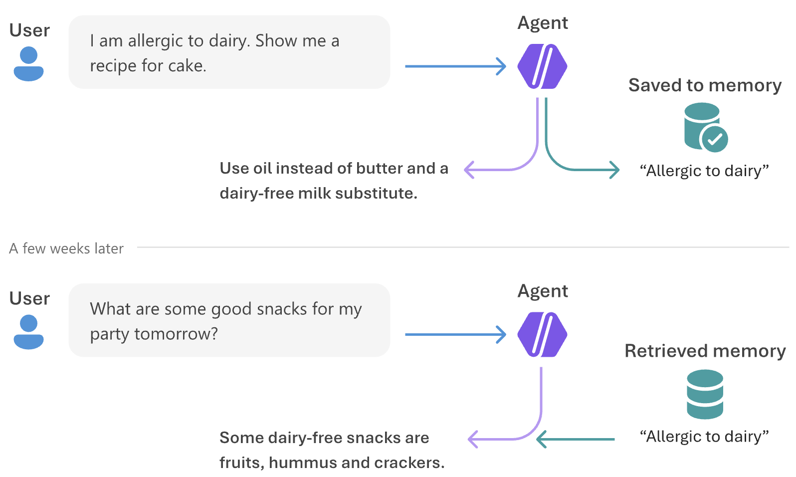
How Memory Works
Notes:
https://learn.microsoft.com/en-us/azure/foundry/agents/concepts/what-is-memory
https://learn.microsoft.com/en-us/azure/foundry/agents/how-to/memory-usage?tabs=bash&pivots=python

Slide 31
Two Types of Long-term Memory
Type | Description
User profile memory | Information and preferences about the user, such as preferred name, dietary restrictions, and language preference. These memories are considered "static" with respect to a conversation because they generally don't depend on the current chat context. Retrieve user profile memories once at the beginning of each conversation.
Chat summary memory | A distilled summary of each topic or thread covered in a chat session. These memories allow users to continue conversations or reference prior sessions without repeating earlier context. Retrieve chat summary memories based on the current conversation to surface relevant threads.

Slide 32
Memory Use Cases
A customer support agent that remembers your name, previous issues and resolutions, ticket numbers, and your preferred contact method (chat, email, or call back). This memory helps you avoid repeating information, so conversations are more efficient and satisfying.
A personal shopping assistant that remembers your size in specific brands, preferred colors, past returns, and recent purchases. The agent can suggest relevant items as soon as you start a session and avoid recommending products you already own.
A travel agent that knows your flight preferences (window or aisle), seat selections, food choices, nonstop versus connecting flights, loyalty programs, and feedback from past trips. The agent uses this information to quickly build an optimized itinerary.

Slide 34
Security Risks of AI Agents
What you might experience | Risk area | What's happening
"The agent just shared confidential salary data in a customer chat!" | Data leakage and privacy exposure | The agent accessed sensitive information but lacked proper controls to prevent exposing it externally.
"Someone tricked the agent into revealing our database password." | Prompt injection and manipulation attacks | A malicious user crafted an input that overrode the agent's intended behavior.
"Our support agent is now deleting customer records—but it shouldn't have that permission!" | Unauthorized access and privilege escalation | Weak access controls allowed the agent to perform actions beyond its intended scope.
"The agent started recommending fraudulent products after we updated the training data." | Data poisoning | Someone corrupted the agent's training or contextual data, causing unsafe outputs.

Slide 35
Security Risks of AI Agents
What you might experience | Risk area | What's happening
"A third-party plugin we integrated is now sending our data to an unknown server." | Supply chain vulnerabilities | External dependencies introduced security vulnerabilities into the agent's workflow.
"The agent automatically processed a refund without verifying the request." | Over-reliance on autonomous actions | The agent executed an action without proper validation or human oversight.
"We can't figure out who accessed what data or when." | Inadequate auditability and logging | Missing or incomplete logs make it impossible to trace agent actions or detect misuse.
"Someone extracted customer information by repeatedly querying the agent." | Model inversion and output leakage | The attacker exploited model outputs to infer sensitive data from training or prompting.

Slide 36
Security Best Practices
Security Practice | What to Do | Why It Matters
Tight Access Control | Enforce role‑based access control (RBAC) and least‑privilege permissions | Limits damage if an agent is compromised
Input Validation | Apply prompt filtering and validation to all inputs | Prevents prompt injection and malicious instructions
Human Oversight | Gate high‑risk or sensitive actions with human‑in‑the‑loop approval | Avoids autonomous high‑stakes mistakes
Comprehensive Logging | Log all agent actions with timestamps, actors, and rationale | Enables auditing, debugging, and accountability
Supply Chain Monitoring | Regularly audit third‑party APIs, plugins, and tools | External dependencies are common attack vectors
Model Maintenance | Retrain and validate models to detect drift or poisoning | Maintains reliability and prevents silent degradation

