Slide 1
Retrieval-Augmented Generation
Hailiang Chen
HKU Business School
The University of Hong Kong

Slide 2
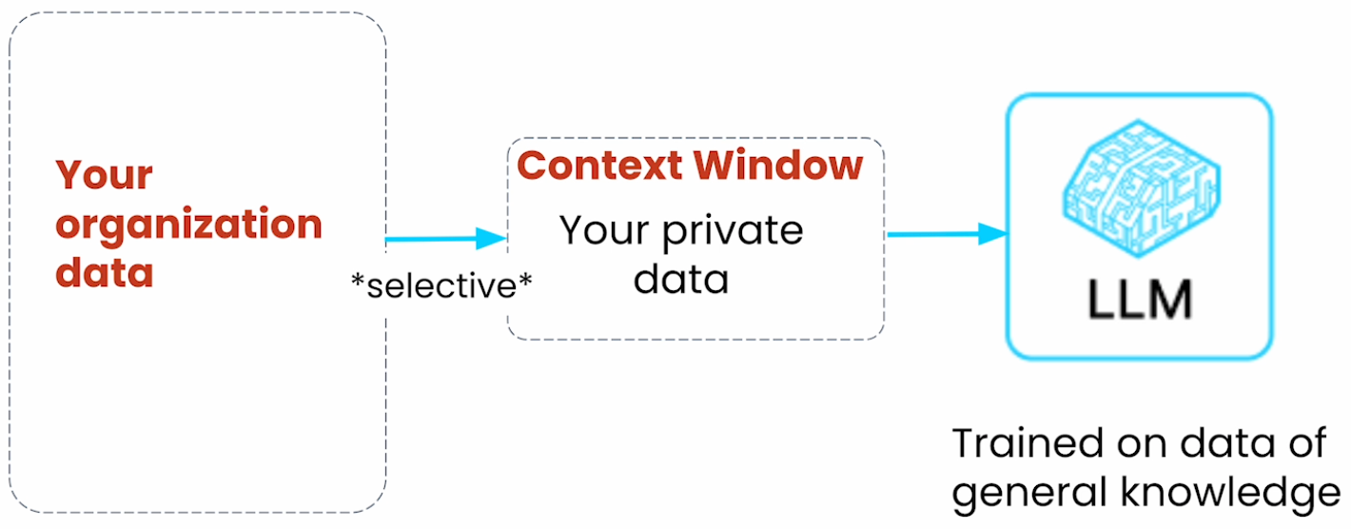
Limitations of LLMs
Trained on general public data
Frequent hallucinations
Limited context window for private data
Image Source: DeepLearning.AI and LlamaIndex

Slide 3
Why RAG?
Information richness: ensures text responses are up to date and relevant. It, therefore, enhances performance on domain specific tasks by accessing the internal knowledge base.
Reduces fabrication or hallucination by utilizing verifiable data in the knowledge base to provide context to the user queries.
It is cost effective as they are more economical compared to fine-tuning an LLM.

Slide 4
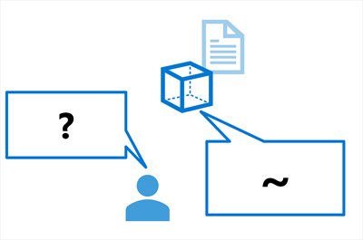
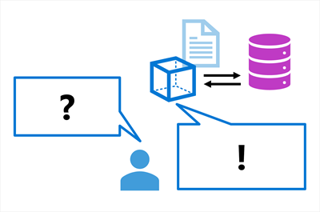
Grounding
Ungrounded
Grounded

Slide 5
Retrieval-Augmented Generation (RAG)
Create Query: Generate a query based on the user's input.
Perform Search: Use the query to search for relevant information in the knowledge base (e.g., database, Internet, vector store).
Extract Information: Extract relevant content from the search results.
Context Integration: Use the extracted information as context for generating an answer.
Generate Answer: The large language model combines the context and user input to produce a response.

Slide 6
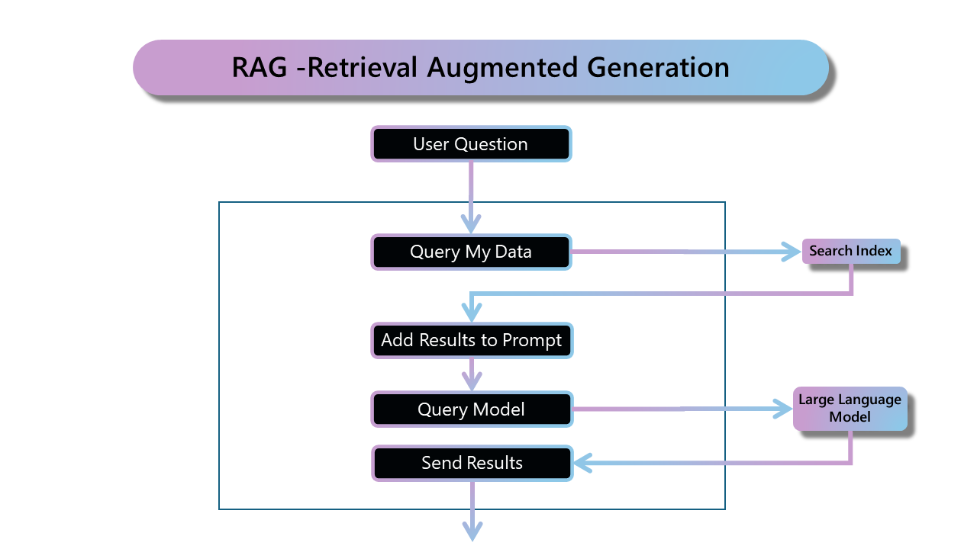
Source: Microsoft Azure
Notes:
https://github.com/Azure/GPT-RAG/blob/main/docs/RAG_CONCEPTS.md

Slide 7
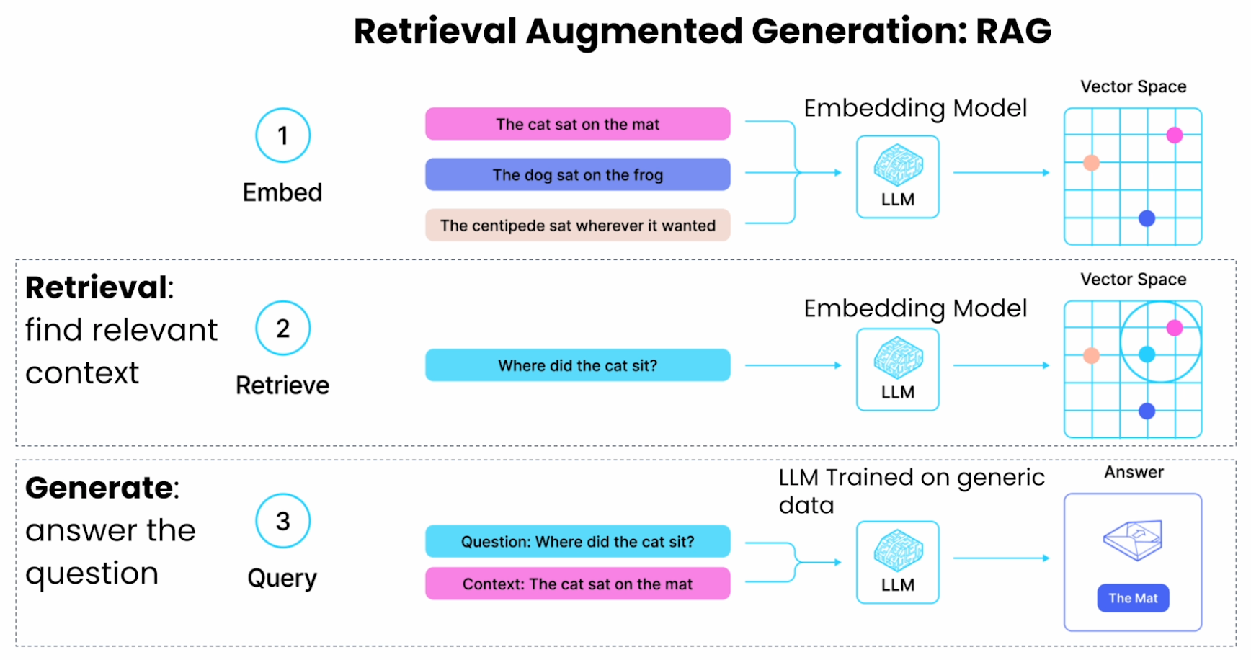
Source: DeepLearning.AI and LlamaIndex

Slide 8
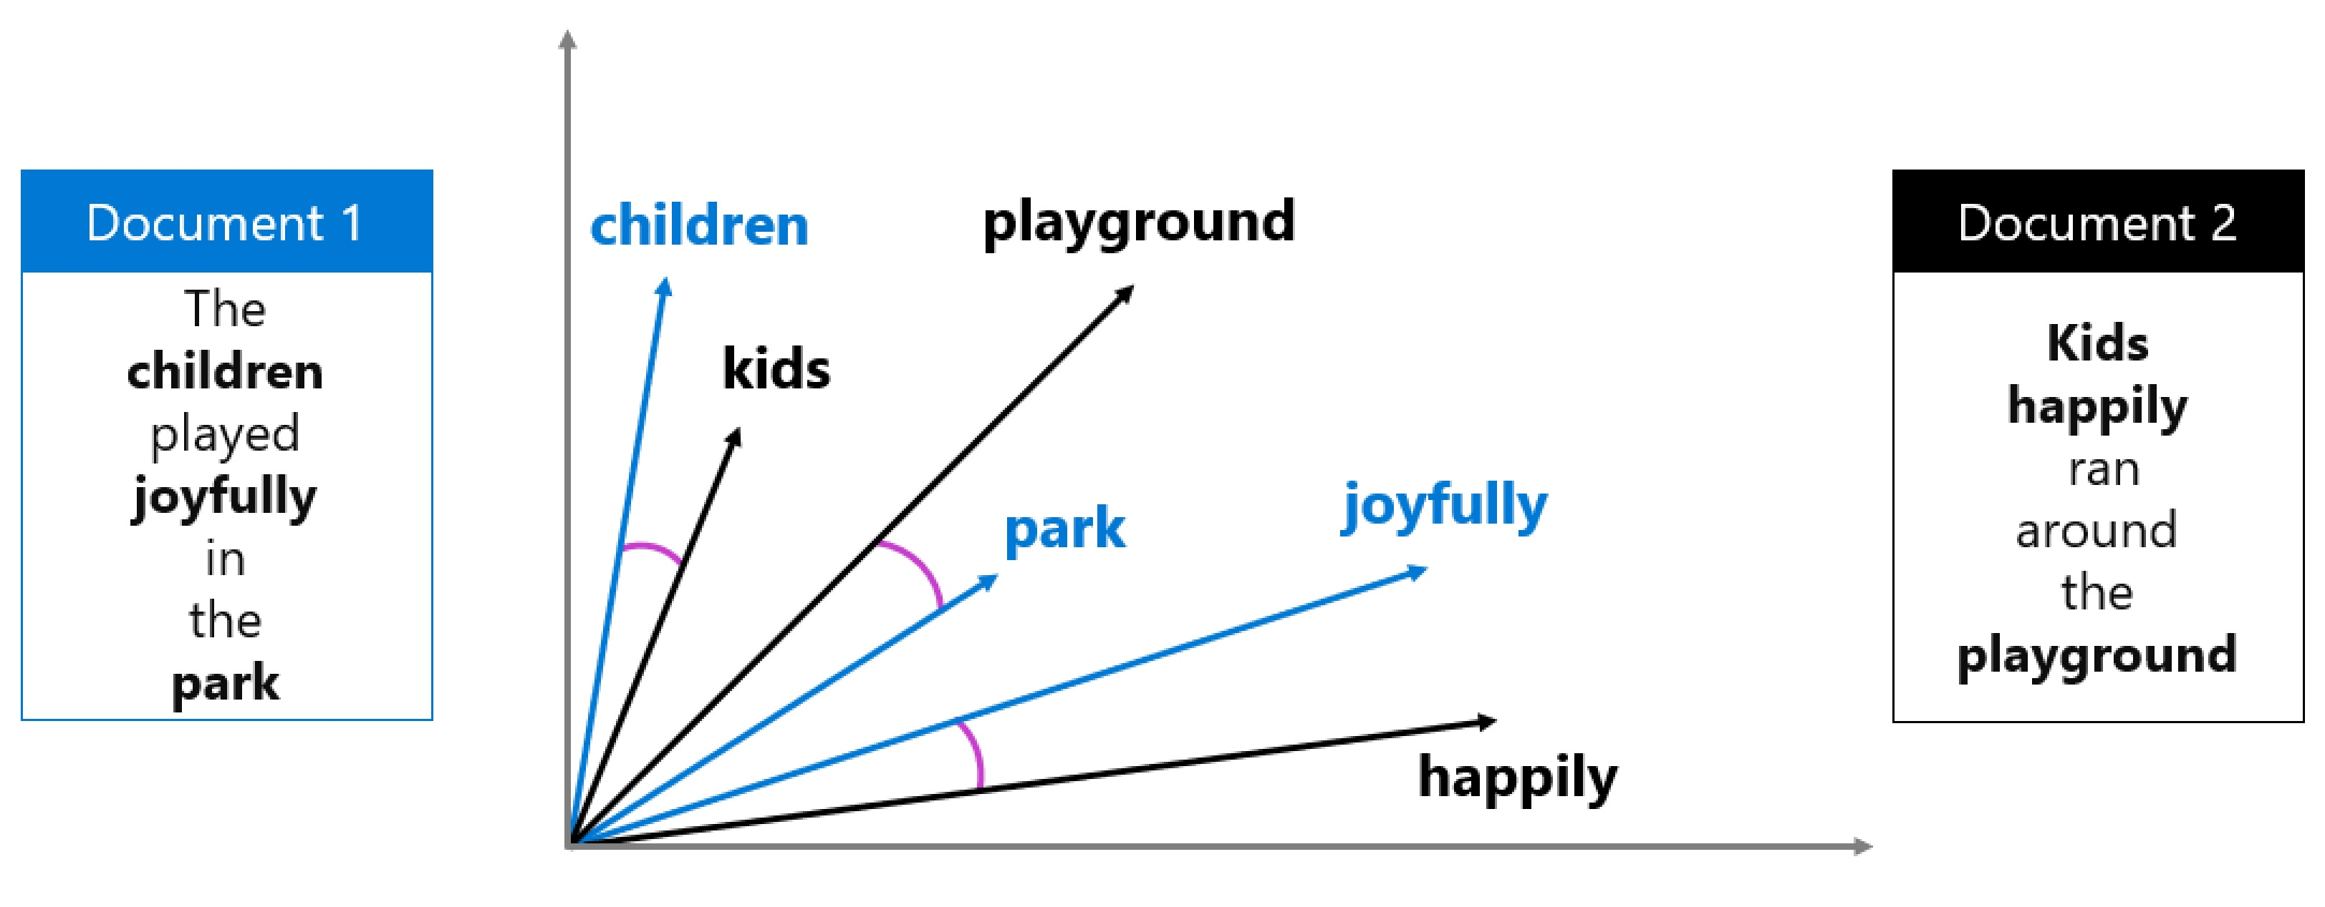
An embedding is a mathematical representation of text as a vector — a list of floating-point numbers that captures the meaning of words, sentences, or documents.

Slide 9
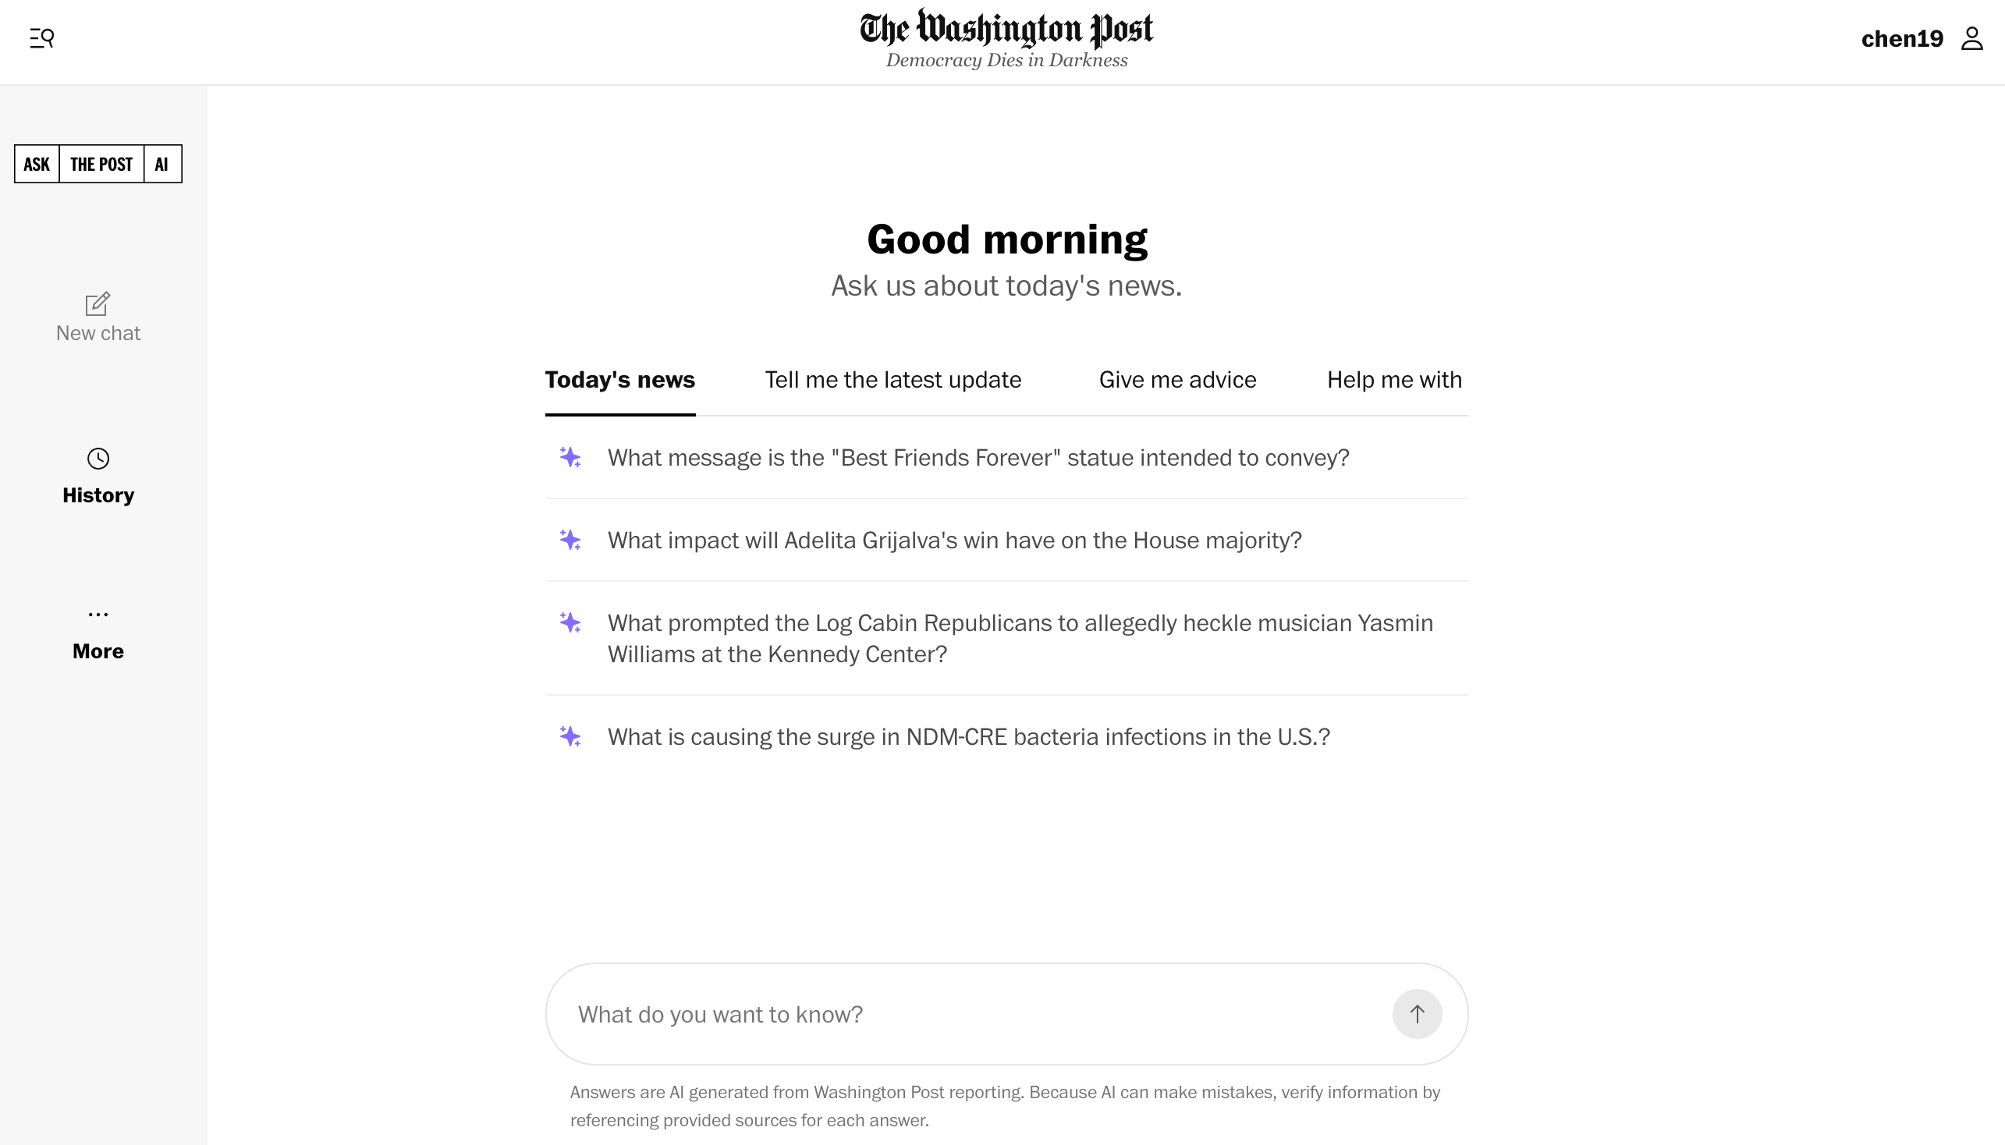

Slide 10

The Washington Post

Slide 11
Policy and Regulation Chatbot
http://47.113.119.241/ (demo site only; may go offline without notice)
Report: http://hlchen.com/doc/rag.pdf
Knowledge Base: Over 15K government documents, including laws, administrative regulations, recent policies, policy interpretations, and departmental public information.

Slide 12
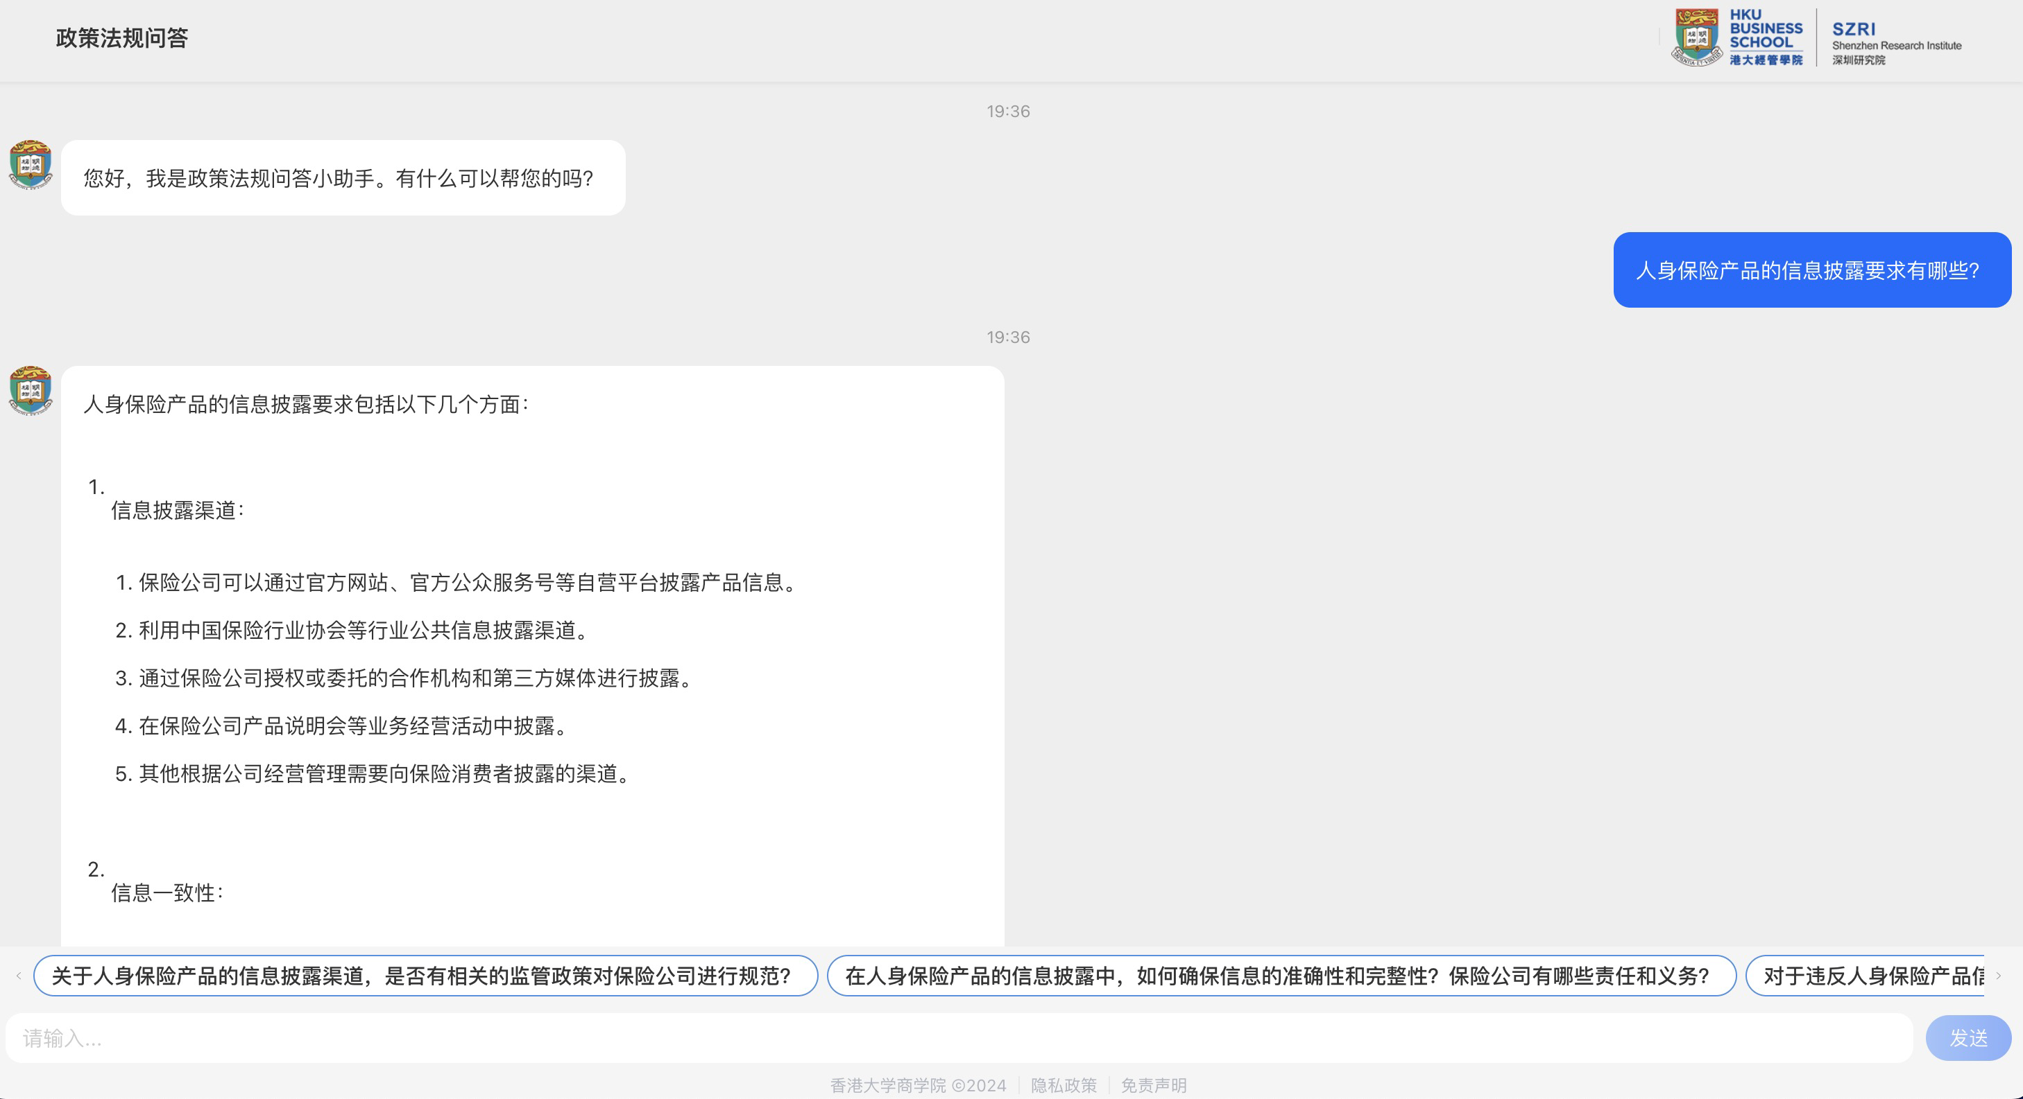

Slide 13
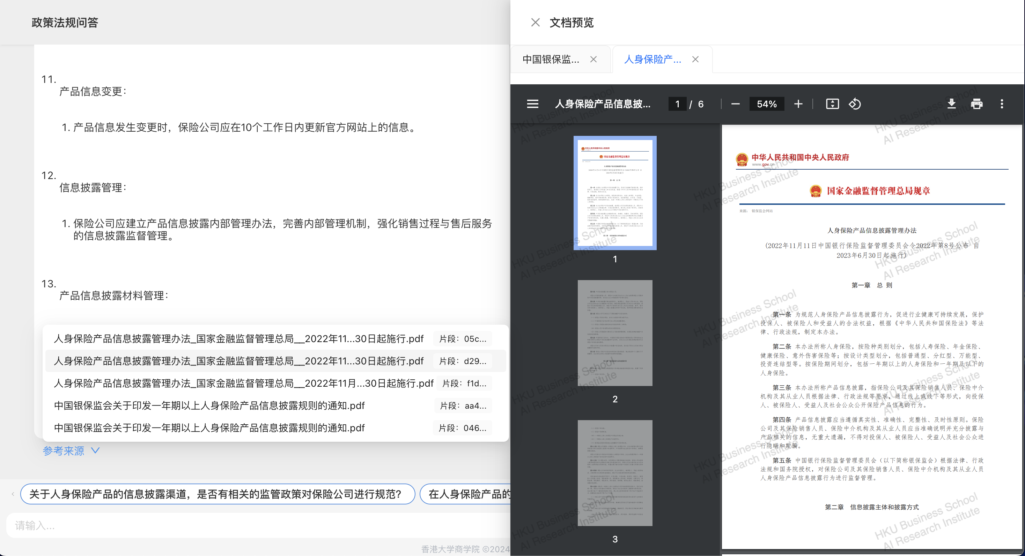

Slide 14
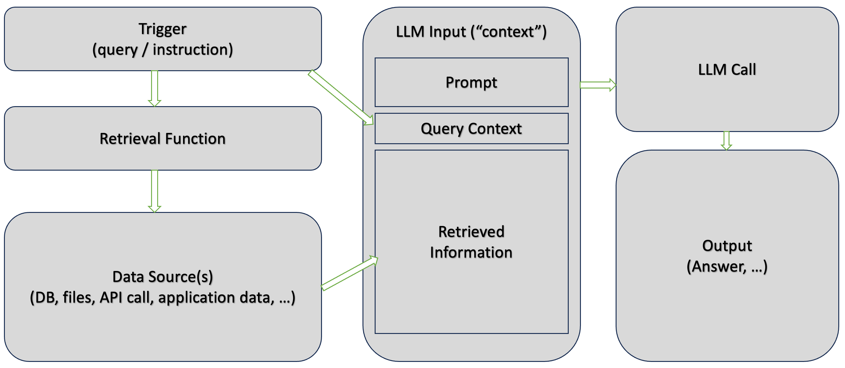
?
Source: Microsoft Tech Community
Notes:
https://techcommunity.microsoft.com/blog/fasttrackforazureblog/grounding-llms/3843857

Slide 15
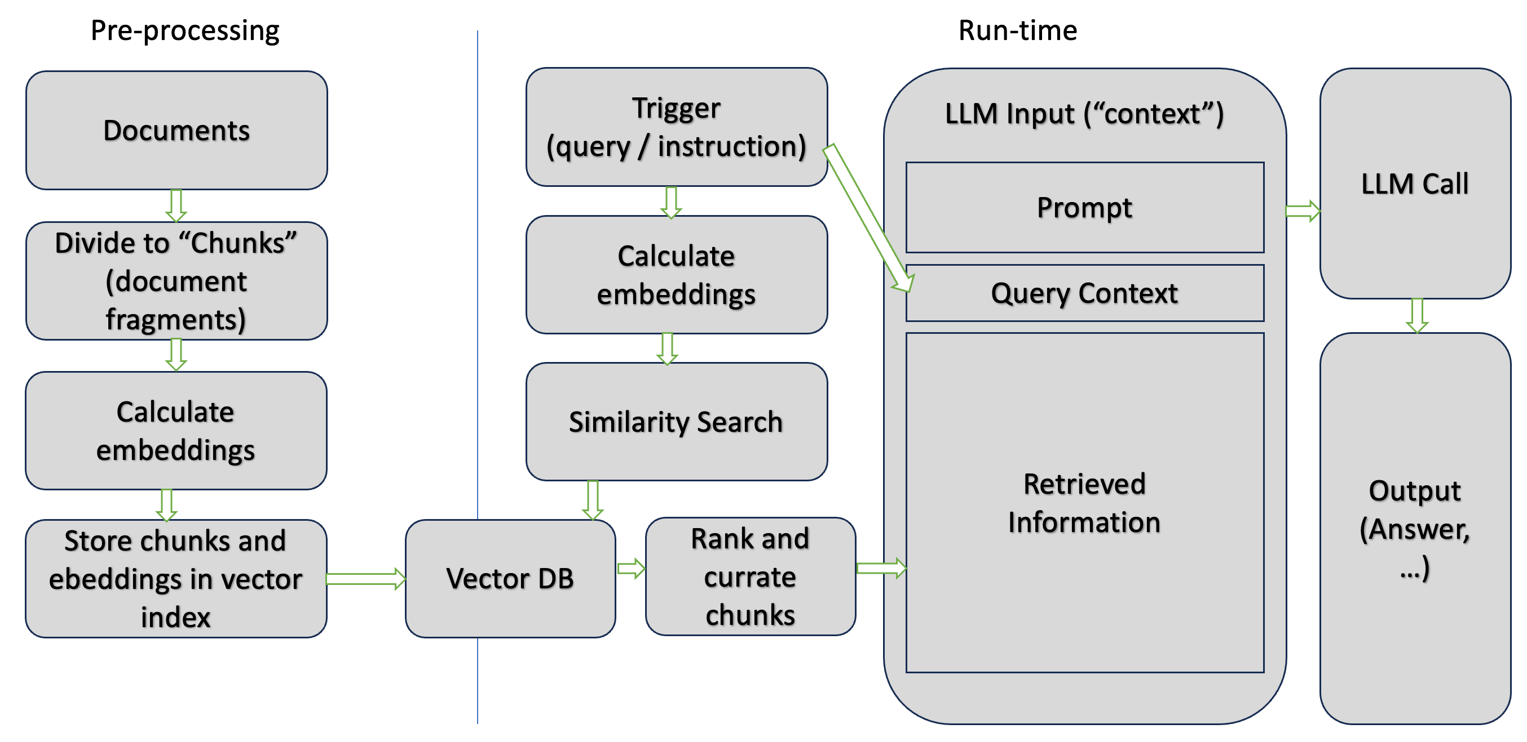
Source: Microsoft Tech Community

Slide 16
What is Chunking?
Dividing large documents into smaller segments.
Chunking is only required if the source documents are too large for the maximum input size imposed by models.
For example, the maximum length of input text for the Azure OpenAI text-embedding-ada-002 model is 8,191 tokens.
Chunks can be defined by document, page, or sentence.

Slide 17
Common Chunking Techniques
Fixed-size chunks: Define a fixed size that’s sufficient for semantically meaningful paragraphs (for example, 200 words) and allows for some overlap (for example, 10-15% of the content) can produce good chunks as input for embedding vector generators.
Variable-sized chunks based on content: Partition your data based on content characteristics, such as end-of-sentence punctuation marks, end-of-line markers, or using features in the Natural Language Processing (NLP) libraries. Markdown language structure can also be used to split the data.

Slide 18
Importance of Chunk Size in RAG
Too Large:
Loss of Specificity: Generalized embeddings reduce relevance.
Information Overload: Excessive data can overwhelm the model.
Too Small:
Loss of Context: Important connections may be lost.
Fragmented Information: Leads to incomplete answers.
Finding the Balance
Meaningful & Concise: Retain essential information while fitting processing limits, e.g., append the document title to chunks from the middle of the document to prevent context loss.

Slide 19
Chunk Enrichment
Cleaning the chunks to support closeness matches by eliminating potential differences that aren't material to the semantics of the text.
Augmenting the chunks with metadata that can be used as either filters or as part of the search.

Slide 20
Cleaning
Lowercasing - Match words regardless of capitalization.
Remove stop words - Reduce dimensionality by removing common words like "a", "an", "the".
Fix spelling mistakes - Ensure correct spelling for accurate embeddings.
Remove Unicode characters - Reduce noise and dimensionality by removing unnecessary characters.
Normalization - Standardize text by expanding abbreviations and contractions.

Slide 21
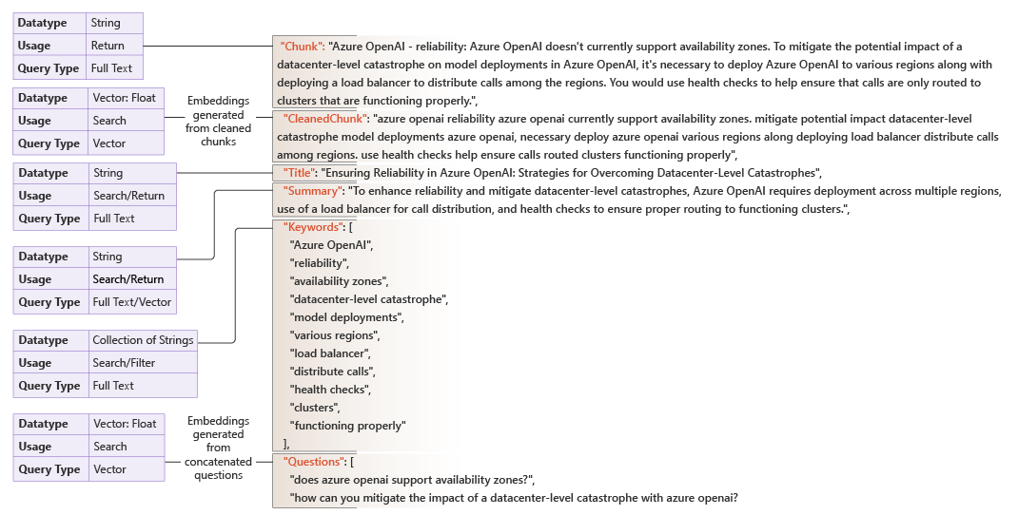
Augmenting

Slide 22
Metadata Field | Description | Tools
ID | Uniquely identifies a chunk | Hashing library
Title | Provides a quick content summary, useful for indexed search | Large language model
Summary | Longer than title, useful for indexed search | Large language model
Rephrasing | Captures variations in language for vector search | Large language model
Keywords | Good for exact match searches | Large language model, RAKE, KeyBERT, MultiRake
Entities | Specific info like people, organizations, locations | SpaCy, SNER, scikit-learn, NLTK
Cleaned Text | Clean version of chunk text | Large language model
Answerable Questions | Formulated queries for better matching | Large language model
Source | Original source information | N/A
Language | Filter queries by language | N/A
Notes:
RAKE (Rapid Automatic Keyword Extraction)
RAKE is a keyword extraction algorithm that identifies key phrases in a text by analyzing the frequency of word co-occurrences. It works by:
Breaking down the text into phrases.
Scoring these phrases based on their frequency and the degree of their words' connections.
It’s particularly useful for extracting keywords from short texts.
KeyBERT
KeyBERT is a more advanced keyword extraction technique that uses BERT (Bidirectional Encoder Representations from Transformers) embeddings to find keywords. It:
Generates contextual embeddings for words and phrases.
Identifies keywords by measuring their similarity to the main text.
Is effective for capturing the semantic meaning of the text, making it suitable for more nuanced keyword extraction.
MultiRake
MultiRake is an extension of the RAKE algorithm that supports multiple languages. Its features include:
Automatic keyword extraction from texts in various languages without needing predefined stopwords.
It generates stopwords dynamically based on the text, making it versatile for multilingual applications.

Slide 23
Text Embedding
Text
Tokenization
Indexing
Embedding

Slide 24
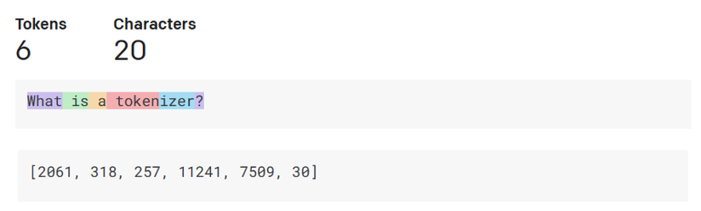
Tokenization
Tokens are common sequences of characters found in a set of text.
A tokenizer is used to split an input text into an array of tokens.
The exact tokenization process varies between models.
Each token is mapped with a token index, which is the integer encoding of the original text chunk.
One token generally corresponds to ~4 characters of text for common English text. This translates to roughly ¾ of a word (so 100 tokens ~= 75 words).
Source: https://platform.openai.com/tokenizer

Slide 25
Word Embeddings
While it may be convenient to represent tokens as simple IDs - essentially creating an index for all the words in the vocabulary, they don't tell us anything about the meaning of the words, or the relationships between them.
To create a vocabulary that encapsulates semantic relationships between the tokens, we define contextual vectors, known as embeddings, for them.
Vectors are multi-valued numeric representations of information, for example [10, 3, 1] in which each numeric element represents a particular attribute of the information.
Vectors represent lines in multidimensional space, describing direction and distance (or amplitude and magnitude) along multiple axes.
Source: Microsoft Learn

Slide 26
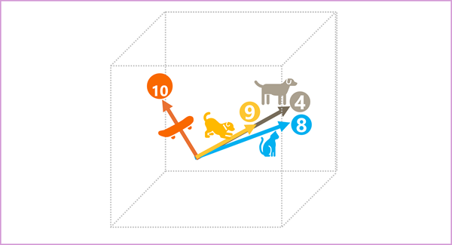
Word Embeddings
4 ("dog"): [10,3,2]
8 ("cat"): [10,3,1]
9 ("puppy"): [5,2,1]
10 ("skateboard"): [-3,3,2]
Semantically similar tokens point in the same direction.
Source: Microsoft Learn

Slide 27
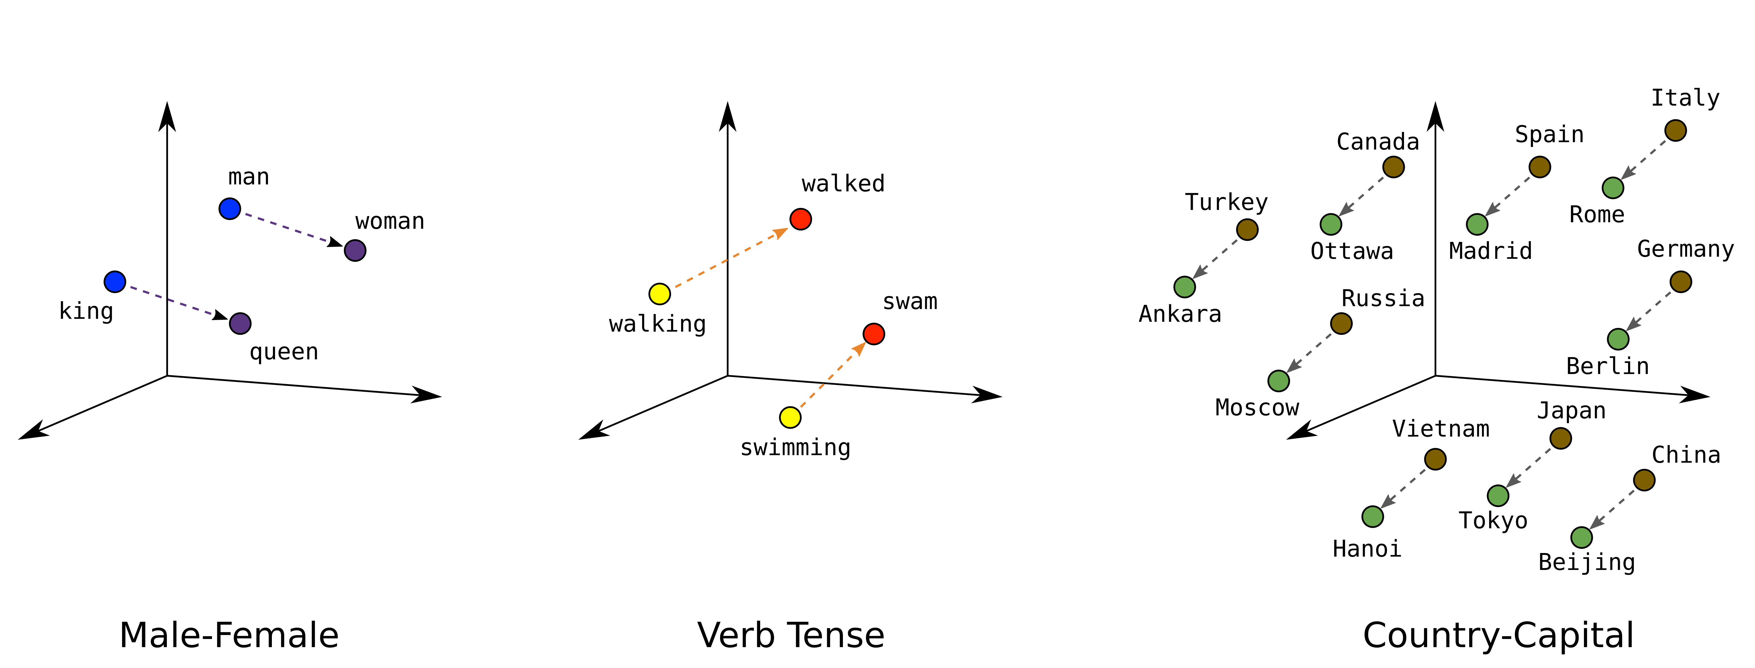
Position (distance and direction) in the vector space can encode semantics.
Source: Google

Slide 28
Word Embedding Techniques
Word2Vec
Principle: “the semantic meaning of a word is defined by its neighbors”
Two approaches: Continuous bag of words (CBOW) and Skip-Gram
GloVe (Global Vectors for Word Representation)
Captures global statistical information by analyzing word co-occurrence matrices
FastText
Considers subword information (like character n-grams), allowing it to create embeddings for out-of-vocabulary words

Slide 29
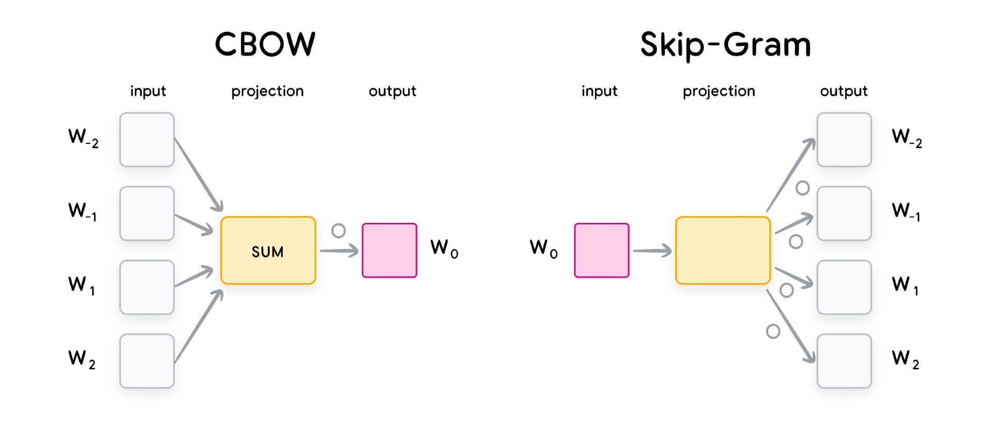
Word2Vec’s Two Approaches
Source: Google

Slide 30
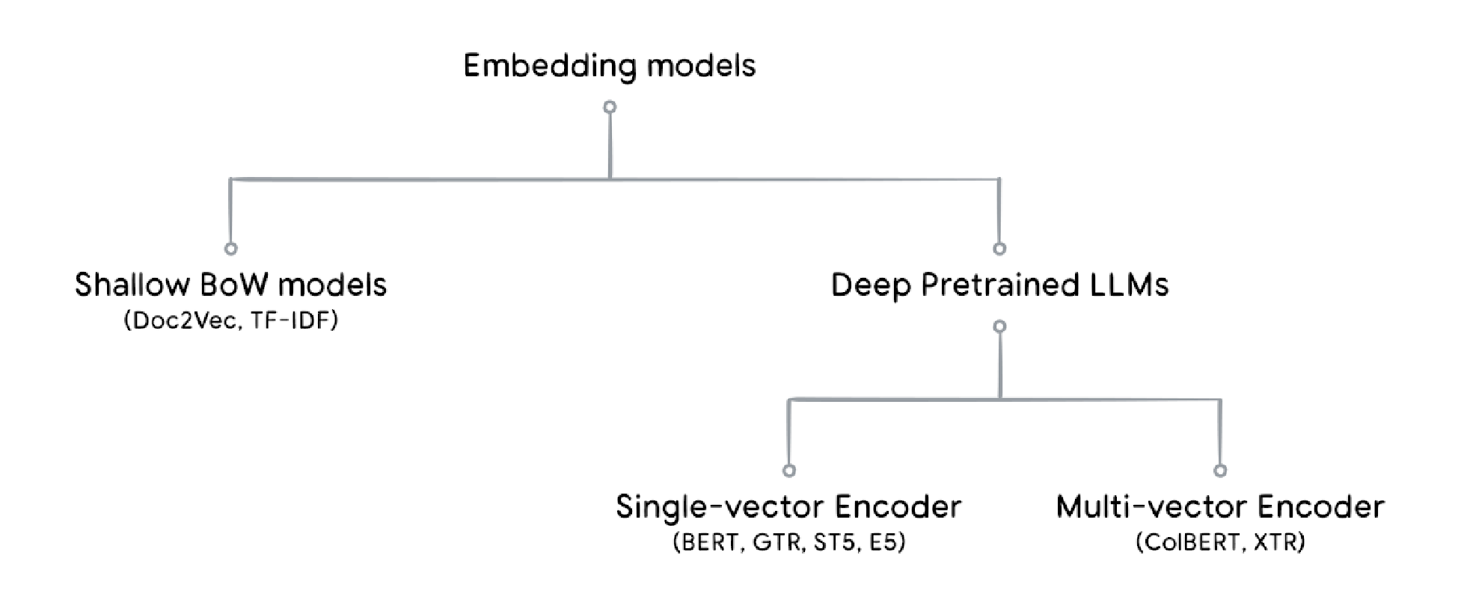
Document Embeddings
Source: Google

Slide 31
Shallow Bag-of-Words (BoW) models
Statistical models that use the word frequency to represent the document embedding
TF-IDF: term frequency-inverse document frequency
Adjust for the weights of popular and niche words
Major weakness: both the word ordering and the semantic meanings are ignored.

Slide 32
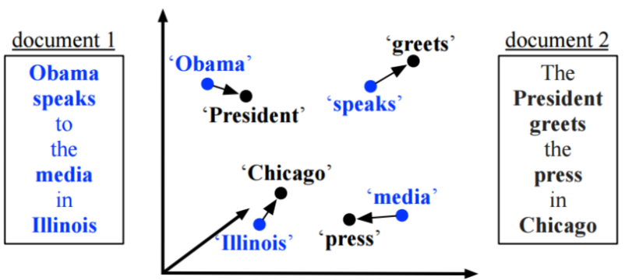
Limitations of BoW Models
Source: Microsoft Tech Community

Slide 33
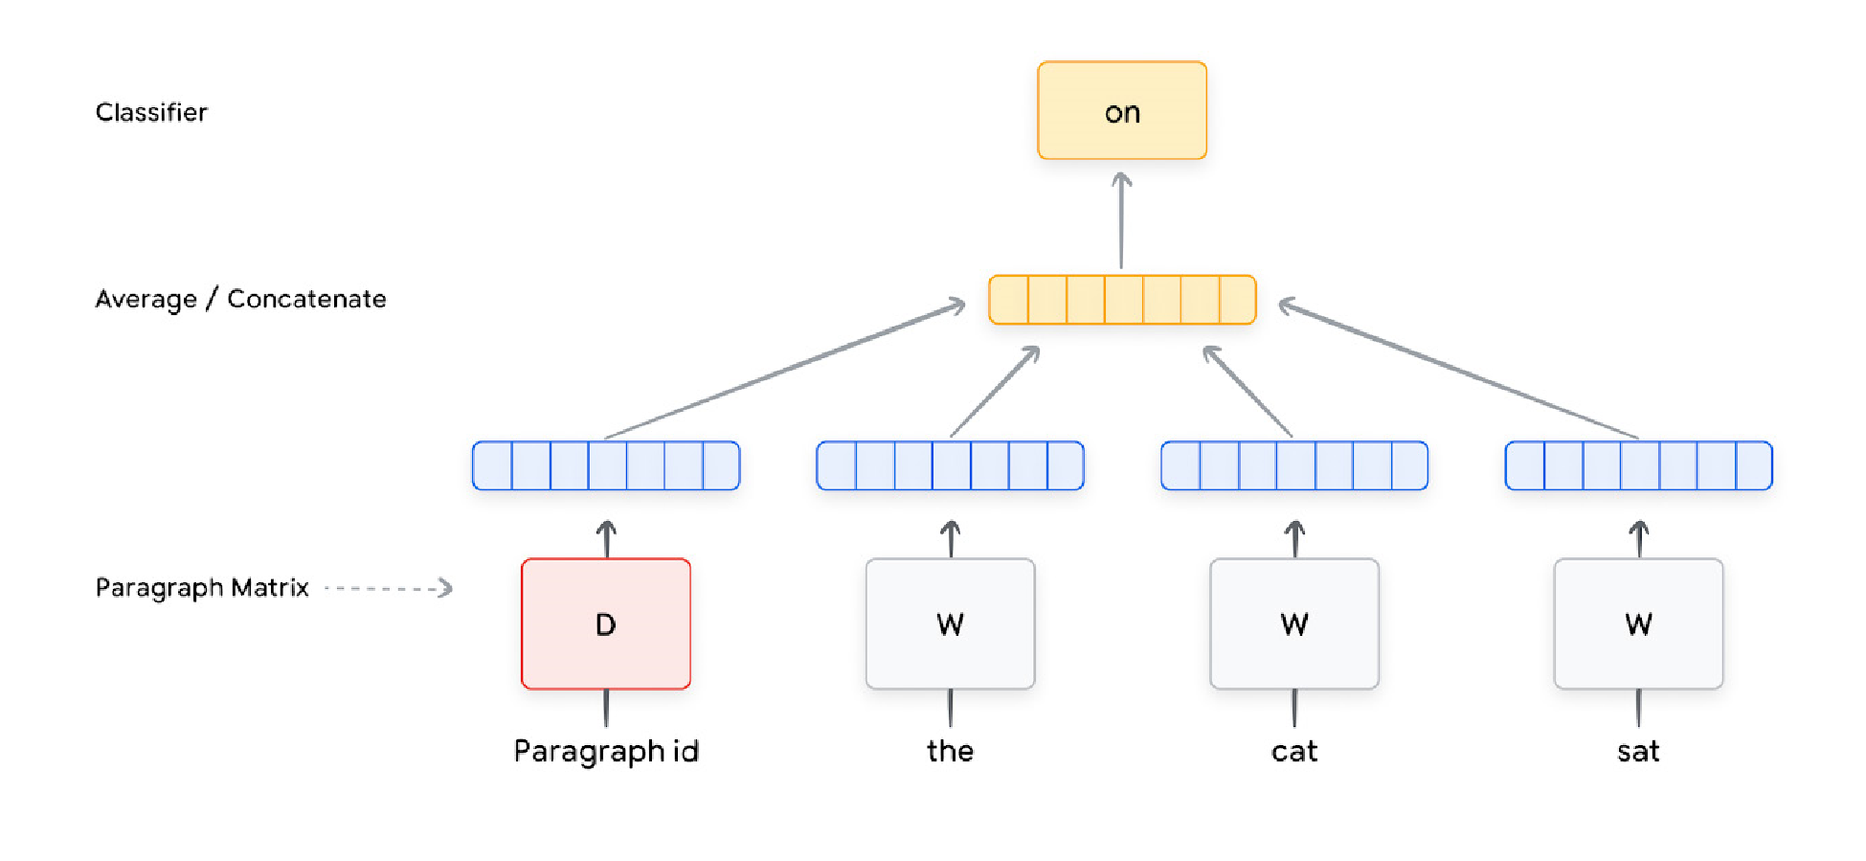
Doc2Vec CBOW model
Source: Google

Slide 34
Deep Pretrained LLMs
Using more complex learning models, especially bi-directional deep neural network models.
The use of massive pre-training on unlabeled text.
The use of a subword tokenizer.
Using fine-tuning for various downstream NLP tasks.

Slide 35
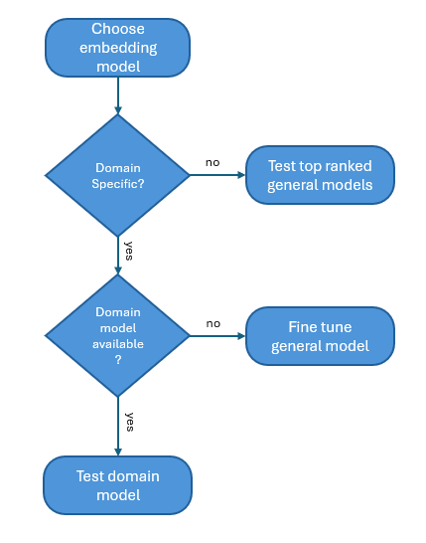
Choosing an embedding model

Slide 36
Vector Search
Full-text Keyword Search Limitations
Relies on explicit keyword matching
Fails with misspellings or different wording
Advantages of Vector Search
Searches for meaning across data modalities
Provides nuanced results

Slide 37
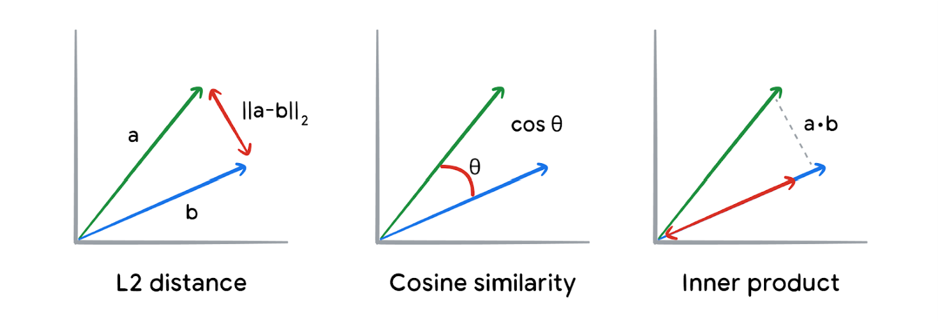
How different metrics compute vector similarity

Slide 38
Vector Similarity
Euclidean distance (i.e., L2 distance) is a geometric measure of the distance between two points in a vector space.
Cosine similarity is a measure of the angle between two vectors
Inner/dot product, is the projection of one vector onto another.

Slide 39
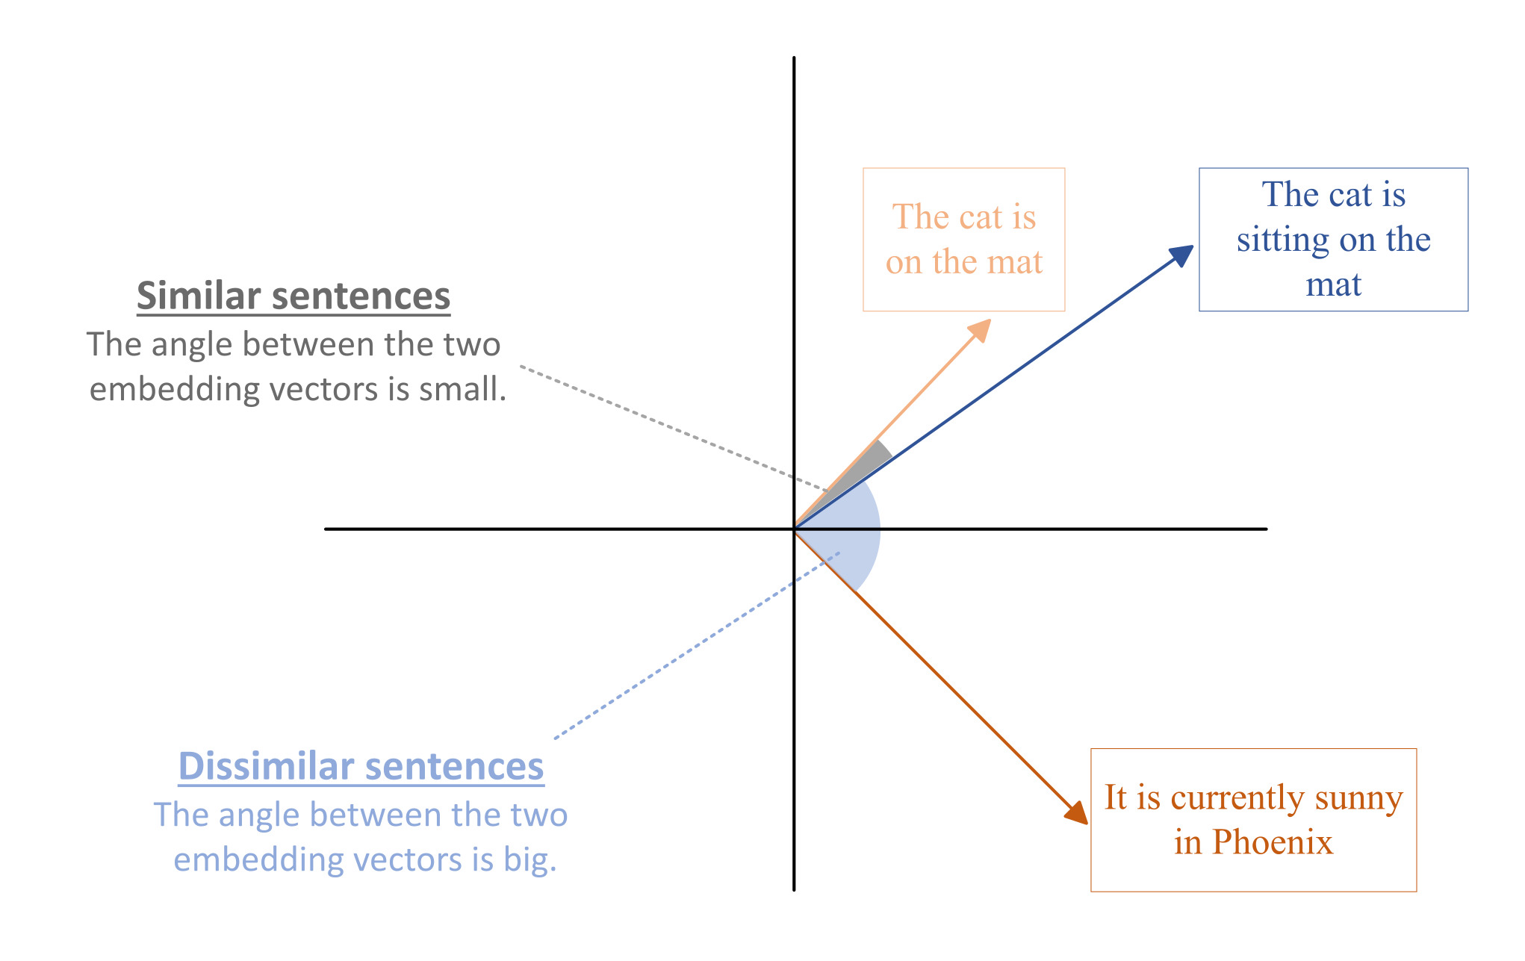

Slide 40
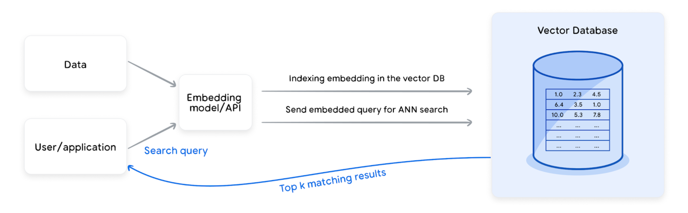
Populating and Querying Vector Databases

Slide 41
Populating and Querying Vector Databases
Embedding: Use a trained embedding model to convert data points into fixed-dimension vectors.
Indexing: Augment vectors with metadata and index them for efficient search.
Querying: Embed incoming queries and retrieve the most semantically similar items. Utilize caching, pre-filtering, and post-filtering to enhance performance.

Slide 42
Vector Search Algorithms
Linear Search
Compares query vector with each document vector
Returns the one with the highest similarity
Scales linearly (O(N)) with the number of documents
Unacceptably slow for large datasets
Approximate Nearest Neighbour (ANN) Search
Finds closest points with a small margin of error
Boosts performance significantly
Uses techniques like quantization, hashing, clustering, and trees
Offers varying trade-offs across scale, indexing time, performance, and simplicity

Slide 43
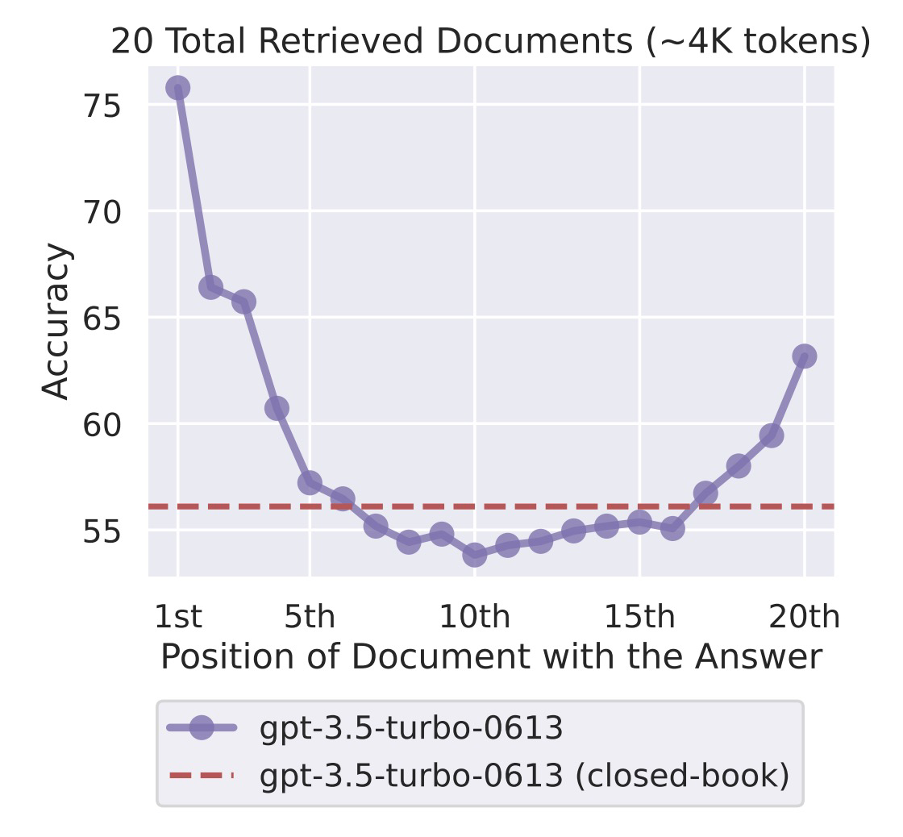
Context Stuffing reduces the LLM’s recall performance
Source: Lost in the Middle: How Language Models Use Long Contexts

Slide 44
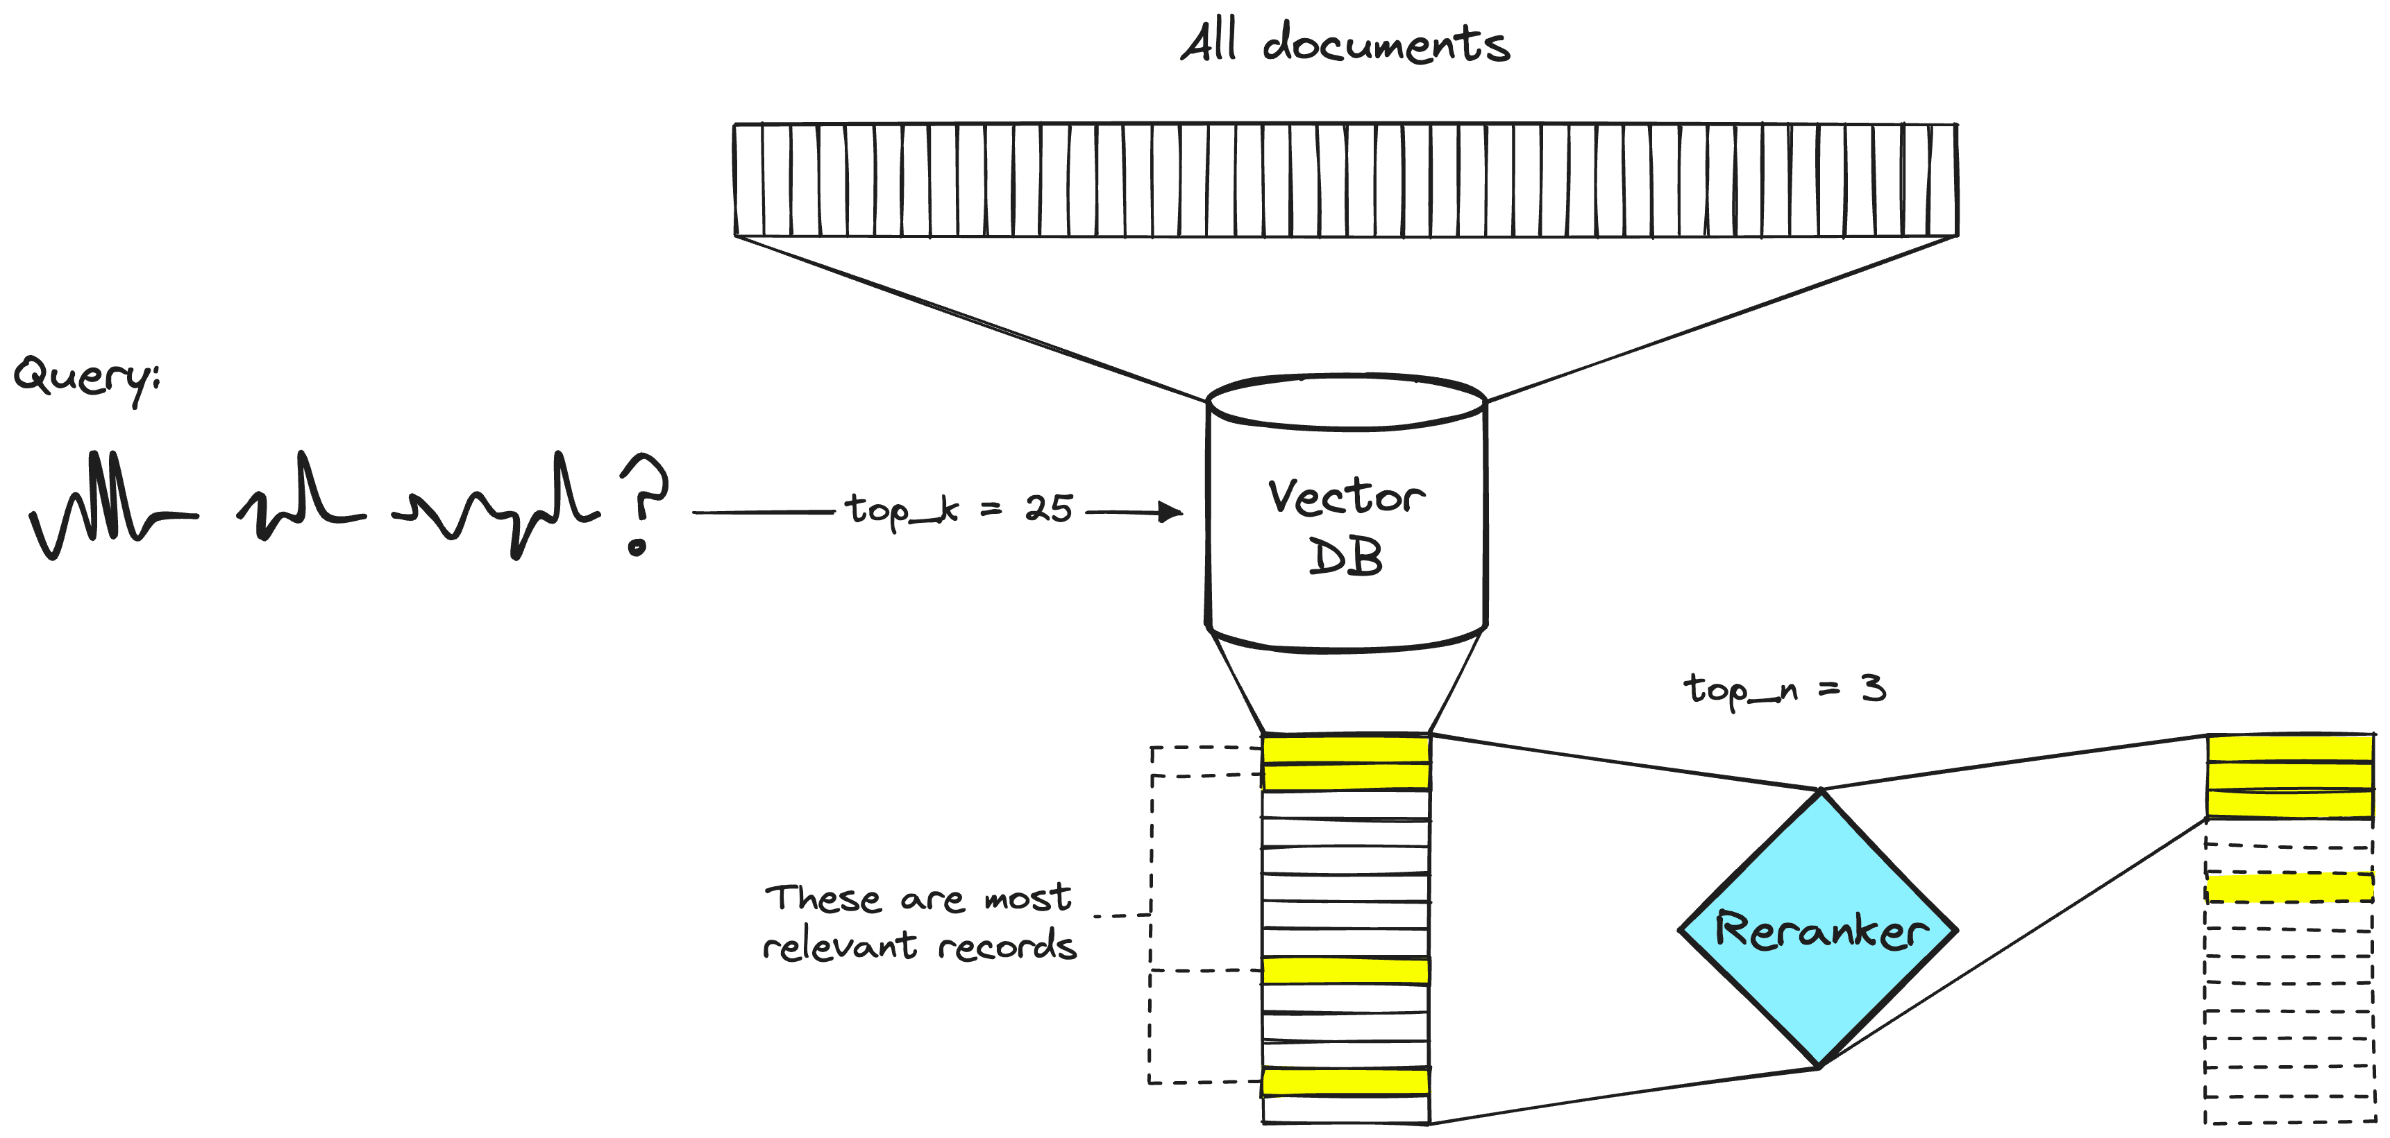
A two-stage retrieval system
Source: https://www.pinecone.io/learn/series/rag/rerankers/

Slide 45
A two-stage retrieval system
A first-stage model (an embedding model/retriever) retrieves a set of relevant documents from a larger dataset.
A second-stage model (the reranker) is used to rerank those documents retrieved by the first-stage model.

Slide 46
Reranking
A reranking model — also known as a cross-encoder — is a type of model that, given a query and document pair, will output a similarity score.
We use this score to reorder the documents by relevance to our query.

Slide 47
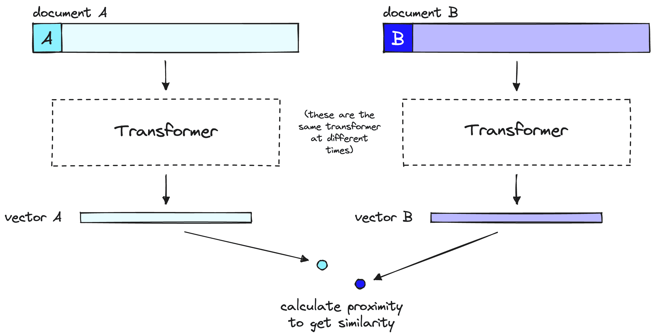
A bi-encoder model
document A here can be the query.
information loss

Slide 48
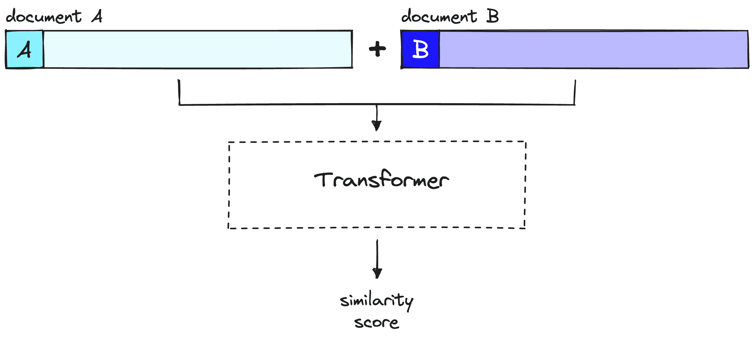
A cross-encoder model (reranker)
document A here can be the query.
No information loss

Slide 49
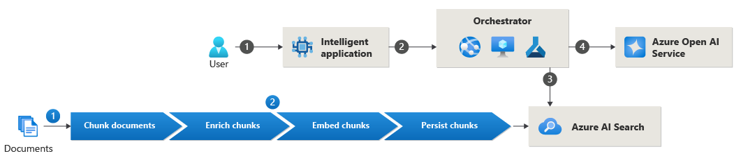
Azure RAG Architecture

Slide 50
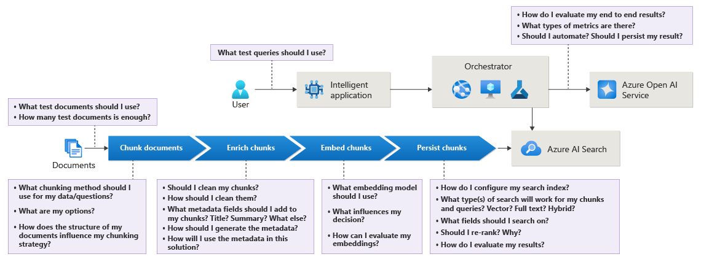

Slide 51
RAG Evaluation
Measure | Description
Groundedness | Measures whether the response is completely based on the context
Completeness | Measures whether the response is answering all parts of the query
Utilization | Measures the extent to which the response is made up of information from the chunks in the context
Relevance | Measures the extent to which the response is pertinent and related to the query
Notes:
https://learn.microsoft.com/en-us/azure/architecture/ai-ml/guide/rag/rag-llm-evaluation-phase

Slide 52
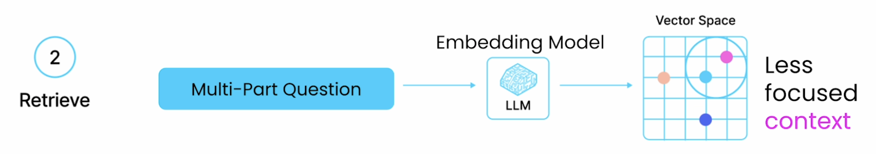
Limitations of RAG
Summarization
Comparison
Multi-part questions
Source: DeepLearning.AI and LlamaIndex

Slide 53
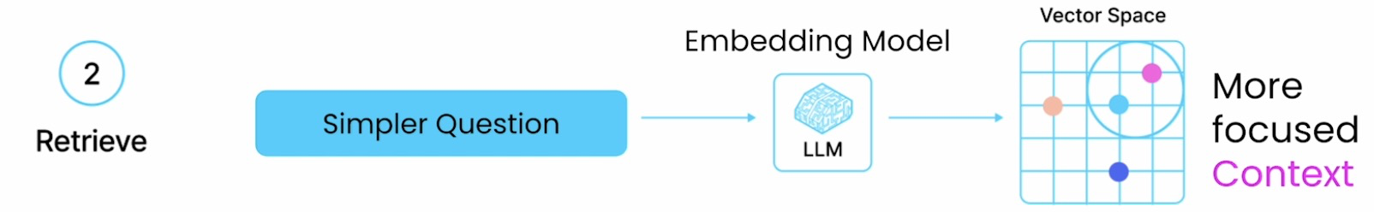
Splitting up complex questions
Split up multi-part questions into simpler questions
Task for LLM:
Split up a complicated question
Glue the answers back together
Building an agent
Source: DeepLearning.AI and LlamaIndex

