Slide 1
Model Hierarchy
Partial Latent Class
Hierarchical prior
Quadratic Exponential Model with Sparse Correlation

Slide 2
Informative prior is needed for θ₂ and d
Latent Variable Distribution:
=
Sparse Correlation:
I_{j} ~ Bernoulli(d)
d ~ Beta(a, b)

Slide 3
Data Simulation
5 candidate etiological pathogens.
BS, SS are available for each of them.
500 cases and 1000 controls.
Marginal Etiology Probability: Pr(pathogen k is infected)
Infection Sparsity: Pr(s pathogens infected)
Data qualities:
SS TPR ≈ 0.1 BS TPR ≈ 0.6 BS FPR ≈ 0.45
k | 1 | 2 | 3 | 4 | 5
 | 0.23 | 0.23 | 0.11 | 0.27 | 0.51
s | 0 | 1 | 2 | 3 | 4 | 5
 | 0.08 | 0.54 | 0.35 | 0.03 | 0 | 0

Slide 4
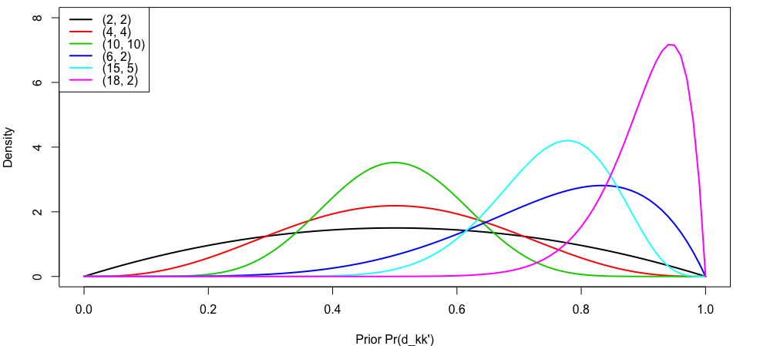
30 combinations of prior values are tested
Prior SD of θ₂ is fixed at 2
Prior Mean of θ₂ is chosen from {-1, -2, -3.5, -7.5, -10}
Prior of d is chosen from

Slide 5
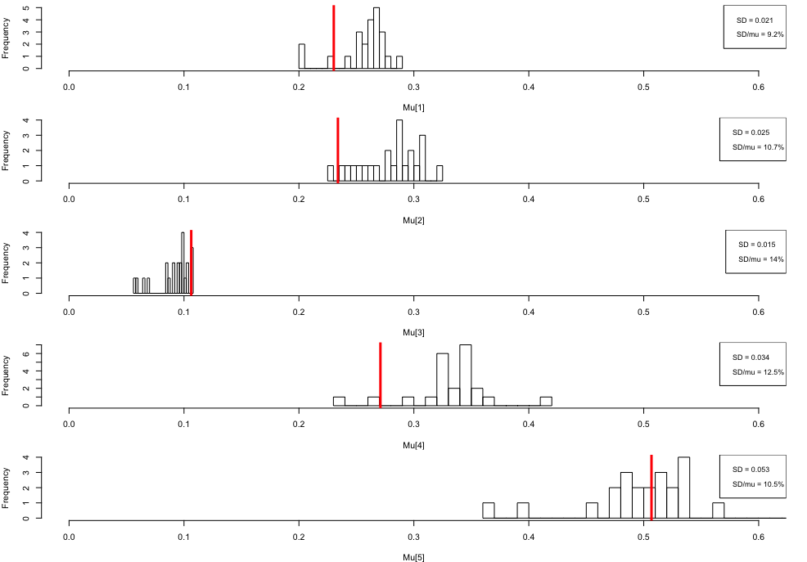
Sensitivity to prior values: Etiology Probability

Slide 6
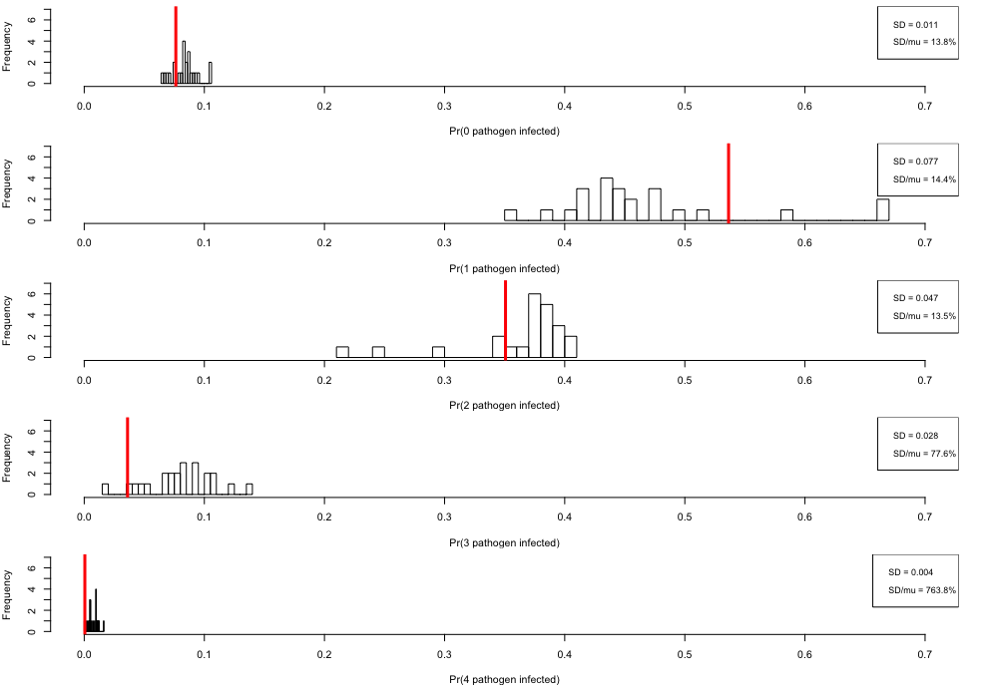
Sensitivity to prior values: Pr(num. pathogens)

