Slide 1
The Latent Sparse Correlation Model
Conditional Independence
M₂^{SS}
M₃^{SS}
M₁^{BS}
M₂^{BS}
M₃^{BS}
Observed
TPR^{BS}: γ_{k}
FPR^{BS}: δ_{k}
TPR^{SS}: η_{k}
Latent
L₂
L₁
L₃
Conditional log odds: θ_{k} = X^{T}β_{k}
Pairwise conditional log odds ratio: ρD_{kk’}
D_{kk’} ~ Bernoulli(d_{kk’}), k, k’ in {1, 2, …, K}, k < k’
d_{kk’} ~ Beta(g, h)
2nd order correlation nonpositive

Slide 2
Analysis of PERCH Data
Notes:
For demonstration purpose, pick one site, 10 pathogens:
3 bacteria – SS+BS only, 7 viruses, BS
Regression functionality, include one binary covariate …
Prior set by expert knowledge and grid search.

Slide 4
Etiology Probabilities with Bootstrap Dist.
Notes:
Enables stratified estimation.
1:2, individual strata
3, the contrast
Red box: singletons: largest RSV, then HMPV, 10-15 % explained by the rest 20+ pathogens
Green box: identified doubletons (90th percentile > 1e-4)
Tripletons and more are basically ignorable.
Korppi et al. (1989) [23] find that RSV serves as a predisposing agent for secondary bacterial infection in the airways of children and HINF is one of the most common bacteria in- volved in the mixed RSV-bacterial infections in pneumonic patients. PNEU and HINF are both commensals of the human nasopharynx and have long been detected together in a multispecies biofilm in infected tissue [32]. Franz, Anna, et al. (2010) [14] reported that in their study on lower respiratory tract infection, 28% RHINO infections has PNEU as the coinfected pathogen.

Slide 5
Etiology Probabilities with Bootstrap Dist.
Notes:
Green box: more infection in very severe, PNEU related.
Red box: less infection in very severe.

Slide 6
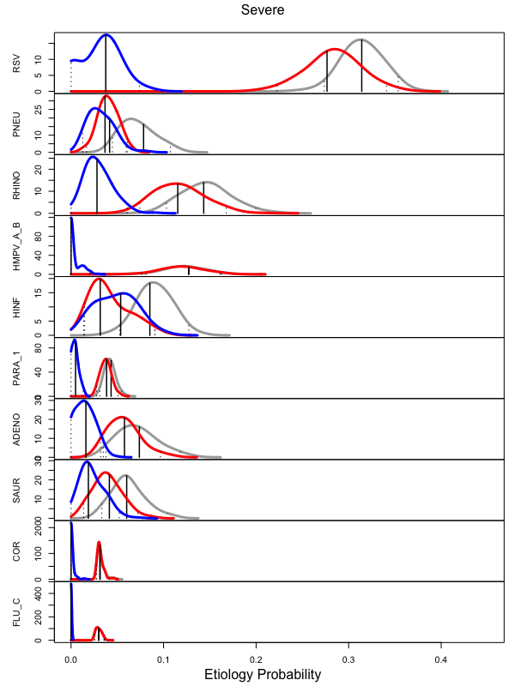
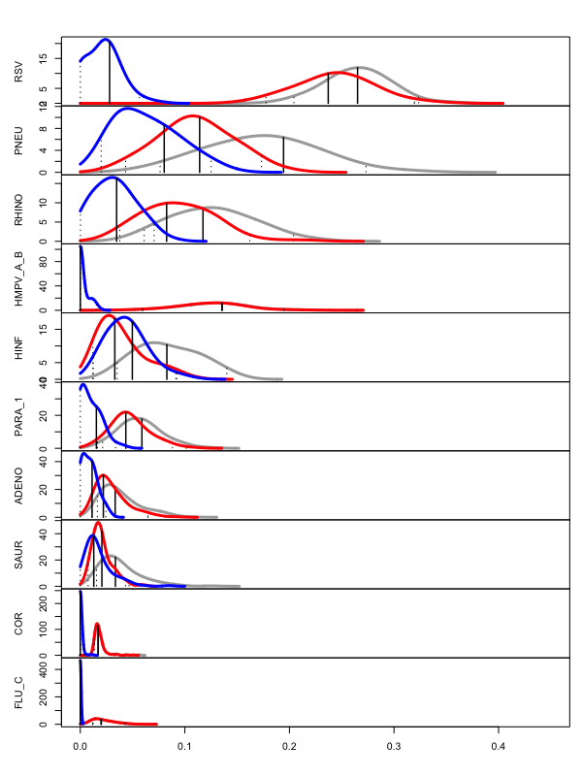
Etiology Probabilities with Bootstrap Dist.
Severe
Very Severe
Notes:
Green box: more infection in very severe, PNEU related.
Red box: less infection in very severe.

Slide 7
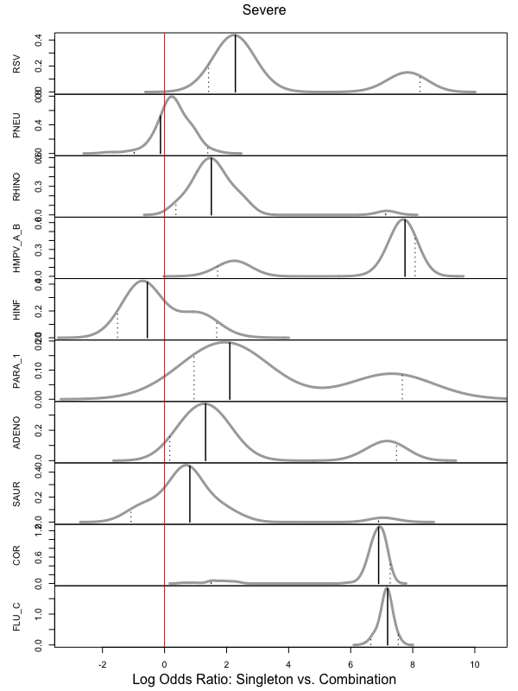
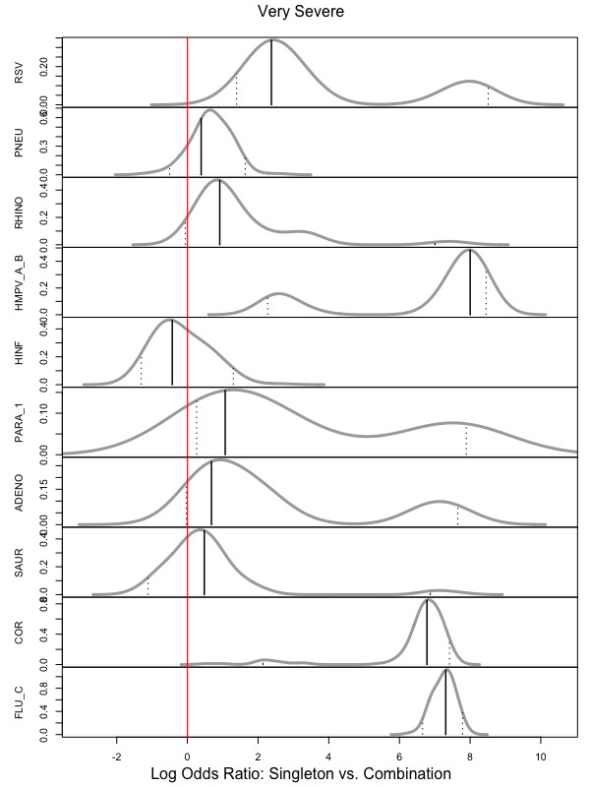
Severe
Very Severe
Notes:
Green box: more infection in very severe, PNEU related.
Red box: less infection in very severe.

Slide 8
Data Simulation
5 candidate etiological pathogens.
BS available for all five. SS available for first three.
500 cases and 1000 controls.
Marginal Etiology Probability: Pr(pathogen k is infected)
Infection Sparsity: Pr(s pathogens infected)
Association Parameters
Data qualities:
SS TPR: [0.05, 0.2], BS TPR: [0.65, 0.95], BS FPR: [0.15, 0.45]
k | A | B | C | D | E
 | 0.06 | 0.10 | 0.15 | 0.35 | 0.44
s | 0 | 1 | 2 | 3 | 4 | 5
 | 0.11 | 0.75 | 0.14 | 0.007 | 0 | 0

Slide 9
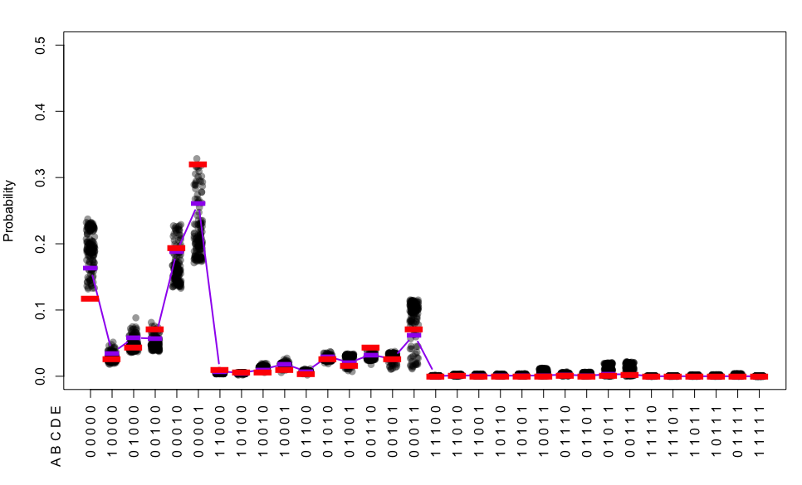
Sensitivity to prior values: Etiology Probability

Slide 10
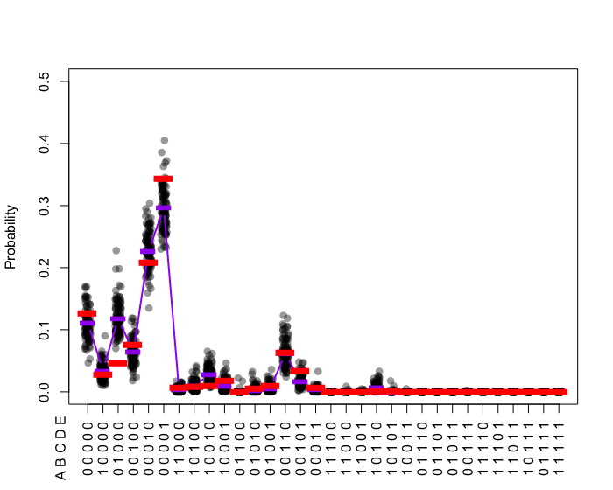
Under Other Association Settings: Case 1
Marginal Etiology Probability: Pr(pathogen k is infected)
Infection Sparsity: Pr(s pathogens infected)
Association Parameters
k | A | B | C | D | E
 | 0.08 | 0.07 | 0.19 | 0.30 | 0.42
s | 0 | 1 | 2 | 3 | 4 | 5
 | 0.13 | 0.70 | 0.17 | 0.004 | 0 | 0
 | A | B | C | D | E
A
B | -0.4
C | -0.7 | -4.1
D | -1.6 | -2.5 | -0.7
E | -1.4 | -2.5 | -1.8 | -4.3

Slide 11
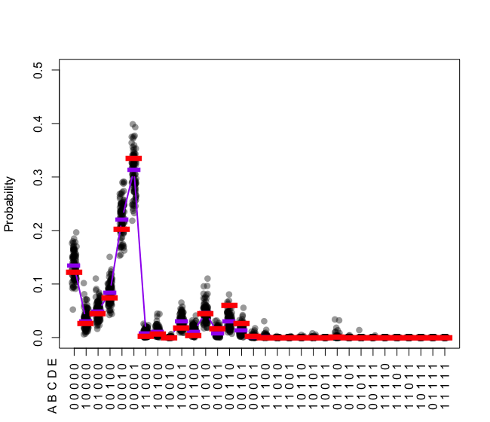
Under Other Association Settings: Case 2
Marginal Etiology Probability: Pr(pathogen k is infected)
Infection Sparsity: Pr(s pathogens infected)
Association Parameters
k | A | B | C | D | E
 | 0.06 | 0.12 | 0.18 | 0.32 | 0.40
s | 0 | 1 | 2 | 3 | 4 | 5
 | 0.12 | 0.69 | 0.19 | 0.003 | 0 | 0
 | A | B | C | D | E
A
B | -1.3
C | -0.8 | -2
D | -4 | -0.5 | -0.7
E | -1.4 | -2 | -2 | -5.3

