Slide 1
Final Project – Essay Search
Deadline : 2024/1/15 23:59

Slide 2




Intro
There are many search engine nowadays
Eg: Google, Yahoo, Baidu… etc.
In this final project, we need to build a simple essay search engine

Slide 3

Dataset

Slide 4
Essay Search
Input
A set of txt files (essays) in the given folder path (0.txt, 1.txt, ....)
A given txt file containing search queries
Output file name
Output
Output a txt file with the given name
Given a word, our objective is to list the essays that their titles or abstracts contain the word
We need to consider only the alphabetic words. You can ignore special symbols or digits
The queries are case insensitive, i.e., we are treating uppercase and lowercase characters the same

Slide 5
Query
Exact Search: “search-word”
Eg: we want to search essay with graph, we use query - “graph”
Prefix Search: search-word
Eg: we want to search essay with prefix graph, we use query - graph
Suffix Search: *search-word*
Eg: we want to search essay with suffix graph, we use query - *graph*
Wildcard Search: <search-pattern>
Eg: we want to search essay with word pattern gr*h, we use query - <gr*h>. “*” can be empty, single or multiple characters, so gr*h should match words like graph, growth…etc.
And operator: “+”
Eg: we want to search essay with graph and sparsity, we use query – “graph” + “sparsity”
Or operator: “/”
Eg: we want to search essay with graph or quantum, we use query – “graph” / “quantum”
Exclude operator: “-”
Eg: we want to search essay with graph but without deep, we use query – “graph” - “deep”

Slide 6
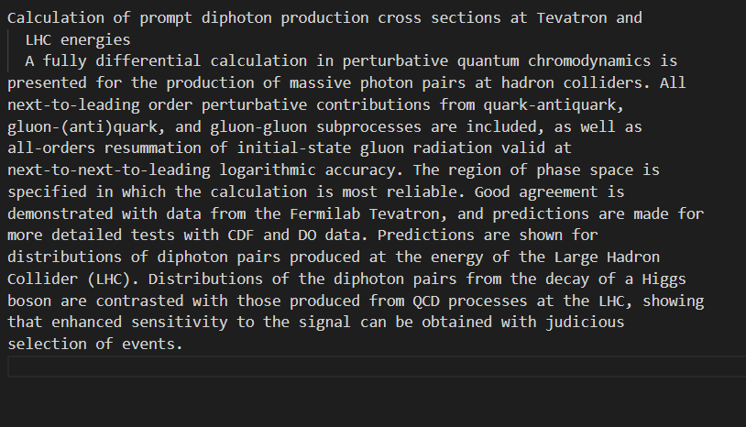
Input file – essay file
There are a set of essay txt files, named 0.txt, 1.txt, ........
Those essay txt files will be put in the given directory
Every essay txt file contains two parts
1. Title (the first line)
2. Abstract (the remaining sentences)

Slide 7
Input file – query file
There would be several queries in a query file
One line represents one query that has to be processed
The And / Or / Exclude operator is left associative
Eg: graph + decomposition / quantum
= (graph + decomposition) / quantum
All the queries are valid, i.e., you don’t need to worry about invalid queries

Slide 8
g++ -std=c++17 -O2 -o essay_search ./111062107.cpp
./essay_search "C:\Users\user\DS_final_project\final_project_2023\data“ "C:\Users\user\DS_final_project\final_project_2023\1st_try.txt“ 1st_try_output.txt
./essay_search “C:\Users\user\DS_final_project\final_project_2023\data“ ”C:\Users\user\DS_final_project\final_project_2023\query.txt“ suck_my_dick.txt
./essay_search "C:\Users\user\DS_final_project\final_project_2023\data-more“ "C:\Users\user\DS_final_project\final_project_2023\query_more.txt“ suck_my_dick.txt

Slide 9
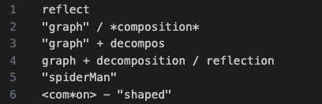
Query example
First query: reflect
Find essays that have word with prefix [reflect], eg: reflect, reflection.
Second query: “graph” / *composition*
Essay set A: Find essays that have exactly the word [graph]
Essay set B: Find essays that have words with suffix [composition]
A, B set with OR operator -> answer = union of sets A and B
Third query: “graph” + decompos
Essay set A : Find essays that have exactly the word [graph]
Essay set B : Find essays that have words with prefix [decompos]
A, B set with AND operator -> answer = intersection of sets A and B

Slide 10
Query example
Fourth query: graph + decomposition / reflection
Essay set A: Find essays that have words with prefix [graph]
Essay set B: Find essays that have words with prefix [decomposition]
Essay set C: Find essays that have words with prefix [reflection]
We know that A + B / C = (A + B) / C
Essay set D = intersection of sets A and B
Answer = union of sets D and C
Fifth query: “spiderMan”
Find essays that have exactly the word [spiderman]
Keep in mind that upper- and lower-case characters are treated the same

Slide 11
Query example
Sixth query: <com*on> - ”shaped”
For pattern com*on, we can find “comparison”, “common”, “commutation”, “compression”, “companion”… in given data
Essay set A: Find essays that have words above with pattern [com*on]
Essay set B: Find essays that have exactly the word [shaped]
A, B set with Exclude operator -> answer = difference of sets A and B (A-B)

Slide 12
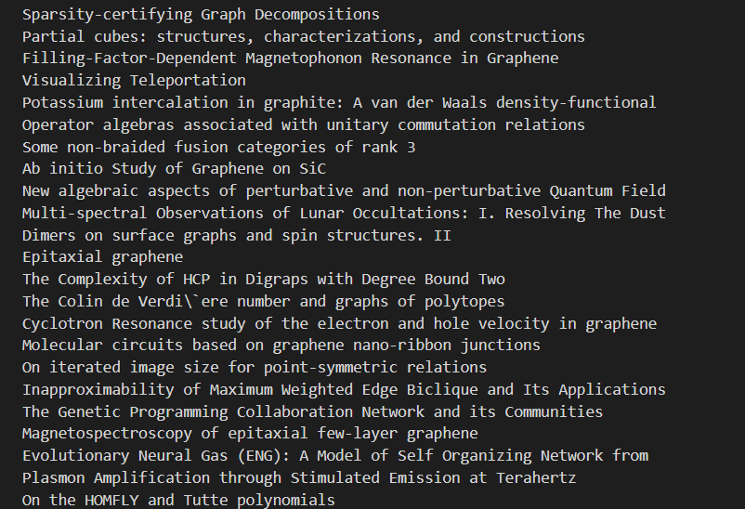
Output file format
Output file name is given as arguments when executing your program
Output the essay titles of the search result in output file
Every essay title should be followed with a new line character
If not found -> print out “Not Found!” (不用印雙引號)
Output order follows the essay order
(0.txt, 1.txt, .....)

Slide 13
Requirements
Implement with C/C++
Design your own data structure to make search faster
Strictly follow the input/output formats
Do not use any string matching library (eg: str.find, …)
Do not copy/paste others’ codes, or you will get 0 point.

Slide 14
Test environment
OS: Ubuntu 22.04.2 LTS
CPU: Intel(R) Core(TM) i7-12700K CPU @ 3.60GHz
RAM: 94GB DDR4
DISK: 1TB Gen3 SSD
GCC version: 11.4.0
If you need another version of the compiler, please let us know the reason

Slide 15
You can compare the differences in CPU specifications between your CPU and the specifications used in the CPU benchmark tests to estimate the potential performance outcome.
Please note that this may not be entirely accurate and is intended only as a reference. It still depends on other factors like OS, SSD speed …etc.
Using WSL may slower than Ubuntu and Windows

Slide 16
The following are the results of all search and scalability test executed with TA’ code on different machines.
TA‘s code is not well optimized, there is still room for improvement.
 | OS | CPU | All search test (1000 testcases) | Scalability test (8000+ testcases)
 | Ubuntu 22.04 | i7-8700K | 0.41 s | 4.38 s
 | Ubuntu 20.04 | R9 5900x | 0.348 s | 3.354s
Test environment | Ubuntu 22.04 | i7-12700K | 0.264 s | 2.780s

Slide 17
Testing
Your code should take three arguments:
input folder path, query file path, output file name
Output file name should be Output file with [output_file_name]
TA will compile your file as follows
g++ -std=c++17 -O2 -o essay_search ./111062107.cpp
If your code need to use other library so that this command cannot compile your code, please send the compile command you used to our email and state the reason clearly in the report
TA will test your code as follows
./essay_search [input_folder_path] [query_file_path] [output_file_name]
Time limits
Your program would be killed after 4 seconds
Brute-force algorithms won’t get through

Slide 18
Scoring
We have a small dataset (1000 files) and a bigger dataset (8000up files)
Exact Search + And / Or / Exclude Operator (40%)
100% query output correct -> get 40 points
80%~99% query output correct -> get 20 points
less than 80% query output correct -> get 0 points
Suffix / Prefix / Wildcard Search (25%)
100% query output correct -> get 25 points
80%~99% query output correct -> get 12 points
less than 80% query output correct -> get 0 points
Scalability Test: test with more essays and queries (10%)
You get these points when the answers are all correct
We will test your code only if you pass above two test
Speed Test: compete the speed with your classmate (15%)
We will test your code only if you get all the points in above three tests (75 points)
Last 10%: 3 points
Top 50% - Top 90%: 5 points
Top 20% - Top 50%: 10 points
Top 20%: 15 points
Report (10%)

Slide 19
Report
Your report should contain
How you implement your code (6%)
Other implementations for optimization (2%)
Challenges you encounter in this project ,or Conclusion (2%)
References that give you the idea (github/paper…)
No more than 2 pages

Slide 20
Submission
Submit your
Code
Report
Submit a zip file with filename “[student_id]_project”
[student_id]_project.zip
|------- [student_id].cpp/.c
|------- Other Implementation code (Optional)
|------- [student_id]_report.pdf
If the submission is not in the above format, 5 points will be deducted.

Slide 21
Submission
After compile command
g++ -std=c++17 -O2 -o essay-search ./*.cpp
a executable file “essay-search.exe” should be created
After execute, [output-file-name] should be created

Slide 22
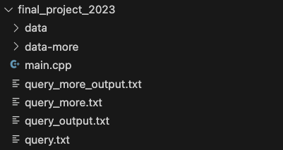
Given File structure
main.cpp: essay txt parser and some hint
query.txt / output.txt: sample input / output
query_more.txt / query_more_output.txt: sample output
data: sample essay data folder
data-more: more essay data provide for self testing (1000 files)

Slide 23
Given main.cpp & parser
We will provide some code in main.cpp
You can use these code for your implementation
助教提供Parser，如要自行implement，請確定與助教提供之parser輸出相同，若因自行實作而導致輸入輸出上有差異，將會視為錯誤。
Functionality that has been provided
Store variable for argv argument
Process essay title and content, storing into two vector<string>
Utility function for parsing and string split

Slide 24
Note
You are allowed to use STL
But don’t use any string matching library function
If you encounter problems, you can ask questions in the discussion area on eeclass first. or you can also email to lobsterlab.cs.nthu@gmail.com.
TAs won’t help to debug your code, please make use of internet ( google it ) .

Slide 25
Implementation
How can we build data structure that efficiently support searching?
These are some common structure that we can reference to
Trie (TA implemented this)
reference: https://www.geeksforgeeks.org/trie-insert-and-search
reference: https://www.hackerearth.com/practice/data-structures/advanced-data-structures/trie-keyword-tree/tutorial/
Suffix-Tree
reference: https://blog.csdn.net/fjsd155/article/details/80211145
reference: https://www.geeksforgeeks.org/ukkonens-suffix-tree-construction-part-1/
Ternary Search Tree
reference: https://www.geeksforgeeks.org/ternary-search-tree/
reference: https://www.cs.upc.edu/~ps/downloads/tst/tst.html
Compressed Trie
reference: https://www.geeksforgeeks.org/compressed-tries/

