Slide 1
SINEAD (Software Integrating NEuroimaging And other Data)
MRI & PET preprocesssing
Machine learning
Cortical thickness
Feature analysis
Close
Preprocessing (SPM12)
Machine learning (PRoNTo)
Cortical thickness (surfstat)
Feature analysis (stat toolbox)
Data selection
Display image
Set origin to center
Thickness view
Feature extraction
Building linear kernels (feature extraction)
Check Reg
MRI/PET preprocessing
Thickness stats
Feature selection (ANOVA)
Model selection
Tissue volumes
-
Disply results & stats
Close
Close
Close
Compute weights
Disply weights
Wong-Lin, Kongfatt <k.wong-lin@ulster.ac.uk>, Intelligent Systems Research Centre, Ulster University
Vahab Youssofzadeh <Vahab.Youssofzadeh@cchmc.org>, Cincinnati Children's Hospital Medical Center
June, 2016

Slide 2
SINEAD
This Matlab based software provides a GUI framework for conducting machine learning on imaging data and in particular for an AD application.
It integrates,
SPM Toolbox (www.fil.ion.ucl.ac.uk/spm/) for preprocessing of imaging data,
PRoNTO (www.mlnl.cs.ucl.ac.uk/pronto) for machine learning and combined analysis of imaging data,
Surfstat (http://www.math.mcgill.ca/keith/surfstat/) and freesurfer (http://freesurfer.net/) for cortical thickness analysis.
References regarding SINEAD are listed below:
Youssofzadeh V, McGuinness B, Maguire L and Wong-Lin K, 2016. A kernel-based Gaussian process for combined MRI and PET in Alzheimer’s disease. In: Alzheimer’s Research UK (ARUK) 2016 Conference, Manchester, UK. 8-9 March 2016.
Youssofzadeh V, McGuinness B, Maguire L and Wong-Lin K. Multi-kernel learning with Dartel enhances MRI-PET classification and prediction of Alzheimer’s disease: group and individual analyses, In preparation.
Installing SINEAD
Download CADSuM on your computer and add the directory path with subdirectories to your Matlab path.
Ensure you have the SPM12, PRoNTO directory in your Matlab path as well.

Slide 3
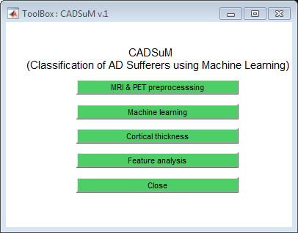
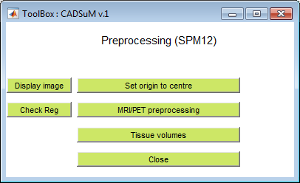
Pre-processing of scans
SPM12 toolbox has to be added to Matlab routines

Slide 4
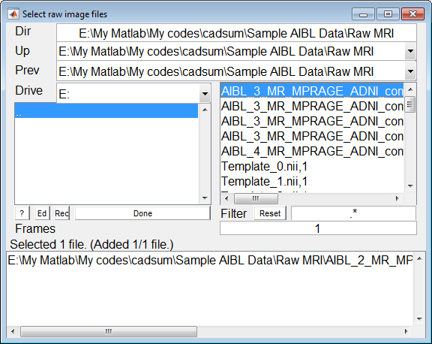
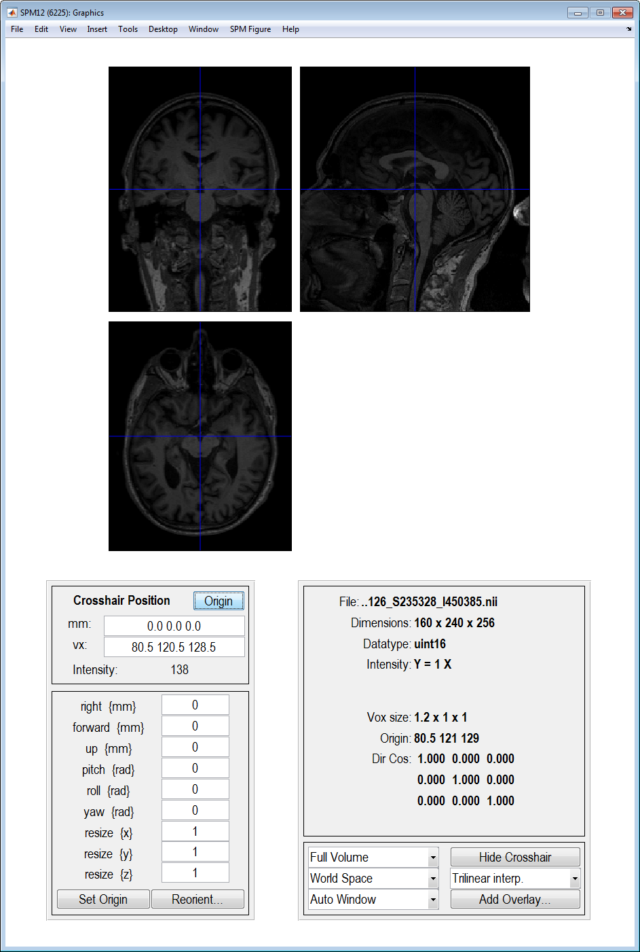

Set origin
1
3
Set origin to AC area was completed!
2

Slide 5
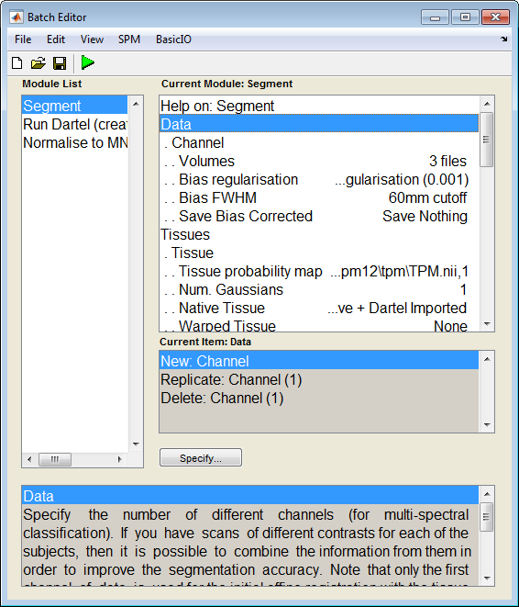
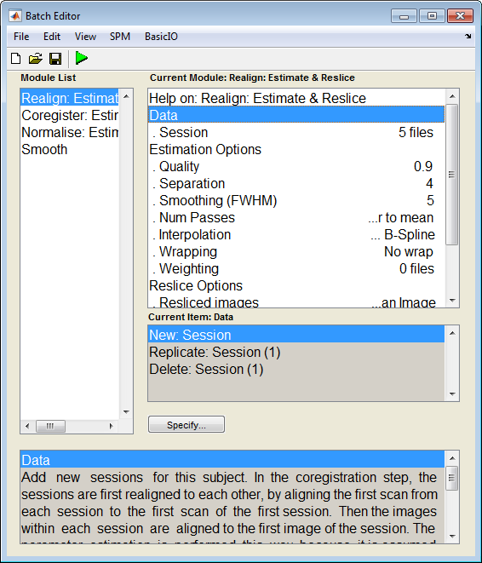
Preprocessing
Data/scans are selected using batch interface. A sample batch is available in “SPM batch” folder.
MRI preprocessing
PET preprocessing

Slide 6
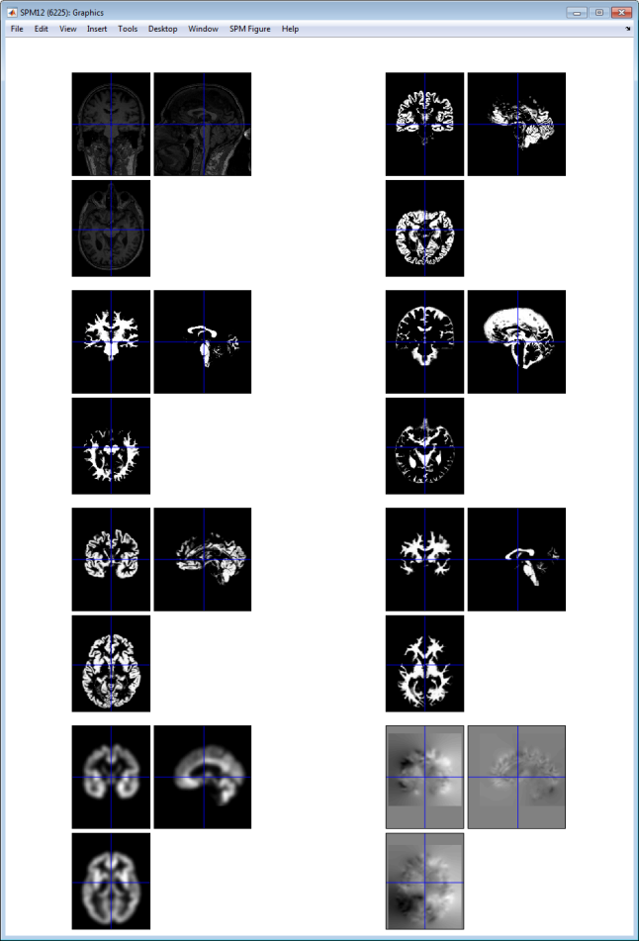
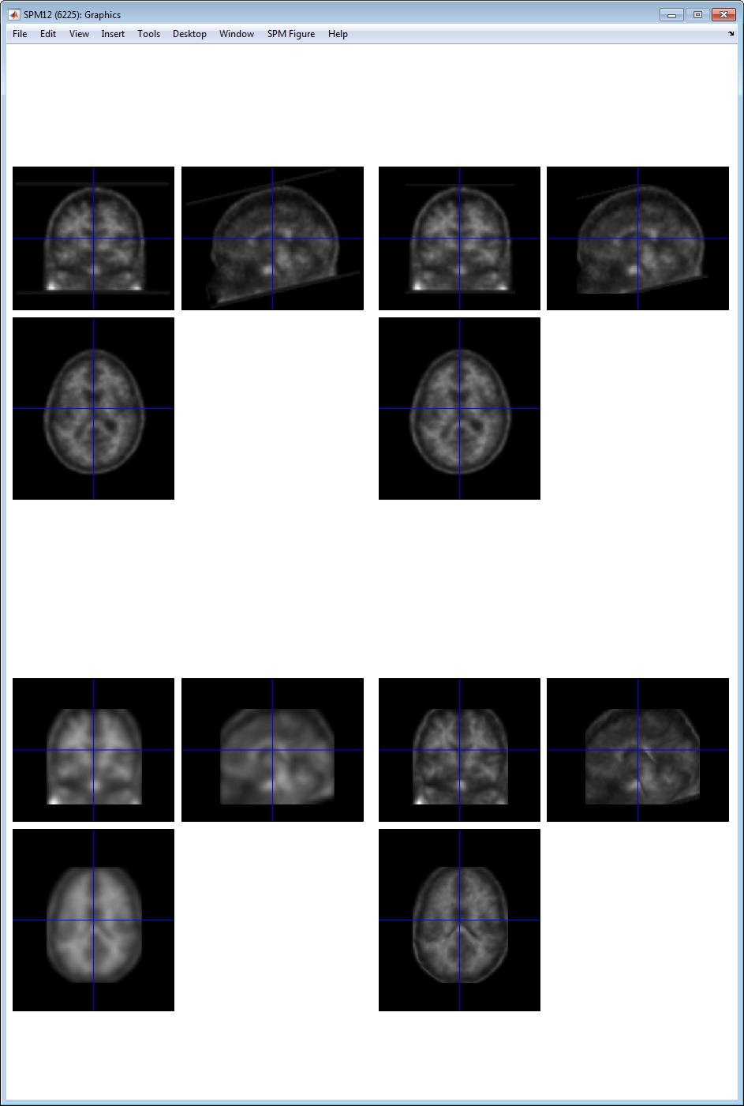
Preprocessing, checking results
MRI
PET

Slide 7
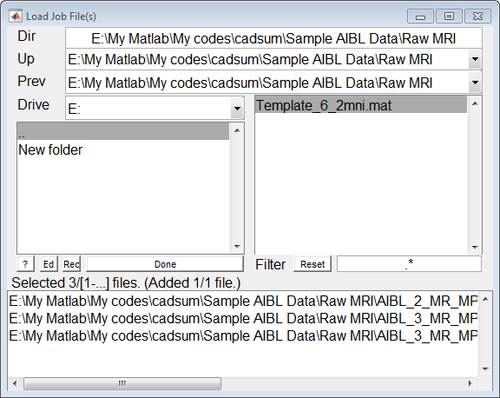
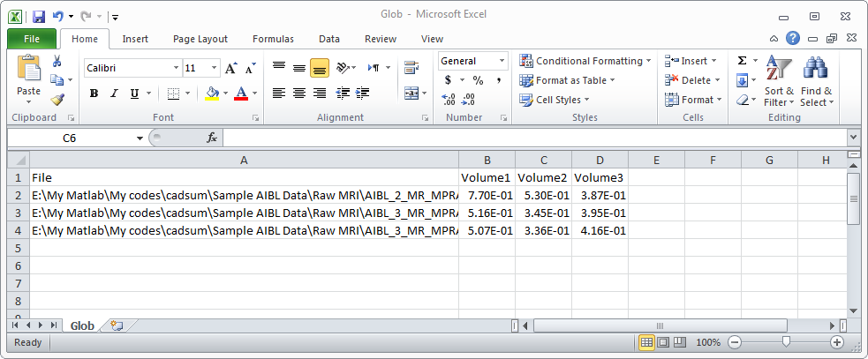
Tissue volumes
For more details about TV, please see, Ashburner 2015 VBM Tutorial that is provided in the Manual folder!
1
2
Volume 1: gray matter
Volume 2: white matter
Volume 3: CSF
Total intracranial volume = Volume 1 + Volume 2 + Volume 3

Slide 8
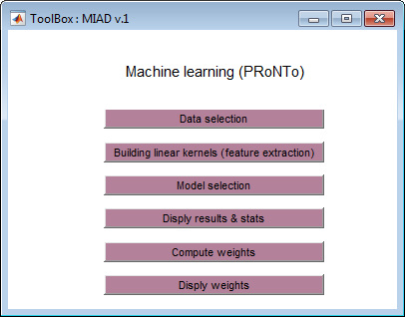
Machine learning
PRoNTo toolbox is utilized for the machine learning process.

Slide 9
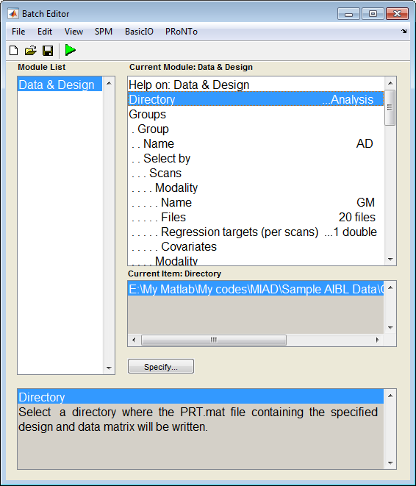
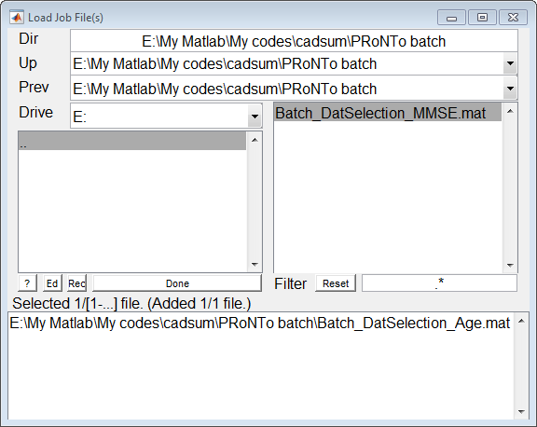
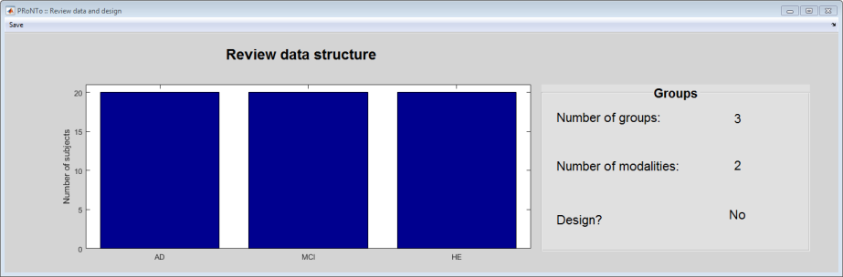
Data Selection
Data/scans are selected using batch interface.
2
1
3
A sample batch is available in “PRoNTo batch” folder. It is related to 3*20 scans from 3 groups of AD, MCI and Healthy elderly subjects .

Slide 10
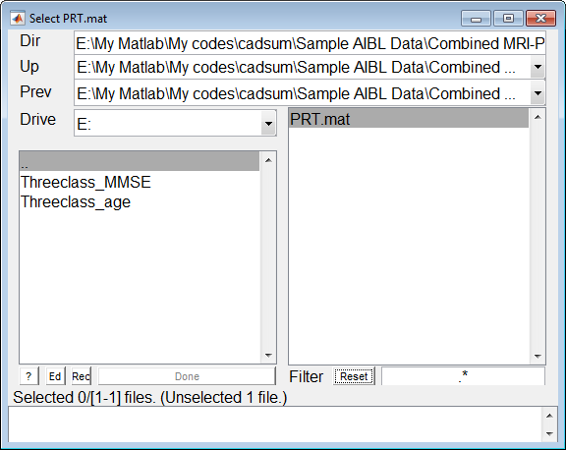
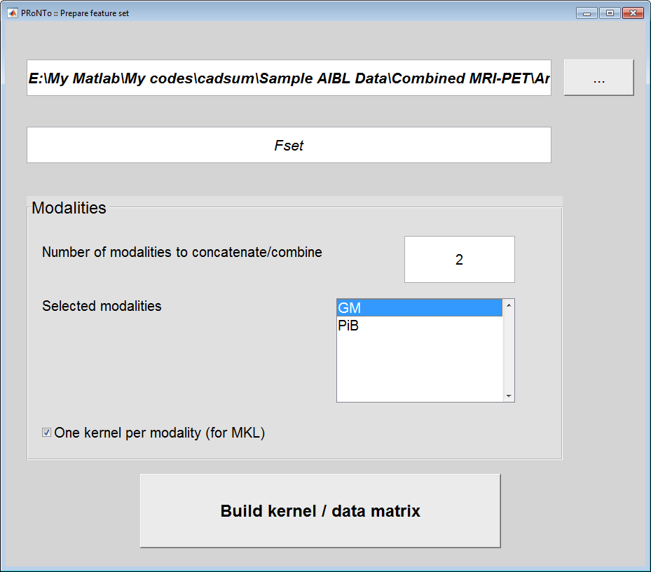
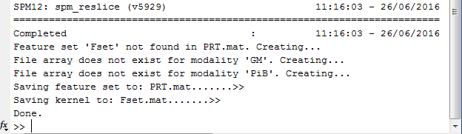
Building kernels
A example of combined PET–MRI
1
2
3

Slide 11
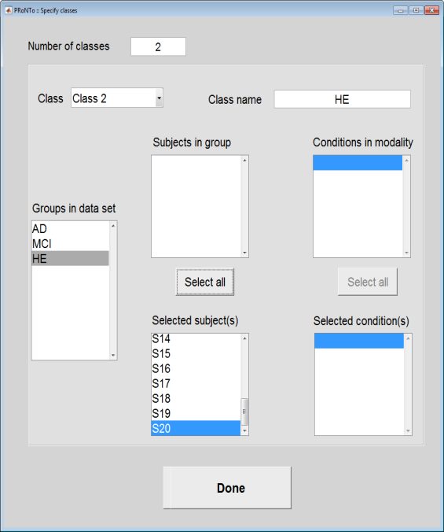
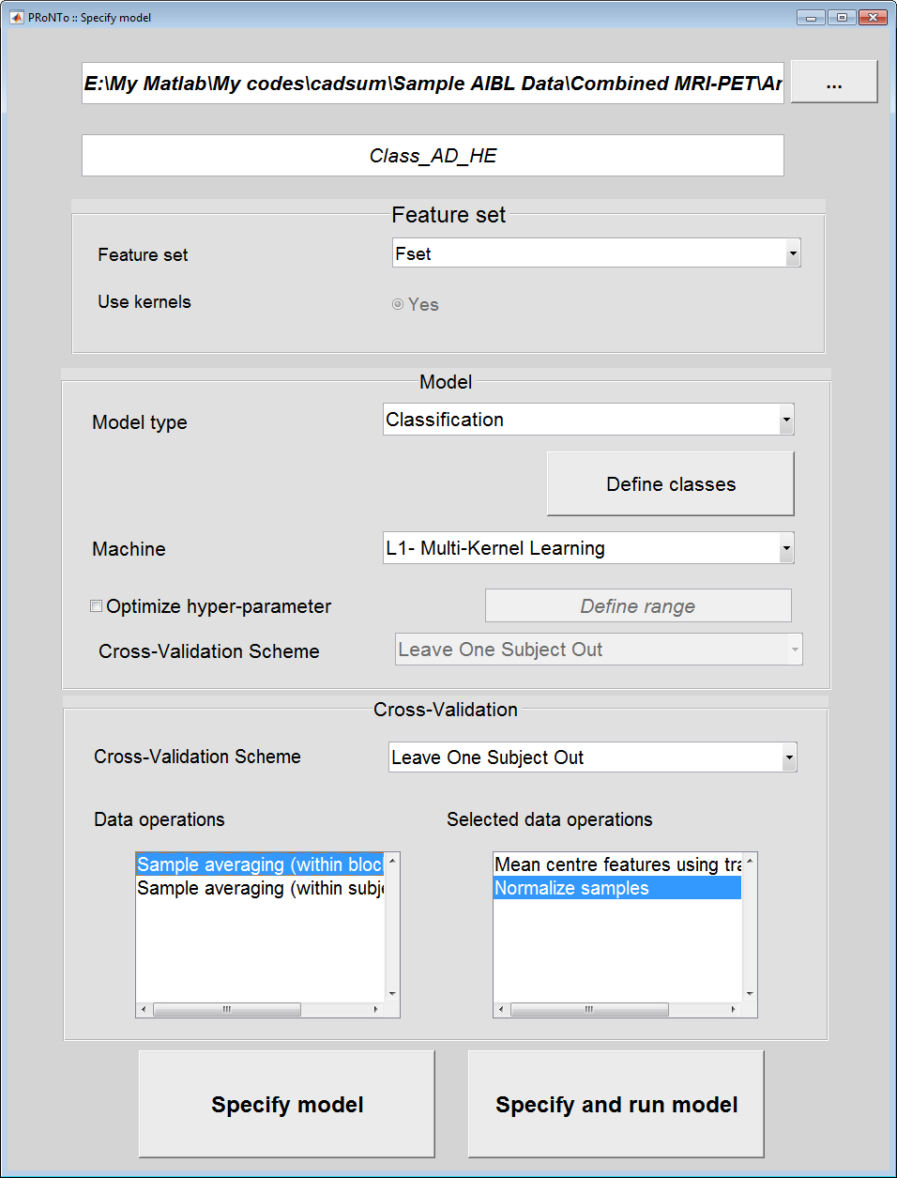
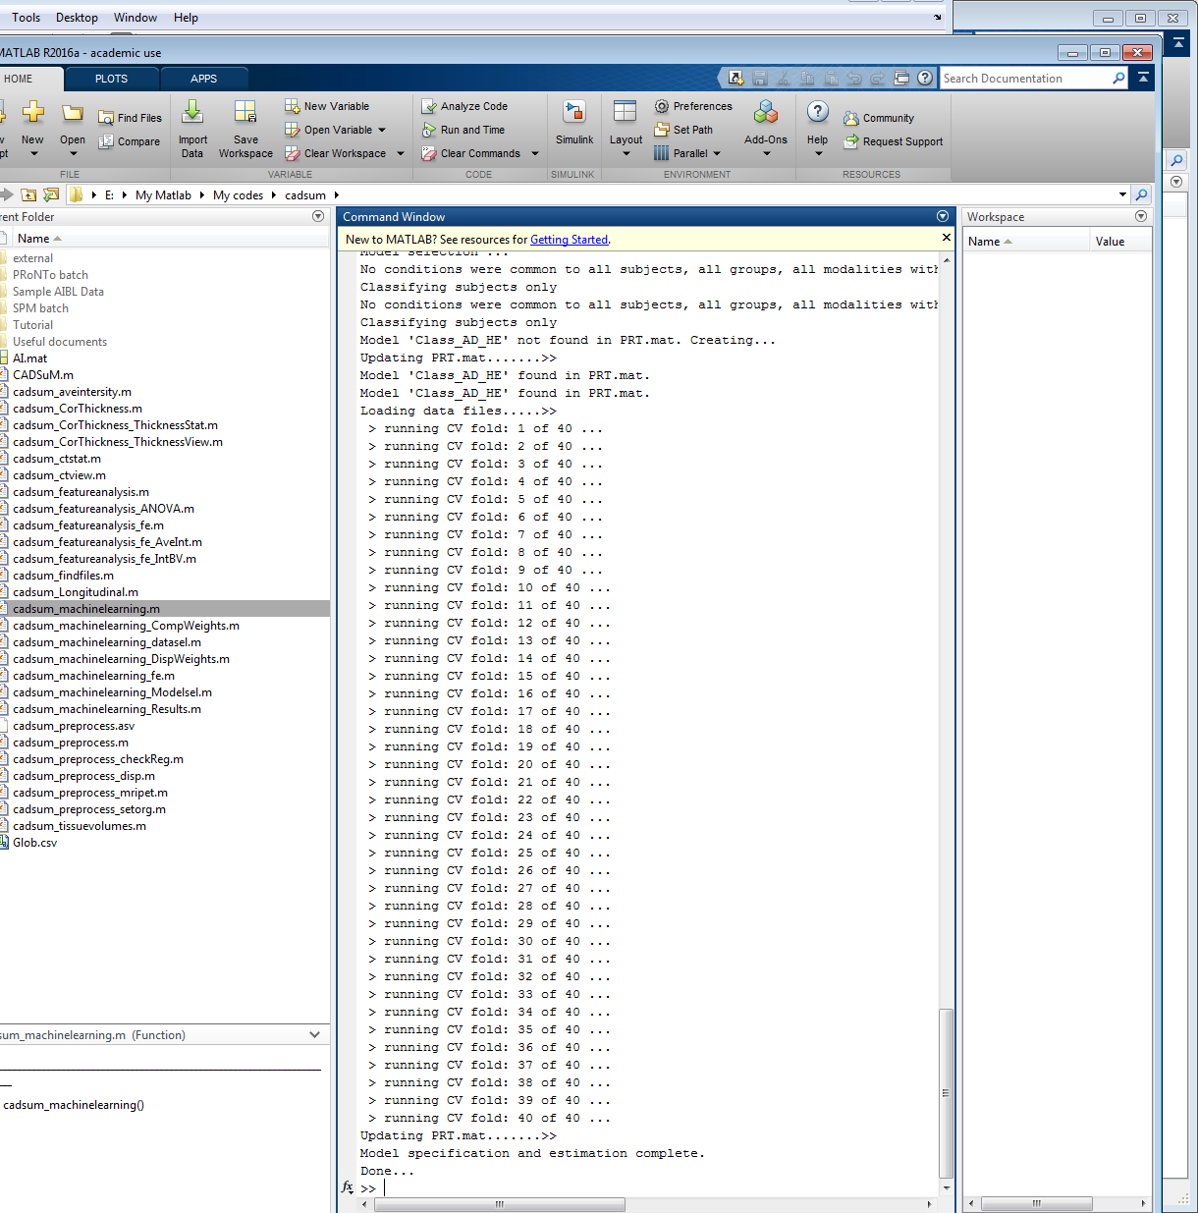
Model selection
Two-class classification example: AD vs HE

Slide 12
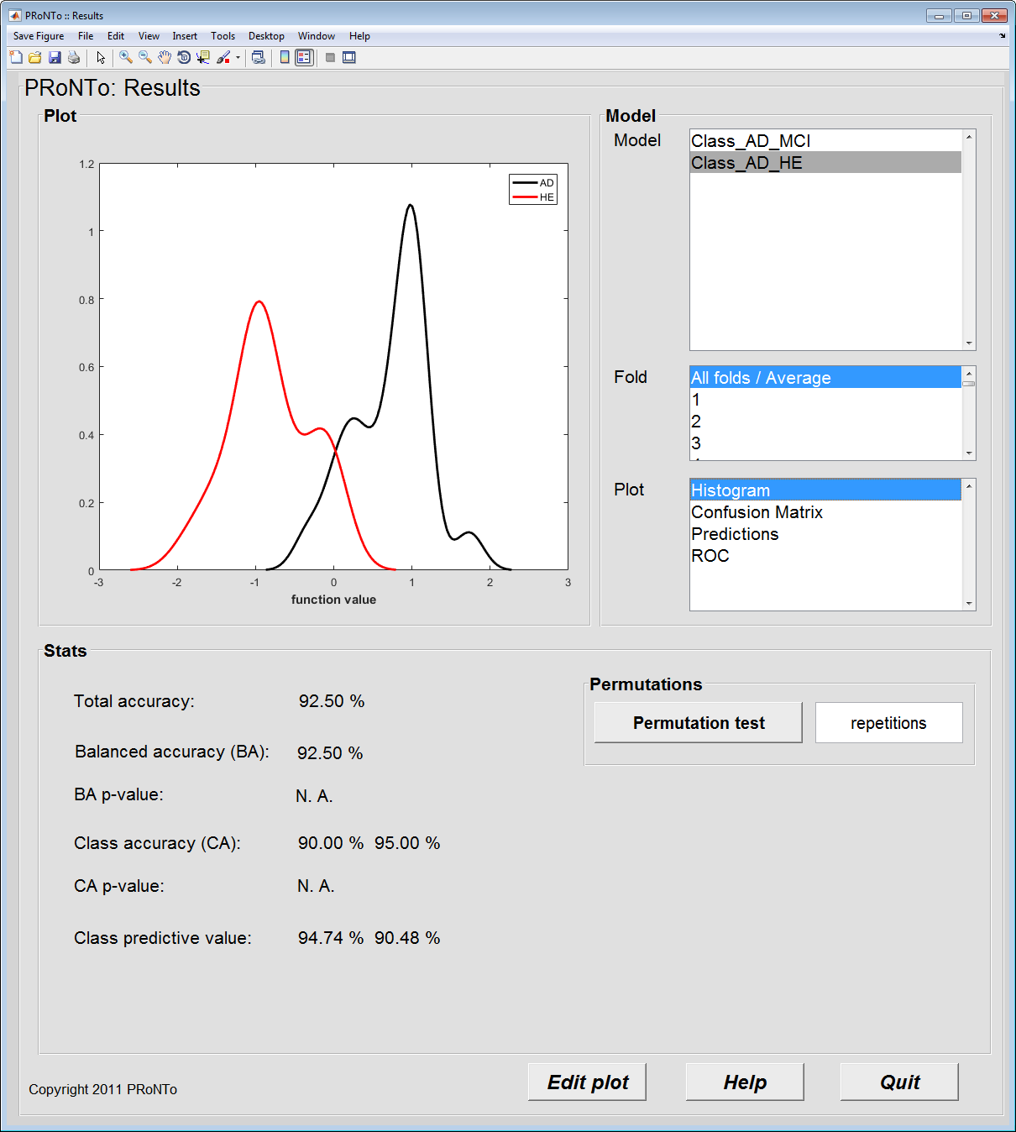
Display results & stat
Example: AD vs HE classification

Slide 13
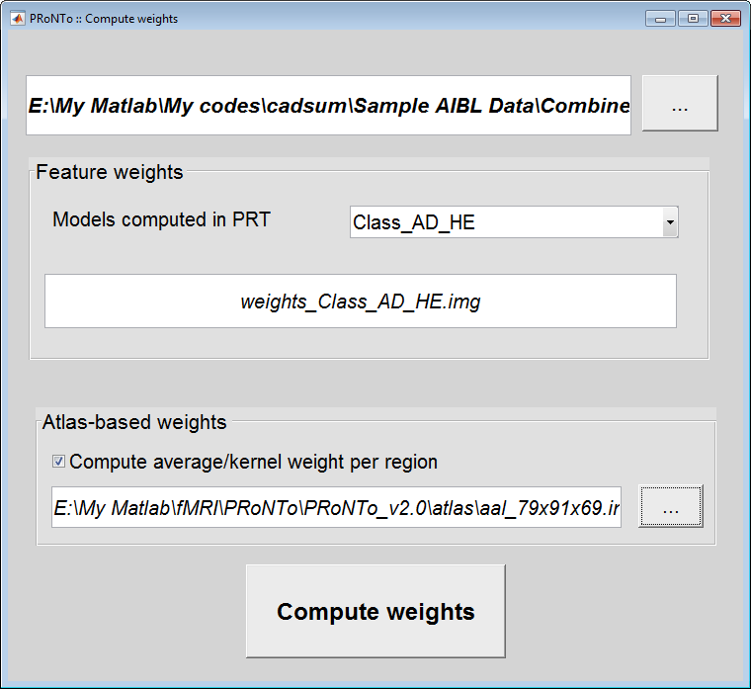
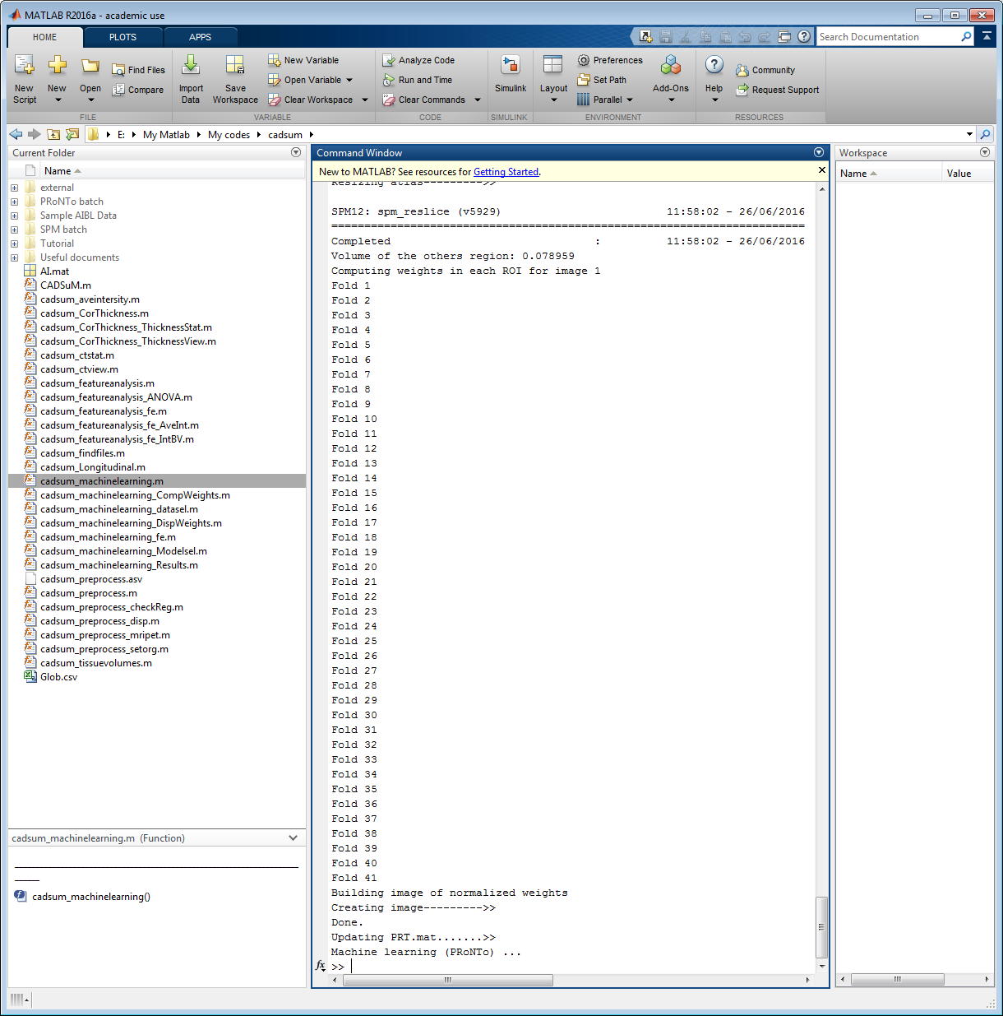
Compute weight maps

Slide 14
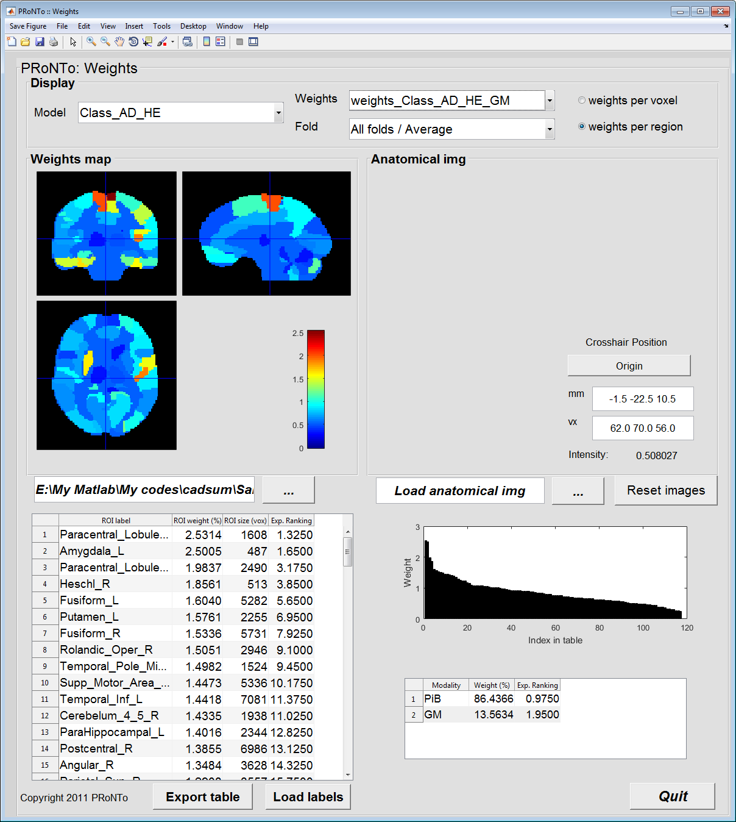
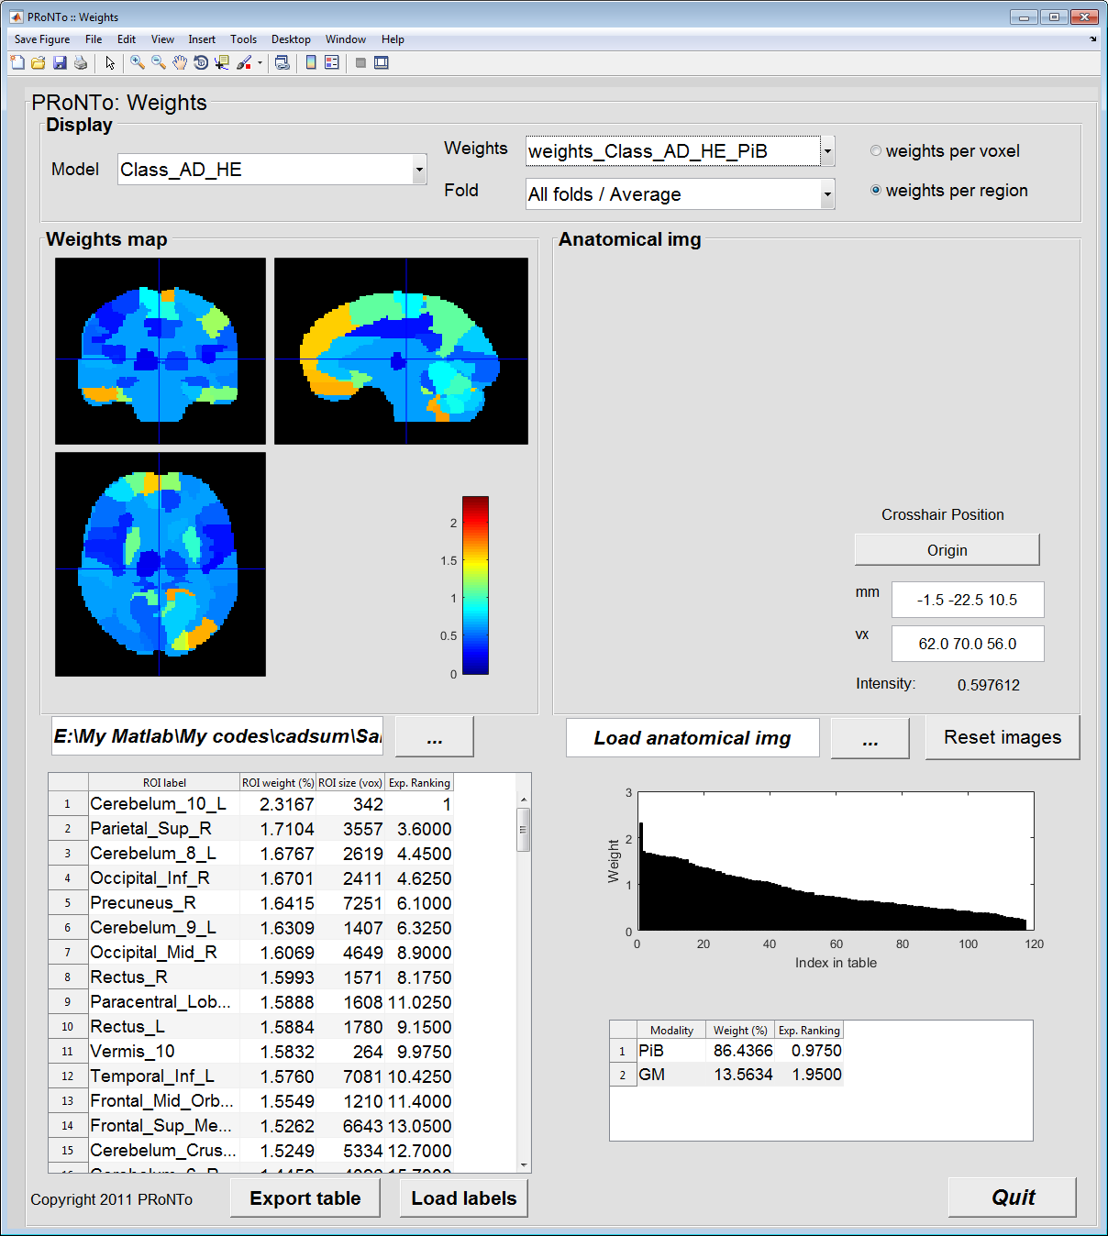
Display weights
MRI
PET

Slide 15
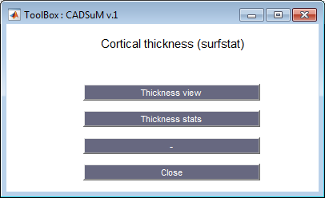
Cortical thickness
Surfstat toolbox has to be added to Matlab routines

Slide 16
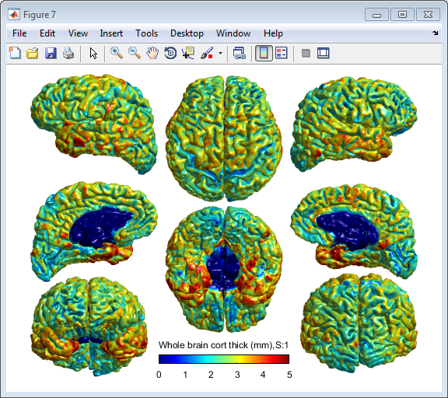
Thickness view
Note: the cortical thickness files has to be already calculated by free surfer!

Slide 17
Thickness stats
The data from a single subject or a group of subject can be analyzed.
An example of longitudinal analysis: multiple scans of one AD subject in 4 intervals.
RID SITEID VISCODE DXCURREN
5 1 bl 2
5 1 m18 1
5 1 m36 1
5 1 m54 1
RID =
Subject ID
VISCODE =
time Interval
DXCURREN =
3 = AD
2 = MCI
1 = Healthy
Results indicates an improvement: Increased cortical thickness from interval 3 (m36) to interval (m54) e.g. at Parahippocampus area~ transition from MCI to Healthy conditions.

Slide 18
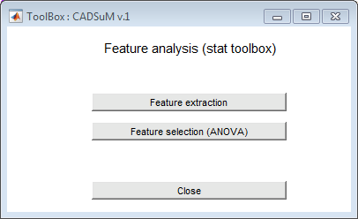
Feature analysis (stat toolbox)

Slide 19
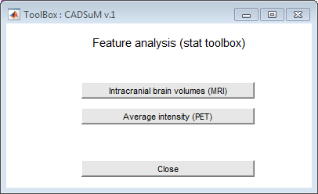
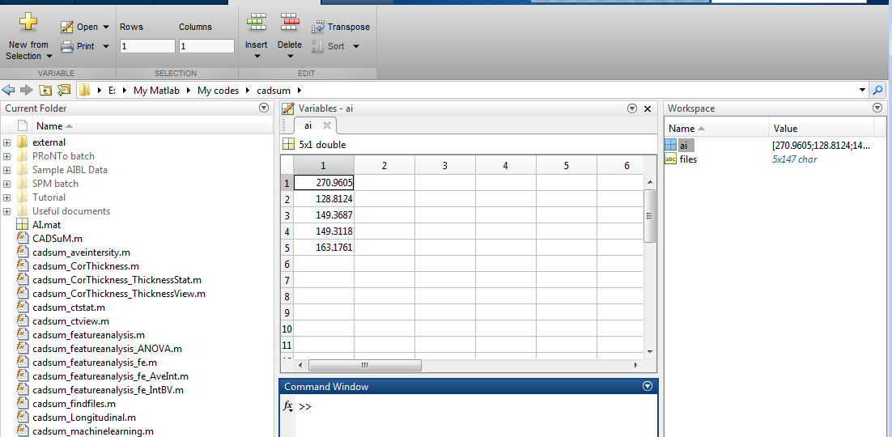
Intracranial brain volumes (MRI) Average intensity (PET)

Slide 20
Feature selection (statistical analysis)
Statistical tests, t-test (2-group analysis) and ANOVA (more than 2 groups) are utilized to analyses features.
This is under reconstruction!

Slide 21
References
Youssofzadeh V, McGuinness B, Maguire L and Wong-Lin K, 2016. A kernel-based Gaussian process for combined MRI and PET in Alzheimer’s disease. In: Alzheimer’s Research UK (ARUK) 2016 Conference, Manchester, UK. 8-9 March 2016.
Youssofzadeh V, McGuinness B, Maguire L and Wong-Lin K. Multi-kernel learning with Dartel enhances MRI-PET classification and prediction of Alzheimer’s disease: group and individual analyses, Submitted to Front. Hum. Neurosci.

