Slide 1
ColPali: Efficient Document Retrieval with Vision Language Models
ICLR 2025
Presenter：黄清华 2026.10.15

Slide 2
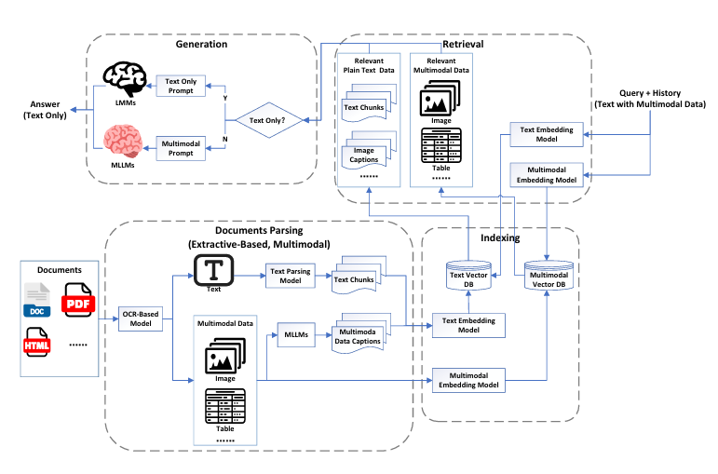
Background
Document retrieval is a fundamental component of search engines and Retrieval-Augmented Generation (RAG) systems.
Despite advances in text embedding models, practical retrieval systems still rely on complex document ingestion pipelines.
Existing pipelines usually convert visual documents into text representations through multiple stages, including OCR, layout detection, chunking and captioning. Such preprocessing may introduce information loss.

Slide 3
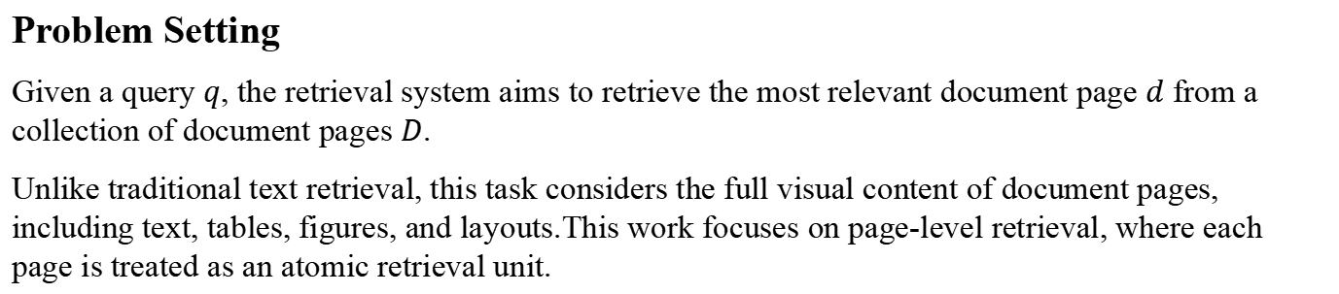
Problem Setting & Challenge
Problem Setting
Given a query $q$, the retrieval system aims to retrieve the most relevant document page $d$ from a collection of document pages $D$.
Unlike traditional text retrieval, this task considers the full visual content of document pages, including text, tables, figures, and layouts.This work focuses on page-level retrieval, where each page is treated as an atomic retrieval unit.
Challenge
Visual information is poorly exploited: existing systems mainly rely on extracted textual content.
Document ingestion pipelines are complex and costly: OCR, layout detection, chunking and captioning introduce substantial preprocessing overhead.
Existing benchmarks are insufficient for visually rich document retrieval: text retrieval benchmarks focus on passages, while vision-language benchmarks mainly focus on natural images.
Core Question: How can we evaluate and retrieve visually rich documents efficiently without relying on text-centric preprocessing pipelines?

Slide 4
Contributions Overview
1. ColPali: A Vision-Based Document Retrieval Method
2. ViDoRe: A Benchmark for Visual Document Retrieval
• Proposes a Vision-Language Model based retriever that directly embeds document page images.
• Represents each page with multi-vector embeddings rather than a single dense vector.
• Uses late interaction for efficient query-to-page matching, avoiding complex OCR-centered preprocessing.
• Introduces a comprehensive page-level retrieval benchmark for visually rich documents.
• Covers multiple modalities, domains, languages, and practical retrieval settings.
• Evaluates not only retrieval quality, but also query latency and indexing efficiency.
ColPali provides an efficient solution;ViDoRe defines the problem.

Slide 5
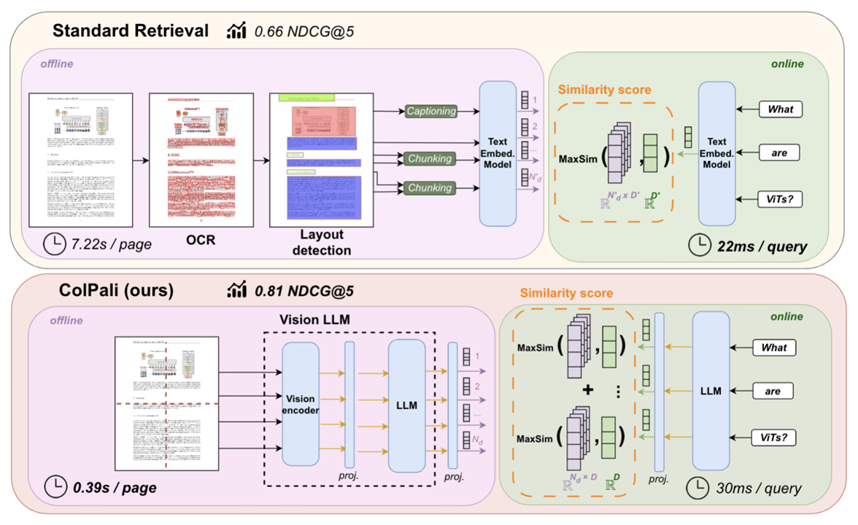
ColPali: Method Overview
ColPali directly embeds document page images for retrieval.
• Encode document pages directly from their rendered images.
• Map text queries and page images into a shared embedding space.
• Represent each page as multiple token-level vectors.
• Compute relevance with late interaction matching.
retrieval in vision space without OCR-centered preprocessing

Slide 6
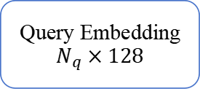

ColPali: Multi-Vector Representation
Both queries and document pages are represented as sequences of 128-dimensional vectors, rather than a single dense vector.
Query Representation
Text Query
Tokenization + PaliGemma
Projection Head
Query Embedding
$$N_{q}×128$$
• Queries are tokenized into subword tokens rather than words.
• Additional formatting and query-expansion tokens are included during preprocessing.
• Therefore, the number of query vectors depends on the query length after tokenization.
• Each resulting token representation is projected to 128 dimensions.
$E_{q}∈ R^{N_{q}×128}$

Slide 7
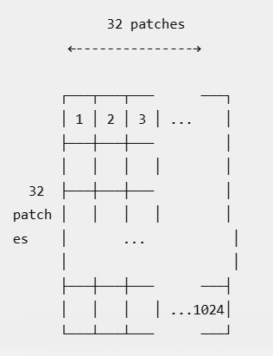
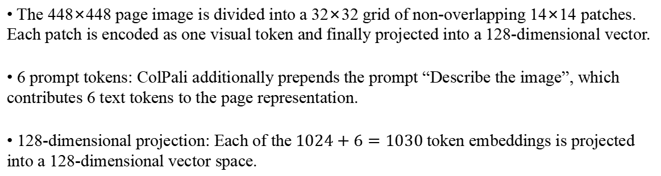
ColPali: Multi-Vector Representation
Document Page Representation
Document Page
Image
PaliGemma-3B
(VLM)
1024 Image Patch Tokens
+ 6 Prompt Tokens
Projection Head
Page Embedding
1030 × 128
• The 448×448 page image is divided into a 32×32 grid of non-overlapping 14×14 patches. Each patch is encoded as one visual token and finally projected into a 128-dimensional vector.
• 6 prompt tokens: ColPali additionally prepends the prompt “Describe the image”, which contributes 6 text tokens to the page representation.
• 128-dimensional projection: Each of the$1024+6=1030$token embeddings is projected into a 128-dimensional vector space.

Slide 8
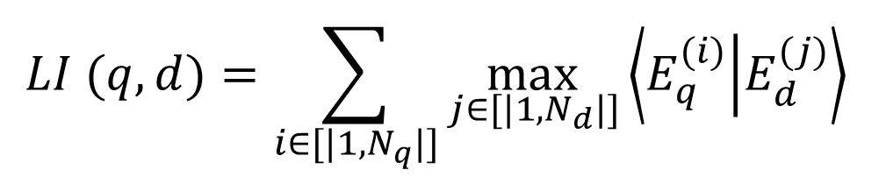
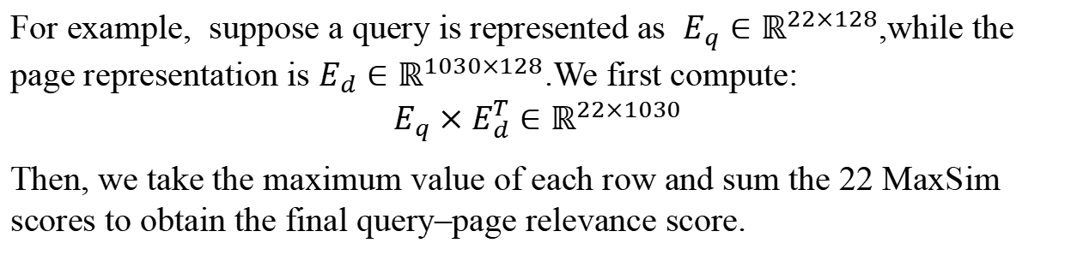
ColPali: Late Interaction
Fine-grained matching happens after query and document representations are computed.
• For each query vector, compare it with all page vectors.
• Keep the maximum similarity score (MaxSim).
• Sum MaxSim scores over all query vectors.
$$LI (q,d)=\sum_{i∈[|1,N_{q}|]}{\max_{j∈[|1,N_{d}|]}\left\langle E_{q}^{(i)} | E_{d}^{(j)}\right\rangle }$$
For example, suppose a query is represented as $E_{q}∈ℝ^{22×128}$,while the page representation is $E_{d}∈ℝ^{1030×128}$.We first compute:
$$E_{q}×E_{d}^{T}∈ℝ^{22×1030}$$
Then, we take the maximum value of each row and sum the 22 MaxSim scores to obtain the final query–page relevance score.
Late interaction preserves fine-grained local matching while allowing document embeddings to be pre-computed offline.

Slide 9
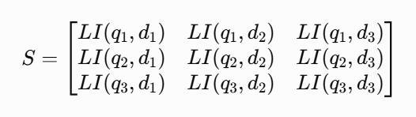
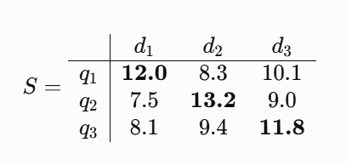
ColPali: From LI Scores to Positive / Negative Pairs
For each query, ColPali computes a Late Interaction score with every candidate page.
The page with the highest LI score is ranked first.However, the Rank-1 page is not necessarily the ground-truth page during training.
• Diagonal entries:
Correct query–page pairs (positive pairs)
• Off-diagonal entries:
Incorrect query–page pairs (in-batch negatives)
• Positive score: the score of the ground-truth query–page pair: ${ s}_{k}^{+}=LI(q_{k},d_{k})$
• Hardest negative: the highest-scoring incorrect page in the same batch$: s_{k}^{−}= \max_{l≠k}{LI(q_{k},d_{l})}$

Slide 10


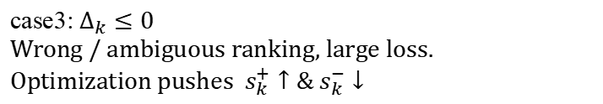

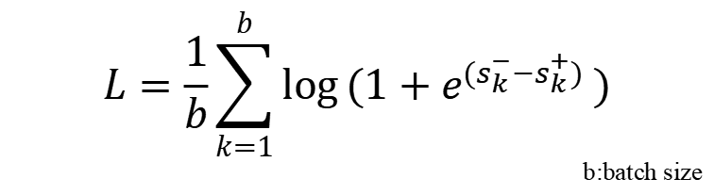
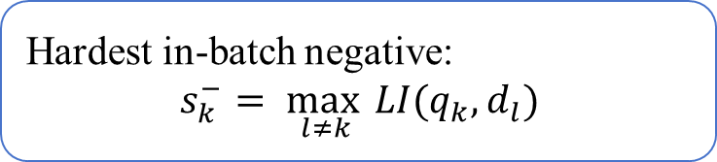
ColPali: Contrastive Training Objective
Late interaction is fully differentiable, allowing ColPali to be trained end-to-end.
Positive score:${ s}_{k}^{+}=LI(q_{k},d_{k})$
$$L=\frac{1}{b}\sum_{k=1}^{b}{\log{(1+e^{(s_{k}^{−}−s_{k}^{+})}})}$$
        b:batch size
Hardest in-batch negative:
$$s_{k}^{−}= \max_{l≠k}{LI(q_{k},d_{l})}$$
$$∆_{k}={s_{k}^{+}− s}_{k}^{−}$$
case1: $∆_{k}≫0$
Small loss, confident correct ranking
The model learns to maximize the margin between the ground-truth page and the hardest negative page.
case2: $∆_{k}>0$
Correct ranking, but margin is still enlarged
case3: $∆_{k}≤0$
Wrong / ambiguous ranking, large loss.
Optimization pushes ${ s}_{k}^{+}↑\& s_{k}^{−}↓$

Slide 11
ColPali: Training Details
The model is trained on query–page pairs and optimized for retrieval.
Training Data
Training Configuration
• 118,695 query–page pairs in total:
- 63% from public academic datasets
- 37% from synthetic web-crawled PDFs
• Synthetic queries generated with Claude-3 Sonnet
• English-only training set
• No document overlap between Training data and ViDoRe test sets.
• 1 training epoch
• LoRA fine-tuning: r = 32, α = 32
• bfloat16 + paged AdamW 8-bit
• Batch size = 32
• Learning rate = 5 × 10⁻⁵
• 8-GPU data parallel training

Slide 12
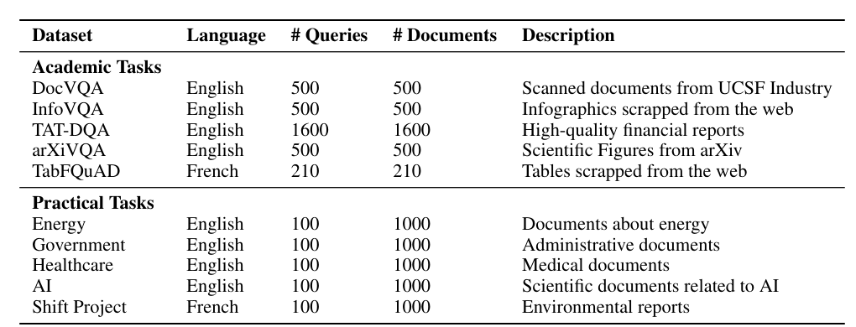
ViDoRe
ViDoRe evaluates whether a retrieval system can match a user query to the correct document page.
Coverage
Modalities: text, figures, infographics, tables
Domains: medical, business, scientific, administrative
Languages: English and French
Task difficulty: from simple to visually complex retrieval settings
10 sub-datasets: 5 academic tasks + 5 practical tasks

Slide 13
ViDoRe: Task Construction
ViDoRe contains two complementary types of retrieval tasks.
Academic Tasks
Existing Visual Question Answering datasets are repurposed as retrieval tasks.
For each (page, question, answer) triplet:
  Query = Question
  Gold document = Corresponding page
Examples: DocVQA, InfoVQA, TAT-DQA, arXivQA, TabFQuAD.
Practical Tasks
Designed to better reflect realistic industrial retrieval scenarios such as RAG.
Public PDF documents are collected from multiple domains.
Queries are generated from document pages using Claude-3 Sonnet.
Each topic contains 1,000 pages and 100 manually filtered queries.
ViDoRe combines existing academic resources with newly constructed practical retrieval tasks, providing a more comprehensive evaluation framework for visual document retrieval.

Slide 14
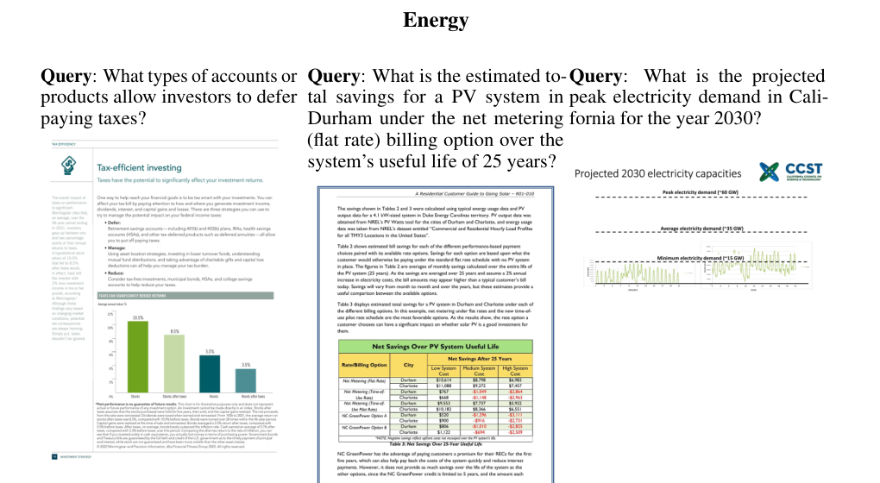
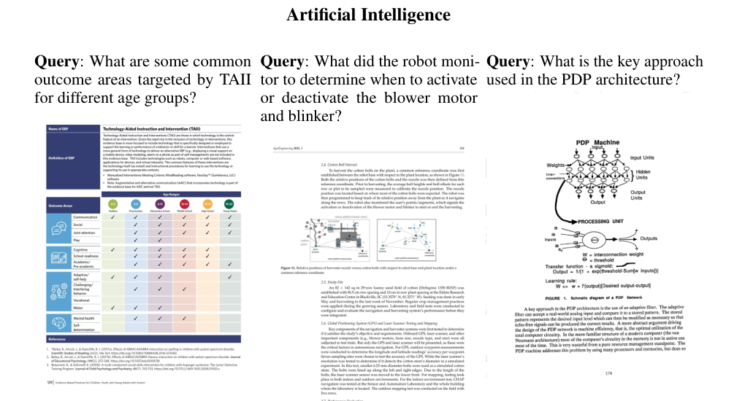
ViDoRe: Examples from the Benchmark
Each example pairs a natural-language query with the relevant document page.
Energy: queries may require reading charts, tables, and report layouts.
Artificial Intelligence: queries may target scientific figures and technical diagrams.

Slide 15
ViDoRe: Evaluation Protocol
The benchmark measures both retrieval effectiveness and practical system efficiency.
Page-level Retrieval
Given a query, the system scores candidate document pages and produces a ranked list.
The gold page should appear as high as possible in the ranking.
Retrieval Metrics
nDCG@5 — main reported metric
Recall@K
MRR
Query
user information need
Candidate Pages
page-level corpus
Ranked List
top-k results
Practical Requirements
R1: strong retrieval performance
R2: fast online querying
R3: high-throughput offline indexing
This design enables fair comparison across text-only pipelines, OCR/captioning systems, and visual retrievers.

Slide 16
ViDoRe: Construction of Practical Datasets
The practical tasks are designed to approximate real-world RAG retrieval settings.
• Web Crawling: Collect public PDFs using topic-specific searches
• PDF Corpus: Documents from Energy, Government, Healthcare, and AI domains
• Page Images: Convert each PDF into page-level visual inputs
• VLM Query Generation: Generate page-grounded Q/A pairs with a VLM
• Human Validation: Filter queries for quality, relevance, and consistency
Making Retrieval Challenging
The corpus is designed with domain-specific documents where candidate pages often share similar topics and vocabulary.This prevents retrieval from becoming a coarse-grained classification problem and requires fine-grained page-level matching.

Slide 17
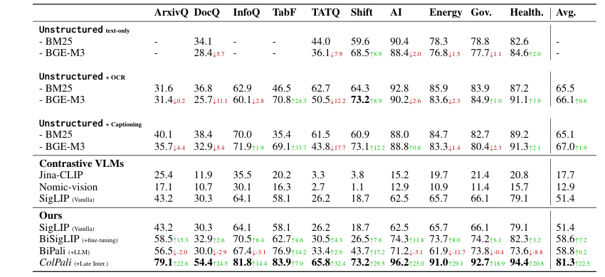
Results: Main Retrieval Performance
Evaluation on ViDoRe (nDCG@5)
Best Overall
ColPali reaches 81.3 average nDCG@5 on ViDoRe.
Strong Baselines
It outperforms OCR and captioning-based retrieval pipelines.
Visual Tasks
ColPali shows particularly strong improvements on visually rich document tasks.

Slide 18
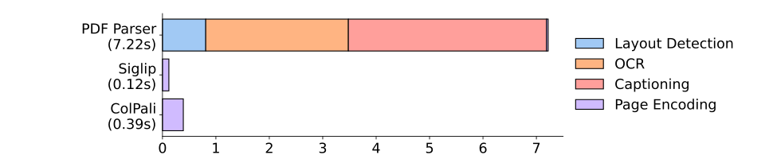
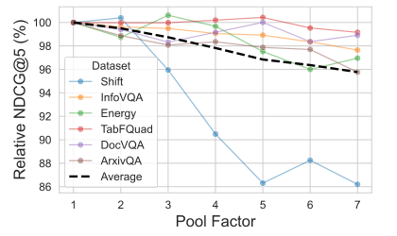
Results: Efficiency and Storage Trade-offs
Offline indexing latency
Standard PDF Parser
7.22 s / page
ColPali
0.39 s / page
Query encoding
≈ 30 ms
Storage cost and token pooling
Raw ColPali index: 257.5 KB per page.
Pooling factor 3 reduces stored vectors by 66.7%.It retains 97.8% of the original retrieval performance.

Slide 19
Conclusion
• Problem Reframing
Visually rich document retrieval should not be treated simply as text retrieval after OCR.
Tables, figures, layouts, and other visual elements may directly determine document relevance.
• ViDoRe
ViDoRe establishes a dedicated page-level benchmark for visual document retrieval, covering multiple modalities, domains, languages, and practical retrieval settings.
• ColPali
ColPali retrieves document pages directly in the visual space. It represents each page using multiple token-level embeddings and applies late interaction for fine-grained query–page matching.
• Main Findings
Experiments on ViDoRe show that ColPali substantially outperforms traditional OCR and captioning-based retrieval pipelines while simplifying the offline document indexing process.

Slide 20
Future Work
• Visual Retrieval + Visual Question Answering
Future systems may combine visual retrieval with downstream visual question answering, enabling fully image-based Retrieval-Augmented Generation pipelines.
• Confidence Estimation and Abstention
Retrieval systems should estimate confidence and abstain when relevant information is not available, improving reliability in practical applications.
• More Languages, Modalities, and Tasks
Extending evaluation to additional languages, document types, modalities, and retrieval tasks would provide a more comprehensive assessment of visual document retrieval systems.

Slide 21
Limitations & Discussion
ViDoRe Benchmark
• Limited scale and evaluation scope
Although ViDoRe provides a systematic evaluation framework for visual document retrieval, its current scale and language coverage are still relatively limited compared with real-world document collections.
ColPali Method
• Multi-vector storage Overhead
ColPali represents each page with hundreds of token-level vectors instead of a single dense embedding. This improves fine-grained matching but significantly increases index storage requirements.Vector compression and efficient indexing strategies are required for large-scale deployment.
• Page-level Representation Limitation
ColPali avoids text chunking by directly encoding rendered pages, but the retrieval unit is still limited to a single page.Information spanning multiple pages, such as cross-page figures or tables, may be fragmented into different page embeddings, making document-level reasoning challenging.

Slide 22
Thanks！

