Slide 1


Deep Residual Learning for Image Recognition
CVPR 2016
Kaiming He Xiangyu Zhang Shaoqing Ren Jian Sun
October 15, 2026

Slide 2
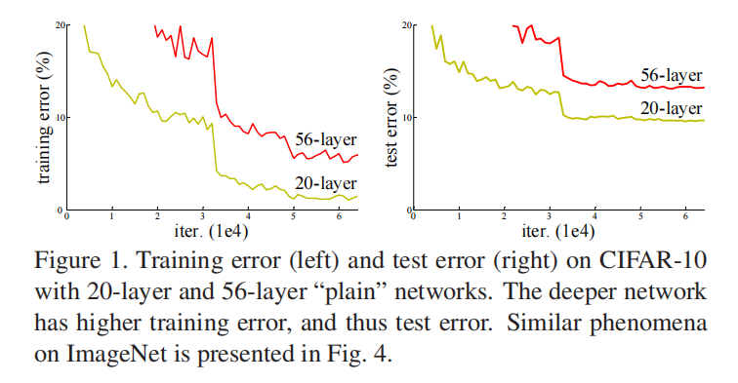
1.The degradation problem of deep networks
VGG and GoogLeNet showed that depth is important for image classification.
But directly stacking more layers leads to "degradation":
Both training error and test error become worse;
This is not overfitting, because performance is also worse on the training set.

Slide 3
1.The degradation problem of deep networks
Vanishing/exploding gradients have been alleviated by methods such as Batch Normalization(BN) and initialization, but degradation still exists. In fact, degradation means that training gets stuck; it is an optimization difficulty.
Key question: Can we make a deeper network at least no worse than a shallower network?

Slide 4
2.Let network learn "residuals"
Initial goal: the stacked layers was expected to learn the target mapping H(x).
ResNet approach: make the stacked layers learn the residual: F(x) = H(x) − x.
To the extreme, If the identity mapping is optimal, the network only needs to learn F(x) to be 0, which is easier than directly learning H(x) = x.

Slide 5
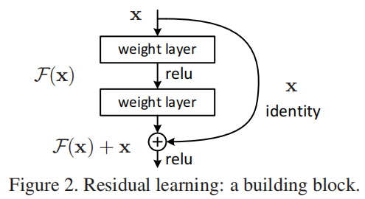
2.Let network learn "residuals"
Shortcut Connection: x is directly added to the output of later layers through a "shortcut." This shortcut has no additional parameters ,does not increase computational cost, and allows gradients to backpropagate directly from deep layers to shallow layers, thereby alleviating the vanishing gradient problem.
Problem: If x and F(x) have different shapes, they cannot be added directly.
core idea: The essence of ResNet is not "deepening," but "making depth trainable."

Slide 6
3.Two residual blocks and architecture
BasicBlock: two 3×3 convolutions, used in ResNet-18/34.
Bottleneck: 1×1 dimensionality reduction → 3×3 convolution → 1×1 dimensionality expansion, used in ResNet-50/101/152. This is mainly for controlling the amount of computation.
Overall architecture:
Preprocessing、downsampling part: conv1---7×7 convolution + max pooling;
4 stages with stacked residual blocks: conv2_x、conv3_x、conv4_x、conv5_x
Global Average Pooling(GAP) + fully connected classification

Slide 7
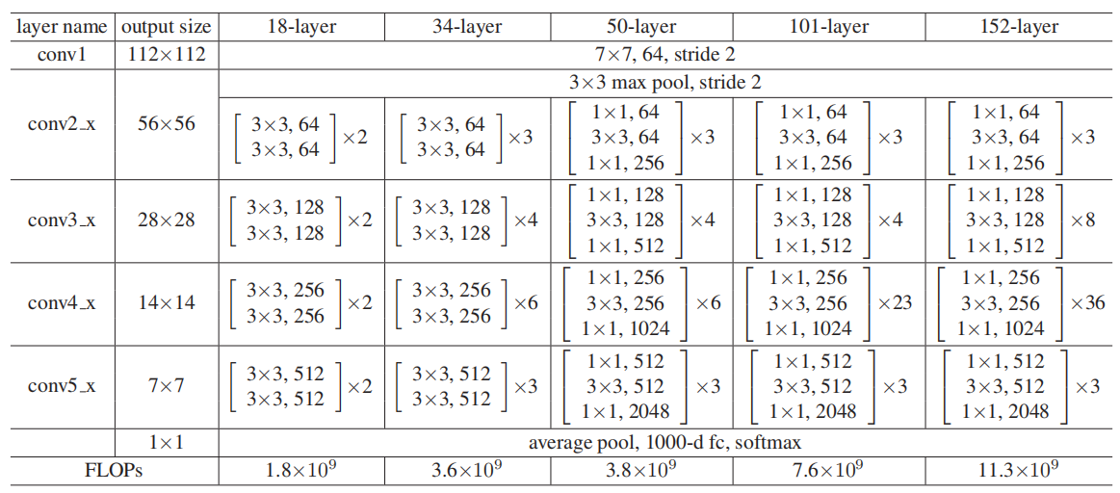
3.Two residual blocks and architecture

Slide 8
4.Experimental procedure
Datasets: ImageNet 1000 classes; CIFAR-10; COCO detection/segmentation.
Data augmentation: random cropping, horizontal flipping, color normalization, etc.
Optimization: SGD, momentum=0.9, batch size=256, weight decay=1e-4.
Learning rate: starts at 0.1, reduced by a factor of 10 when the error plateaus.
Use BN, do not use dropout.
Comparison:
Same depth: plain network vs. residual network.
Residual networks at different depths: ResNet-18/34/50/101/152.
Highlight: The plain and ResNet structures are basically identical; the only key difference is whether a shortcut is used.

Slide 9
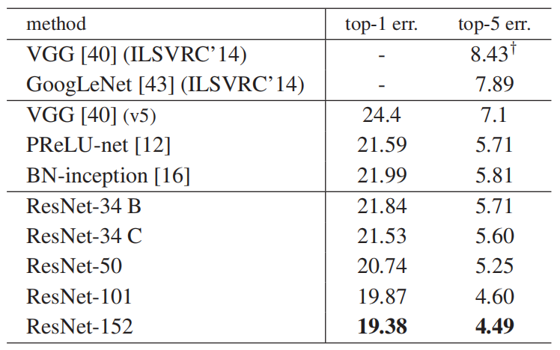
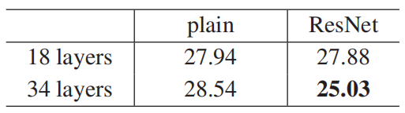
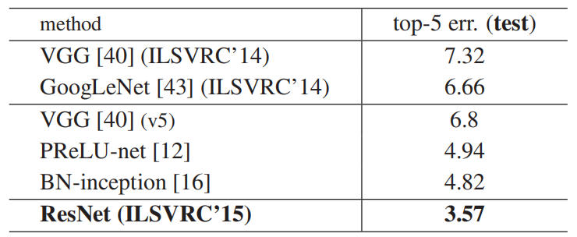
5.Results
ImageNet:
ResNet-152 ensemble model achieved a top-5 error of 3.57% and won the ILSVRC 2015 classification championship;
the single model achieved about 4.49% top-5 error.
The impact of depth:
When plain networks are made deeper, they instead suffer from degradation.
ResNet-34 is significantly better than ResNet-18; 50/101/152 continue to improve;
Experimental conclusion: Residual connections are generally effective and make extremely deep networks truly trainable.

Slide 10
6.Contributions
Proposed the residual learning framework;
Solved the degradation problem of deep networks;
Became a foundational component in subsequent network design;
Provided a general method for making deep networks optimizable;

