Slide 1
Mini-Project:
KeyLogger

Slide 2

Hello!
I am Anass Denguir
OS-SEC Student
You can find me at:
andengui@ulb.ac.be

Slide 3
0.
Design Plan
Let’s start with the plan

Slide 4
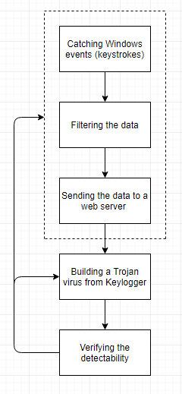
Design Plan
1- Constantly check new keystrokes
2- Filter the data with an algorithm
3- Send the filtered data to a server
4- Hide the Keylogger
5- Verify the detectability

Slide 5
1.
Architecture Design

Slide 6
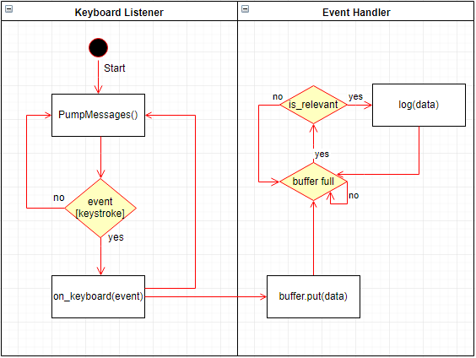
Architecture Design
Two main objects are working concurrently

Slide 7
2.
Extracting Passwords

Slide 8
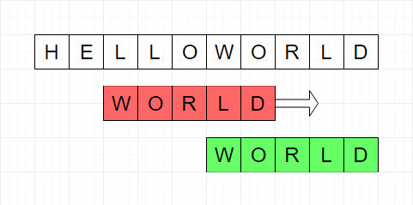
Extracting passwords
1- Define key words
2 - Evaluate if key word appears in Window Name

Slide 9
3.
Sending the logs

Slide 10
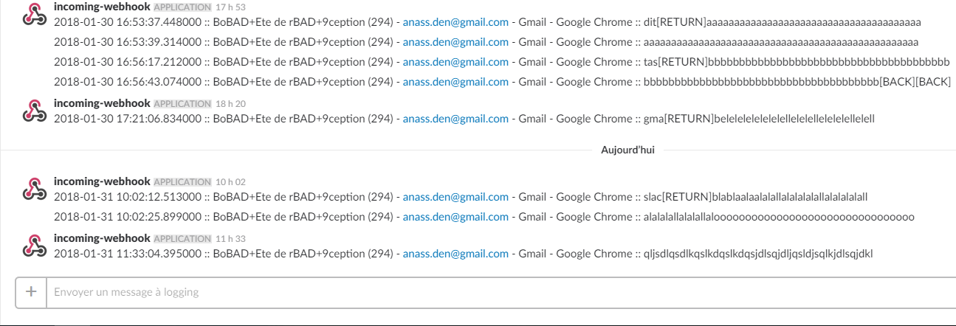
Format of the logs
Date + Hour :: Window Name :: Text

Slide 11
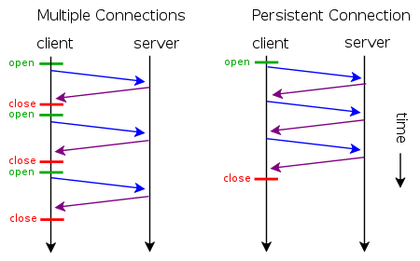
Persistent Connection

Slide 12
4.
Hide the Keylogger

Slide 13

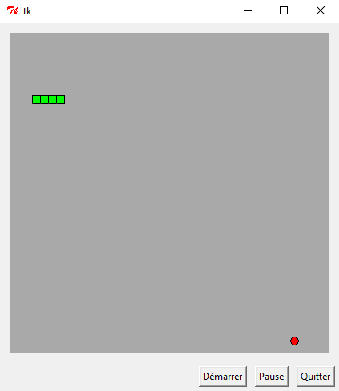
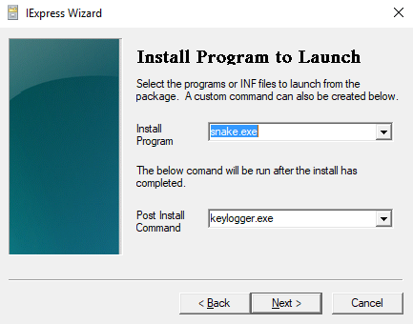
Making a Trojan Virus
Merging the virus with another application
For example, a game

Slide 14
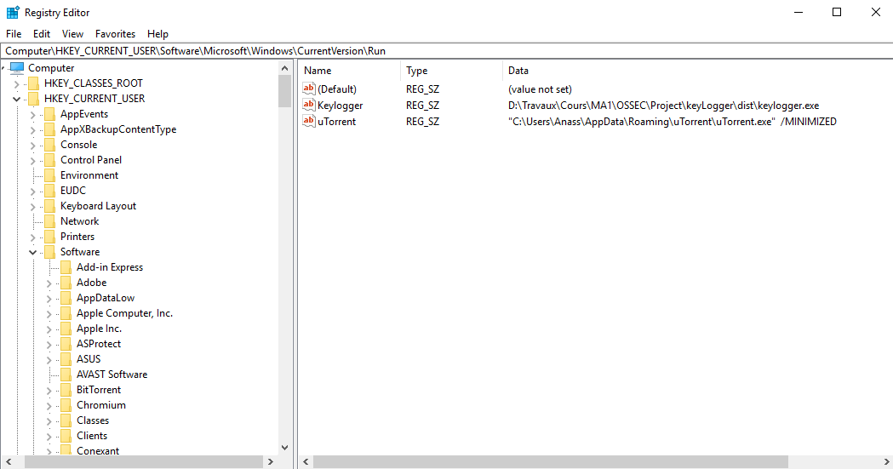
Persistence in Registry

Slide 15
5.
Verify Detectability

Slide 16
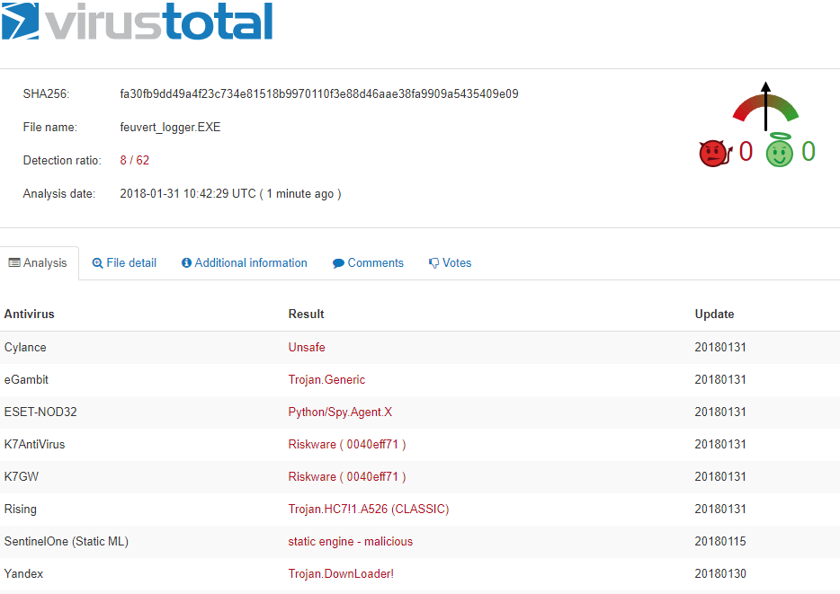
Detectability Analysis
Detectability Ratio: 13%

Slide 17
Thanks!
Any questions?

Slide 18
Credits
Special thanks to all the people who made and released these awesome resources for free:
Presentation template by SlidesCarnival
Photographs by Unsplash & Death to the Stock Photo (license)

