Slide 1
Pericom’s Latest USB S&C PI5USB2544, PI5USB2544A, PI5USB2546, PI5USB2546A

Slide 2
USB Charging Controller for PC
Provide charging function when OS is in any mode:
S0 (on) /
S3 (Standby mode)/
S4 (Hibernate mode)/
S5 (Shut down)

Slide 3
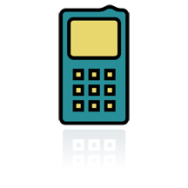

USB Charging Controller for PC
S0: Standard port (500mA) or Charging port (CDP - 1.5A) per USB BC1.2
S3/S4/S5: convert port from a dead port to a dedicated charging port per USB BC1.2, YD/T-1591-2009, and fulfill Samsung Galaxy charger or Apple charger requirements
Pericom’s
USB
Charger IC
USB
controller
D+
D-

Slide 4
S0 (Normal USB operation)
Standard Downstream Port - SDP
If bus is not suspended and configured, maximum output current = 500mA (USB2.0)
Charging Downstream Port – CDP
supply a maximum of 1.5 A

Slide 5
S3/S4/S5 = Sleep and Charge
Dedicate mode charger (DCP)
USB charging specification 1.1/1.2
Chinese Telecommunication Industry Standard YD/T1591-2009 charger specification
Maximum current = 1.5 A at 5.25 V.
D+
R
0 to 200Ω
D-

Slide 6
S3/S4/S5 = Sleep and Charge
Non BC 1.2 spec.
Apple different charger mode
iPad charger (Max. charging current 2A and 2.4A)
Other Apple device charger (Max. charging current up to 1A)
Samsung fast charger mode (for Galaxy Tab)
Output Voltage | Apple 1A | Apple 2A | Apple 2.4A
D+ | 2.0V | 2.7V | 2.7V
D- | 2.7V | 2.0V | 2.7V
Output Voltage | Samsung Galaxy
D+ | 1.2V
D- | 1.2V

Slide 7
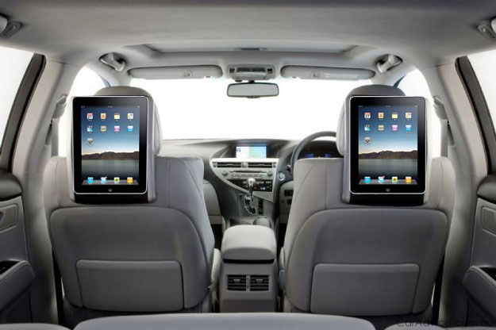
Different Charging per BC1.2 - CDP/ SDP/ DCP
CDP: Charging downstream port ( 1.5A), data transaction + charging
SDP: Standard downstream port (USB2.0 = 500mA; USB3.0 = 900mA ), data transaction + charging
DCP: Dedicated charging port, (1.5A), charging only

Slide 8
How Portable device distinguish the SDP, CDP, DCP
Two Detection stage according to Battery Charging Specification
Primary detection - distinguish whether the USB port is SDP or CDP and DCP
PD send out a 0.5-0.7V pulse from D+ and check whether the USB port reply a 0.5-0.7V pulse from D-
SDP - No reply on D-
CDP/DCP – reply on D-
Secondary detection - distinguish whether the USB port is CDP or DCP (BC1.2 only)
PD send out a 0.5-0.7V pulse from D- and check whether the USB port reply anything on D+
CDP - No reply on D+
DCP – receive a signal from D+ (As D+/D- short together)

Slide 9
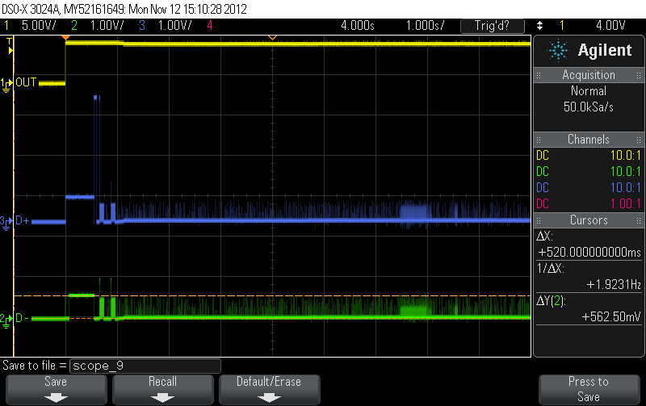
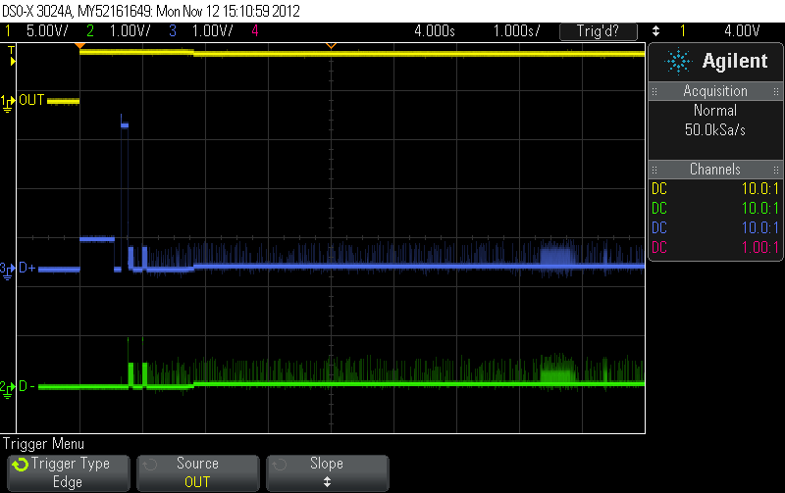
Waveform of CDP and SDP
A CDP requested PD plugged into a CDP port and a SDP port
Waveform index:
Yellow = Vbus
Green = D-
Blue = D+
CDP mode
SDP mode
Notes:
9

Slide 10
Pericom’s latest USB S&C IC – PI5USB2544, PI5USB2544A, PI5USB2546, PI5USB2546A

Slide 11
PI5USB2543 vs 2546/A vs 2544/A
Features | PI5USB2543 | PI5USB2546 = TPS2546 | PI5USB2546A | PI5USB2544 = TPS2544 | PI5USB2544A
Port power control (PPC) | No | Yes | Yes | No | No
Automatic CDP/SDP switching for devices that do not connect to CDP port | No | Yes | Yes | Yes | Yes
LS KB/mouse wake-up when S0 ←→ S3 | Yes | Yes | Yes | Yes | Yes
FS KB/mouse wake-up when S0 ←→ S3 | No | Yes | Yes | Yes | Yes
OCP, OTP, OVP | Yes | Yes | Yes | Yes | Yes
OCP Precision | +/-20% | +/-7% (trim) | +/-7% (trim) | +/-7% (trim) | +/-7% (trim)
Power wake (plug-in detection in S3, S4 and S5) | Yes | Yes | Yes | Yes | Yes
YD/T 1591-2009 charging (D+/- shorted and charging) | Yes | Yes | Yes | Yes | Yes
BC 1.2: DCP, SDP, CDP | Yes | Yes | Yes | Yes | Yes
Power MOSFET RON | 100mΩ | 73mΩ | 73mΩ | 73mΩ | 73mΩ
Non-BC 1.2 charging: Apple 1A, 2A (Divider-1A, -2A) charging | Yes | Yes | Yes | Yes | Yes
Non-BC 1.2 charging: Samsung 1.2V fast charging (DCP-1.2V) | No | Yes | Yes | Yes | Yes
Non-BC 1.2 charging: Apple 2.4A charging, (Divider-2.4A) | No | No | Yes | No | Yes
Reverse leakage protection | No | Yes | Yes | Yes | Yes

Slide 12
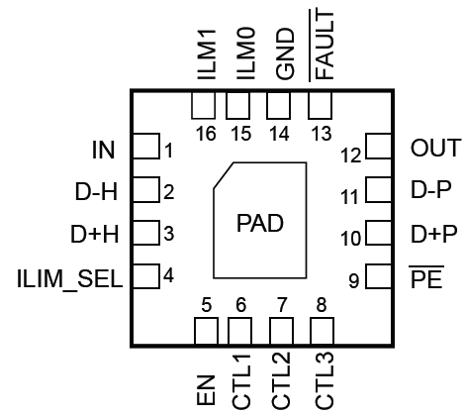
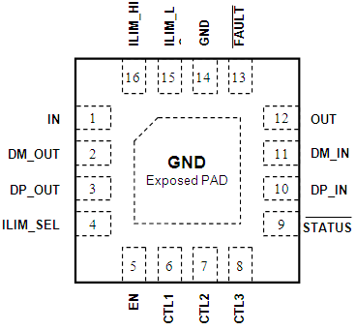
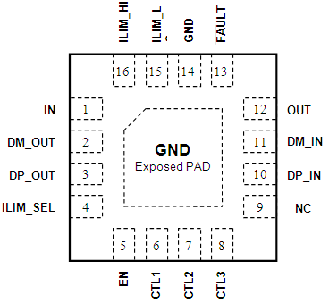
PI5USB254x Pin assignment
All part are in the same package – TQFN 16 pin
Same package of PI5USB2543
PI5USB2543
PI5USB2546
PI5USB2546A
PI5USB2544
PI5USB2544A

Slide 13
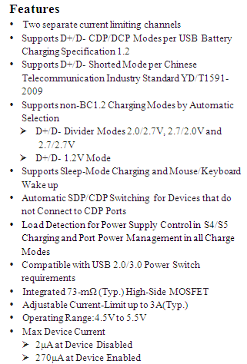
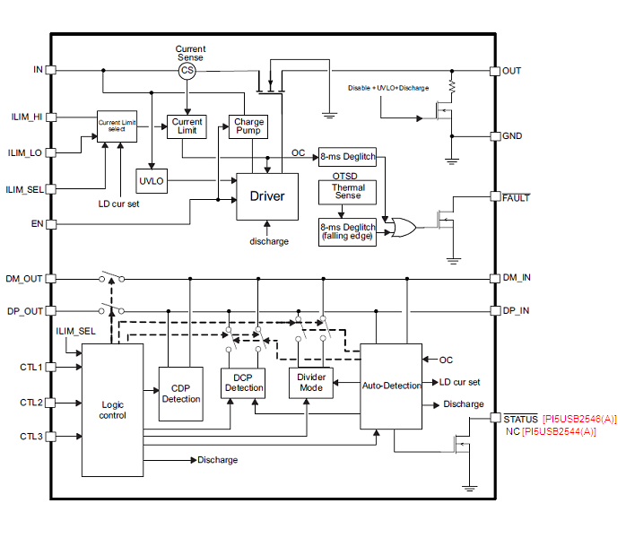
PI5USB2544/A / PI5USB2546/A Block Diagram
Power Switch
Charging Port Controller
Back

Slide 14

PI5USB25XX in SDP mode
BC 1.2, SDP - same as a normal USB port in USB 2.0.
In Windows, PI5USB254X will simply connect (lines in red) the cell-phone to the USB controller only.
Cell phone
D+
USB
controller
D-
OUT
VBUS 5V
Divider-2.4A (PI5USB2546A / 2544A only)
USB connector
power switch plug detect, pulse control, OCP, OTP OVP
Sensing
Control
15K x 2
Divider-2A
DC-DC
5V
Divider-1A
IN
DCP
CTL1_2_3 = 110
DCP-1.2V
PI5USB254X
Laptop

Slide 15
PI5USB254X – CDP mode
CDP request cell-phone plugged and seen 5V Vbus, the cell phone will apply a 0.6V on D+ (primary detection) and PI5USB254x will reply a 0.6V on D- (see the connections in red).
cell-phone will apply 0.6V on D- (secondary detection) and PI5USB254x will not reply.
cell-phone will start to charge maximum 1.5A and will also enumerate to Windows for data access.
Reply 0.6V D- (primary)
0.6V D+ (primary)
USB
controller
D+
D-
OUT
VBUS 5V
Divider-2.4A (PI5USB2546A / 2544A only)
Cell phone
USB connector
power switch plug detect, pulse control, OCP, OTP OVP
Sensing
Control
15K x 2
Divider-2A
DC-DC
5V
Divider-1A
IN
DCP
CTL1_2_3 = 111
DCP-1.2V
Laptop
PI5USB254X

Slide 16
PI5USB254X – Auto DCP mode
PI5USB2544/A, PI5USB2546/A enter Divider-1A mode after CTL1/2/3 = 001 or 011
2 detection method:
Detect D+/D- voltage for charging to DCP mode
Detect the current for Divider-2.4A (PI5USB2544A/PI5USB2546A only), Divider-2A or Divider-1A mode
CTL1_2_3 = 001 or 011
USB
controller
D+
D-
OUT
VBUS
Divider-2.4A (PI5USB2546A / 2544A only)
Cell phone
Cell phone
USB connector
power switch plug detect, pulse control, OCP, OTP OVP
Sensing
Control
15K x 2
Divider-2A
1. Set D+ & D- to Divider-1A charger mode
Divider-1A
2. Monitor D+ & D- voltage and determine whether keep in Divider-1A or change DCP mode (including Samsung fast charge mode)
DC-DC
5V
IN
DCP
3. If not change to DCP mode, monitor current draw from cell phone and determine whether change to Divider-2.4A, Divider-2A or keep in Divider-1A mode
DCP-1.2V
PI5USB2544/A / PI5USB2546/A
Laptop

Slide 17


PI5USB254X– Keyboard, mouse pass through
USB charging port is keep the connection of the low speed (LS) or full speed (FS) keyboard-mouse to USB controller, rather than change to charging mode, when switching from Windows to sleep.
Under sleeping mode, PI5USB254X will stay in USB switch mode to keep the connection between LS / FS keyboard-mouse and USB controller (lines in red).
Remark: PI5USB2543 detect LS device only
D+
USB
controller
D-
OUT
VBUS 5V
Divider-
2.4A
USB connector
power switch plug detect, pulse control, OCP, OTP OVP
15K x 2
Mouse
Sensing
Control
Divider-2A
P
Divider-1A
DC-DC
5V
IN
DCP
DCP-1.2V
CTL1_2_3 = 111 / 110 ➔ 011
PI5USB254X
Laptop

Slide 18
Other information

Slide 19
1. Vbus Off pulse

Slide 20
Vbus Off Pulses
A chargeable device will detect the mode (SDP, DCP, CDP, Apple, etc.) of a USB charging port one-time only, when it detect the rising-edge of Vbus 5V. It need another 5V Vbus rising-edge to re-detect the USB port again (BC 1.2 requests Vbus pulse when changing between SDP, CDP and DCP).
There are two ways that can reset a chargeable device:
re-plug,
generate a Vbus pulse to mimic a re-plug.
PI5USB254X will generate Vbus pulses when switching between various charging mode and USB modes to assure proper charging and working
t (s)
5V
OUT
Part Number | Vbus off timing for each device – t(s)
PI5USB2543 | 500ms
PI5USB2544/A PI5USB2546/A | (a) 2s (b) 400ms (change back to CDP or SDP mode)

Slide 21
2. Power Wake

Slide 22
Power wake : PI5USB2543 vs PI5USB2546/A
PI5USB2543
Didn’t support Power wake feature
Will detect Vbus current >0.1mA as for plugged-in
Will detect certain D+/- voltage as plugged-out.
PI5USB2546/A
With current sensing and behavior same as TPS2546
Will detect Vbus current >55mA as for plugged-in
Will detect Vbus current <45mA as plugged-out.
(please refer to P.23 to P27 for details)

Slide 23
PI5USB2546/A Power Wake in Notebook
Power wake is activated in S4 / S5 mode of the system
CTL1/2/3 & ILIM_SEL = 0011
Select between high power DC-DC converter or low power LDO based on charging requirements

Slide 24
PI5USB2546/A Power Wake in notebook
When device is connected to the charging port and provide charging current > 55mA (typ),
STATUS# will pull “LOW” => the power supplier of the charging port will be switched out from LDO and to DC-DC converter
VBUS turn off for 2s
Current limit auto switch to ILIM_HI => (depends on the RILIM_HI - Pin 16 of PI5USB2546/A)

Slide 25
PI5USB2546/A Power Wake in notebook
CTL1 | CTL2 | CLT3 | ILIM_SEL
0 | 0 | 1 | 1
Power Block
PI5USB2546/A
I > 55mA
19V
5V DC-DC
IN
OUT
VBUS
5V LDO
EN#
D-_IN
D-
D+_IN
D+
/STATUS = L
STATUS#
GND
GND
Embedded Controller
CTL1
CTL2
CTL3
ILIM_SEL
D±
D±OUT
ILIM_HI
OC#
FAULT#
ILIM_LO
Current limit change to ILIM_HI
USB Host Controller

Slide 26
PI5USB2546/A Power Wake in Notebook
When device is unplugged or device is fully charge and current is drop to < 45mA (typ),
STATUS# of PI5USB2546 will pull “HIGH” after 15s => control the low power LDO supplies the standby power of the charging port.
Current limit set to internally => 55mA for LDO

Slide 27
Power Wake in notebook
CTL1 | CTL2 | CLT3 | ILIM_SEL
0 | 0 | 1 | 1
Power Block
PI5USB2546/A
I < 45mA
19V
5V DC-DC
IN
OUT
VBUS
5V LDO
Device is un-plugged or Device is fully charged
EN#
D-_IN
D-
/STATUS = H
After 15s
D+_IN
D+
STATUS#
GND
GND
Embedded Controller
CTL1
CTL2
CTL3
ILIM_SEL
Internal current limit (55mA)
D±
D±OUT
ILIM_HI
OC#
FAULT#
ILIM_LO
USB Host Controller

Slide 28
3. Port Power Management

Slide 29
PI5USB2546/A Port Power Management (PPM)
PPM is activated in S0 (CDP) or S3 - S5 (DCP_Auto) mode of the system
CTL1/2/3 & ILIM_SEL = 1111 or 0111
Prevents overloading of the system’s power supply
Limiting the total power of USB port
System monitors /STATUS pin for different USB port
Once # of USB port assert /STATUS, system will toggle the reminding port to a SDP
If the charging current drop to < ILIM_LO + 60mA, /STATUS pin will de-assert and system resume the charging feature for all USB ports.

Slide 30
PPM in notebook
CTL1 | CTL2 | CLT3 | ILIM_SEL
1 | 1 | 1 | 1
0 | 1 | 1 | 1
PI5USB2546 – U1
/STATUS = High
USB port 1
STATUS#
Embedded Controller
CTL1
USB signal
CTL2
ILIM_HI
CTL3
ILIM_LO
ILIM_SEL
PI5USB2546 – U2
USB port 2
D±
/STATUS = High
STATUS#
ILIM_HI
USB signal
OC#
CTL1
ILIM_LO
CTL2
ILIM_HI
USB Host Controller
CTL3
ILIM_LO
If current draw < ILIM_LO + 60mA
ILIM_SEL
Remark: USB signal including Vbus, D+, D- and GND signal

Slide 31
PPM in notebook
CTL1 | CTL2 | CLT3 | ILIM_SEL
1 | 1 | 1 | 1
0 | 1 | 1 | 1
PI5USB2546 – U1
/STATUS = High
USB port 1
STATUS#
Embedded Controller
CTL1
USB signal
CTL2
ILIM_HI
CTL3
ILIM_LO
ILIM_SEL
Current limit changed to ILIM_LO
Change CTL1/2/3 & ILIM_SEL to SDP
PI5USB2546 – U2
USB port 2
D±
/STATUS = Low
STATUS#
ILIM_HI
USB signal
OC#
CTL1
ILIM_LO
CTL2
ILIM_HI
USB Host Controller
CTL3
ILIM_LO
If current draw > ILIM_LO + 60mA
ILIM_SEL
Remark: USB signal including Vbus, D+, D- and GND signal

Slide 32
The End
Thank You

Slide 33
Appendix: Difference between PI5USB2546 vs TPS2546

Slide 34
Difference between PI5USB2546 and TPS2546
Major feature and behaviors are the same between PI5USB2546 and TPS2546
Difference only found on specially condition, eg. Charging current drop suddenly when IC just enter Divider-2A mode

Slide 35
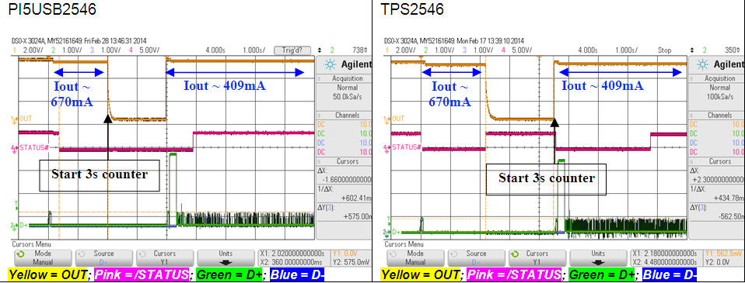
Difference between PI5USB2546 and TPS2546
/STATUS disable time (CTL1/2/3 & ILIM_SEL = 0111 or 1111)
When Iout < ILIM_LO+50mA, /STATUS will be resumed after 3s.
The counter starting time between PI5USB2546 and TPS2546 is slightly difference.
/STATUS resume faster than TPS2546
Example for Samsung Galaxy S2 plugged into CDP mode (Samsung Galaxy S2 is non-CDP device)

Slide 36
Difference between PI5USB2546 and TPS2546
Detection time from Divider-2A back to Divider-1A (or Divider-2.4A to Divider-2A)
Only when current will drop < 100mA when D+/D- JUST enter Divider-2A (or 2.4A)
trigger OUT drop (2s) before resume to Divider-1A
This difference solve the looping issue on HTC butterfly and Sony Xperia Z under dead battery case

Slide 37
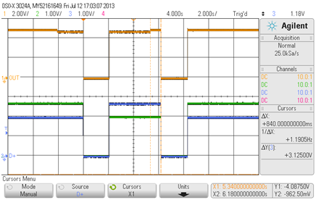
Difference between PI5USB2546 and TPS2546
When current drop to < 100mA when D+/D- enter Divider-2A / 2.4A within t(sec), 2sec OUT drop before resume to Divider-1A
Detection time (t) = 15s for PI5USB2546; 3s for TPS2546
OUT drop found @ ~17s for PI5USB2546 after enter Divider-2A/2.4A mode; @4s for TPS2546
OUT
Iout > ~ 700 – 750mA which trigger to Divider-2A mode
2s out off
Iout < 100mA
2s out off
t
D-
D+
Divider-1A
Divider-2A
Divider-1A

