Slide 1
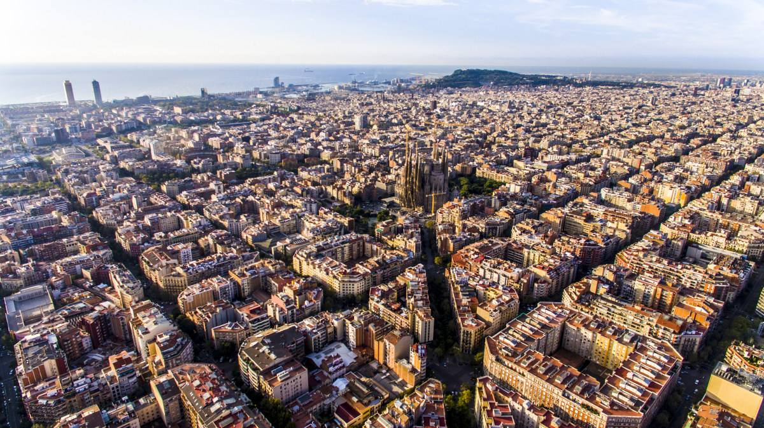
IBM Data Science
Capstone Project
Find myself the best neighborhood
to live in Barcelona
Yu Deng
2020.3

Slide 2
1. Introduction
A Chinese student
↓
ESADE Business School, Barcelona, Spain
My analysis goes through following processes:
Pick out neighborhoods near my school, ESADE, as candidates.
Use data from Foursquare to explore famous venues in selected neighborhoods.
Cluster these neighborhoods base on their.
Sort out the most common venues in each neighborhood.
Multiply the neighborhoods dataframe by the preference vector to choose the best place to live.

Slide 3
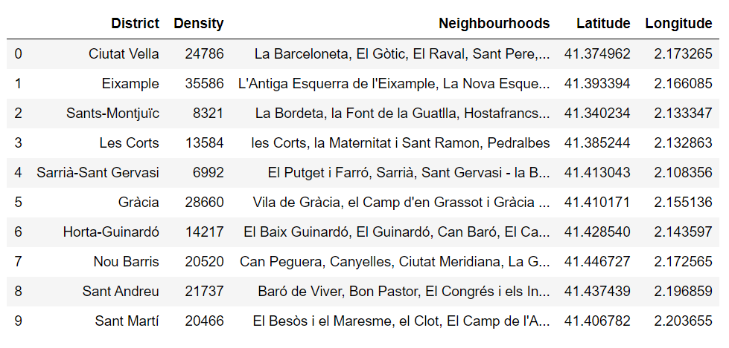
2. Data
The geospatial data of ESADE Business School.
The list of neighborhoods in Barcelona and their geospatial data.

Slide 4
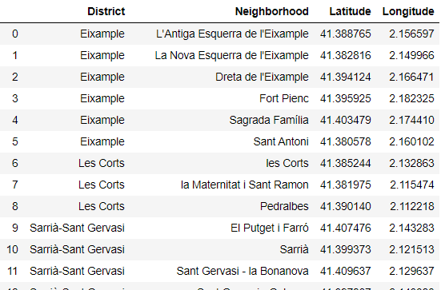
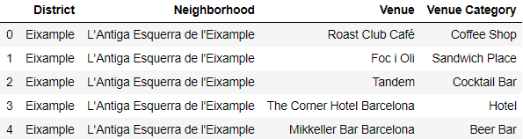
2. Data
The geographical coordinates of the top 5 closest districts to ESADE Business School.
Information of venues in specific
neighborhoods provided by Foursquare.com.

Slide 5
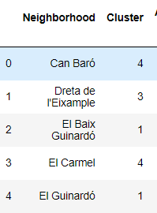
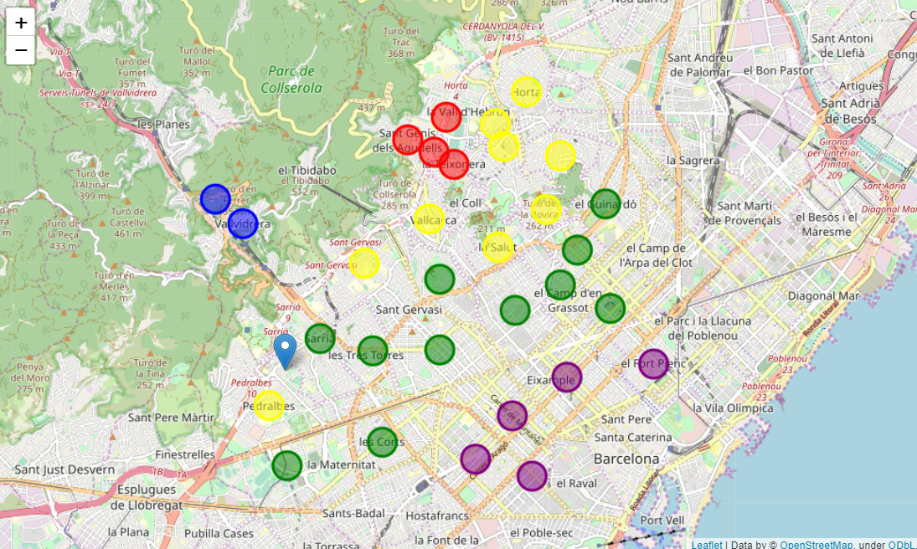
3. Analysis
Machine learning: k-means clustering

Slide 6
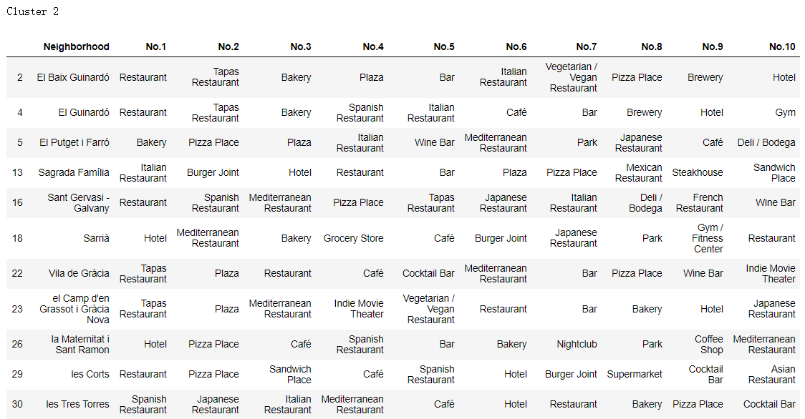
3. Analysis
Sort out the top 10 most common venues

Slide 7
3. Analysis
Sort out the top 10 most common venues

Slide 8
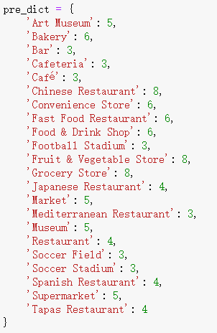
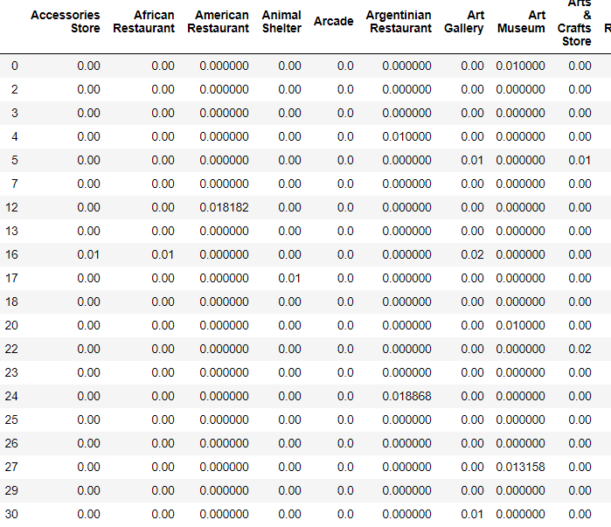
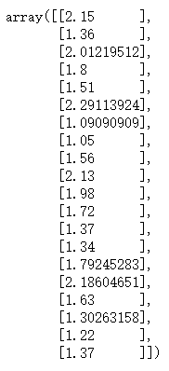
3. Analysis
Preferences vector and recommend system
=

Slide 9
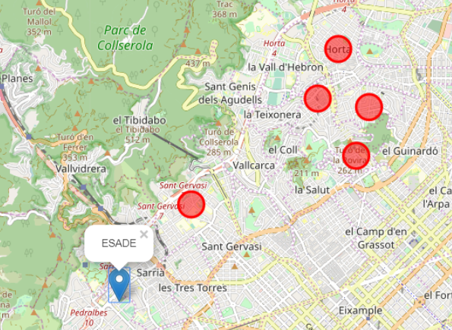
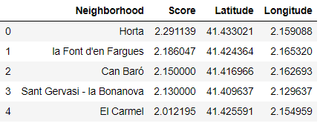
4. Results
The best neighborhoods to live:

Slide 10
Thanks!

