Slide 1
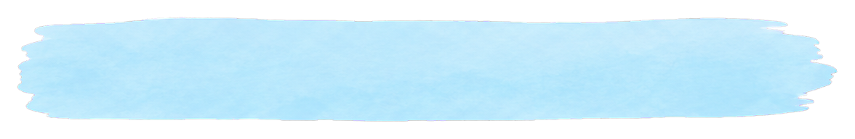







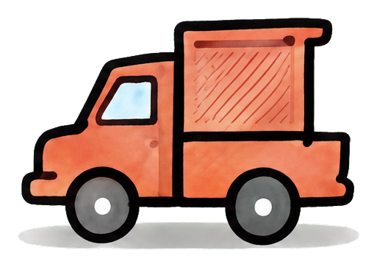





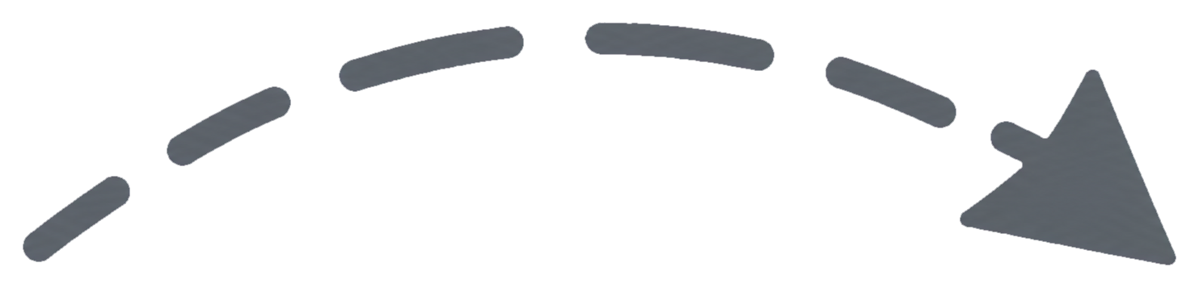

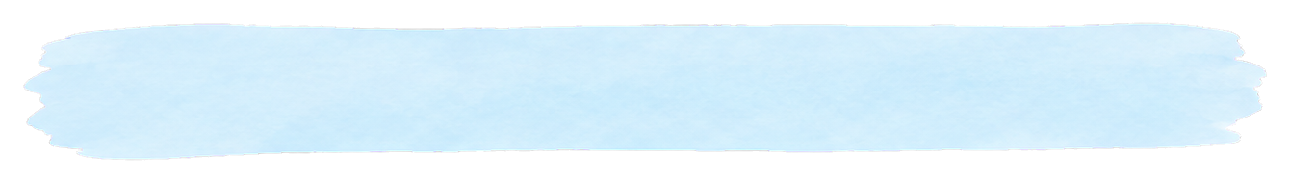
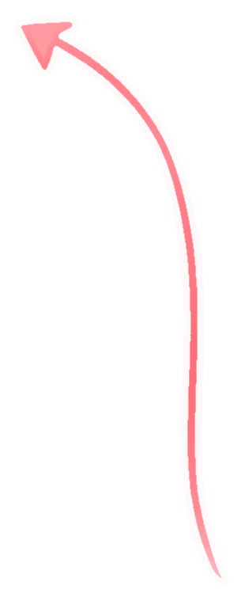
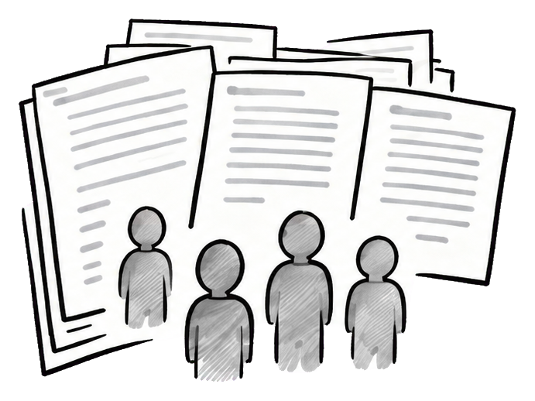


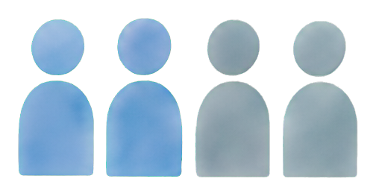
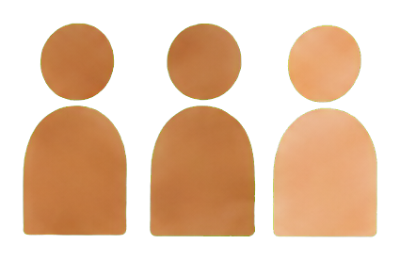


1
Model measurements
2A
Task-score structure
(models)
Unified text-adapted protocols
13 scores · 54 models
across 13 cognitive paradigms
54 language models
Model responses
2-back
702 complete cells
Schematic
G = g
G
V
g
...
Models
Model
Model
Model
Model
Task 1
Task 2
...
Task 13
Flanker
middle arrow
A
B
C
M1
...
...
...
...
CVLT-II word recall
M2
...
...
...
...
Tasks
apple
river
stone
...
M3
...
...
...
...
2B
Cross-family prediction (held-out)
False belief
Model
Model
Model
...
...
...
...
Box → sofa
X
Y
Z
...
M54
...
...
...
...
Train on
Test on
held-out family
Todd absent
model families
Search: box
13 paradigms
...
...
Schematic examples
3
Matched model subsets
Human reference evidence
4B
4A
Behavioral correspondence
Human vs. model structure
Task-specific behavioral references
Joint cohorts
(human-referenced)
Matched task subsets
(from published sources)
for structural analyses
SRO: 5 tasks
SRO: 5 tasks
Ball: 3 measures
Condition-level comparison
Human
Models
(human vs. model)
Human behavior
Model response
Task 1
Measure 1
(source-specific)
Task 2
Measure 2
Ball: 3 measures
Task 3
Measure 3
Compare
Human
Models
...
Task 4
by task
Task 5
Multiple sources
...
...
Schematic matrices
Separate cohorts
Not a full 13-task human matrix
•

