Slide 1

Selecting optimal sites for Lime scooter in Dane County
Ziqian Deng

Slide 2
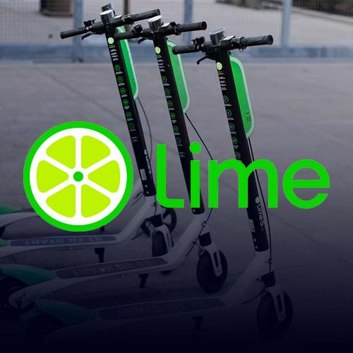
Introduction to the company
Lime, formerly LimeBike, is a transportation company based in the United States.
It runs electric scooters, electric bikes, normal pedal bikes and car sharing systems in various cities around the world.
Lime is considered as No.1 electric scooter and bike sharing app. …
“With Lime, you'll never have to worry about traffic or finding a parking station, and you can leave your ride safely at your destination for a fraction of the cost of a taxi or a ride share”

Slide 3
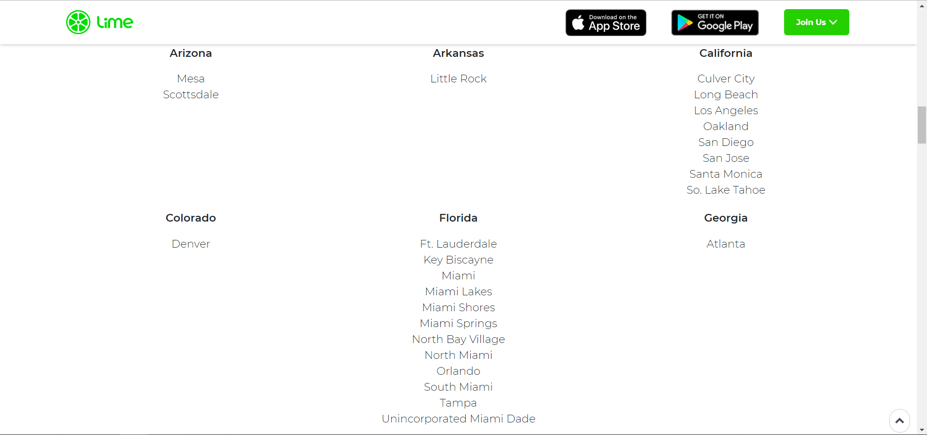
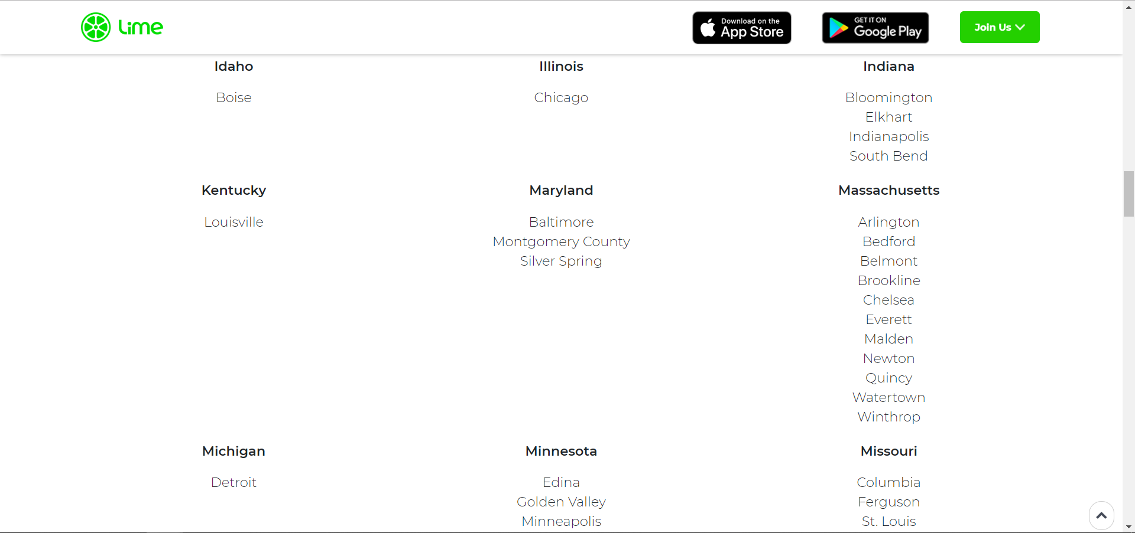
Introduction to the project
Lime has already covered many cities across the United State, however, it hasn't reached out any city in Wisconsin.
Since we have witnessed its great popularity, Lime is believed to expanding the business to Wisconsin.
The goal of the project is to simulate the campaign in Dane County in Wisconsin, to find the potential sites for Lime to arrange the scooters and to build a model to solve the Vehicles Routing Problem for later use.

Slide 4
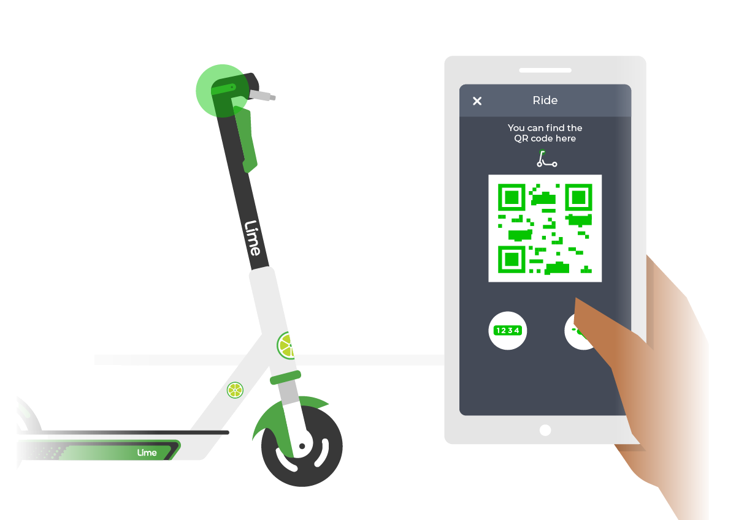
Methodology --- Set Packing Problem
The major part of the project can be considered as a Set Packing Problem.
First, we need to simulate a list of potential sites in Dane County for Lime scooters
Then we will set the allocation constraints to separate sites by at least 0.5 km to avoid cannibalizing demand.

Slide 5
Methodology --- Vehicles Routing Problem
The other part of the project is a Vehicles Routing Problem (VRP).
We will use the optimal solution from the first part and solve a simulated VRP for Lime
The first problem is solved by Pyomo and the second one is solved by Google OR-Tools.

Slide 6
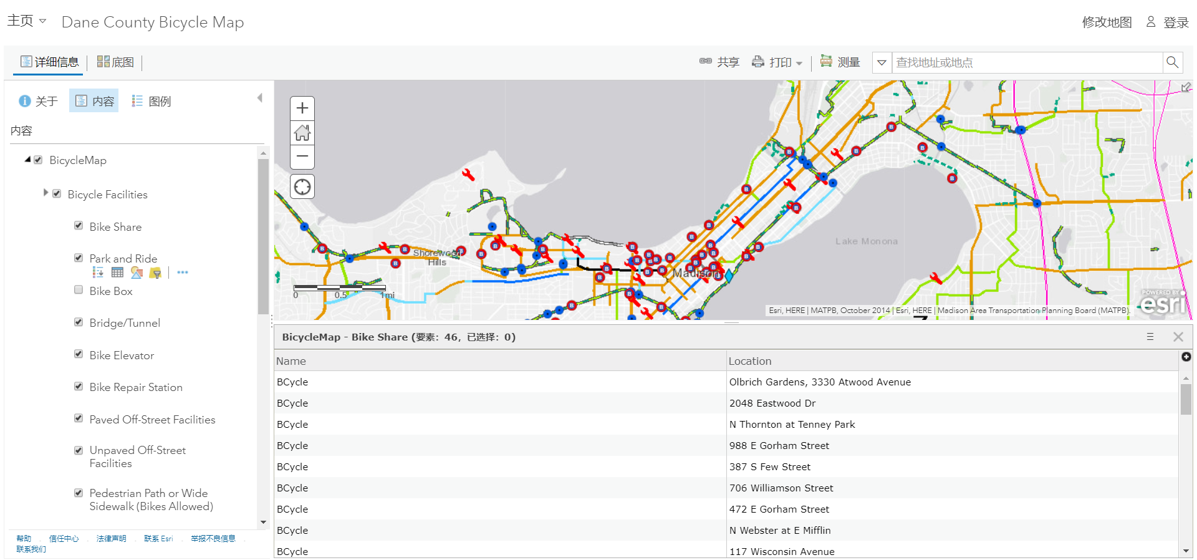
Set Packing Problem
Simulation sites: To find the potential sites for Lime scooters, we will refer to the BCycle sites in Dane County. https://cityofmadison.maps.arcgis.com/home/webmap/viewer.html?webmap=65608cc71b924f82965b83daaccf99a1
Solver: Second, we need to leverage python packages to get the coordinates for the sites, calculate the distance between every two sites, and solve the set packing problem under the constraints that the sites need to be separated by at least 0.5 km.

Slide 7
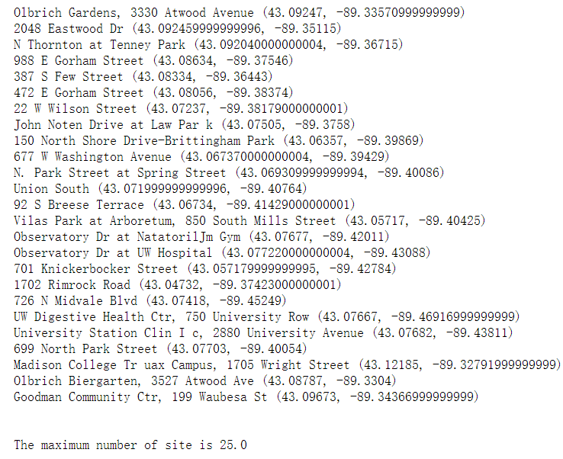
Set Packing Problem
Since the BCycle has 46 sites in Dane County, we will 46 initial Lime scooter sites .
And the optimal solution suggests the following 25 sites and the coordinates for Lime scooter

Slide 8
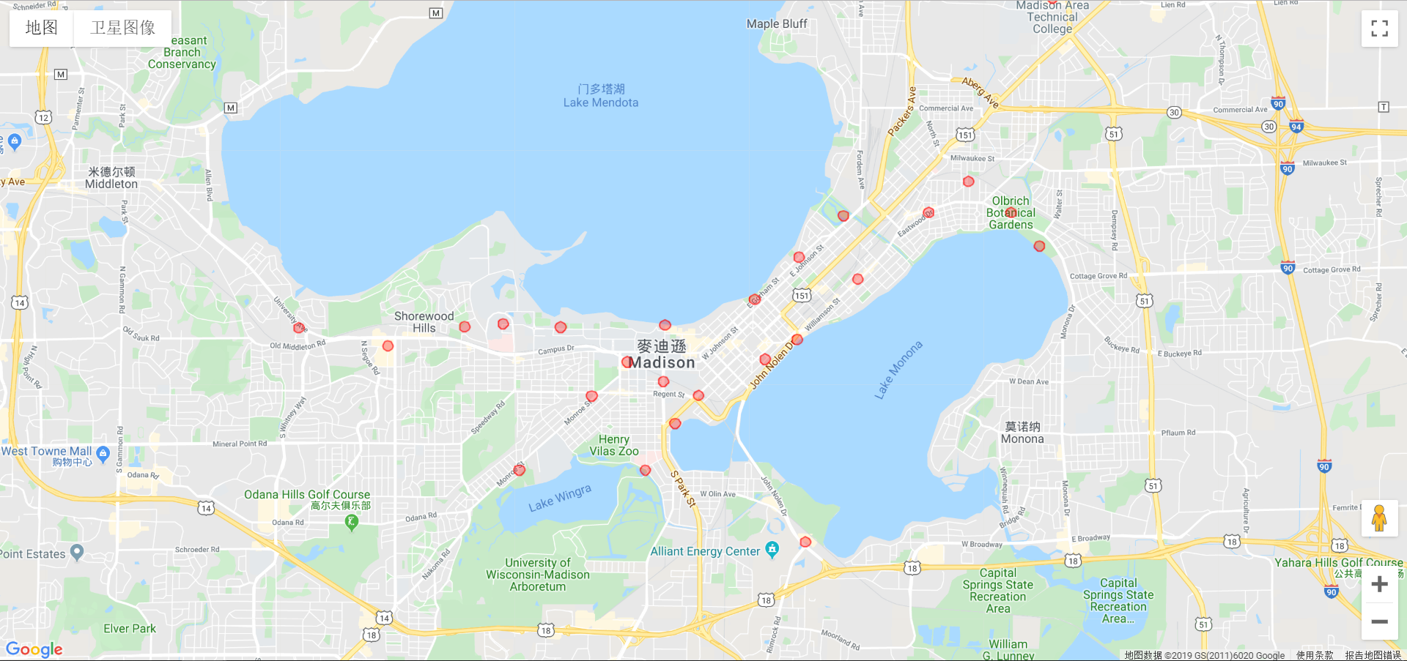
Visualization for the optimal sites
Since the BCycle has 46 sites in Dane County, we will 46 initial Lime scooter sites .
And the optimal solution suggests the following 25 sites and the coordinates for Lime scooter

Slide 9
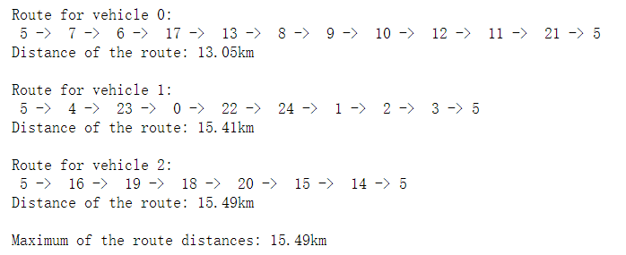
Vehicles Routing Problem
After obtaining the optimal sites for Lime scooter, we will build a model for Lime to solve the future vehicles routing problem when distributing the scooters to all the sites.
We assume that Lime has 3 vehicles to distribute the scooters and the scooter depot is build at site 5.
The optimal solution suggests that the maximum of the route distance would be 15.49 km.

Slide 10
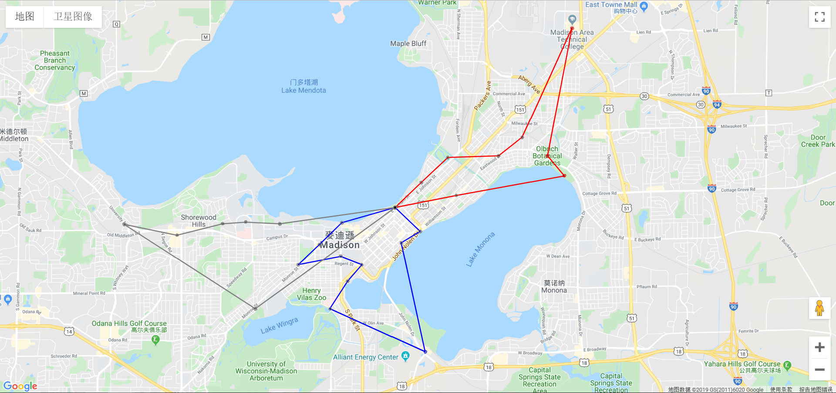
Visualization for the optimal routing

Slide 11
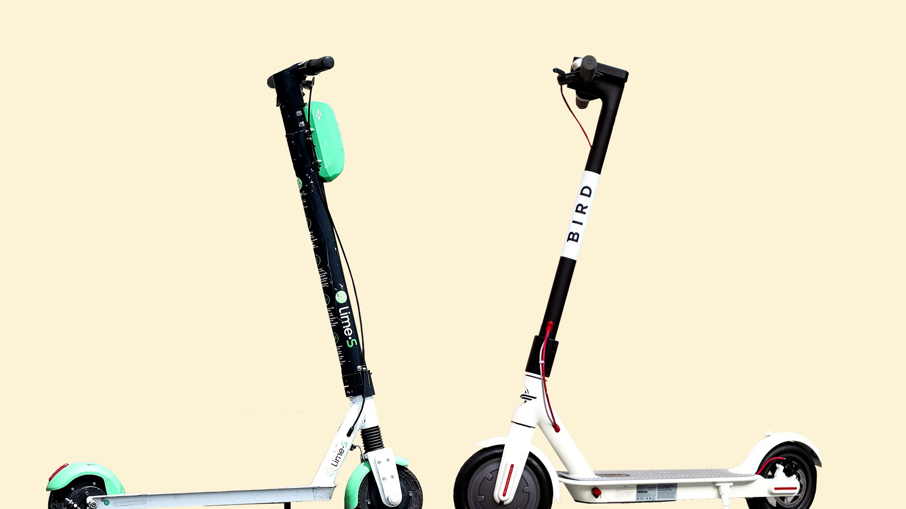
Conclusion
Necessity for leverage Python:
The solver Pyomo and Google OR-Tools provide better optimization than Excel, and other packages in Python enable us to visualize the optimal solution easily.
Project construction:
The files include a Excel that illustrate a toy instance of the set packing problem, and the optimization for Lime is processed on Python.

