Slide 1
Simulation of the Elevator Transport in An Office Building
PROJECT 2
Xu Zhang (MS CSE), Daxuan Huang (MS CSE),
Qinlan Zhang (MS CSE), Zheng Deng (MS CSE)

Slide 2
Background
During the past decades, in order to relieve the large amount of flow rate of passenger in some complex high rise buildings, more and more elevators were equipped into these buildings[1]. In this case, it has become vitally significant to control the use of the energy resources in our world of severe energy depletion[2], for reaching the goal of high effectiveness and energy-saving.
When facing the rush hour, elevators should be operated properly to not only save time of people going to their destination floors but also decrease the energy consumption.
How to operate the elevator in an appropriate way? How to design an effective strategy of opening and closing some elevators during the peak time? It is worthwhile to explore these issues.

Slide 3
Model Description
Simulating the operation of the elevators in Clough Commons Building
Figuring out the balance between transport efficiency and energy consumption
Passenger arrival and destination floors are typically generated randomly following a particular distribution in the building according to our observation
The number of passenger on the second floor and the fourth floor is significantly larger than the number of other floors
We will mainly focus on the peak-time of elevator transportation in Clough Building
Passengers wait in queue until a elevator arrives, after entering the elevator, passengers give calls and travel to the destination floors

Slide 4
Conceptual Model: Assumptions and Simplifications
The elevators’ capacity is finite and homogeneous
The velocity will be assumed to be uniform across all elevators and set to one floor per time step
The elevators’ stopping time at each floor will be four units of simulation time interval
At the beginning of the simulation, there are no passengers in the elevators
All elevators start at 1st floor
All passengers will originate from one of the floors in the building and know their destinations in advance.
The number of elevators in operation is determined at the beginning of the simulation
In this simulation process we mainly focus on peak-time simulation process
We ignore the interactions between passengers, for example, more passengers need more time to enter or exit an elevator
Finally, we assume that passengers would only take elevators to go upstairs and downstairs, excluding any other transportation methods

Slide 5
Conceptual Model---Input &Output
Input:
The number of people will enter the system in total:
The number of elevators in operation
Output:
The outputs be the execution time. We assume that operating each elevator consumes certain amount of energy. So in the end we will evaluate energy consumed and time consumed to give a best solution to peak-time operation

Slide 6
Conceptual Model---Contents
Consumer entity: Passengers
Attributes: init_floor, dest_floor, direction
All passengers will have an initial floor and a destination floor, which are all generated by the random number generator. The initial floor is different from the destination floor
Resource Entity: Elevators
Attributes: number of passengers in it, direction, current floor
The initial state of the elevator car is on 1st floor with no passengers in it and going up. When an elevator stops at one floor, it takes in passengers whose initial position is the same as the elevator’s current floor and checks whether the elevator will change its direction.
Whether the passenger can enter the elevator is decided by the degree of crowding in an elevator and his position in the queue.

Slide 7
Initiate Model
Building( Pools)
At each Time step
Update pools
Output
Total Time
System( Elevators)
Update request
Update elevator
Move/ Load& Release customers
Approach
Customer: An object representing the passenger, containing attributes like init_floor, dest_floor and direction
Pool: An object which is the list of passengers waiting on a specific floor
Building: An object containing a dictionary whose key is the number of the floor and value is the pool of that floor
System: An object containing all the elevators in the building

Slide 8
Direction Control
Direction conditions: Up, Down and Stay
Core rules:
Comparing Next request with Current floor : Generate next step’s direction
Request List:
Inner demand : People’s destination floor
Outer demand : Floors calling for an elevator
Forming final request list:
Sorted Inner demand + Next Outer demand
Outer demand keep updating for each time step

Slide 9
Direction Control
Finding next outer demand:
Only the best condition elevator will responds
Comparing Algorithm:
Up/down: Following same direction, stop searching when first meets outer demands or other same direction elevator
Stay: Searching two directions, response to the nearest demand

Slide 10
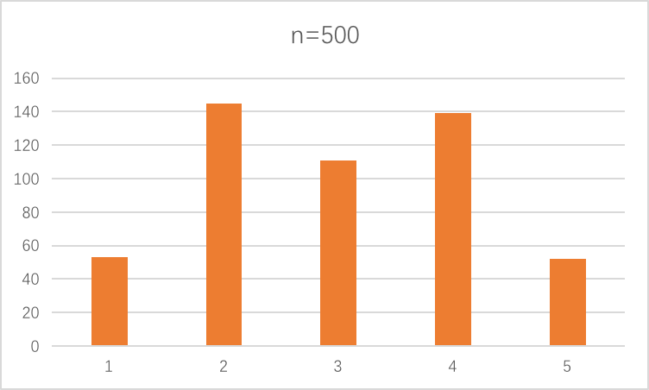
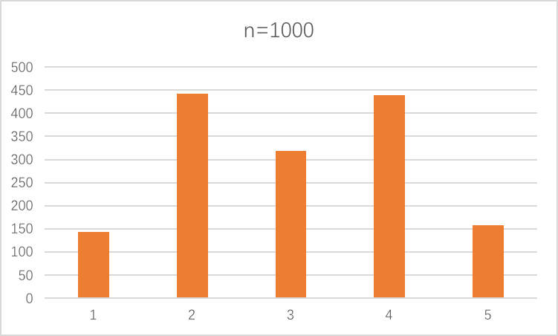
RNG Validation
By observation: ratio of number of people’s start floor: about 1:3:2:3:1
ratio of number of people’s destination floor: about 1:3:2:3:1
Use python default random() to generate random numbers that follows distribution

Slide 11
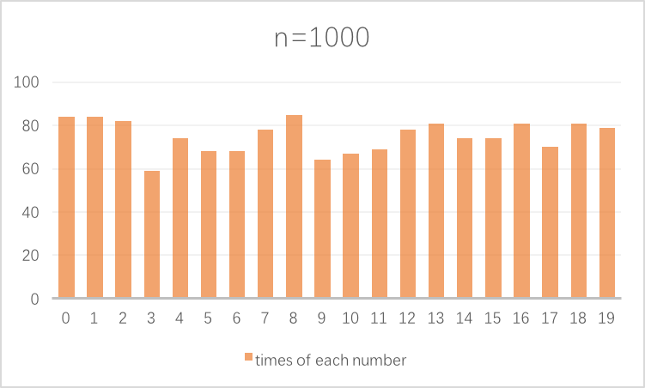
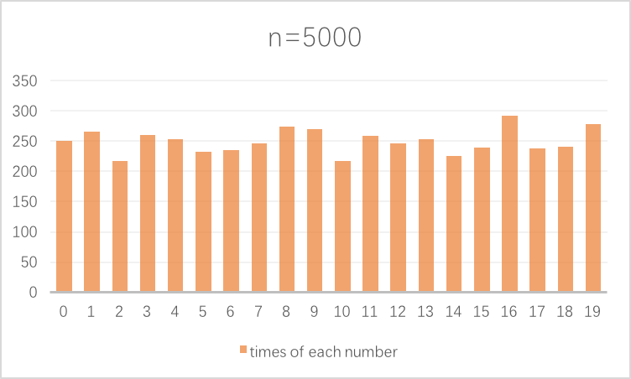
RNG Validation
Assume at every time step there’s a random flow of people go in this building which follows a uniform distribution (set to be 0 to 20)
Use Python default RNG to generate an int from 0 to 20 that follows uniform distribution

Slide 12
Results
Estimated energy consumed = Average time consumed $×$ Number of elevators
(Repeat 50 times to get average time consumed)

Slide 13
Results
Percentage Trend : Set 2000 passengers = 1.0

Slide 14
Future Works
1. Focus more about passengers’ behaviors:
patience, particular aim, possibility to walk, etc.
2. Other distribution type of Passengers’ flow
Normal, Poisson
3. Visualization
4. More detailed estimated_energy_consumed calculation

Slide 15
Reference
[1] Ding, Yuanchun, et al. "Investigation of combined stairs elevators evacuation strategies for high rise buildings based on simulation." Simulation Modelling Practice and Theory 53 (2015):60-73.
[2] Adak, M. Fatih, Nevcihan Duru, and H. Tarık Duru. "Elevator simulator design and estimating energy consumption of an elevator system." Energy and Buildings 65 (2013): 272-280.
[3] Ding, Bao, et al. "A hybrid approach for the analysis and prediction of elevator passenger flow in an office building." Automation in Construction 35 (2013): 69-78.
[4] Al-Sharif, Lutfi, and Mohamed D. Al-Adhem. "The current practice of lift traffic design using calculation and simulation." Building Services Engineering Research and Technology (2013): 0143624413504422.
[5] Al-Sharif, Lutfi, et al. "The HARint Space: A methodology for compliant elevator traffic designs." Building Services Engineering Research and Technology 36.1 (2015): 34-50.
[6] Hummet, George T., Thomas D. Moser, and Bruce A. Powell. "Real time simulation of elevators." Proceedings of the 10th conference on Winter simulation-Volume 2. IEEE Computer Society Press, 1978.
[7] Susi, Tuomas, Janne Sorsa, and Marja-Liisa Siikonen. "Passenger Behaviour in ElevatorSimulation." Elevatori 34.5 (2005): 28-37.
[8] Al-Sharif, Lutfi, Husam M. Aldahiyat, and Laith M. Alkurdi. "The use of Monte Carlo simulation in evaluating the elevator round trip time under up-peak traffic conditions and conventional group control." Building Services Engineering Research and Technology 33.3 (2012): 319-338.

Slide 16
Thanks!
Q & A

