Slide 1

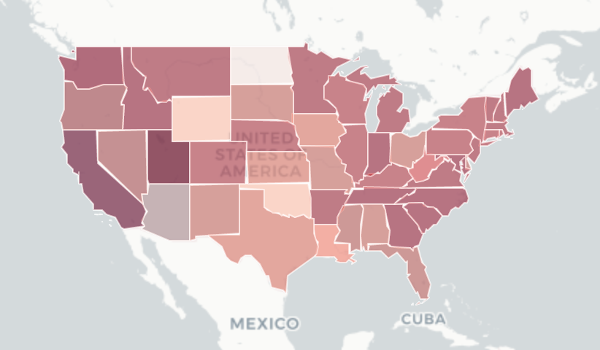
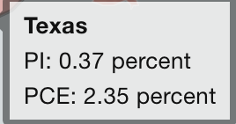
1
Get data from BEA API
2
Get shapefiles from Census
FIPS | Name | PCE Growth
48 | Texas | 4.0%
36 | New York | 4.0%
. . . | . . . | . . .
Geometry
Properties
Index | Feature (Geometry, type)
1
2
. . . | . . .
Index | Name | FIPS
1 | Texas | 48
2 | New York | 36
. . . | . . . | . . .
Properties
Geometries
3
Process +Join Data
“Properties: is associated with “Attributes” using FIPS as the key
4
Set Styles
5
Render Map
Colors
Tooltip
Details

