Slide 1

Sound Realty
From proof of concept to production-ready valuation service
Client story, technical design, and AWS deployment path
Client value
Technical design
AWS roadmap
phData presentation for Sound Realty
Sound Realty | phData

Slide 2
Sound Realty
Client value

Slide 3
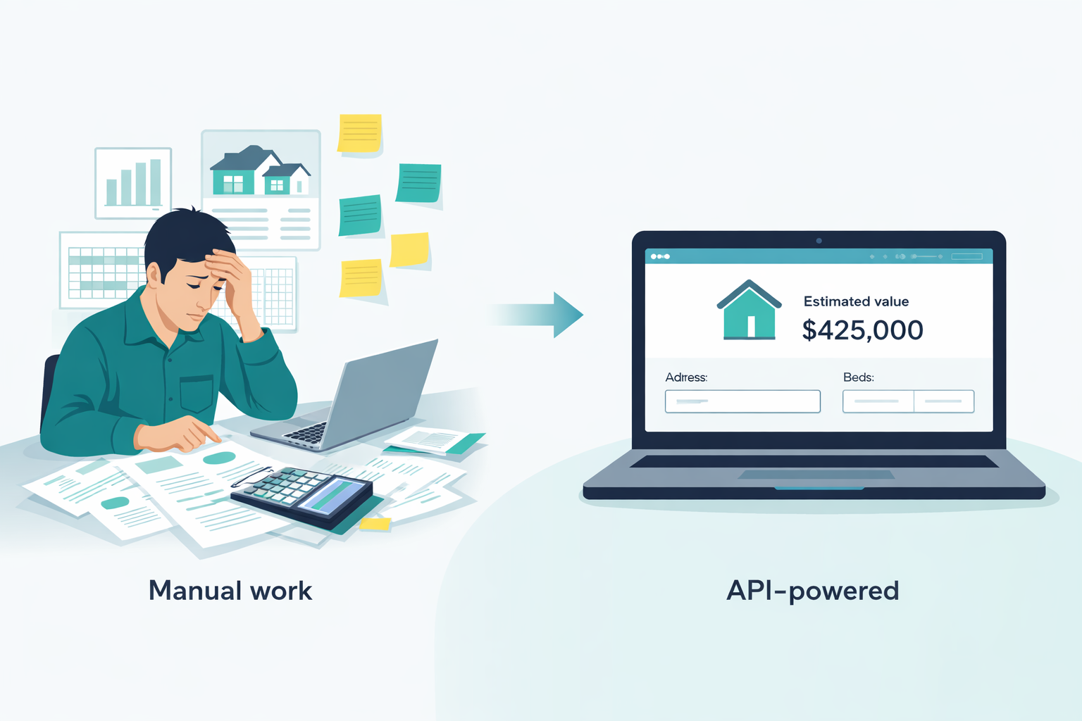
The business problem we solved first
Client view
Start with a usable valuation service, not a giant platform.
Manual effort
Notebook ≠ product
Need a practical first step
Estimating home value takes time and depends heavily on manual review. That makes it harder to respond consistently and quickly.
A model can predict in isolation, but that does not mean a business team can actually use it in a repeatable way.
The right first milestone is a proof of concept that already behaves like an application.
Sound Realty | phData
Our proposal
Simple first. Useful immediately. Expand only after value is proven.
Build a small but complete proof of concept (PoC) that can estimate price, be used by an UI/application, and demonstrate value
Sound Realty | phData

Slide 4
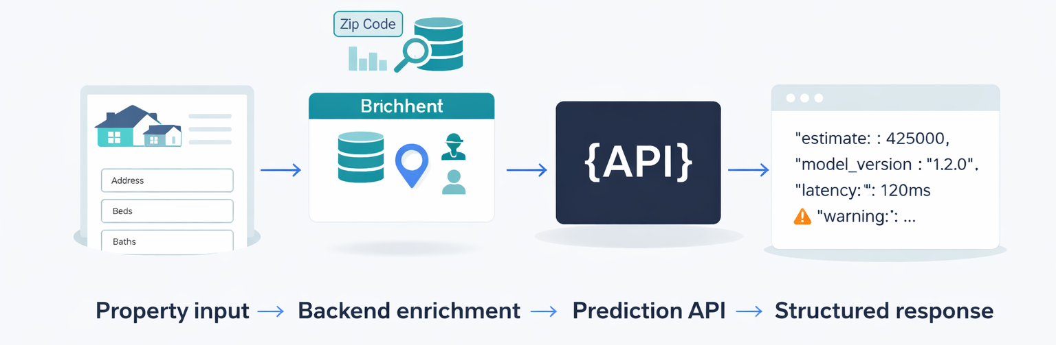
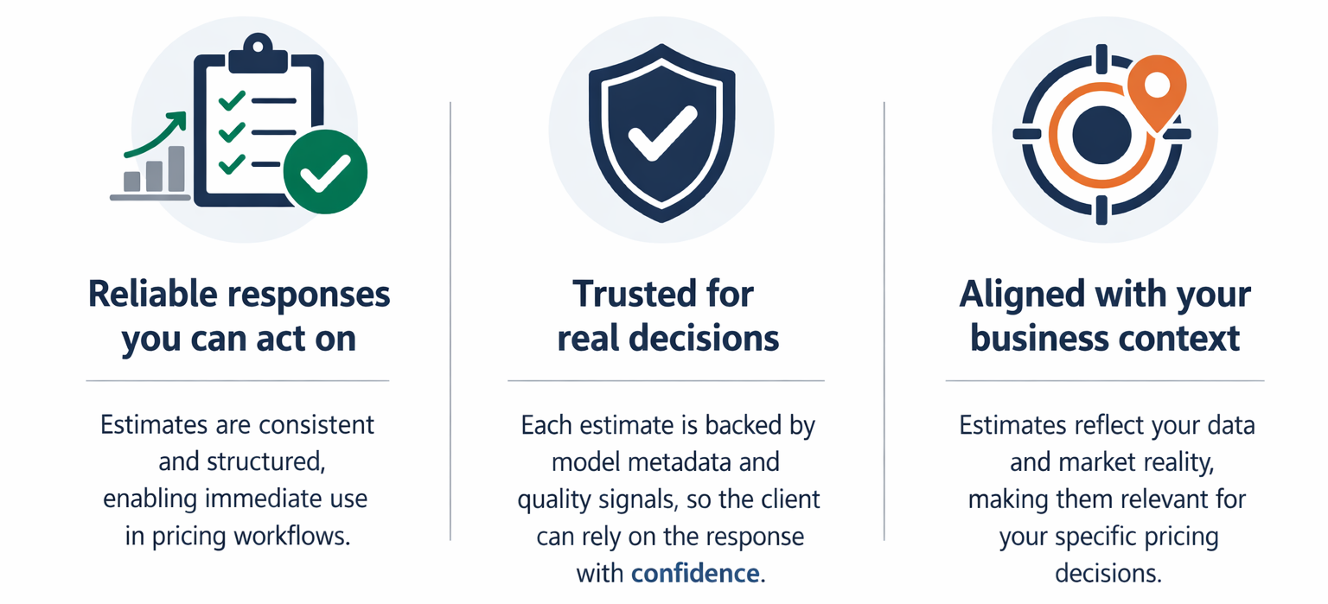
What the PoC can do today
Client value
A clean workflow for turning property details into a governed estimate.
Ready to integrate
Can be called by a portal, internal tool, or future client app.
Available in two versions:
Full endpoint
Basic endpoint
For complete property records and richer workflows.
18 property characteristics.
For simpler intake when only essential details are available.
8 minimum: Bedrooms, bathrooms, living area, lot size, floors, above-ground area, basement area, zip code
Why this matters to Sound Realty
Sound Realty | phData

Slide 5
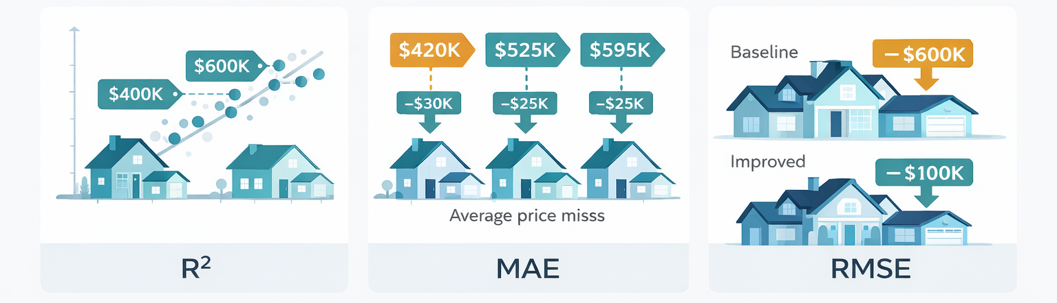
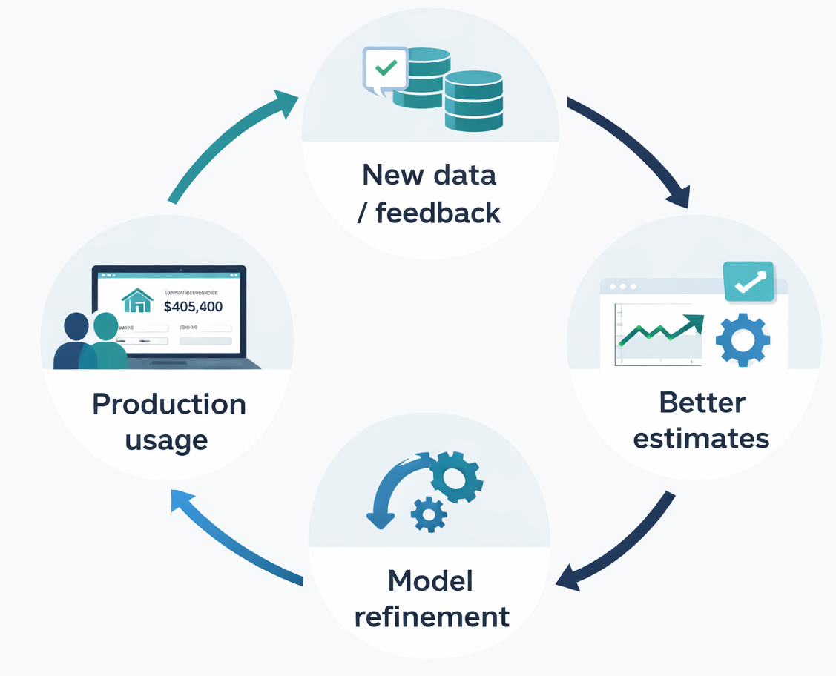
There is more: improved model before deploying it
Client value
We already made it better, and this is only the beginning.
Trained-model TESTING
on unseen data
Baseline
kNN
Imp. Random
Forest
Training test R²
0.7398 → 0.8831
+0.143
Training MAE
$97,436 → $68,975
−29%
Higher is better
Lower is better
Lower is better
Training RMSE
$192,439 → $128,983
−33%
The POC is not only a deployable solution — it is a foundation for continuous improvement.
Deployed-model EVALUATION
on newer labeled set
Eval R²
0.7367 → 0.8396
+0.103
Eval MAE
$107,316 → $82,668
−23%
Eval RMSE
$188,795 → $147,340
−22%
Model versions shown in API responses (traceable release)
Sound Realty | phData

Slide 6
Beyond price prediction: where this can go next
Expansion
Once the API foundation is approved, new endpoints become natural extensions.
Succes Criteria after PoC launch
Prediction accuracy after launch remains stable
R² above 0.75–0.80 and MAE below $90,000–$110,000
API availability during pilot use:
95%–99% of prediction requests return a successful response
API response time for end users:
average prediction latency below 300–500 milliseconds
Input quality remains within expected bounds:
no more than 10% of requests trigger a data-quality warning
Some next
possibilities
Scenario simulation
Explanation endpoint
Housing Segmenting Model
Explore “what if” cases such as renovations or property changes.
Summarize the main factors that influenced a valuation.
Instead of one model covers all, we build different model for difference house sizes
Sound Realty | phData

Slide 7
Sound Realty
Technical Design

Slide 8
Current technical design
Technical view
The proof of concept already covers training, serving, deployment, versioning, and basic monitoring.
Training pipeline
Model artifacts
FastAPI service
Docker image
Docker Swarm
create_model.py trains, candidate models, add cross-validation, compute metrics, compares models, feature importance (if applicable) and exports artifacts.
→
model.pkl, feature order, defaults (median for basic endpoint), percentiles (p5, p95 for warnings), metadata (run id, run name, model type, timestamp, for traceability).
→
Loads artifacts at startup, add validation layer (pydantic), add warnings, exposes prediction endpoints.
Fast API + Uvicorn (web server)
→
Application and model packaged together for deployment.
Versioned app + model with dependencies and built-in health check.
→
2 replicas, one-at-a-time update,10s delay between updates,
start-first for zero downtime,
restart on failure
Endpoints
Evaluating
GET /health
POST /predict
POST /predict/basic
evaluate_model.py
Used for service health checks.
Full request schema for richer property inputs.
Simpler intake with imputed optional fields.
Checks deployed model performance on newer labeled data, added MLFlow for experiment tracking
Key engineering idea: package the smallest end-to-end MLE system that still behaves like a real service.
Sound Realty | phData

Slide 9
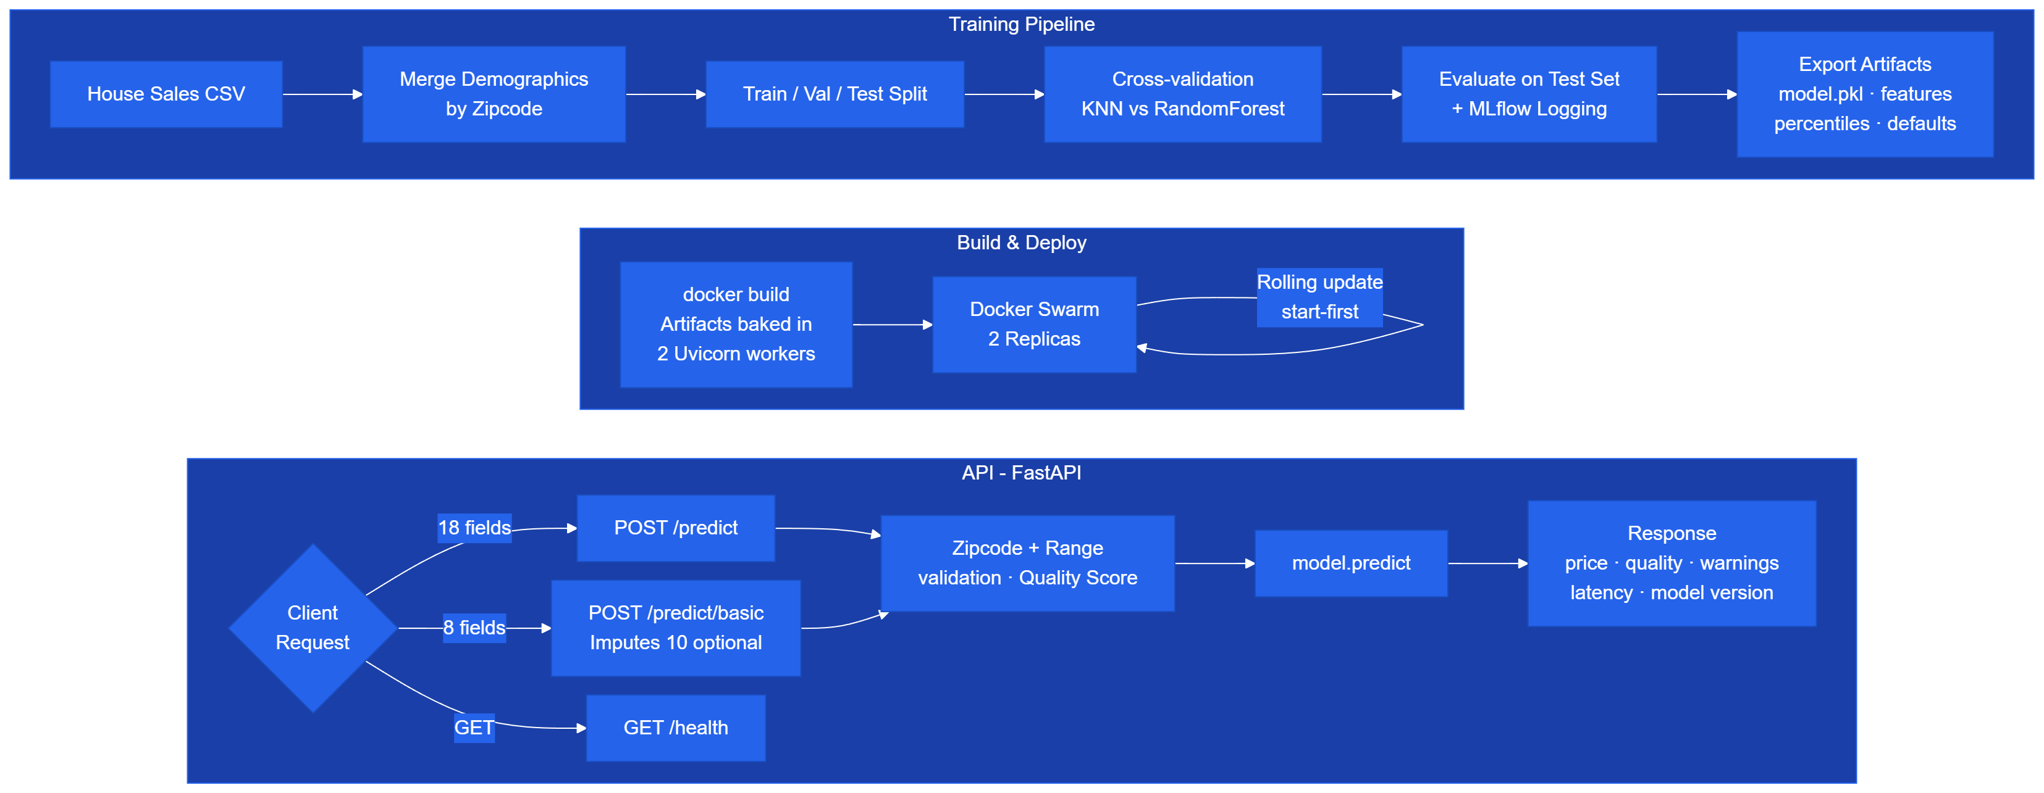
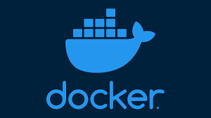
System Flowchart and Testing
Technical view
Training – Build & Deploy - API
With Docker Swarm, the project runs the API as 2 replicas by default, supports scaling the number of replicas up or down, and performs rolling updates with start-first, so a new container starts before the old one stops.
That gave a simple local solution for horizontal scaling and zero-downtime model updates without needing cloud infrastructure for the proof of concept.
Sound Realty | phData

Slide 10
API Prediction Endpoints
Endpoints return not just a prediction, but also operational context.
POST /predict
POST /predict/basic
Accepts all 18 property features. Demographics are joined server-side using zipcode and must not be sent in the request.
Requires only the 8 core house features plus zipcode. Remaining optional fields are imputed with training-set medians when omitted.
Input: 18 fields
Output: prediction + warnings
Required: 8 fields + zipcode
Optional: 10 imputed
Example request
Example response
Example request
Example response
{
"bedrooms": 4,
"bathrooms": 1.0,
"sqft_living": 1680,
"sqft_lot": 5043,
"floors": 1.5,
"waterfront": 0,
"view": 0,
"condition": 4,
"grade": 6,
"sqft_above": 1680,
"sqft_basement": 0,
"yr_built": 1911,
"yr_renovated": 0,
"zipcode": "98118",
"lat": 47.5354,
"long": -122.273,
"sqft_living15": 1560,
"sqft_lot15": 5765
}
{
"prediction_id": "d2919088-da15-434f-b167-ee19128df395",
"predicted_price": 352202.0,
"warnings": [
"yr_built=1911 is outside the typical training range
(p5=1915.0, p95=2011.0)"
],
"data_quality_score": 0.9,
"model_name": "sound-realty-price-predictor",
"model_version": "1.1.0",
"model_stage": "development",
"schema_version": "1.0",
"prediction_latency_ms": 39.6,
"timestamp": "2026-04-02T14:16:52.375195+00:00"
}
{
"bedrooms": 4.0,
"bathrooms": 1.0,
"sqft_living": 1680.0,
"sqft_lot": 5043.0,
"floors": 1.5,
"sqft_above": 1680.0,
"sqft_basement": 0.0,
"zipcode": "98118"
}
{
"prediction_id": "29948b83-2794-473d-91bf-902157fbdd4c",
"predicted_price": 432658.76,
"warnings": [
"waterfront not provided, median value used",
"view not provided, median value used",
"condition not provided, median value used",
"grade not provided, median value used",
"yr_built not provided, median value used",
"yr_renovated not provided, median value used",
"lat not provided, median value used",
"long not provided, median value used",
"sqft_living15 not provided, median value used",
"sqft_lot15 not provided, median value used"
],
"data_quality_score": 0.0,
"model_name": "sound-realty-price-predictor",
"model_version": "1.1.0",
"model_stage": "development",
"schema_version": "1.0",
"prediction_latency_ms": 34.24,
"timestamp": "2026-04-02T20:00:20.010710+00:00"}
One warning was generated because yr_built=1911 falls outside the typical training distribution, reducing the data quality score from 1.0 to 0.9.
Every imputed field is listed in warnings. In this example, 10 imputations reduce the data quality score from 1.0 to 0.0.
Input distribution drift system
data_quality_score = 1.0 - 0.1 × warnings
At prediction time, each incoming feature is checked against the p5/p95 bounds stored in model_percentiles.json, computed from the training set during model build.
If a value falls outside those bounds, the API adds a warning to the response. A sustained increase in warning rate across requests is an early signal that the input distribution has shifted before labeled outcomes are available.

Slide 11
Full system testing
Testing and operational validation
Technical view
What we validated in practice
Swarm deployment
Rolling update
Scale test
API tests
Basic endpoint
2 replicas
1.0.0 → 1.1.0
2 → 4 → 2
Responses before/after
Imputation verified
Deploy
API tests
Rolling update
Scale check
Initial stack deployed in Swarm
Full endpoint tested before and after update
Image updated from 1.0.0 to 1.1.0
Scaled up to 4 replicas
Service exposed on port 8000
Predictions returned model version in output
Old tasks shut down after new tasks started
Scaled back down to 2 replicas
Baseline image: sound-realty-api:1.0.0
Basic endpoint showed field imputation
Confirms start-first rolling replacement
Service returned to steady state
NAME MODE REPLICAS IMAGE
realty_api replicated 0/2 sound-realty-api:1.0.0
Submitting 5 examples to /predict
... $374,470 [model 1.0.0]
... $352,202 [model 1.1.0]
Submitting 1 example to /predict/basic
... $432,659 [model 1.1.0]
realty_api.1 1.1.0 Running
\_ realty_api.1 1.0.0 Shutdown
realty_api.2 1.1.0 Running
\_ realty_api.2 1.0.0 Shutdown
realty_api replicated 4/4 sound-realty-api:1.1.0
realty_api replicated 2/2 sound-realty-api:1.1.0
This log confirms the stack/service was created and bound to the published port.
The scale logs demonstrate horizontal elasticity and confirm the final post-test steady state at 2 replicas.
This is the clearest operational proof that the service updated live without fully stopping the API.
Small metrics strip
The logs show the API stayed callable and that responses reflected the active deployed model version.
R² 0.7398 → 0.8831
MAE $97,436 → $68,975
Basic endpoint also listed imputed optional fields, validating the simplified intake path.
Sound Realty | phData
Notes:
[Sources] - swarm_deploy.txt: realty_api deployed with published port mapping and initial 1.0.0 image. - rolling_update.txt: 1.0.0 tasks replaced by 1.1.0 tasks during rolling update. - scale_up.txt and scale_down.txt: service scaled to 4/4 replicas and returned to 2/2. - test_api_baseline.txt, test_api_improved.txt, test_api_basic.txt: API prediction tests before/after update and basic endpoint imputation behavior. - train_baseline.txt and train_improved.txt: baseline and improved model quality metrics used only in the small metrics strip.

Slide 12
Sound Realty
AWS Roadmap

Slide 13
Why the AWS version is better if the POC is approved
AWS path
It closes the gaps that matter once the application becomes operational.
More reliable
More secure
More observable
More repeatable
Managed orchestration, health routing, and multi-AZ deployment reduce operational risk.
Authentication, secret management, and tighter access control become part of the baseline.
Centralized logging, alarms, and prediction history help teams trust the service over time.
Model releases and app deployments move from manual steps to governed pipelines.
Operational upgrade
Business upgrade
Delivery upgrade
The application code stays largely the same; the infrastructure becomes production-ready.
The service becomes easier to support, safer to expose, and easier to expand.
Staging, production, and promotion workflows reduce deployment risk.
Big idea: move from local/manual responsibilities to managed/versioned cloud services.
Sound Realty | phData

Slide 14
AWS target state
AWS path
Same application logic, stronger infrastructure around it.
Clients / apps
API Gateway
ALB
ECS Fargate
CloudWatch
Internal tools, future portal, partner apps.
→
Authentication, rate limiting, managed API layer.
→
Traffic routing and health-aware load balancing.
→
Runs the FastAPI container across AZs.
→
Logs, metrics, alarms.
Amazon ECR
Amazon S3
SSM Parameter Store
DynamoDB
CodePipeline + CodeBuild
Versioned container images.
Model artifacts stored outside the image.
Controls the active model version.
Prediction logging and audit trail.
Automated app and model release flow.
Sound Realty | phData

Slide 15
Current vs AWS Comparison
AWS path
Component | Current Setup | AWS Service | Gap Closed
Container registry | Local Docker images | Amazon ECR | Versioned image storage, team access
Container runtime | Docker Swarm (manual replicas) | ECS Fargate | Auto-scaling, managed orchestration
Load balancing | Swarm routing mesh | Application Load Balancer (ALB) | Distribute HTTP traffic across Multi-AZ, health routing
Authentication | None – no authentication (JWT, Token, etc) | Amazon API Gateway | API key auth, rate limiting, WAF
Model storage | Local model/ directory | Amazon S3 | Versioned artifacts, decoupled from image
Model version control | Parameter into Docker image | SSM Parameter Store + S3 | (Trigger) Change model without rebuilding image
Prediction logging | None – no prediction logging | Amazon DynamoDB | Single-digit-millisecond reads and writes , Audit trail, real outcome drift monitoring
Experiment tracking | MLflow (local) | SageMaker Experiments | Shared team access, managed, no infra
High availability | 2 replicas, same host | Multi-AZ ECS placement | Survive AZ failure
Monitoring / alerts | Manual log inspection | CloudWatch + SNS | Automated alerts, drift detection
CI/CD | Manual docker build + push | CodePipeline + CodeBuild | Automated deploy, all execution in AWS
Environments | Single (local) | Staging + Production | Safe pre-production validation
Secrets | Environment variables | AWS Secrets Manager | Encrypted, audited, rotatable
Sound Realty | phData

Slide 16
Suggested AWS rollout in phases + Expected Costs
AWS path
Keep the path pragmatic: harden what matters first.
1
2
3
4
5
6
Foundation
→
Security
→
Logging
→
Observability
→
CI/CD
→
Lineage
ECR, ECS Fargate, ALB, S3, SSM
API Gateway, Secrets Manager, tighter networking
DynamoDB audit trail for predictions
CloudWatch metrics, alarms, SNS notifications
Automated build, deploy, and model promotion flow
SageMaker Experiments for shared run tracking
Service | Configuration | Est. Cost / Month
ECS Fargate (Production) | 2 tasks, 0.5 vCPU, 1 GB RAM | ~$36
ECS Fargate (Staging) | 1 task, 0.25 vCPU, 0.5 GB RAM | ~$10
Application Load Balancer x2 | 1 prod + 1 staging | ~$36
Amazon ECR | ~1 GB image storage, a few versions | ~$2
Amazon S3 | Model artifacts + training data | ~$2
API Gateway | ~100k requests/month | ~$3*
Amazon DynamoDB | On-demand, ~10k predictions/month | ~$2*
CloudWatch | Logs ingestion + metrics + alarms | ~$8
SSM Parameter Store | Standard parameters | Free
SageMaker Experiments | Metadata only, no training compute | ~$1
NAT Gateway | 1 gateway, low data transfer | ~$35*
SNS | Email/Slack notifications | ~$1
CloudTrail | 1 trail, management events | ~$2*
CodePipeline + CodeBuild | 2 pipelines, ~10 builds/month | ~$2
TOTAL |  | ~$140/month
Result: a gradual transition from “working POC” to “operated product.”
Sound Realty | phData

Slide 17
Recommendation for Potential Clients
Close
Use the POC to prove value. Use AWS to operationalize it.
Today
Next
We have a usable proof of concept: improved model, prediction API, backend enrichment, basic monitoring, and a credible demo story.
If approved, the AWS version turns the same application into a secure, scalable, monitored, production-ready valuation service.
What we have today is enough to prove the business value.
What AWS gives us next is the confidence to operate it as a real product.
Sound Realty | phData

