Slide 1

Problem statement

Slide 2
Theoretical result
To simplify a Boolean function given in a disjunctive canonical form, means to cover all its minterms with a minimum number of maximal monoms and with a minimum number of overlaps.
The simplification process is formalized by the steps below:
The initial function f is transformed into a DCF(f)
Factorization process -> the set of maximal monoms M(f)
From the set of maximal monoms the central monoms are selected -> C(f)
The case of the simplification algorithm is identified and all simplified forms are obtained

Slide 3
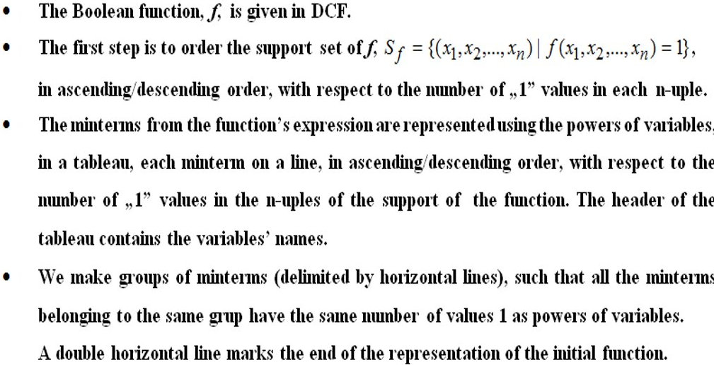
Quine’s method

Slide 4
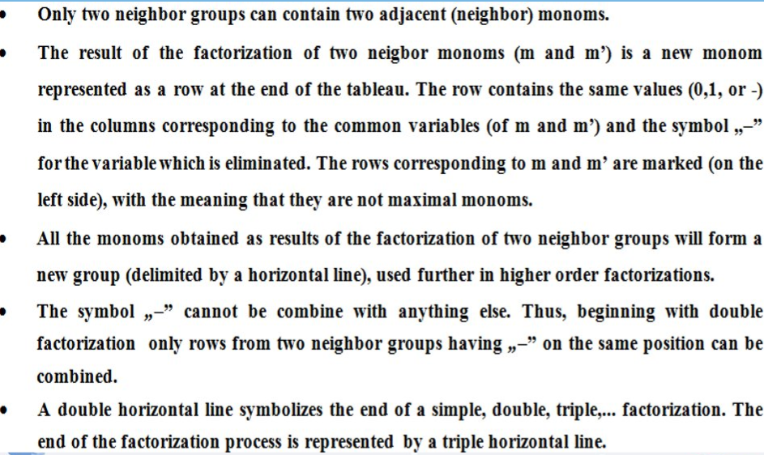

Slide 5
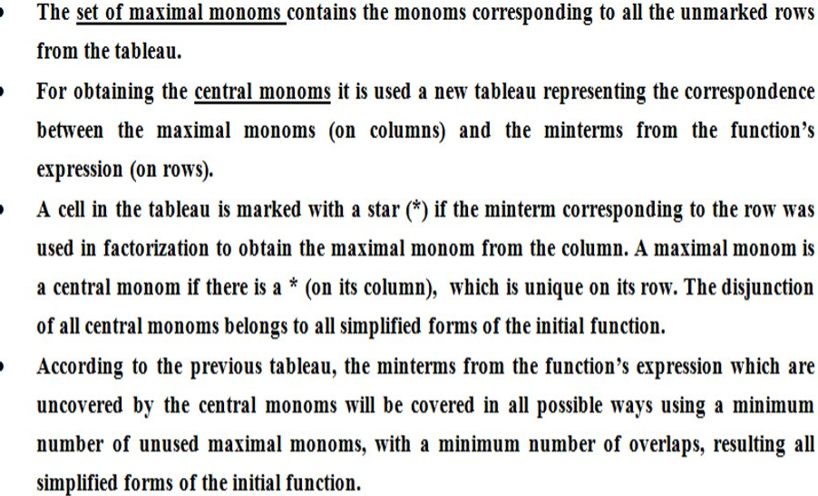

Slide 6
f(0,0,1) = f(1,0,1) = f(1,1,0) = 0
 | x₁ | x₂ | x₃ | f(x₁, x₂, x₃)
m₀ | 0 | 0 | 0 | 1
m₁ | 0 | 0 | 1 | 0
m₂ | 0 | 1 | 0 | 1
m₃ | 0 | 1 | 1 | 1
m₄ | 1 | 0 | 0 | 1
m₅ | 1 | 0 | 1 | 0
m₆ | 1 | 1 | 0 | 0
m₇ | 1 | 1 | 1 | 1
= = {(0,0,0), (0,1,0), (0,1,1), (1,0,0), (1,1,1)} -> the support set of f

Slide 7
We have to order the support set of f, in ascending order, with respect to the number of “1” values in each n-uple.
Representation Simple factorization
Group | x₁ | x₂ | x₃
I | 0 | 0 | 0 | m₀
II | 0 | 1 | 0 | m₂
 | 1 | 0 | 0 | m₄
III | 0 | 1 | 1 | m₃
IV | 1 | 1 | 1 | m₇
Group | x₁ | x₂ | x₃
V = I + II | 0 | - | 0 | m₀vm₂ = x₁x₃ = max₁
 | - | 0 | 0 | m₀vm₄ = x₂x₃ = max₂
VI = II + III | 0 | 1 | - | m₂vm₃ = x₁x₂ = max₃
VII = III+ IV | - | 1 | 1 | m₃vm₇ = x₂x₃ = max₄
Then we begin the process of factorization. We can apply this process only on neighbouring groups.

Slide 8
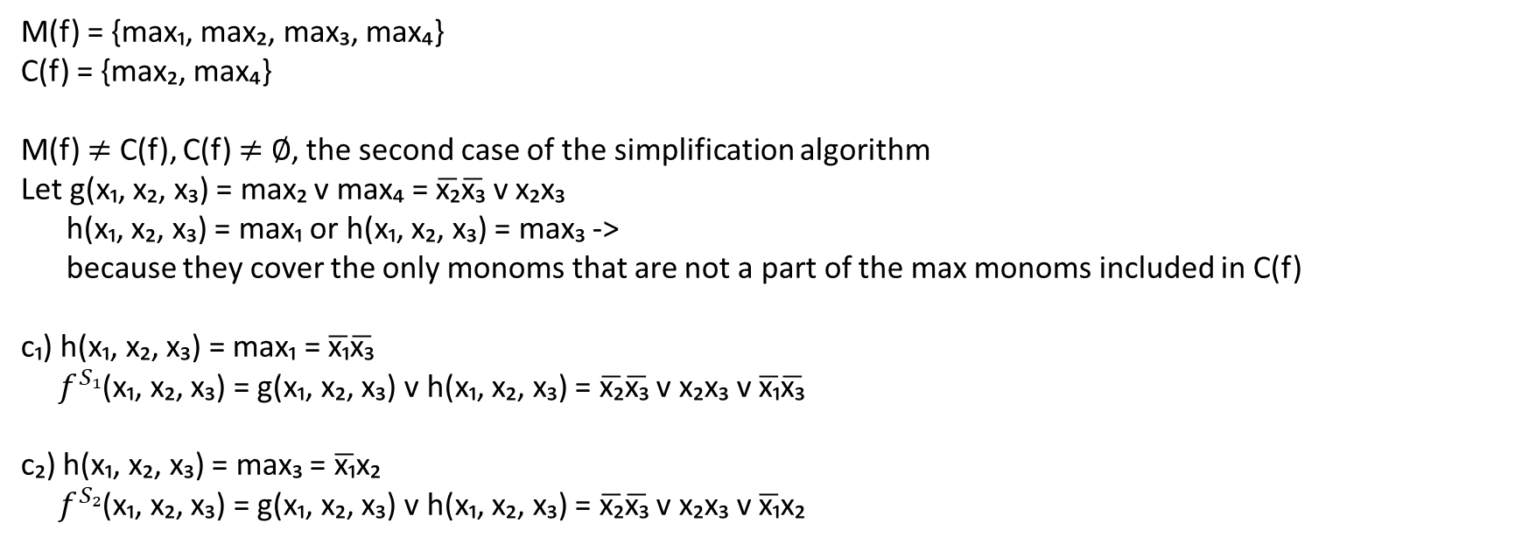
 | max₁ | max₂ | max₃ | max₄
m₀ | * | *
m₂ | * |  | *
m₄ |  | £
m₃ |  |  | * | *
m₇ |  |  |  | £
M(f) = {max₁, max₂, max₃, max₄}
C(f) = {max₂, max₄}
M(f) $≠$ C(f), C(f) $≠$ $∅$, the second case of the simplification algorithm
Let g(x₁, x₂, x₃) = max₂ v max₄ = $\overline{\text{x}\text{₂}}\overline{\text{x}\text{₃}}$ v x₂x₃
h(x₁, x₂, x₃) = max₁ or h(x₁, x₂, x₃) = max₃ ->
because they cover the only monoms that are not a part of the max monoms included in C(f)
c₁) h(x₁, x₂, x₃) = max₁ = $\overline{\text{x}\text{₁}}\overline{\text{x}\text{₃}}$
$f^{S₁}$(x₁, x₂, x₃) = g(x₁, x₂, x₃) v h(x₁, x₂, x₃) = $\overline{\text{x}\text{₂}}\overline{\text{x}\text{₃}}$ v x₂x₃ v $\overline{\text{x}\text{₁}}\overline{\text{x}\text{₃}}$
c₂) h(x₁, x₂, x₃) = max₃ = $\overline{\text{x}\text{₁}}$x₂
$f^{S₂}$(x₁, x₂, x₃) = g(x₁, x₂, x₃) v h(x₁, x₂, x₃) = $\overline{\text{x}\text{₂}}\overline{\text{x}\text{₃}}$ v x₂x₃ v $\overline{\text{x}\text{₁}}$x₂

