Slide 1
Problem Statement

Slide 2
Theory
An interpretation i which evaluates the formula U as true is called a model of U.
i:{p₁, … , pₓ} → {T, F} such that i(U) = TU
In order to find the models of the given formula, we must convert it to normal form.
DNF(U) provides the models of U by evaluating as true one by one its cubes.

Slide 3
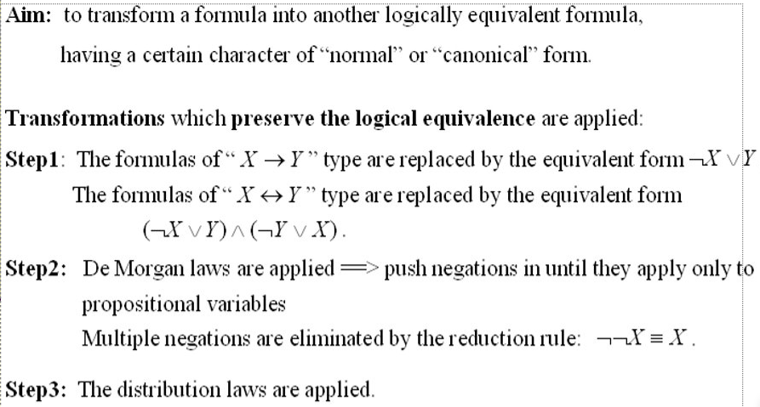
Normalization Algorithm

Slide 4
U₄ ≡ (p v q) ʌ ⌐r → p ʌ q ʌ r
Step 1: We write the implication A → B as ⌐A v B
U₄ ≡ ⌐( (p v q) ʌ ⌐r) v p ʌ q ʌ r
Step 2: We apply de Morgan’s law on the parenthesis
U₄ ≡ ⌐(p v q) v ⌐(⌐r) v (p ʌ q ʌ r)
Step 3: We apply de Morgan’s law on the parenthesis again
U₄ ≡ (⌐p ʌ ⌐q) v r v (p ʌ q ʌ r)
This is the final form, a DNF with 3 cubes.
The models of U₄ are the interpretations that evaluate one by one the cubes of DNF as true.

Slide 5
DNF(U₄) = (⌐p ʌ ⌐q) v r v (p ʌ q ʌ r)
Cube: ⌐p ʌ ⌐q provides 2 models:
i1:{p,q,r} -> {T,F}, i1(p) = F, i1(q) = F, i1(r) = F
i2:{p,q,r} -> {T,F}, i2(p) = F, i2(q) = F, i2(r) = T
Cube: r provides 4 models:
i3:{p,q,r} -> {T,F}, i3(p) = T, i3(q) = T, i3(r) = T
i4:{p,q,r} -> {T,F}, i4(p) = T, i4(q) = F, i4(r) = T
i5:{p,q,r} -> {T,F}, i5(p) = F, i5(q) = T, i5(r) = T
i6:{p,q,r} -> {T,F}, i6(p) = F, i6(q) = F, i6(r) = T
Cube: p ʌ q ʌ r provides 1 model:
i7:{p,q,r} -> {T,F}, i7(p) = T, i7(q) = T, i7(r) = T
We notice that i2 = i6 and i3 = i7

Slide 6
Conclusions
The models of U₄ are interpretations: i1, i2, i3, i4, i5
i1(U₄) = i2(U₄) = i3(U₄) = i4(U₄) = i5(U₄) = T
Models:
i1, i2, i3, i4, i5:{p,q,r} -> {T,F}
i1:{p,q,r} -> {T,F}, i1(p) = F, i1(q) = F, i1(r) = F, i1(U₄) = T
i2:{p,q,r} -> {T,F}, i2(p) = F, i2(q) = F, i2(r) = T, i2(U₄) = T
i3:{p,q,r} -> {T,F}, i3(p) = T, i3(q) = T, i3(r) = T, i3(U₄) = T
i4:{p,q,r} -> {T,F}, i4(p) = T, i4(q) = F, i4(r) = T, i4(U₄) = T
i5:{p,q,r} -> {T,F}, i5(p) = F, i5(q) = T, i5(r) = T, i5(U₄) = T

