Slide 1
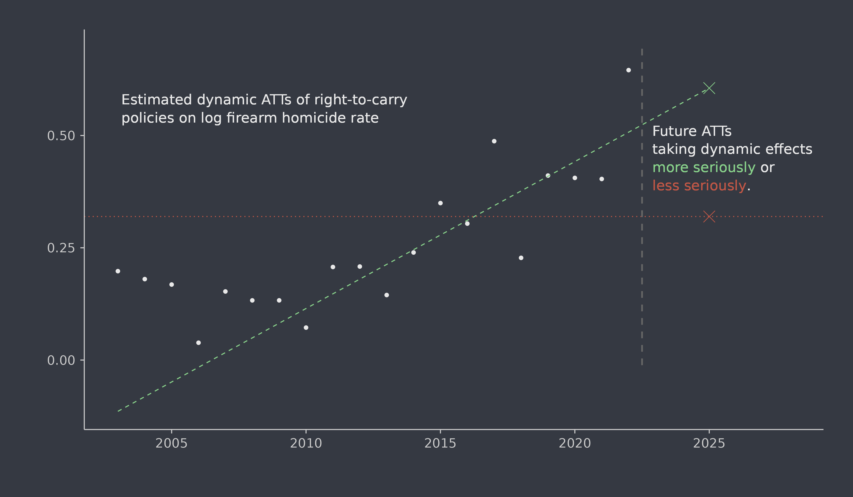


Overcoming the Streetlight Effect: The Role of Time Heterogeneity in Estimating Firearm Policy Effects
Two paths forward for quantitative analysis of firearm policies
We estimate in the past but implement policies in the future.
Denis Agniel*, Terry Schell, Rosanna Smart, Andrew Morral
*dagniel@rand.org
Take dynamic policy effects less seriously
Assume policy effects do not change over time (homogeneity)
Past data identifies future impact
More statistical efficiency, but may not be plausible
Firearm policies change, and their effects may change, too
Dynamic policy effects require future-oriented causal inference.
Quantitative studies estimate policy effects on historical data
Public behavior, enforcement, and attitudes shift over time
Policy effects may therefore change over time
Studies of right-to-carry laws suggests effects may differ by time of adoption
Recent difference-in-differences literature stresses dynamic effects
Either path translates historical data into insights relevant to future policy decisions
Take dynamic policy effects more seriously
Explicitly model change in policy effects over time
Extrapolate historical effects to present day
Acknowledge additional variability due to extrapolation
Example: policy effects may wane as people adapt
How can estimates on yesterday’s data inform policy decisions today if policy effects are always changing?
Analysis of right-to- carry policies in CDC WONDER mortality data, 2001-2022
Policy data come from RAND State Firearm Law Database
Dynamic group-time ATT estimates obtained using the did package in R
Taking dynamic effects more seriously: projecting group-specific effects to 2025
Taking dynamic effects less seriously: assuming constant group-specific effects
Influence functions may be used to obtain estimates of variability (not shown)
Definitions: ATT = Average treatment effect on the treated
ATE = Average treatment effect
Keywords: Causal inference · Dynamic firearm policy effects · External validity

