Slide 1
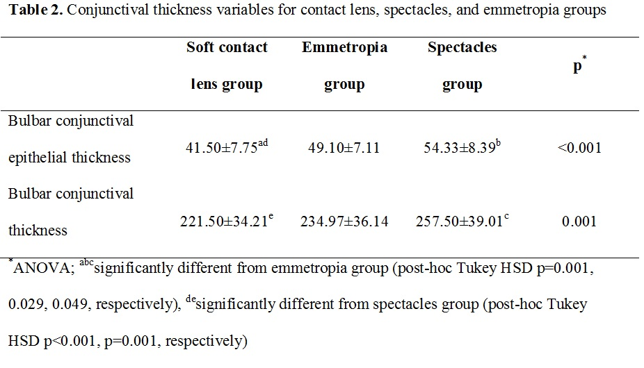
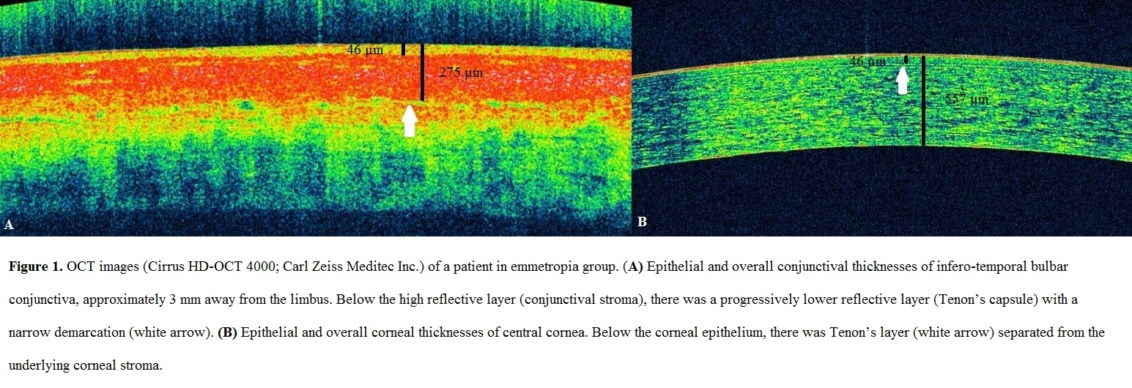
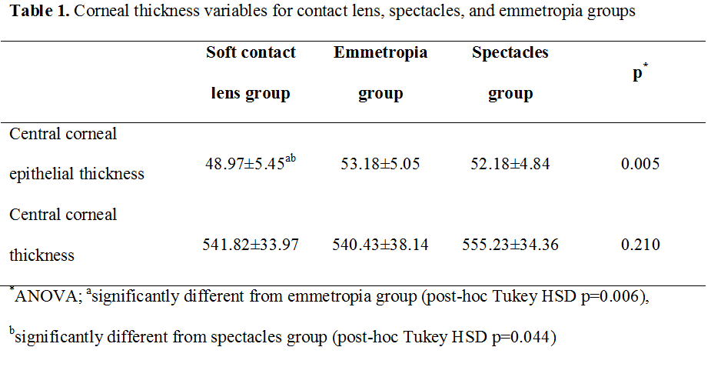
Non-invasive assessment of corneal and conjunctival deterioration in soft contact lens users using anterior segment optical coherence tomography Ismail Ersan, Sedat Arikan, Selcuk Kara, Baran Gencer, Asiye Koklu, Hasan Ali Tufan Canakkale Onsekiz Mart University, Faculty of Medicine, Department of Ophthalmology, Canakkale , Turkey
INTRODUCTION
RESULTS
Anterior segment optical coherence tomography (AS-OCT) is becoming more widely used in clinical studies, for example to investigate the thickness changes of the total cornea and epithelium after overnight corneal refractive therapy rigid contact lens wear¹ and to evaluate the influence of soft contact lens design on epithelial indentation.² Using this technology, corneal epithelial involvement in soft contact lens (SCL) wearers has been previously reported;^{3,4} however, there has thus far not been much studies have been done into changes in the conjunctival layer of SCL wearers.
The aim of the present study was to compare the epithelial and overall corneal and bulbar conjunctival thicknesses of SCL wearers with those of members of a refractive error-matched group and a control group with no refractive error.
The soft contact lens group included 30 subjects (10 males) with a mean spherical equivalent refraction of -2.69±1.19 diopters and with a mean age of 23.17±2.55 years (range, 17 to 29 years); the spectacles group included 30 subjects (15 males) with a mean spherical equivalent refraction of -2.70±1.63 diopters and with a mean age of 22.33±3.84 years (range, 14 to 33 years); the emmetropia group included 30 subjects (13 males) with a mean spherical equivalent refraction of 0.00±0.31 diopters and with a mean age of 23.70±3.09 years (range, 18 to 33 years). There was no significant difference in age and gender distribution among the three groups (p=0.281 and 0.421, respectively). Further, there was no significant difference in the spherical equivalent refraction of SCL and spectacles groups (p=0.216). The mean duration of contact lens wear was 3.68±2.11 years (ranging from 1-7 years).
Corneal thickness measurements are shown in Table 1. The inter examiner ICCs of the corneal epithelial thickness and CCT were 0.894 (95%CI, 0.706-0.949), 0.901 (95%CI, 0.746-0.951), respectively.
Conjunctival thickness measurements are shown in Table 2. The inter examiner ICCs of the conjunctival epithelial thickness and conjunctival thickness were 0.917 (95%CI, 0.801-0.958), 0.848 (95%CI, 0.769-0.900), respectively.
METHODS
Subjects with dryness symptoms, tear breakup times shorter than 5 seconds, Schirmer I test results shorter than 10mm/5 min, positive corneal fluorescein staining, and chronic eye drop use were excluded.
Half of the subjects in the SCL group wore Air Optix Aqua (Ciba Vision, Duluth, GA) and remaining 15 subjects wore Acuvue Oasys (Vistakon; Johnson& Johnson Vision Care, Jacksonville, FL) on a daily wear basis. All contact lens wearers were asked to put their contact lenses in in the morning and were asked to remove their lenses one hour before measurements were taken. The right eyes of all participants were assessed and all measurements were carried out between 15:00 and 17:00 PM. Epithelial and overall thicknesses of the cornea and conjunctiva were measured using a Cirrus HD-OCT 4000 (Carl Zeiss Meditec, Dublin, CA, USA) (Figure 1).
One-way ANOVA was used to compare these measurements among the groups. Pairwise post-hoc tests were performed using Tukey’s HSD test. The inter examiner reproducibility of the corneal and conjunctival epithelial thicknesses measures were assessed by measuring the intraclass correlation coefficient (ICC).
DISCUSSION
We demonstrated that the corneal epithelial thickness in the SCL group was significantly thinner than in both the spectacles and emmetropia groups (p=0.044 and 0.006, respectively). Our result is important in terms of showing that epithelial thinning in SCL wearers is only associated with the contact lens usage, not with refractive error.
Efron et al⁵ using LSCM found that the overall bulbar conjunctival epithelial thickness of asymptomatic contact lens wearers was thinner than those of controls, in whom the refractive error were not measured. To our knowledge, this is the first OCT study evaluating conjunctival epithelial thickness in contact lens wearers. We agreed with Efron et al,⁵ who concluded that such thinning of the conjunctival epithelium in contact lens wearers may be due to mechanically induced impairment of the epithelial metabolism caused by the release of inflammatory mediators as a result of constant subclinical irritation by the lens.
To our knowledge, the responses of the cornea and conjunctiva to contact lens wear have not been evaluated in a single study. According to our results, contact lens wear caused thinning of the corneal and conjunctival epithelium, and bulbar conjunctiva.
Further studies using AS-OCT on larger patient cohorts wearing different contact lens materials and designs for myopia and hypermetropia are required to detect ocular involvement in contact lens wearers.
References
Haque S, Fonn D, Simpson T, Jones L. Corneal and epithelial thickness changes after 4 weeks of overnight corneal refractive therapy lens wear, measured with optical coherence tomography. Eye Contact Lens. 2004; 30: 189-193.
Wolffsohn JS, Drew T, Dhallu S, Sheppard A, Hofmann GJ, Prince M. Impact of soft contact lens edge design and midperipheral lens shape on the epithelium and its indentation with lens mobility. Investig Ophthalmol Vis Sci. 2013; 54: 6190-6196.
Haque S, Jones L, Simpson T. Thickness mapping of the cornea and epithelium using optical coherence tomography. Optom Vis Sci. 2008; 85: E963-E976.
Hong J, Qian T, Yang Y, Jiang C, Liu Z, Sun X, Deng SX, Xu J. Corneal epithelial thickness map in long-term soft contact lenses wearers. Optom Vis Sci. 2014; 91: 1455-1461.
Efron N, Al-dossari M, Sc MA, Pritchard N, Optom BAS. Confocal Microscopy of the Bulbar Conjunctiva in Contact Lens Wear. 2010; 29: 43-52.

