Slide 1
The effects of gender, age, and refractive error on corneal and conjunctival epithelial and overall thicknesses
Ismail Ersan, Selcuk Kara, Sedat Arikan, Baran Gencer, Hasan Ali Tufan Canakkale Onsekiz Mart University, Faculty of Medicine,
Department of Ophthalmology, Canakkale , Turkey

Slide 2
PURPOSE: To evaluate the corneal, conjunctival epithelial and overall thicknesses measured by anterior segment optical coherence tomography (OCT) in healthy population.
METHODS
This retrospective study included 134 eyes of 134 healthy individuals who were undergone a Cirrus HD-OCT examination using the Anterior Segment 5 Line Raster protocol.
Corneal, conjunctival epithelial and overall thicknesses were measured on OCT images.
The average values of four OCT parameters were compared between sexes and among the six subgroups with respect to age.

Slide 3
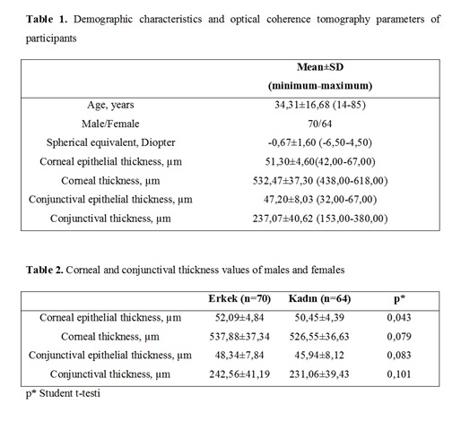
RESULTS

Slide 4
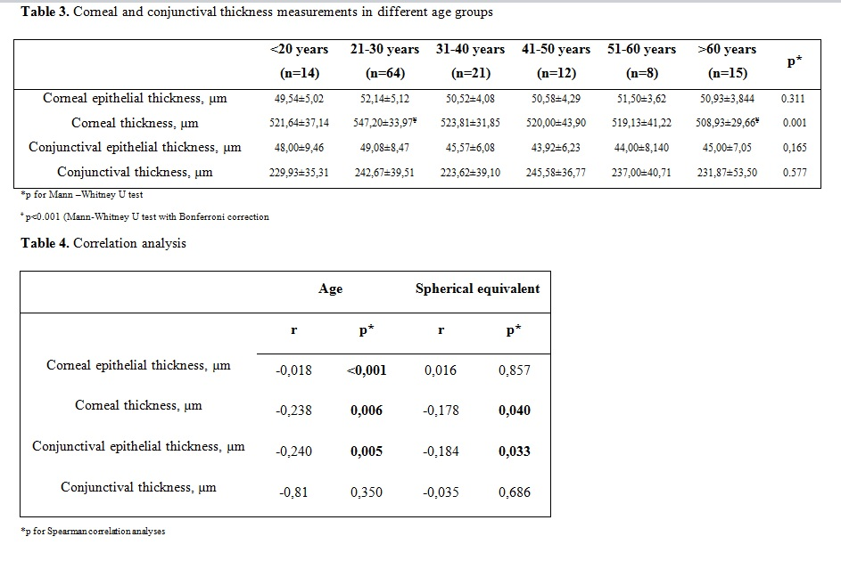

Slide 5
DISCUSSION
Corneal epithelial thickness, CCT, and conjunctival epithelial thickness measurements showed negative correlation with age.
CCT and conjunctival epithelial thickness measurements showed negative correlation with spherical equivalent.
Some of ocular surface parameters measured by anterior segment OCT were gender, age, and refraction-related. Thus, further studies conducted to evaluate the corneal and conjunctival thicknesses should involve gender, age, and refraction-matched control groups.

