Slide 1
Corneal and Tear Film Changes after Botulinum Toxin-A in Blepharospasm or Hemifacial Spasm
Alime Gunes¹, Seden Demirci², Hasan Rifat Koyuncuoglu², Levent Tok¹, Ozlem Tok¹.
¹ Department of Ophthalmology, Süleyman Demirel University Faculty of Medicine, Isparta, TURKEY.
² Department of Neurology, Süleyman Demirel University Faculty of Medicine, Isparta, TURKEY.

Slide 2
INTRODUCTION
Benign essential blepharospasm and hemifacial spasm are two of the most common eye movement disorders.
Botulinum toxin- A (BTX-A) therapy is currently the gold-standard treatment for these diseases, due to its efficiency and safety.
The aim of this study was to investigate the influence of BTX-A injection on corneal parameters and tear film in patients with blepharospasm or hemifacial spasm.

Slide 3
METHODS
Twelve benign essential blepharospasm and 30 hemifacial spasm patients treated with BTX-A were included in this study.
We injected 2.5 IU subcutaneously at each selected five point with a 27-gauge insulin syringe in all of the patients.
Disease severity was evaluated using Jankovic’s scale.
Corneal parameters were measured by Pentacam.
Schirmer test, tear breakup time (TBUT), corneal fluorescein staining, and Ocular Surface Disease Index (OSDI) score were also evaluated.
All measurements were performed before treatment, at three weeks after the injection, and three months after the injection.

Slide 4
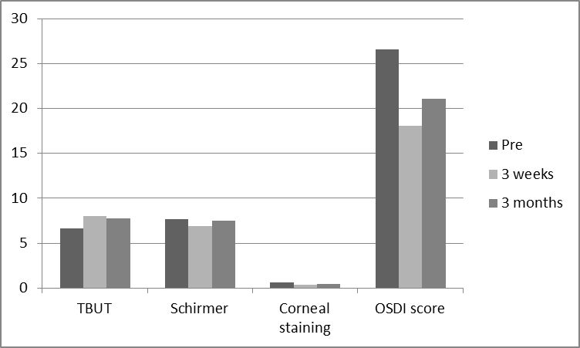
RESULTS
The BTX-A treatment relieved spasms in all of the patients.
There was a statistically significant difference in disease severity between pretreatment and third week (2.73±0.80 and 1.28±0.55, respectively; p<0.001), but there was no statistically significant difference between pretreatment and third month (2.73±0.80 and 2.70±0.81, respectively; p=0.80).
TBUT was found to be significantly higher at both three weeks and three months after injection (6.64±4.02 at pretreatment, 8.06±3.91 at third week, and 7.80±4.20 at third month; p=0.04 and p=0.02, respectively).
Schirmer test, corneal fluorescein staining values, and OSDI score were lower three weeks after injection, but these values increased again by three months after injection.
Corneal astigmatism decreased significantly at three weeks and at three months after injection (1.41±1.24 D at pretreatment, 1.15±0.81 D at third week and 1.11±0.81 D at third month, respectively; p=0.02, for both), but other corneal parameters did not change.
Figure 1. Comparison of dry eye test and OSDI score before, three weeks after, and three months after injection of botulinum toxin-A in patients.

Slide 5
CONCLUSION
BTX-A injection therapy was effective on tear film in patients with blepharospasm or hemifacial spasm. However, there were no changes in corneal parameters, except corneal astigmatism, in these patients after treatment.

