Slide 1


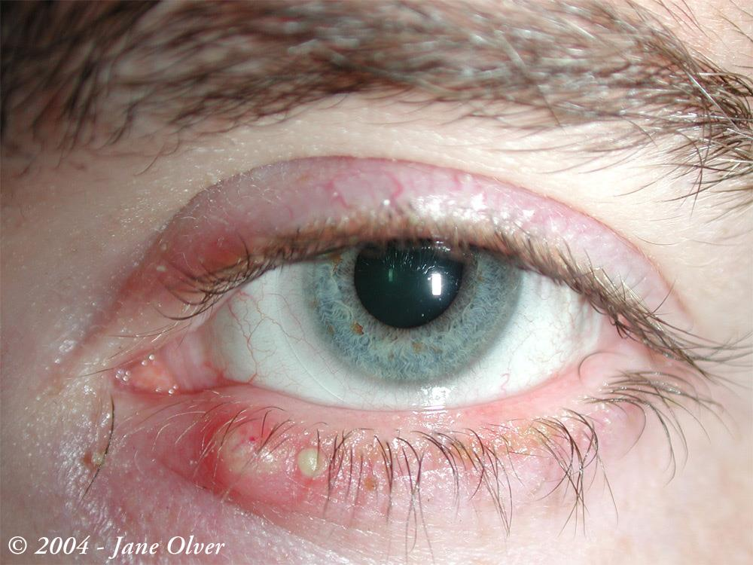
TREATMENT OF MEIBOMIAN GLAND DYSFUNCTION IN CONTACT LENSES USERS WITH TEA TREE OIL
Garzón P., Johanna *; López-Alemany, Antonio** * O.D., MSc. Pharm., Ph.D (c),. Assistant professor Universidad de la Salle, Bogotá, Colombia. Member research Cuidado primario visual y ocular
** M.D. Ophtalmologist, Professor Universidad de Valencia, Spain, Ocular Surface, Cornea and Contact Lenses: Miguel F. Refojo,
ABSTRACT
INTRODUCTION
Frecuently is common in contact lenses user a chronic disorder of the eyelids with inflammation of lid margins, involving meibomian glands. The inflammatory etiology includes non-infection causes and bacterial agents such as S.Epidermidis and S. Aureus and in the great majority of cases over infections which hide parasitarian causes such as Demodex Folliculorum. Soft contact lenses materials modify the lipid secretion from the meibomian glands and their imbalance disrupts the ability of tear evaporation and generate dry eye. PURPOSE: Demonstrate the effect of eyelid cleanser based on Melaleuca Alternifolia in resolution of inflammatory signs of Meibomian gland dysfunction in contact lens users.
METHODOLOGY : Study prospective series of 10 cases during 30 days, before and after to use the cleaner foaming for eyelids with Tea Tree Oil/ TTO.
INCLUSION CRITERIA: Soft contact lenses users longer than 30 days, no microbial or pathogens infections previus as conjunctivitis, blepharitis or keratitis, age over 18 were included in the study. All of patients were examined with green lissamine to study the Marx´s line and the Glands Meibomian external morphology.
RESULTS The contact lenses materials were Galyfilcon A and Comfilcon A. The mean of basal Meibomian Gland Dysfunction was quantified through external morphology and Marx´s line state. After 30 days the grading decrease CONCLUSIONS: External morphology in Meibomian Glands dysfunction of contact lens users are modified with the clean of their eyelids using a cleaner system based in melaleuca alternifolia The goal to eliminate the secretions through the use of detergent agents which don’t produce toxicity contribute to the anti-inflammatory process and the elimination of the causative agents and contributes to lipids.
KEY WORDS: Meibomian gland dysfunction, Silicone hydrogel, cleanser, TTO.

Slide 2
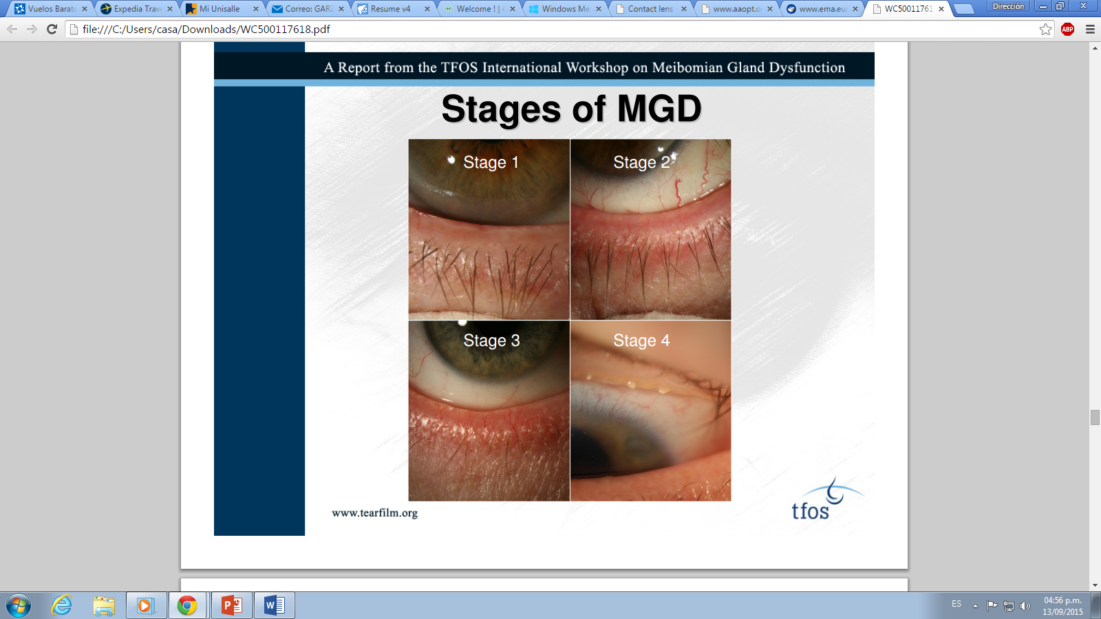
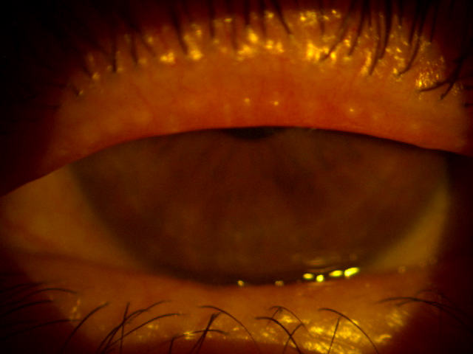
Meibomian Gland Dysfunction
1.
MDG is defined as chronic, diffuse abnormality of the meibomian glands, characterized by terminal ducto obstruction and or qualitative auantitative changes in the glandular secretion: inflammation, and ocular surface disease (Workshop, 2013).
Symptoms : Eye dryness, burning, sticky, tearing, redness, lash crusting.
Signs: Telangiectasis, collarettes, gland plugging (3).
Testing includes: expression, lid assessment: redness, irregularity, MG location, staining. (4)
In contact lens wearers is frequently the discomfort and no tolerance caused by the obstruction of the meibomian gland orifices. MGD is a major cause of evaporative dry eye in these patients, and this correlation cause desertion.
A recent study has shown that contact lens wear is associated with a decrease in the number of functional meibomian glands, associated to soft contact lenses materials that modify the lipid secretion (1). In addition, this causes “lid scrubs” with foreign body sensation and itching. The traditional treatment includes warm pads, eye drops for humidify, and changes in materials.
Purpose: Demonstrate the effect of eyelid cleanser based on Tea Tree oil, in resolution of inflammatory signs of Meibomian gland dysfunction in contact lens wearers.
.
Stage depends of symptoms and signs severity.
In Stage 1, no symptoms presents, but in Stage 2, the expression is limited and the lid is redness and gland are inflammated.
In Stage 3 and 4, secretion is altered, and exists staining, with more symptoms.

Slide 3
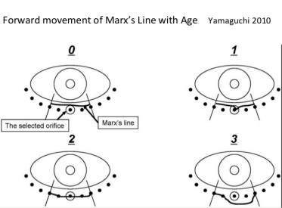
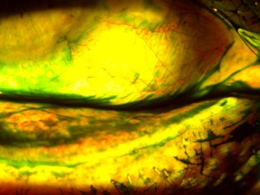
Methodology
2.
Study of 10 soft contact lenses cases with discomfort associated to Meibomian Gland Dysfunction/MGD were evaluated after 30 days to treatment by lid hygiene with Tea Tree Oil/ TTO.
Methods: All of patients were examined to study external signs as redness, debris, and telangiectasis, and the Meibomian gland was evaluated using green lissamine to view the marx line. The Marx´s line and the Glands meibum secretion by expression were the most important variables after the treatment, and the results were classified by material contact lens.
The Marx line (ML) was evaluated with lisammine green staining, according with the score of Yamaguchi (2010). After applying lisammine dye solution to the eye, the ML score was calculated for the outer, middle, and inner thirds of the lower eyelid margin. ML scoring was as follows: 0, entirely on the conjunctival side of the meibomian orifices (MOs); 1, part of the ML touches the MOs; 2, ML runs through all of the MOs; and 3, ML runs on the eyelid-margin side of the MOs.
Meibum secretion: the gland secretion was expresed. To assess meibum expression and meibomian gland orifice obstruction, digital pressure was applied to the upper tarsus, and the degree of ease of expression of meibomian secretions (meibum) was evaluated semiquantitatively as follows: grade 0, clear meibum easily expressed (none); grade 1, cloudy meibum expressed with mild pressure; grade 2, cloudy meibum expressed with more than moderate pressure; and grade 3, meibum cannot be expressed even with strong pressure.
End point: The treatment only consisted in hygiene with a foammy ocular cleanser with Tea tree oil, during 30 days. Then, the signs were evaluated again.
Inclusion criteria: Soft contact lenses users longer than 30 days, no microbial or pathogens infections previous as conjunctivitis, blepharitis or keratitis, age over 18 were included in the study.
Data were analysed by Wilcoxon matched pairs signed ranks test for non-parametric paired data.A p level of <0.05 was accepted as statistically significant. GRAPHPAD InStat 3 for Mac OS X was used for the statistical analysis.

Slide 4
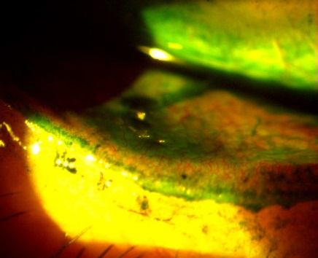
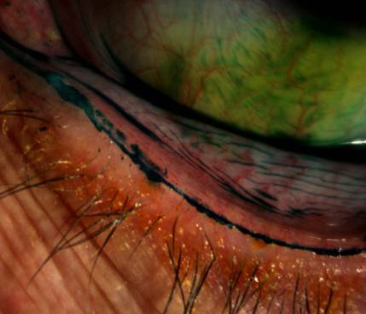
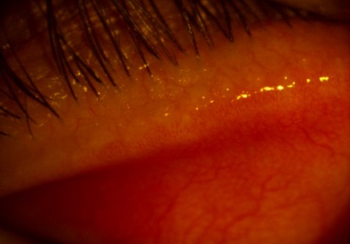
Results
2.
3.
We examined a series of 10 subjects with MGD (mean age was 25 years, SD 4.11; 18-59) at Salle university, optometric clinic, Bogotá Colombia. 70% female gender and 30% male. MGD was confirmed in the 10 patients. Subjective symptoms were checked on the discomfort sensation, patients chose the most representative as burning sensation (60%.
The mean of Marx line grading score was 2,7 SD 0,6; P<0,005, meaning a mild inflammation in the meibomian glands, and then 30 days using contact lenses and eyelid cleaner, was 0,7 (SD 0,1; P<0,0003).
In the correlation between materials, we found no significant difference between contact lenses material group ( P>0,005).
 | Galyfilcon A |  |  | Comfilcon A
 | Before | After 30 days | P Value | Before | After 30 days | P Value
Marx Line | 2,5 (SD 0,6) | 0,83 (SD 0,1) | <0,0003 | 2,5 (SD 0,6) | 0,66 (SD 0,34) | <0,0003
Meibum | 2,83 (SD 0,45) | 1,63 (0,56) | 0,03 | 2,01 (SD 0,9) | 1,01 (SD 0,3) | P> 0,05
Debris | 2,6 (SD 0,31) | 1,2 (SD 0,2) | 0,03 | 1,5 (SD 0,49) | 0,5 (SD 0,1) | P> 0,05
MG signs was present in 86,6% of patients, with redness (80%), Telangiectasis (80%) and lid inflammation (100%).
The results showed 70% of the cases with grade 3, in meibum, no expressed even with strong pressure (70%), with no significatly diference between materials group. After 30 days, the meibum secretion improved considerably.

Slide 5
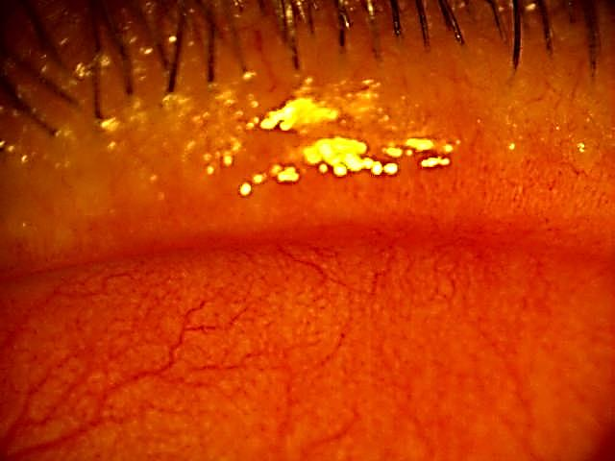
Conclusions
References
The goal to eliminate the secretions through the use of cleansers agents which don’t produce toxicity contributed to the anti-inflammatory process with lipids balance through the dilation of the forming structures of the gland.
There is an association between discomfort in contact lenses users with MGD.
The external morphology in Meibomian Glands dysfunction of contact lens users are modified with the clean of their eyelids using a cleanser system with TTO.
There is a statistical significant difference with the treatment based in lid hygiene with TTO, but materials in contact lenses are no compromised in clinical features .
Tea tree oil is a compound with anti-inflammatory activities, involving reduction in the obstruction ducts meibomian glands, and it increases and normalized the meibum secretion in MGD.
The proposed treatment not develop eyelid toxicity or desertion in the use of contact lenses.
Arita R, Itoh K, Inoue K, Kuchiba A, Yamaguchi T, Amano S. Contact lens wear is associated with decrease of meibomian glands. Ophthalmology 2009;116:379-84
The International Workshop on Meibomian Gland Dysfunction. Invest Ophthalmol Vis Sci2011;52(4):1917–2085.lekhanont, Bangkok Study. Molvis 2006. 116:219-24
Inada K. Studies of human tear proteins. 3. Distribution of specific tear prealbumin in lacrimal glands and other adnexa. Jpn J Ophthalmol 1984;28:315–30.
Glasgow BJ, Abduragimov AR, Farahbakhsh ZT, et al. Tear lipocalins bind a broad array of lipid ligands. Curr Eye Res 1995;14:363–72.
Gasymov OK, Abduragimov AR, Yusifov TN, et al. Binding studies of tear lipocalin: the role of the conserved tryptophan in maintaining structure, stability and ligand affinity. Biochim Biophys Acta 1999;1433:307–20
Glasgow BJ, Marshall G, Gasymov OK, et al. Tear lipocalins: potential lipid scavengers for the corneal surface. Invest Ophthalmol Vis Sci 1999;40:3100–7.
Nagyova´ B, Tiffany JM. Components responsible for the surface tension of human tears. Curr Eye Res 1999;19:4–11. 9 Schoenwald RD, Vidvauns S, Wurster DE, et al. Tear film stability of protein extracts from dry eye patients administrated a sigma agonist. J Ocul Pharmacol Ther 1997;13:151–61.
Glasson MJ, Stapleton F, Wilcox MDP. Lipid, lipase and lipocalin differences between tolerant and intolerant contact lens wearers. Curr Eye Res 2002;25:227–35.
Discussion
This study demonstrated a benefit of using the TTO cleanser to treat MGD, so symptoms showed significant improvement. Also, MG orifice obstruction improved in all 10 cases. No subjective complaints with CL and TTO treatment were noted.
The mechanism of the decrease in meibomian gland orifice
obstruction using TTO is unclear. McCulley et al found that
meibomian secretions with TTO can cause a shift towards lipid with higher melting points, producing a stagnant, and less dynamic, tear film.
There is no correlation between the contact lens Hi si material and MGD. However, all the patients were diagnosed as MGD, but no significant changes depends to material.

