Slide 1


ACCOMMODATIVE RESPONSE TO DIFFERENT ACCOMMODATIVE STIMULUS IN KERATOCONUS PATIENTS FITTED WITH SCLERAL CONTACT LENSES
Dr. Meltem toklu
Dr. Hatice elvin yıldız
Dr. Ece turan vural
Haydarpaşa numune training and research hospital, İstanbul, turkey

Slide 2
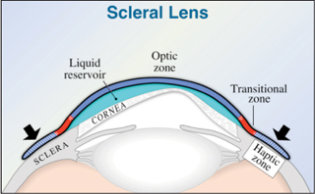
Purpose:
To evaluate accommodative response to different accommodative stimulus in keratoconus patients fitted with scleral contact lenses and compare the results with healthy control group

Slide 3
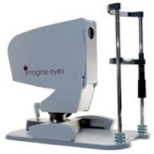
Materials and methods:
9 eyes of 6 keratoconus patients who wore scleral contact lens (Mini Misa scleral lens, Holland) were included in the study group (age range from 22 to 37 years)
30 eyes of 16 patients without ophthalmic pathology were assigned as the control group (age range from 21 to 35 years)
The following parameters were noted:
Best corrected near visual acuity (BCNVA)
Best corrected distance visual acuity (BCDVA)
Accommodative response to accommodative stimulus ranging from 0,5 to 5,0 D with intervals of 0,5 D
*Accommodation parameters were measured with Hartmannn- Shack aberrometer. (IRX-3; Imagine Eyes, Orsay, France)

Slide 4
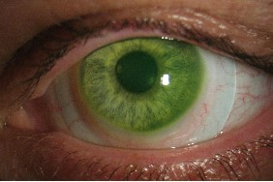
Results:
Mean age:
30,6±6,1 years (study group)
29,5±4,2 years (control group)
The mean BCDVA (p= 0,002)
0,1±0,1 logMAR (study group)
0,00±0,00 logMAR (control group)
Statistically significant difference was not found between two groups for accommodative response to accommodative stimulus of 0,5- 1,0- 1,5- 2,0 D
The mean BCNVA (p= 0,004)
0,2±0,2 logMAR (study group)
0,0±0,1 logMAR (control group)

Slide 5
The accommodative response to accommodative stimulus of 2,5-3,0-3,5-4,0-4,5-5,0 D were lower in the study group compared to the control group
Study group showed a decreased accommodative response as they approach to the maximum accommodative stimulus
The overall accommodative response was 0,35±0,52 D in the study group and 0,92±0,36 D in the control group (p=0,01)
Conclusions:
The result of this study suggest that scleral contact lenses may negatively effect accommodative response

