Slide 1

Using the soft contact lenses for children with refractive errors
Irina Lobanova¹, Irina Astasheva¹,
Igor khatsenko², Irina Leshchenko ³
1.Russian National Research Medical University, Moscow, Russian Federation
2.Morozov Children's Clinical Hospital, Moscow, Russian Federation
3. Medical - Biological Postgraduate institute, Moscow, Russian Federation

Slide 2
Material and methods
Study objective: Refractive errors are the most common ophthalmopathology among children who were born prematurely and those who have suffered the retinopathy of prematurity (ROP). Uncorrected refractive errors in childhood lead to breach of adaptation of visual perception. Correction of refractive errors with using the soft contact lenses (SCLs) is one of the most effective methods which promotes correct and full formation of children visual functions. Quality of vision defines quality of life for these children.
The group included 218 children who were born prematurely: 129 children with myopia at the age from 4 to 13 years and 89 children (98 eyes) after lensvitrectomy at stages IV-V ROP at the age from 4 month to 10 years
The examination included retinoscopy (1), refractometry (2), ophthalmometry, visocontrastometry (VCM) with contact lenses versus spectacles, pattern visual evoked potentials (pVEP) (3).
Daily disposable silicone hydrogel SCLs were used for children with myopia. For children who had undergone lensvitrectomy silicone hydrogel SCLs with a diameter 13,2-13,8 mm, base curve 7,6-8,0, lens power 19-33D considering the vertex correction were selected individually 3-4 weeks after the surgery

Slide 3
The Results
The difference among children with low and moderate myopia in visual acuity between contact and spectacles lens wearers wasn’t detected (p>0,05). Among the children with moderate myopia the contact lens wearers recorded higher rates of VCM (3.7 +/- 2.1 dB) at high spatial frequencies versus those wearing spectacles (4). The visual acuity was exactly higher by 10/200 – 20/120 (p <0,01) among the children with high degree of myopia who were contact lens wearers versus spectacles wearers. Higher rates of VCM in the high (4.6 +/- 2.9 dB), and medium spatial frequencies (3.1 +/- 2.2 dB) (p <0,01) were recorded with contact lens wearers in this group (5).
In 82,0% cases the difference was observed in behavior of children who had undergone lensvitrectomy (8) after 3-4 months of using SCLs. Contact lens wearers' ocular deviation, amplitude of nystagmus decreased, orientation improved versus spectacles wearers (9). According to the pVEP there were an increase of amplitude and decrease of latency (7). According to visometry quality of vision of contact lens wearers older than 3 years old was better in 70,4% cases (p <0,01).

Slide 4
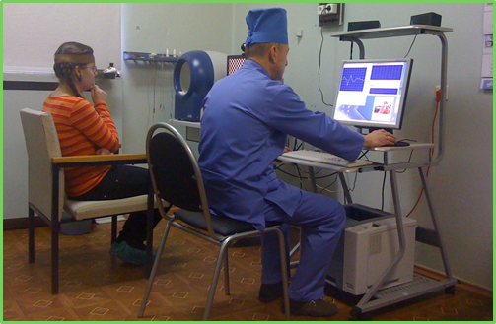
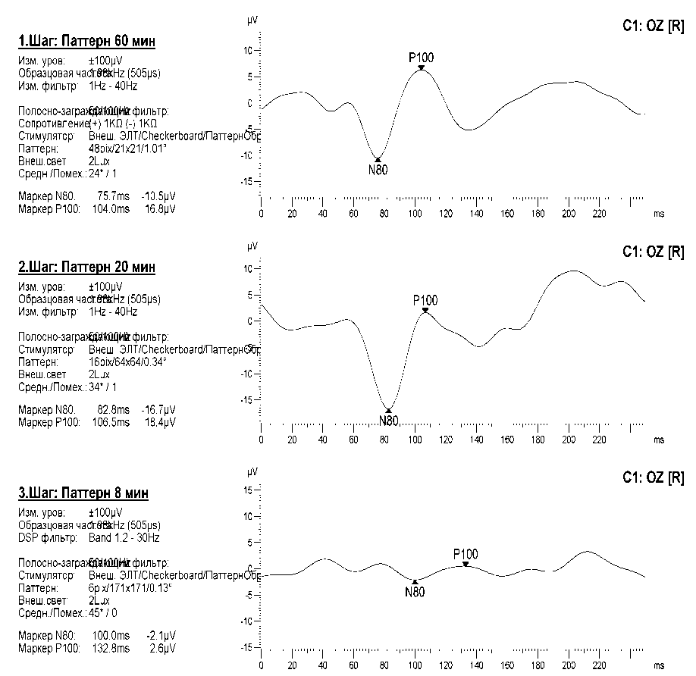
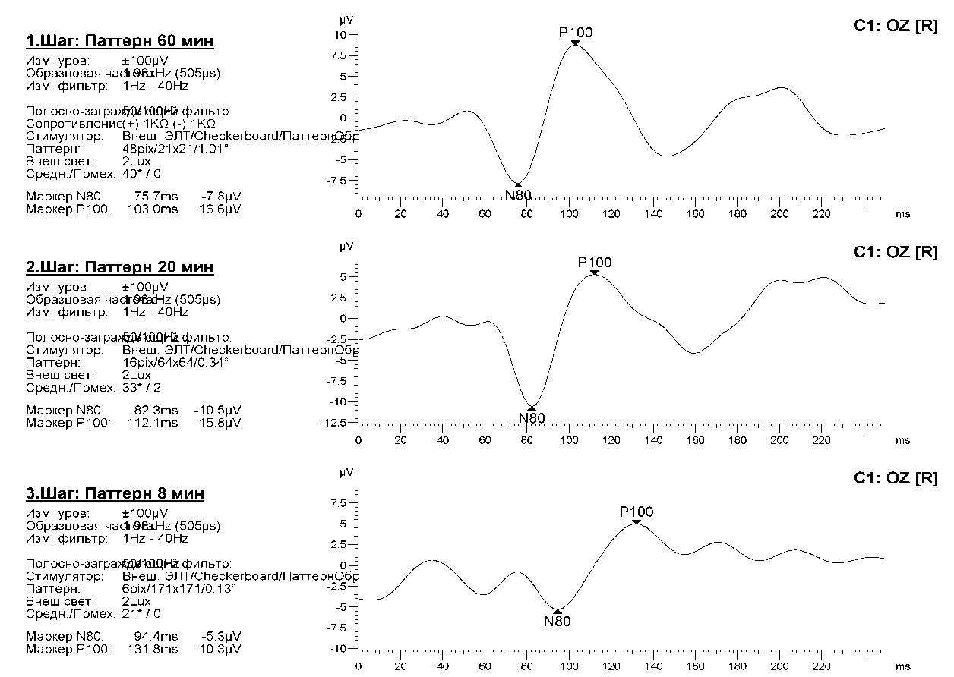
Pattern visual evoked
potential
Pattern 60
Pattern 20
Pattern 8
Patients with high myopia with spectacle correction
Patients with high myopia with SCL correction

Slide 5

Indicators of spatial contrast sensitivity in the black and white stripes in children with moderate myopia using spectacles and SCLs compared with the norm
Indicators of spatial contrast sensitivity in the black and white stripes in children with high myopia using spectacles and SCLs compared with the norm.

Slide 6
Conclusion
Early adequate using the soft contact lenses is advised for children with high refractive errors for the correct and full functional development of the vision.
Basing on the results of the visometry, VCM, pVEP we come to the conclusion that vision quality was higher with contact lens wearers versus patients wearing spectacles.

