Slide 1

Eposter 86
METHODOLOGY TO CHOOSE THE BEST SPECULAR MICROSCOPE TO PERFORM ENDOTHELIAL EXAMINATION
Fernando Cesar Abib, MD, PhD *
Federal University of Parana
Hospital Erasto Gaertner, Brazil
Dulcemar Szeremeta Abib, MD
Federal University of Parana, Brazil
Author E-mail: drfcabib@mps.com.br
Notes:
1

Slide 2
Purpose
Non-Contact (NC) Corneal Specular Microscope (CSM) acquire Endothelial Mosaic (EM) images when the patient sets the target light, each model of this type of CSM has fixed positions.
Contact (C) CSM (CSM) can acquire EM images of any area of the endothelial surface by sliding the objective lens on the cornea.
This study aims to present the methodology to guide the selection of the best type of CSM to perform the specular microscopy.

Slide 3
Material and Methods
All SM done in 2013 at the Eye Clinic Dr. Fernando Abib, Curitiba, Brazil. The type of the CSM was: NC CSM (CSO, Italy) and C CSM (BioOptics, USA).
The methodological steps:
1 - ANAMNESIS OF THE ENDOTHELIAL EXAMINATION: Prior examination, reason of request, preoperative situation, endothelial disease, trauma, contact lenses, endothelial degeneration and other causes of endothelial cell loss, polimegethysm and pleormorphism;
2 - SLIT LAMP EXAMINATION: Endothelial examination on central area, paracentral area and peripheral area; the findings are unilateral or bilateral;
3 - CLASSIFYING THE CORNEAL ENDOTHELIAL PATTERN: Using the ocular pathology knowledge, directed anamnesis and slit lamp examination it’s possible to classify the corneal endothelium mosaic pattern in three different patterns:
Regular Pattern (RP): This endothelium mosaic has only cells with similar morphology without other attached structures;
IRREGULAR PATTERN (IP): This endothelium mosaic always has attached structures, they must be searched and they always have to be found;
CHAMALEON PATTERN (CP): The endothelium mosaic may or may not have an specific characteristic or attached structure, its presence depends on the stage of the disease. Some disease stages present the specific characteristic or attached structure, other stages do not. They must be searched thoroughly.

Slide 4
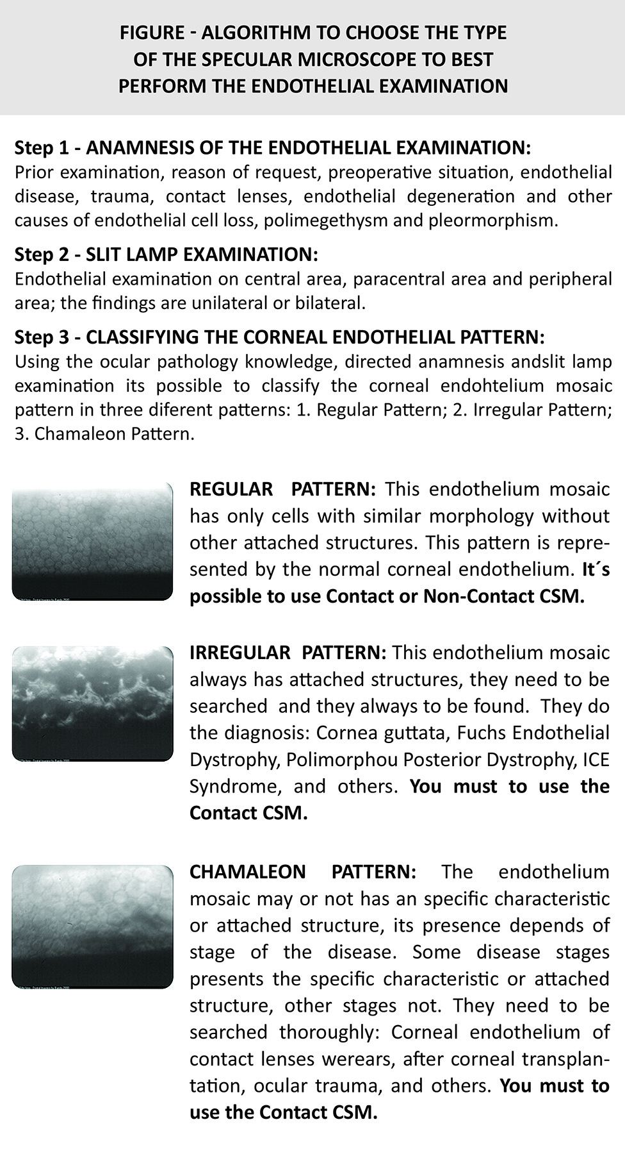
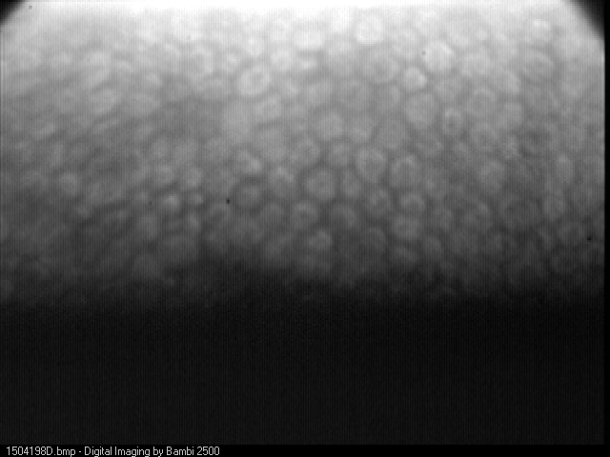
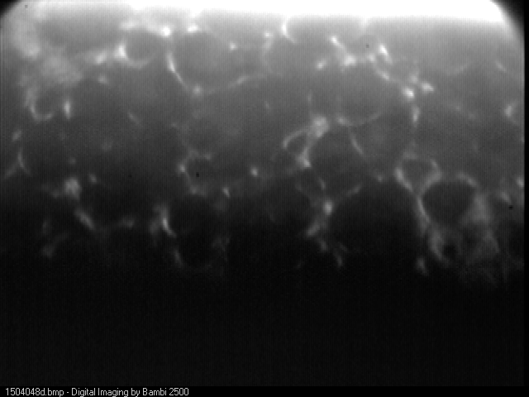
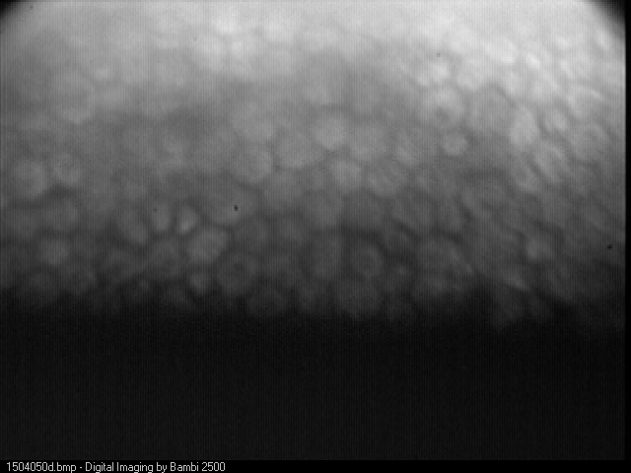
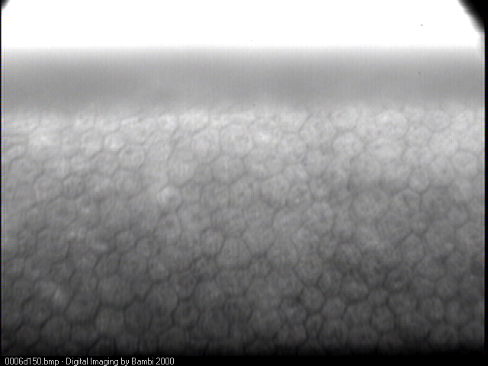
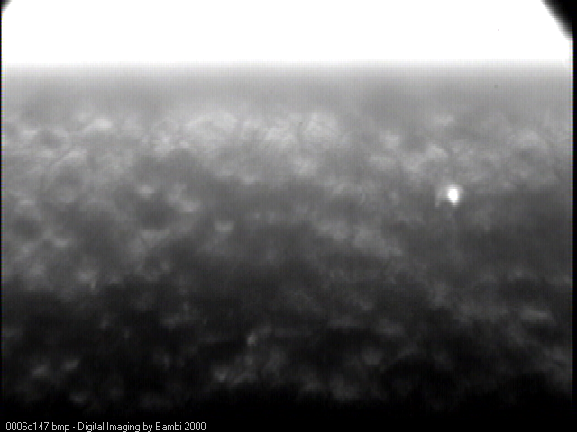
Normal corneal endothelium
Fuchs endothelial dystrophy
A
N
D
Ocular trauma
O
R

Slide 5
Results
During 2013 879 SM examinations were performed:
606 (69%) was possible to be examined with Non-Contact CSM because the pattern of the EM was classified as RP;
273 (31%) was not possible to examine with Non-Contact CSM because the pattern of the EM was classified as IP or CP and to perform these examinations was used C CSM.
Regular Pattern was represented by normal corneas;
Iregular Pattern was represented by Cornea guttata, Fuchs Endothelial Dystrophy, Polymorphous Posterior Dystrophy, and ICE Syndrome.
Chamaleon Pattern was represented by corneal endothelium of contact lenses wearers, after corneal transplantation, ocular trauma, and others.

Slide 6
Conclusion
All REGULAR PATTERN could perform the examination with NC CSM, IRREGULAR PATTERN and CHAMALEON PATTERN the examination was conducted with C CSM to a more precise description of the EM and diagnosis.
We suggest the presented routine and:
Utilize Non Contact SM perform endothelial examinations of the to Regular Pattern EM;
Utilize Contact SM to perform endothelial examinations of the Chamaleon Pattern and Irregular Pattern.

