Slide 1

Eposter 87
PROFILE OF THE PERFORMED
CORNEAL SPECULAR MICROSCOPY ON at A CORNEA SERVICE
Fernando Cesar Abib, MD, PhD *
Federal University of Parana
Hospital Erasto Gaertner, Brazil
Dulcemar Szeremeta Abib, MD
Federal University of Parana, Brazil
Author E-mail: drfcabib@mps.com.br
Purpose
To know the profile of the Endothelial Mosaic (EM) examined by Non-Contact (NC) Corneal Specular Microscope (CSM) and Contact (C) CSM considering the characteristics of the CSM.
Notes:
1

Slide 2
Methods I
All the SM done in 2013 at the Eye Clinic Dr. Fernando Abib, Curitiba, Brazil.
The NC CSM (CSO, Italy) was utilized when the EM mosaic was classified as a Regular Pattern (This type acquires EM images when the patient sets the target light, each model of this type of CSM has fixed positions) - Next template ;
The C CSM (BioOptics, USA) were utilized when the EM was classified with Irregular Pattern or Chameleon Pattern (This type acquires EM images of any area of the endothelial surface by sliding the objective lens on the cornea) – Next template .
The results are reported in terms of gender, number of examinations performed with NC and C CSM, indications and diagnoses, utilizing descriptive statistics.

Slide 3
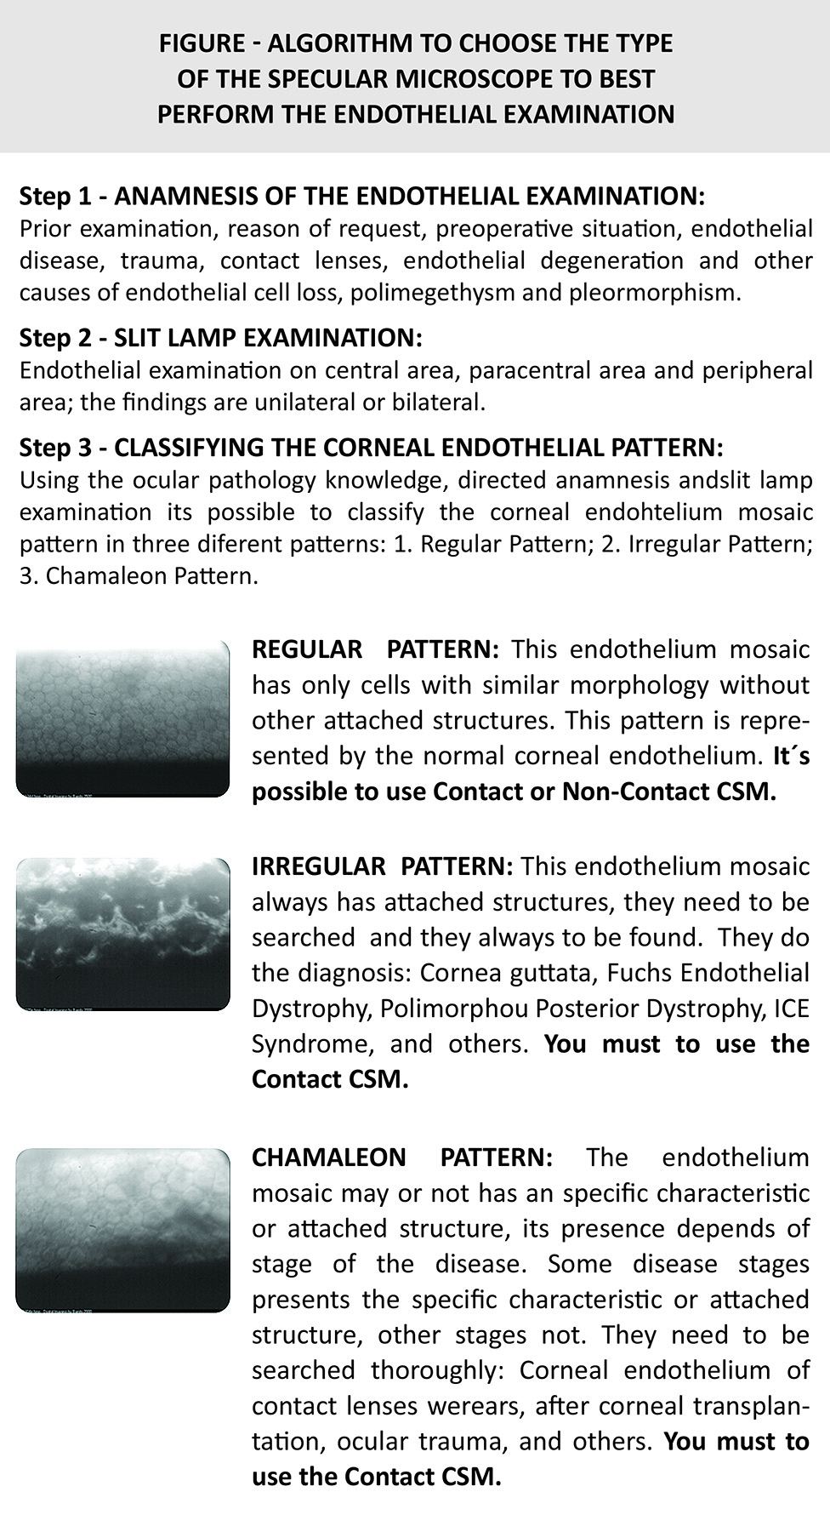
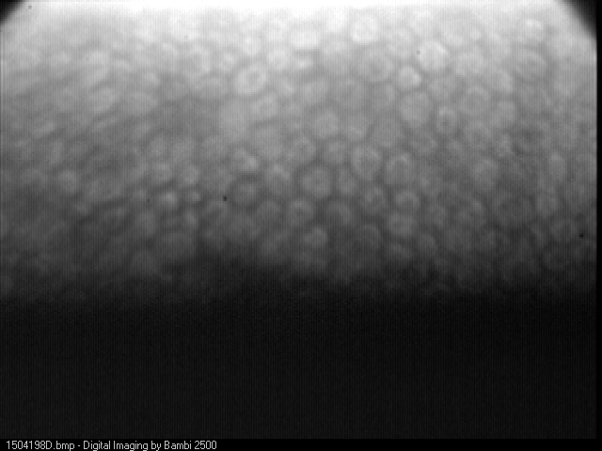
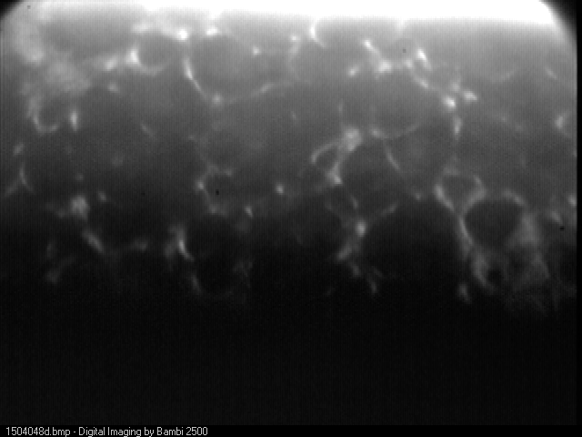
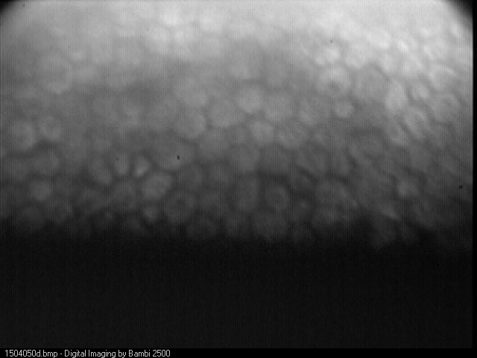
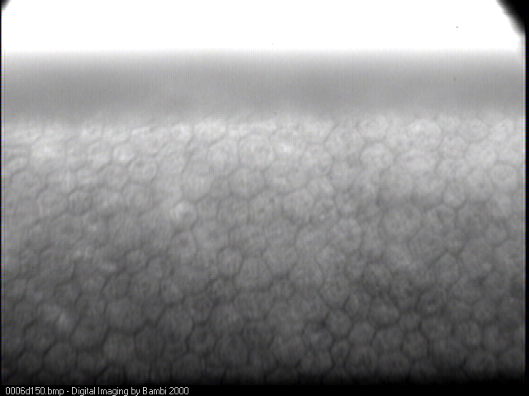
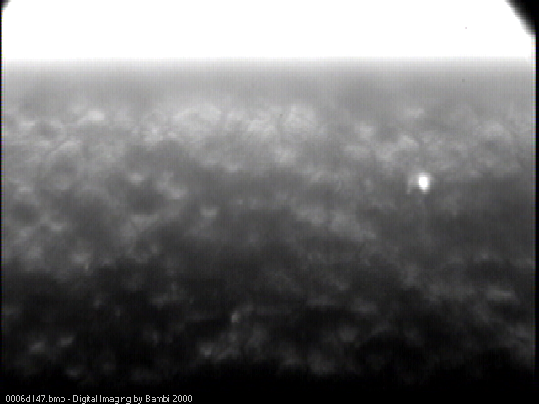
Normal corneal endothelium
Methods II
Fuchs endothelial dystrophy
A
N
D
Ocular trauma
O
R

Slide 4
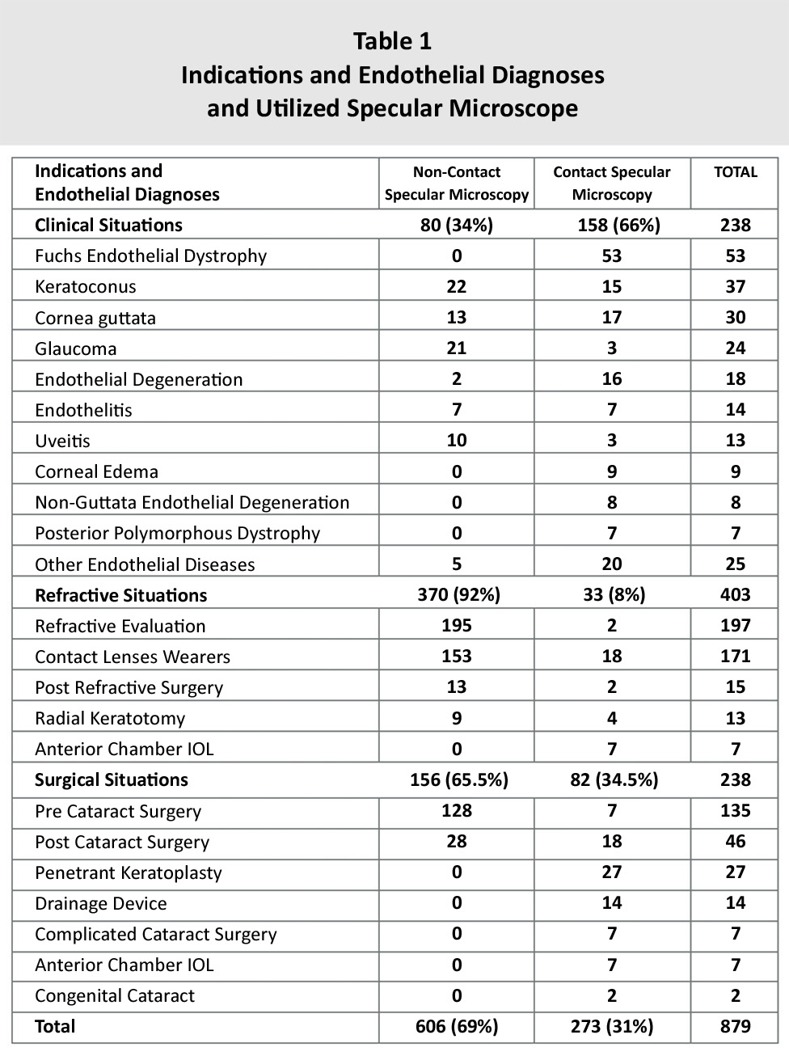
Results
879 patients:
634 (72%) female;
245 (38%) male;
NC CSM examinations 606 (69%);
C CSM examinations 273 (31%);
19 out of 606 (3%) designed with NC CSM had to be performed with C CSM becasuse the NC CSM, as it was not able to capture endothelial images;
The situations and diagnosis of the SM are presented at the Table 1.

Slide 5
Results
879 patients: 634 (72%) female and 245 (38%) male;
NC CSM examinations 606 (69%);
C CSM examinations 273 (31%);
19 out of 606 (3%) designed with NC CSM had to be performed with C CSM becasuse the NC CSM, as it was not able to capture endothelial images;
The endothelial examinations were performed:
For clinical situations in 238 patients:
80 (34%) with NC CSM
158 (66%) with C CSM
The most frequent situations were: Fuchs Endothelial Dystrophy 55 (23%), Keratoconus 37 (15%), cornea guttata 30 (13%), glaucoma 24 (10%), endothelial degenerations (8%), endothelitis (6%), and others 62 (25%);
For refractive situations in 403 patients:
370 (92%) with NC CSM
33 (8%) with C CSM
The most frequent situations were refractive evaluation 197 (49%), contact lenses wearers 171 (42%), post refractive surgery 15 (4%), Radial keratotomy 13 (3%) Anterior chamber IOL 7 (2%);
For surgical situations in 238 patients:
156 (65%) with NC CSM
82 (35%) with C CSM
The most frequent situations were pre cataract surgery 135 (57%), post cataract surgery 46 (19%), penetrant keratoplasty 27 (11%), drainage device 14 (6%), complicated cataract surgery 7 (3%), and others 9 (4%).

Slide 6
Conclusion
To perform thespecular microscopy to represent the reality of the endothelial mosaic was necessary to use NC and C CSM.
The two most frequent clinical situations were Fuchs endothelial dystrophy and keratoconus;
The two most frequent refractive situations was refractive evaluation contact lenses wearers;
The two most frequent surgical situations was pre and post cataract surgery.

