Slide 1


Eposter 88
Predicting Corneal Decompensation
Fernando Cesar Abib, MD, PhD *
Federal University of Parana
Hospital Erasto Gaertner, Brazil
Dulcemar Szeremeta Abib, MD
Federal University of Parana, Brazil
Author E-mail: drfcabib@mps.com.br
Purpose
Demonstrate a methodology to predict the corneal decompensation by using the specular microscopy examinations.
Notes:
1

Slide 2
Methods
Study of the 6 eyes of patients with different clinical endothelial situations: Normal endothelium, non-guttata endothelial degeneration, penetranting keratoplasty, drainage device, post radioterapy due to orbital pseudotumor, and ocular trauma.
The endothelial examinations at the central area were done with the contact specular microscope (SM) Bio-Optics LSM 2000 and Bambi 2500 software, guided by Reliability Indexes (Reliability Degree 95%; Sample Error <5%) calculated by the Cells Analyzer Software – Corneal Endothelial Statistical Lab (Technicall, Brazil).
The methodology to calculate the corneal transparency longevity is described as follows:
The endothelial Cell Density (ECD) was calculated during the follow-up;
With ECD and follow-up time the linear regression equation was calculated (GraphPad QuickCalcs);
The period of time to start the corneal decompensation was defined as ECD of 700 cells/mm² (T₇₀₀₎)(months and years), using the linear regression formula;
The period of time to the total corneal decompensation was defined as ECD of 400 cells/mm₂ (T₄₀₀) (months and years), using the linear regression formula;
Range Period of Decompensation was calculated: T₄₀₀ - T₇₀₀ (months and years);
The Predicting Corneal Decompensation Time (PCDT) was defined as PCDT = Time T₇₀₀ + (T₄₀₀ - T₇₀₀) (months and years);
Age to corneal decompensation (months and years);
The descriptive data were calculated by Microsoft Excel 2010.

Slide 3
Results I
The range of the:
Age 18 to 60 years old;
ECD at first SM 922 to 3901;
ECD at last SM 542 to 3216;
Number of SM examinations 5 to 7;
Total number of endothelial images 10 to 60;
Follow-up 71 to 164 months;
T₇₀₀ 46 to 1111 months;
T₄₀₀ 46 to 1219 months;
PCDT 46 to 1111 months;
The range of the period of decompensation 14 to 204 months;
All results considering each clinical case will be presented in a specific table (next template).

Slide 4
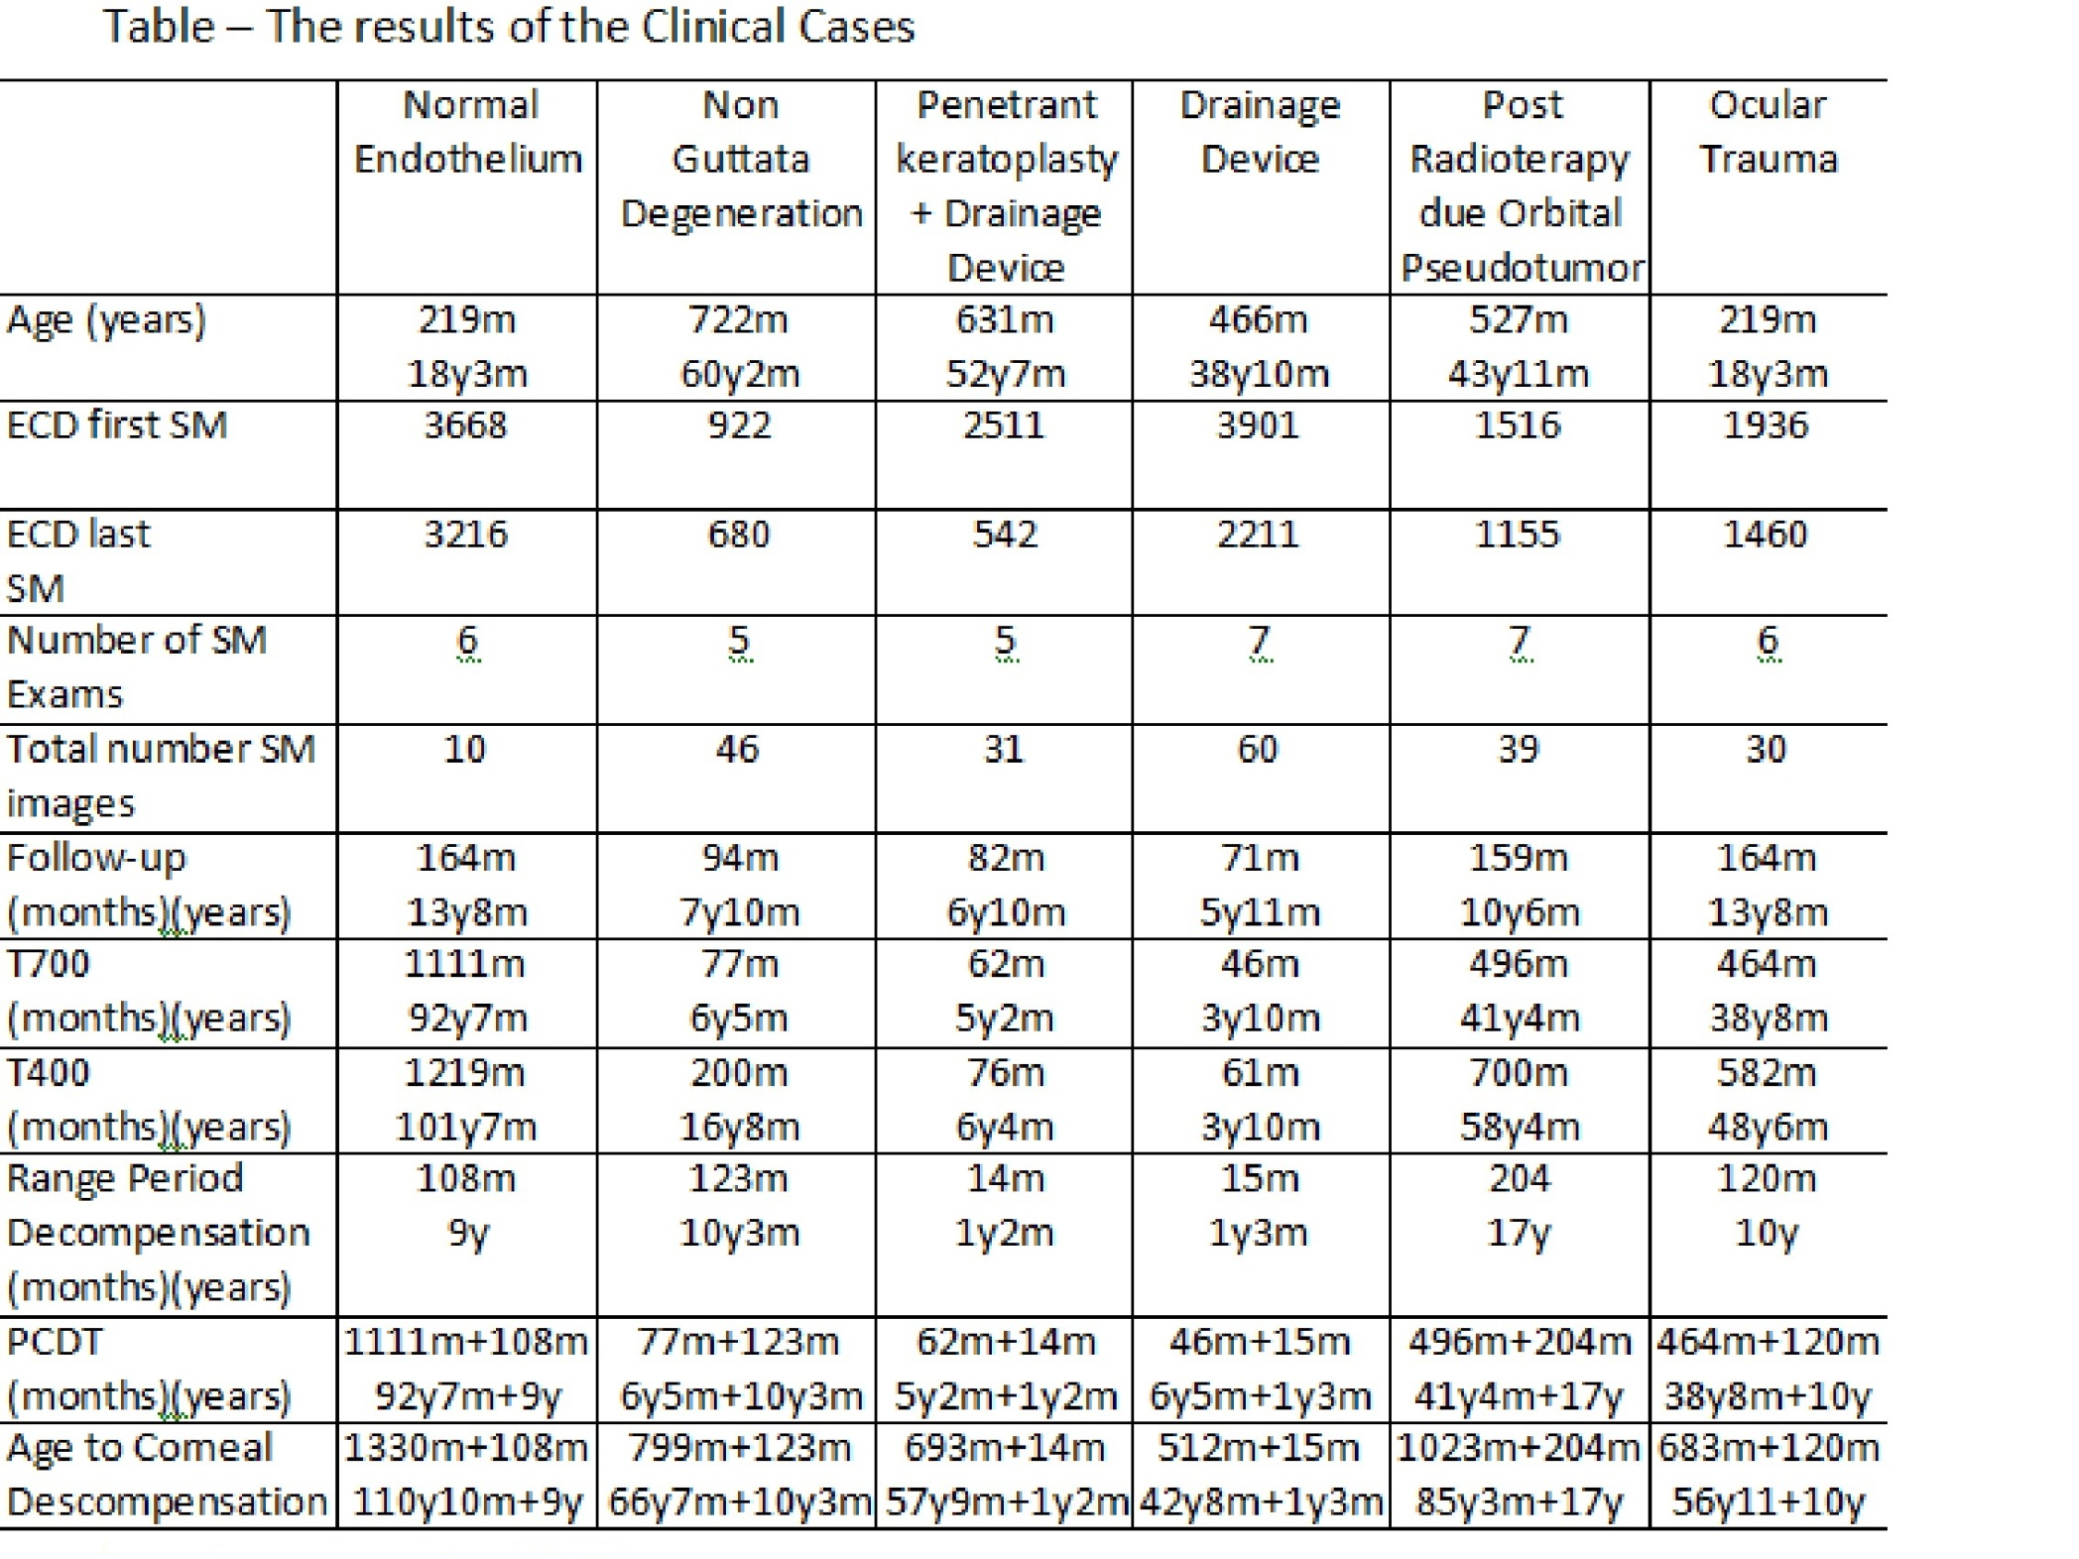

Slide 5
Conclusion
This is the first study to demonstrate, the use theoretical calculations, the period of time when the corneal decompensation starts and finishes.
This study was conducted only with endothelial examinations with sample error smaller than 5%.

