Slide 1
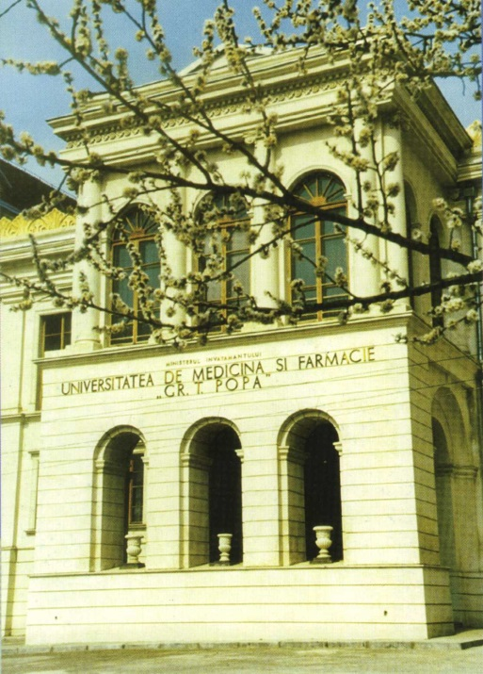
Vision and life quality after orthokeratology treatment BOGDANICI Camelia, BOGDANICI Tudor University of Medicine and Pharmacy „Gr. T. Popa” IASI, ROMANIA
Purpose: To establish the improvement of vision and life quality after Ortho-k treatment
Materials and methods: Prospective observational study on 7 patients treated in Stereopsis ophthalmological clinic from Iasi, Romania.
The age of patients was between 9 and 32 years.
The clinical parameters studied: sex, age, visual acuity (before and after Ortho-K), objective refraction (before and after Ortho-K – Menicon Z Night), corneal topography (Keratron Piccolo), motivation and compliance of the patients with Ortho-K and quality of life changings.

Slide 2
Material
3 Female: 9 years ( 2 girls), 21 years (1 student)
4 Male: 14 years,15 years, 29 years, 32 years
All cases asked for Ortho-K for aesthetic reasons or supplimentary hobbies. Boxing (1 boy), basket (1 boy), swimming (1 girl), skying (1 male)
Results
VA (6 cases) = 20/20 cc after 6 months
1 case – VA = 20/30 cc
Visual comfort (4 cases) very good
All are happy without spectacles !!!
Psychic effect – VERY GOOD !!!

Slide 3
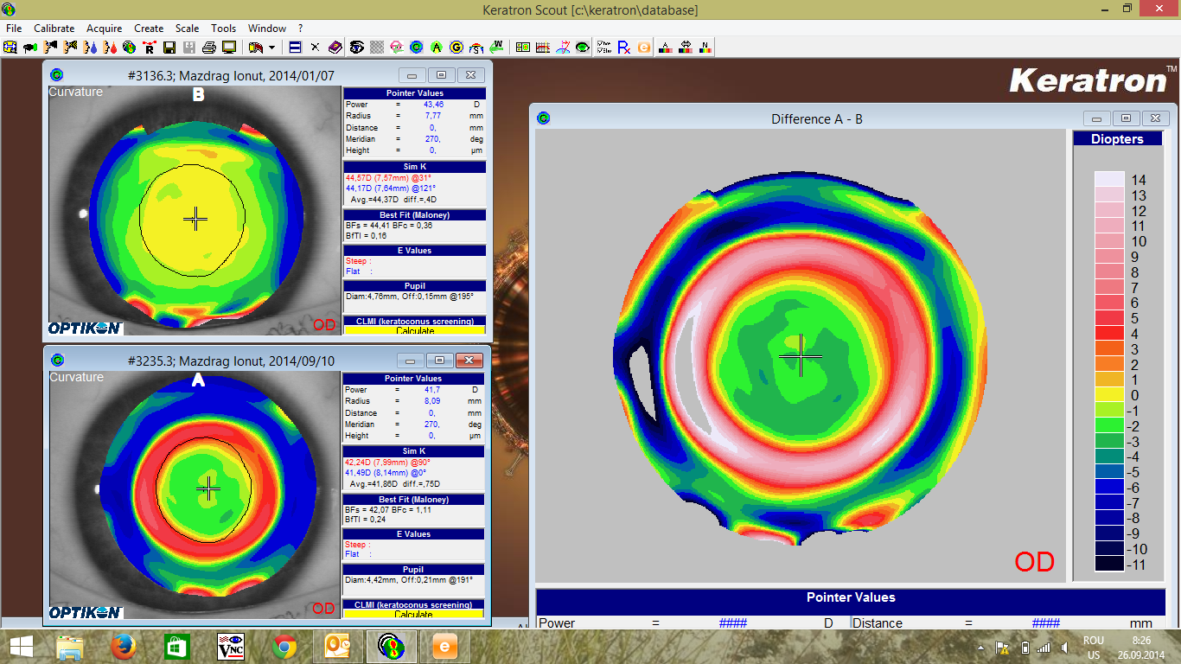
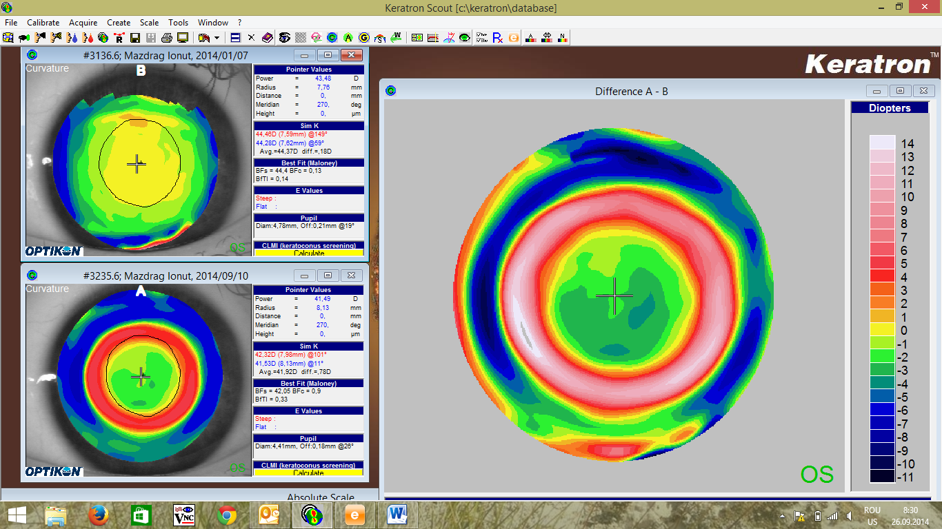
MI – 14 years, after 8 months
Calitative: Differential tangential map (in curvature). Central effect. Central zone easy neomogenity. 2 changes (at 4 and 7 months)
Cantitativ e : Optimal correction.
VA = 1 (20/20).
Performance boxing
RE: - 3,5 cyl -0,50/120; 0,1 fc
LE: - 3,5 cyl -0,50/70; 4/50 fc

Slide 4
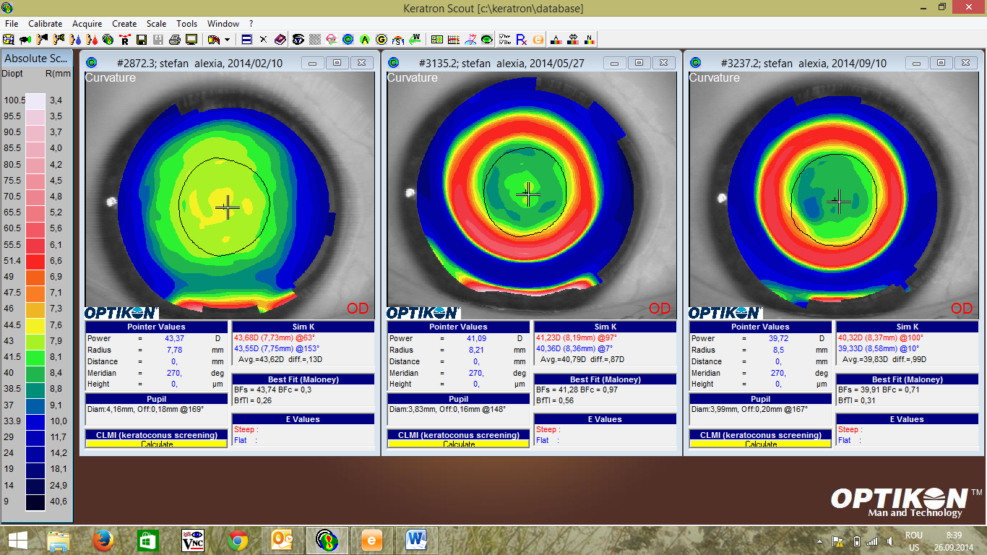
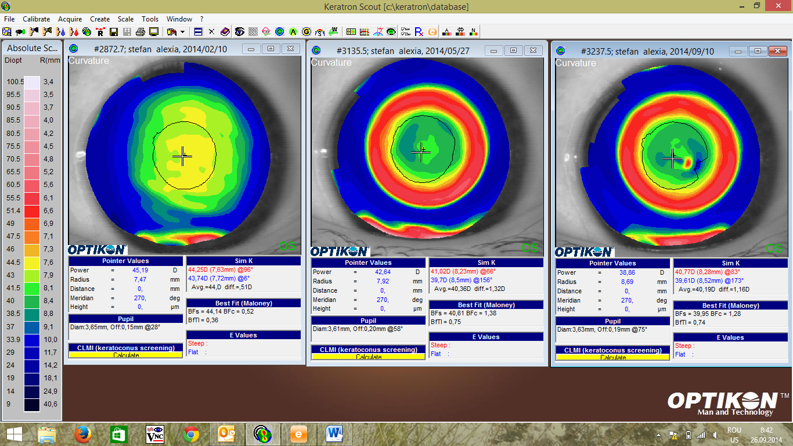
SA – 9 years, after 8 monts
Calitave : Differential tangential map (in curvature). Central effect. Central zone easy neomogenity. 1 change at 4 months (central island). Dust on last measurement – red color !!!
Cantitativ e : Optimal correction.
VA = 1 (20/20).
Mathematics Olimpic Results
Swimming
OD: -4,25 cyl -0,25/158; 0,5 fc
OS: -4,25 cyl -0,50/174; 0,5 fc

Slide 5
CONCLUSIONS ….
1.Contact lenses are very usefull, and ortokeratology has good results with improving of visual and health quality.
2. Correction with contact lenses for children in Romania are smallest than in other countries because doctors (general and even ophthalmologists) are not use with this correction, and because of social problems.
3. Patients asked to inform more by media, Romanian population about using Ortho-k.

