Slide 1
THERMOTHERAPY TREATMENT OF DRY EYE SYNDROME (DES) SECONDARY TO MEIBOMIAN GLAND DYSFUNCTION (MGD)
Katarzyna Szymanek^{1,2,}, Piotr Szymanek ¹, Anna Maria Ambroziak²
¹ACL-VISION Okuliści, Warsaw Poland
² Samodzielny Publiczny Kliniczny Szpital Okulistyczny, Warsaw, Poland

Slide 2
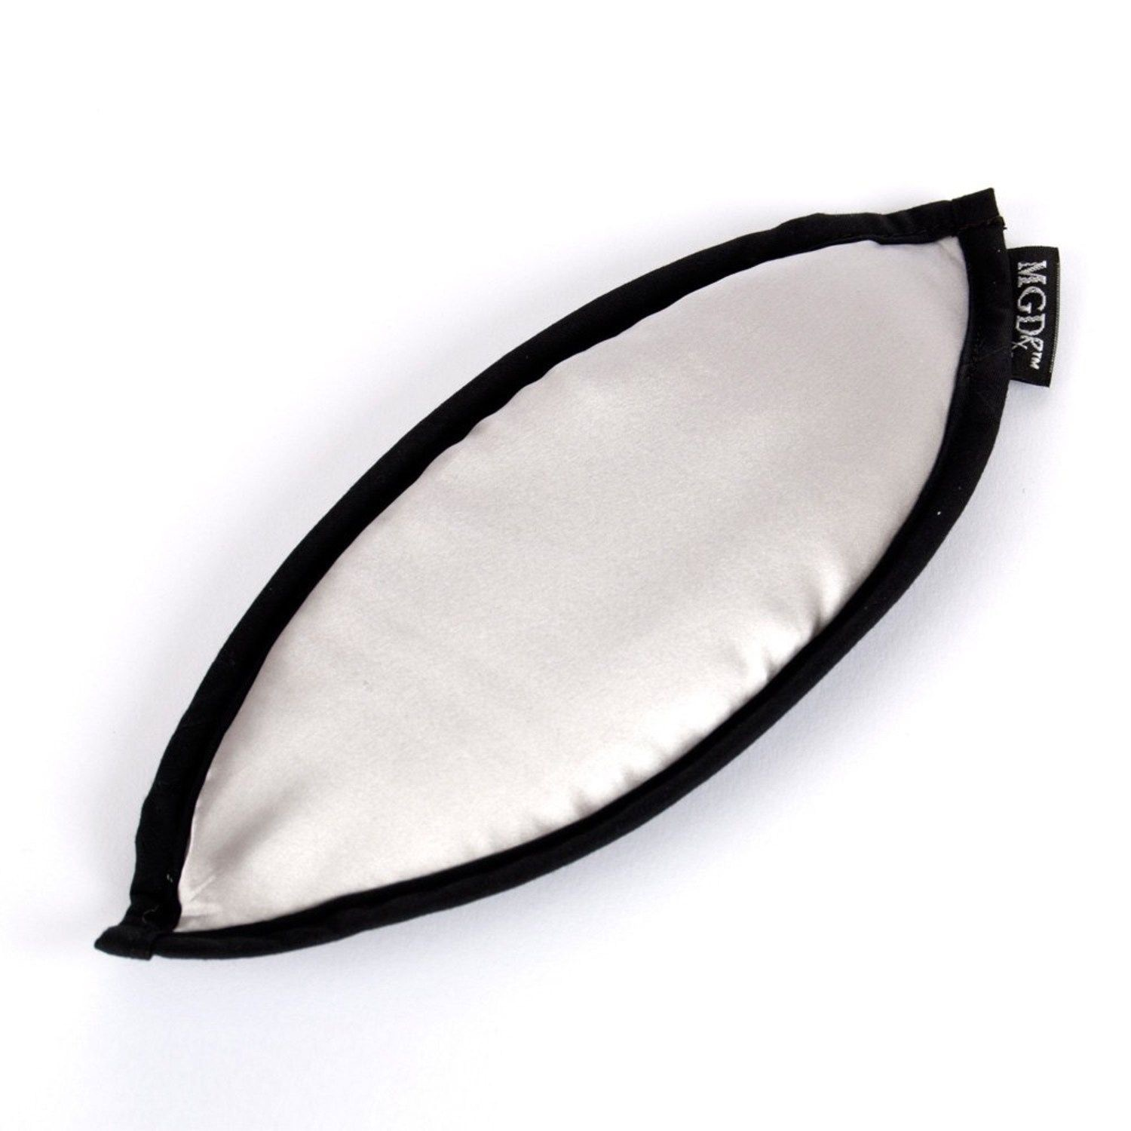


Materials and methods:
50 patients - 100 eyes; 38 F, 12 M with DES secondary to MGD
Thermotherapy (EyeBag MGDRx warm compress)
+
lid massage
8 weeks: 2 weeks – twice a day x 10 minutes
and 6 weeks – once a day x 10 minutes
The mean age - 49,4 years
Contact lens wearers -18 subjects
10 soft CLs
8 RGP

Slide 3
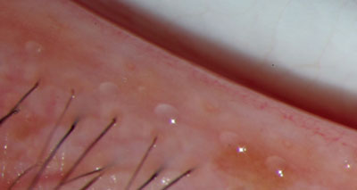
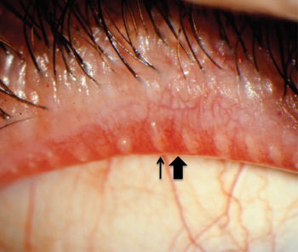
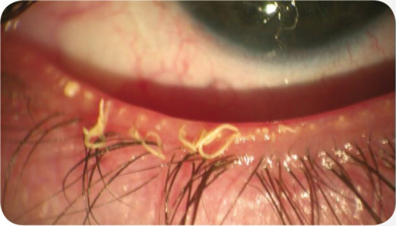
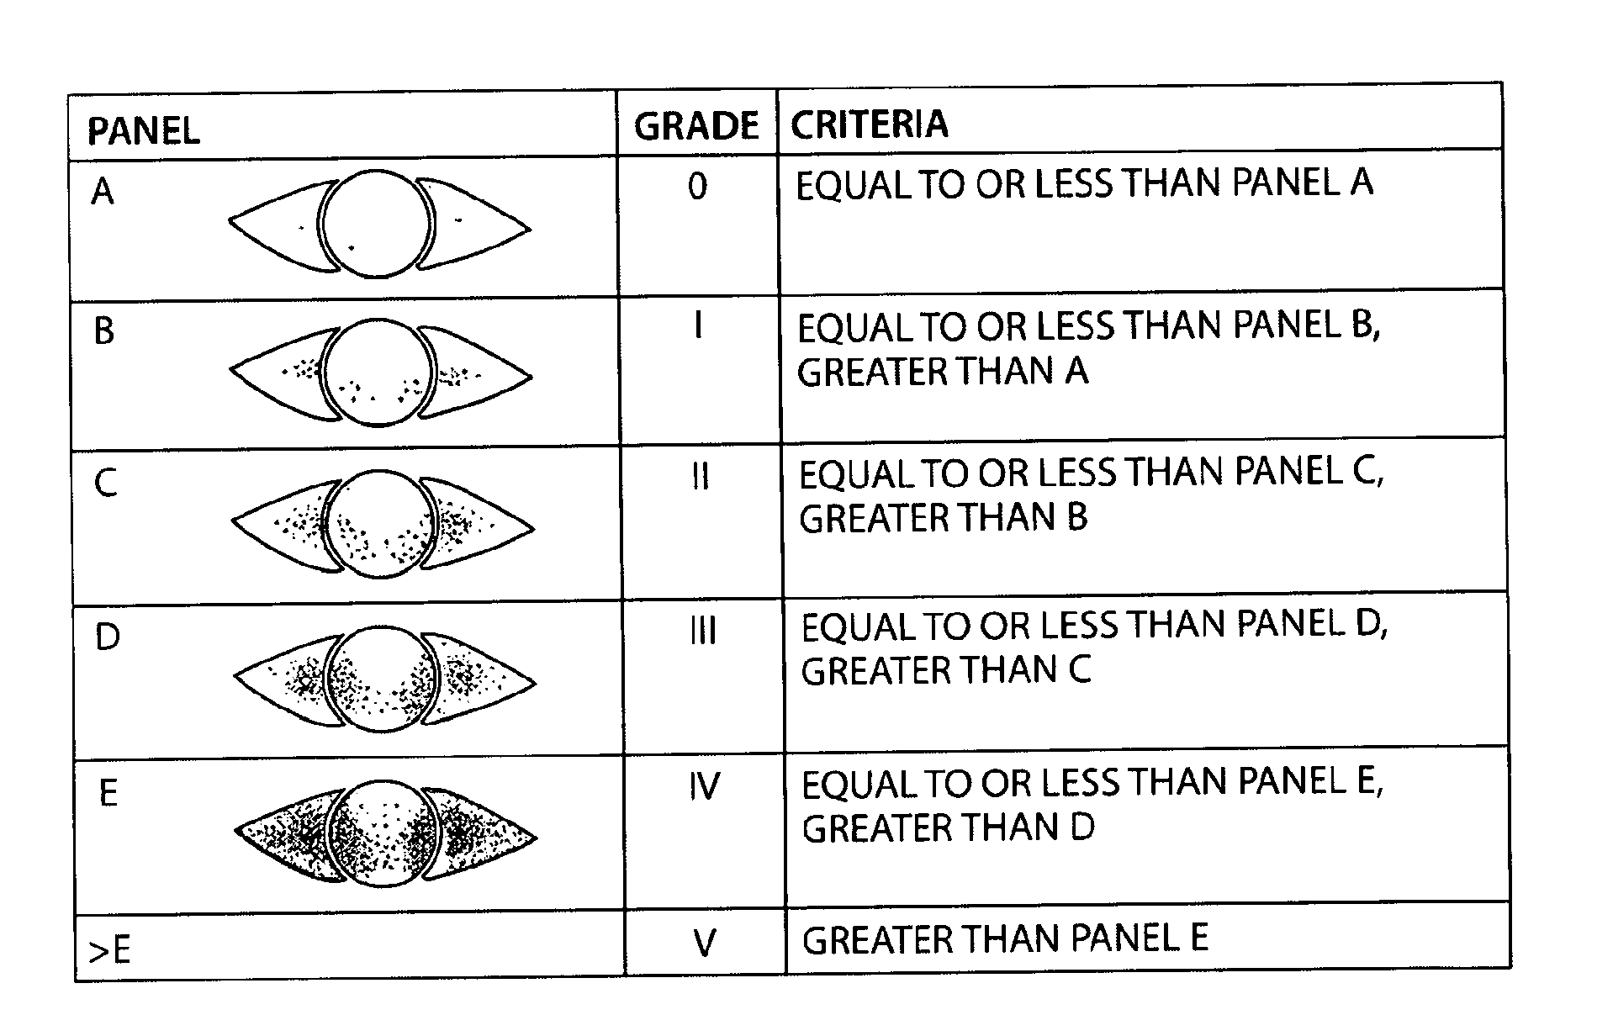
The evaluated parameters were:
Eyelid condition: based on the eight central Meibomian glands in the lower eyelid
Quality of meibum:
0 = clear fluid 1 = cloudy fluid
2 = cloudy particulate fluid 3 = inspissated, like toothpaste
Tear film break-up time (TBUT)
Corneal fluorescein staining –
- Oxford Scheme (CFS)
subjective symptoms using the OSDI questionnaire and thermotherapy tolerance level.
The subjects underwent examination and were asked to complete the questionnaire after 2 and 8 weeks of therapy
Expressility of meibum from five glands
0 = all glands expressible
1 = 3–4 glands expressible
2 = 1–2 glands expressible
3 = no glands expressible

Slide 4
Results
less = better
Meibomian glands -quality and expressility of meibum
(overall score)
more = better
TBUT
Tear film break-up time [seconds]
less = better
less = better
CFS
Corneal Fluorescein Staining
(Oxford Scheme)
OSDI questionnaire
(subjective symtoms)

Slide 5
Conclusions
EyeBag warm compress therapy increases the outflow from the Meibomian glands and improves the quality of secretions, which results in better clinical condition of the patient and reduction of the subjective symptoms.
In the contact lens wearers sub-group the improvement of all study parameters (lid margins, TBUT, CFS) was even more significant and the subjective improvement according to the OSDI form was more profound. Comfort of wearing contact lenses was better after therapy.
The therapy was well tolerated by the patients and there were no complications related to the application of EyeBag warm compresses.
It is a safe and effective method to treat and alleviate dry eye syndromes secondary to Meibomian Gland Dysfunction.

