Slide 1

Contact Lens Assisted Corneal Collagen Crosslinking in Thin Corneas
Marmara University School of Medicine
Department of Opthalmology
Dr.Özge Begüm Seferoğlu, Dr Ebru Toker
İstanbul,TURKEY

Slide 2
Purpose
In CXL procedure, a minimal corneal thickness of 400 µm during UV-A irradiation is required to protect the endothelium and deeper ocular structures.¹
Our purpose is to present the results of a recently described new technique called ‘Contact lens assisted crosslinking’ for patients with corneal stromal thickness under 400 µm after epithelial debridement and riboflavin (RF) soaking.
¹ Jacoob S. et al.Contact lens assisted collagen cross-linking(CACXL):A new technique for cross-linking thin corneas. J Refract. Surg.2014;30 (6):366-372

Slide 3
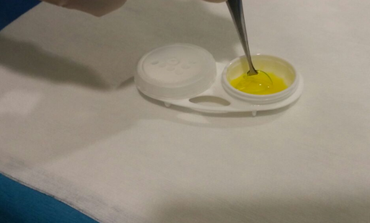
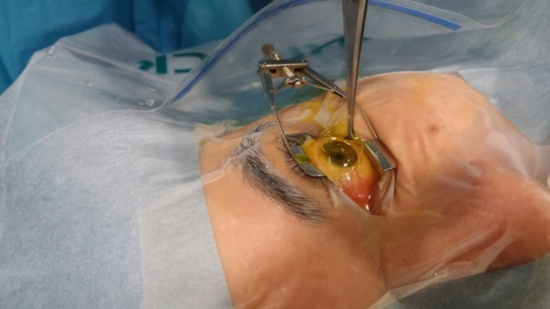
Method
Three eyes of 3 patients with progressive keratoconus were included in this prospective study
After epithelial debridement, corneal stroma was soaked with RF+HPMC solution for 30 minutes.
A soft hydrophilic lens immersed in RF was placed over the cornea and UVA irradiation (3 mW /cm2,30 minutes) was commenced. Corneal thickness was measured during UVA irradiation by ultrasonic pachymetry (0 min, 10 min, 20 min, 30 min). Endothelial cell counts were measured before and after the procedure. The depth of stromal demarcation line was assessed with anterior segment OCT.

Slide 4
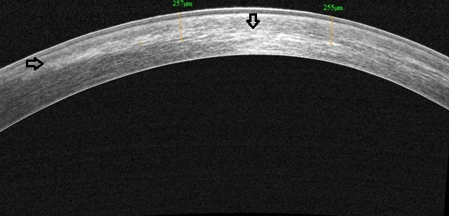
Results
The mean age of patients was 19.3 ± 4.9 years.
Mean corneal thickness was 386 ± 29.8 µm.
After epithelium removal and RF soaking all corneas were measured under 400 µm.
Mean reduction in corneal thickness was 29.6 ±10 µm. After contact lens application, corneal pachymetry increased by 68.6 ±18.03 µm.
During UVA irradiaton, pachymetric measurements were maintained above 400 µm at all times. The stromal demarcation line was visible at a depth of 360 ±31 µm ( range 325-385 ) at the first month.
No serious side effect, complication or endothelial damage was observed.

Slide 5
Conclusion
Contact lens assisted corneal collagen crosslinking is a new technique for thin corneas and our results suggest that it can be a safe and effective method with induction of a deep stromal demarcation line, however longer follow up is needed to elucidate its long term efficacy.

