Slide 1
State of Art in High Tech
Medical Contact Lenses
Dr. Hilmi OR, FEBO
Private Office
İstanbul - Turkey
Purpose: The nanotechnologic changes in science make new using modalities of contact lenses possible. These are reviewed in medical contact lenses.
Materials and methods: The technology in producing medical contact lenses makes it possible, that the lenses may be used as mimicking physiologic and pathologic conditions. Medical contact lenses are also used as drug delivering sources.
Results: The technology in producing contact lenses for mimicking physiologic ophthalmological conditions make it possible, for example to mimic presbyopia in non-presbypoic patients. Other contact lense may mimic the visual perception of AMD patients. So research about the visual capability of the AMD patients can be done on normal subjects wearing these contact lenses. As carrier and releasing source of drugs the medical contact lenses can be used in difficult clinical cases. On the other hand, the drug delivery over a long time is important in patients with chronic eye diseases like glaucoma. The non-compliance of these patients in using medication may be overcomed with the use of long approximately equally distributed drug delivery technology in contact lenses. Contact lenses may be also used in measuring intraocular pressure. These and other uses of medical contact lenses are discussed.
Conclusion: New applied technologies in medical contact lenses give the resarchers new types of study designs and the patients new possibilities in getting treatment.

Slide 2
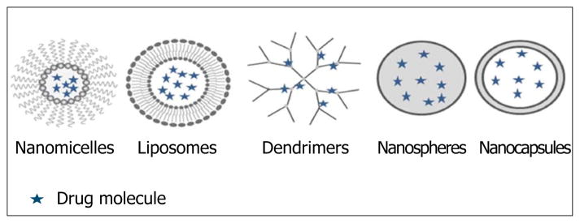
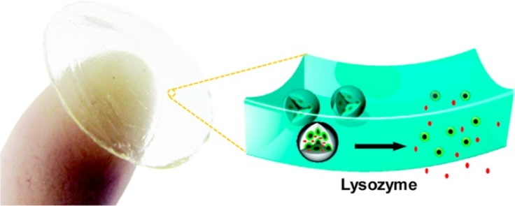
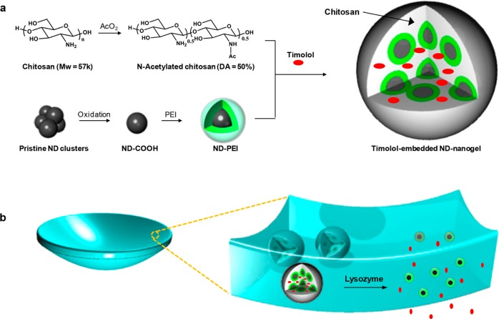
Patel A, Cholkar K Agrahari V, Mitra AK.
Ocular drug delivery systems: An overview.
World J Pharmacol. 2013;2(2):47-64.
Nanocarriers for ocular drug delivery.
Kim HJ, Zhang K, Moore L, Ho D.
Diamond nanogel-embedded contact lenses mediate lysozyme-dependent therapeutic release.
ACS Nano. 2014 Mar 25;8(3):2998-3005.
Schematic illustration of lysozyme-activated drug eluting contact lens

Slide 3
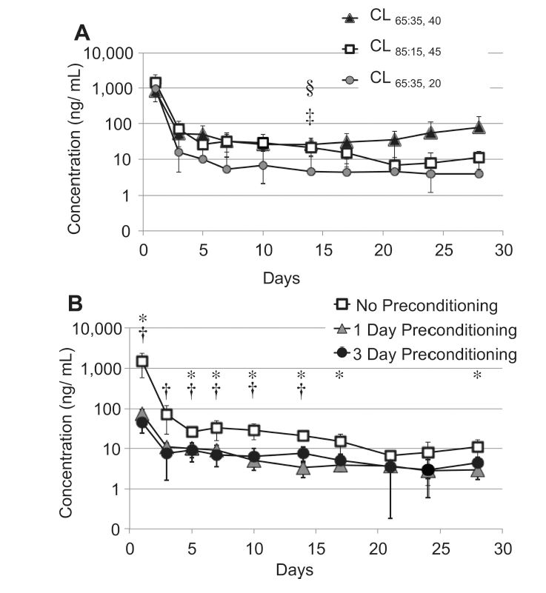
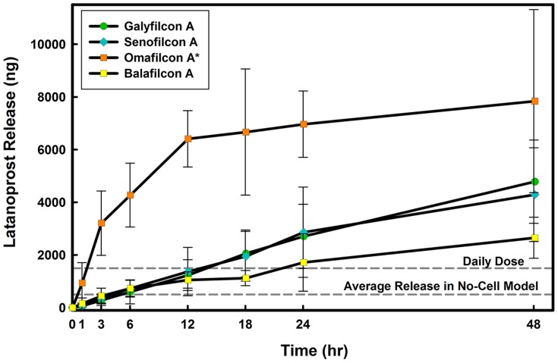
Ciolino JB(1), Stefanescu CF, Ross AE, Salvador-Culla B, Cortez P, Ford EM, Wymbs
KA, Sprague SL, Mascoop DR, Rudina SS, Trauger SA, Cade F, Kohane DS.
In vivo performance of a drug-eluting contact lens to treat glaucoma for a month.
Biomaterials. 2014 Jan;35(1):432-9.
Mohammadi S, Jones L, Gorbet M.
Extended latanoprost release from commercial contact lenses: in vitro studies
using corneal models.
PLoS One. 2014 Sep 10;9(9):e106653.
Latanaprost CL in rabbit eyes for 1 month
Time course of latanoprost release from four contact lens materials through the monolayer model

Slide 4
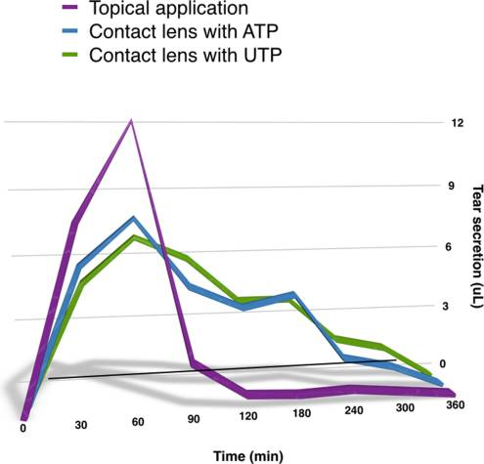
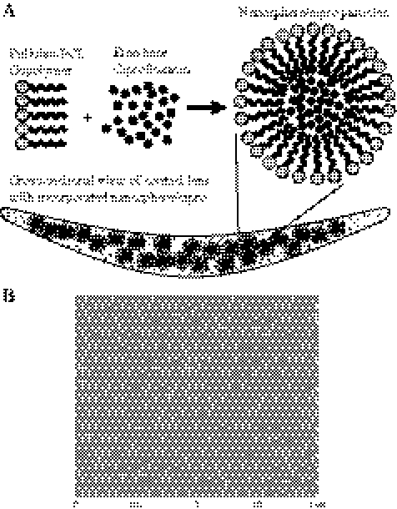
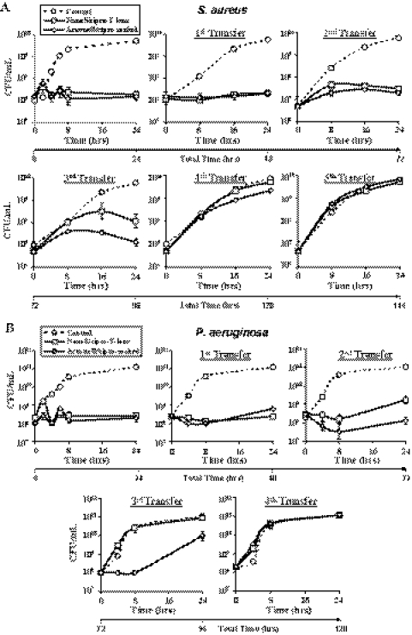
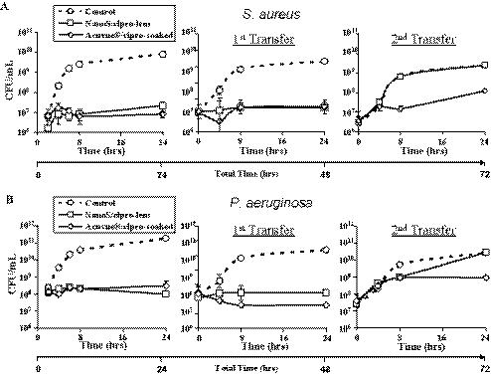
Garhwal R, Shady SF, Ellis EJ, Ellis JY, Leahy CD, McCarthy SP, Crawford KS, Gaines P.
Sustained ocular delivery of ciprofloxacin using nanospheres and conventional contact lens materials.
Invest Ophthalmol Vis Sci. 2012 Mar 13;53(3):1341-52.
Pintor J
Contact lenses: new devices for nucleotide delivery in ocular pathologies.Purinergic Signal. 2014;10(3):419-20.
In dry eyes the delivery of ATP and UTP through a carrier CL prolongs the effect of them up to 6 hours.
Antibacterial activity of nanosphere/cipro-incorporating thin lenses
Depiction of nanospheres used to encapsulate ciprofloxacin
Antibacterial activity of nanosphere/cipro-incorporating thick lenses

Slide 5
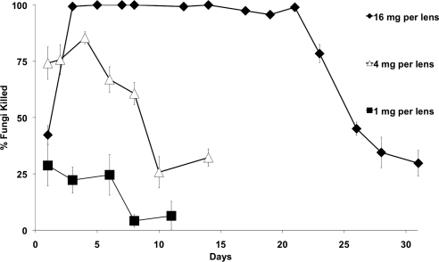
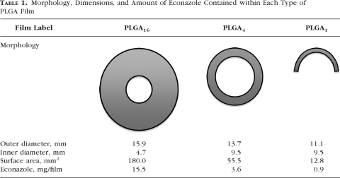
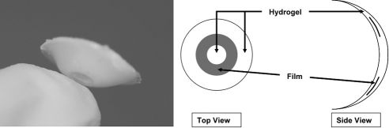
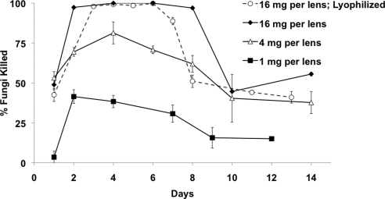
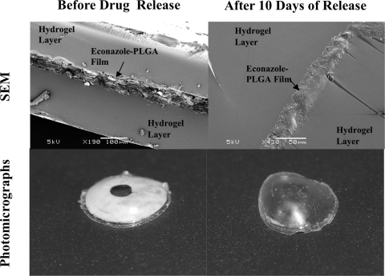
Ciolino JB(1), Hudson SP, Mobbs AN, Hoare TR, Iwata NG, Fink GR, Kohane DS.
A prototype antifungal contact lens.
Invest Ophthalmol Vis Sci. 2011 Aug 9;52(9):6286-91.
Antifungal activity of YNB media containing econazole eluted from drug-containing contact lenses
Scanning electron and photomicrographs of econazole-PLGA films within pHEMA hydrogels before and after 10 days of drug release
C. albicans killed by direct exposure to the econazole-containing contact lenses

